Slide 1

DOCTOR APPOINTMENT APP
Ungarala Devi Nagalakshmi Sunitha
SHESHAPALLI NAGA JAHNAVI
Jakkamsetti Siri Durga
Sunkara Sindhu

Slide 2
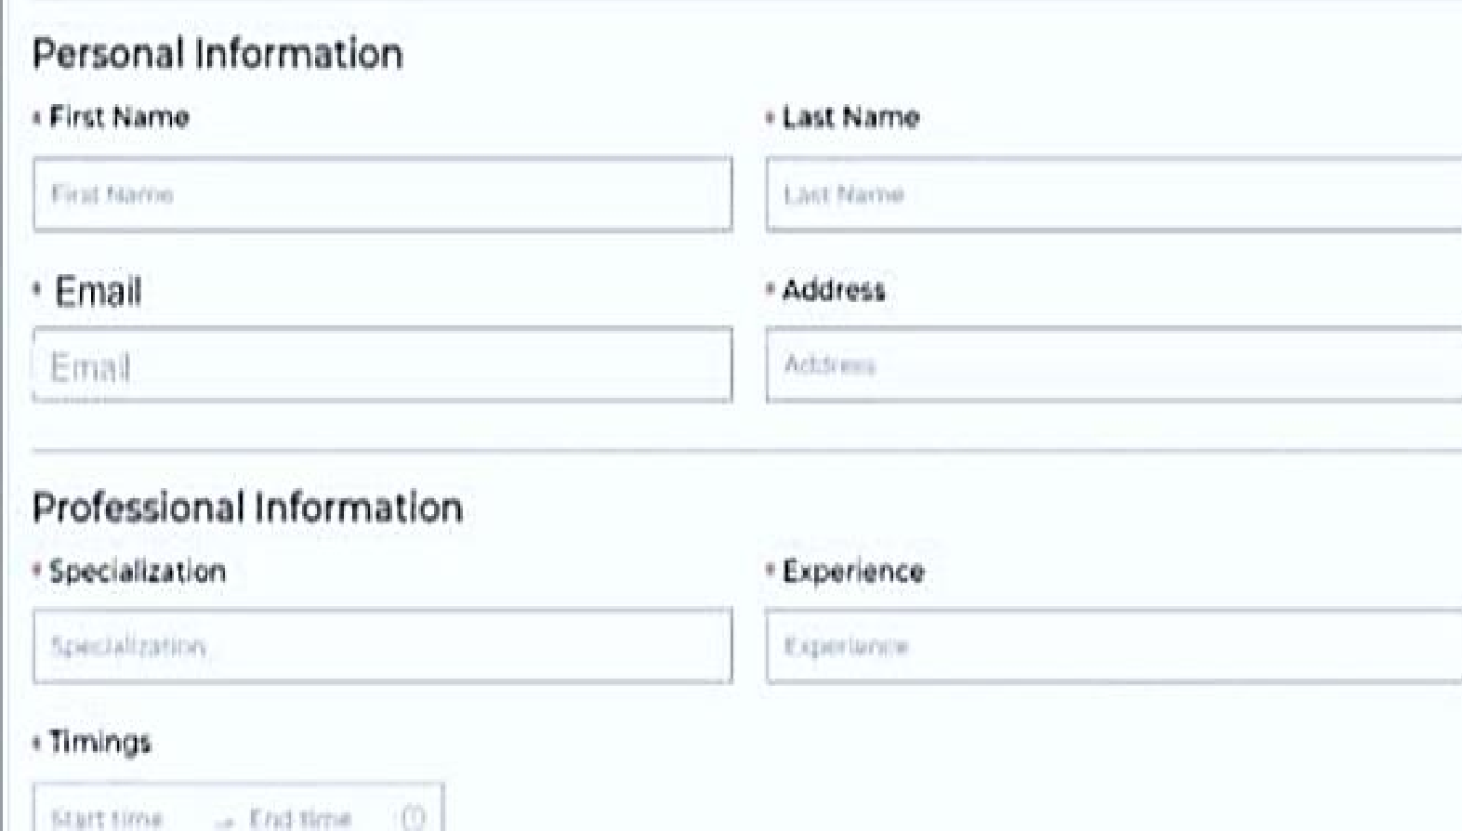
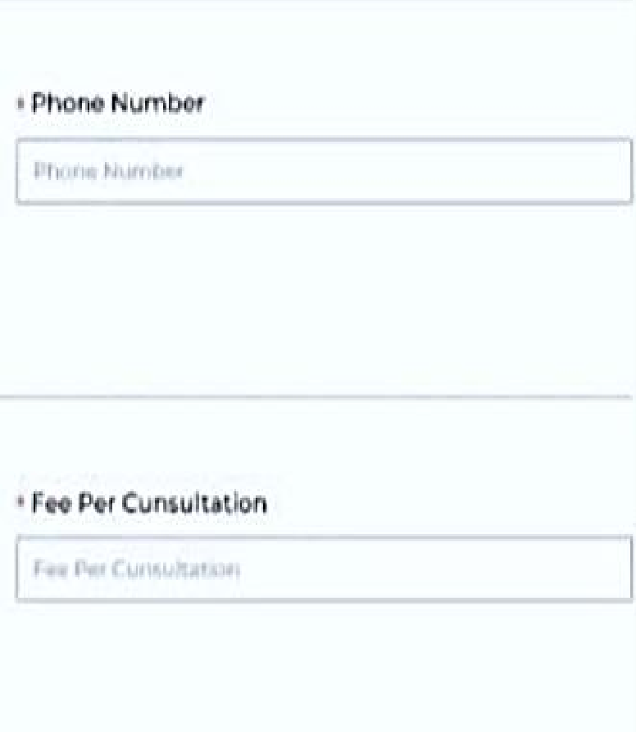
INTRODUCTION

Slide 3

PROBLEM STATEMENT
Long wait times to book appointments
Difficulty finding a doctor that matches specific criteria

Slide 4
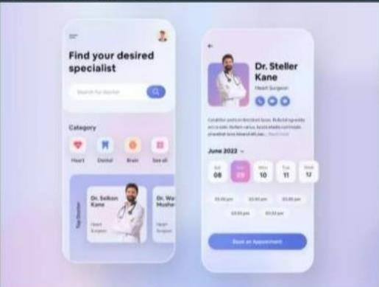
PROPOSED STATEMENT
To address these challenges,we propose a doctor appointment MERN(Mongodb,Express,Node.js,React)app
That enables patients to easily book appointments with their preferred doctors for a specific time slot and free

Slide 5
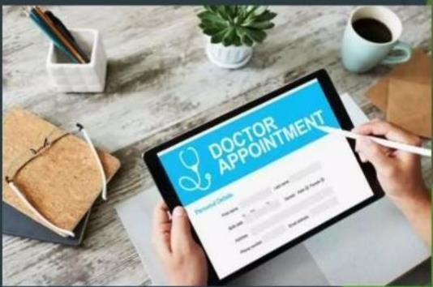
KEY FEATURES
User login/Registratio
Appointment based on specialization, experience ,fee, timing
Appointment History
Appointment approval by admin team
Suggest alternative doctors ,if not available
On the basis:
Specialization Experience Fee
Timing

Slide 6

CONCLUSION
Solution to the long wait times and difficulty in finding a doctor that matches specific criteria.
The app offers value for patients by allowing them to easily book appointments with their
preferred doctors and providing transparency in terms of availability ,fees, and qualification.
For doctors ,if offers a platform to manage their schedules more efficiently.

