Slide 1

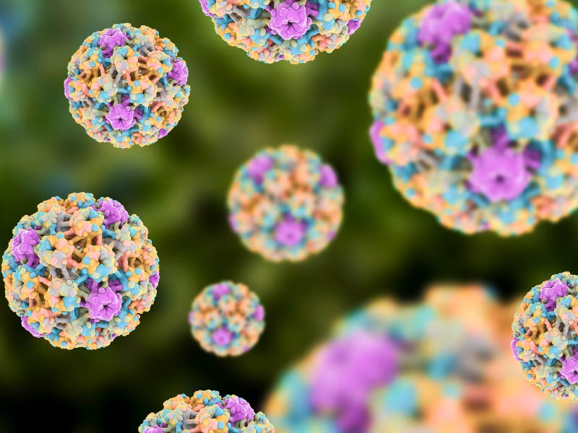
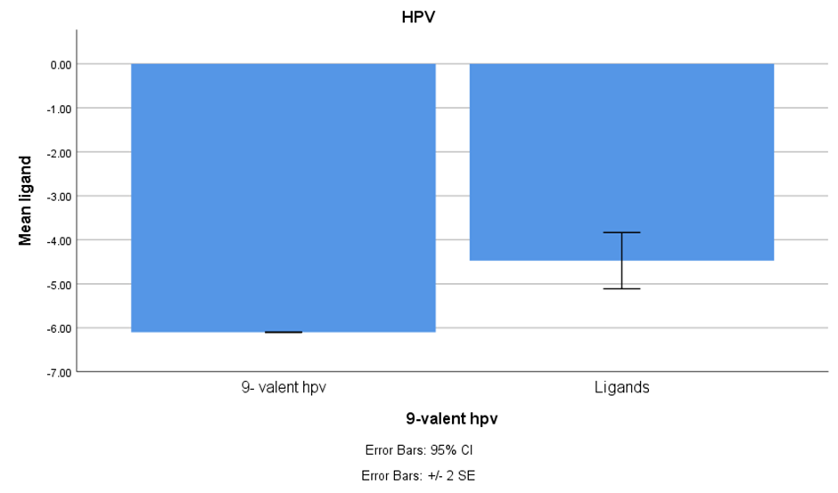
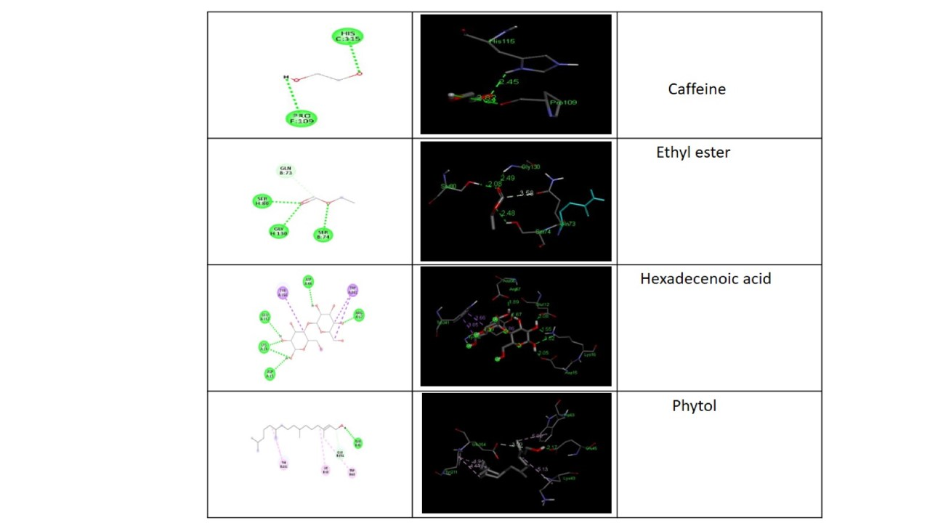
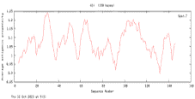
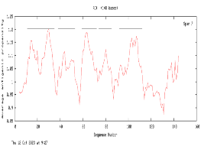

Name: Ms. Nellepalli Jahnavi
Register Number: 192119043
Guided by Dr. K. Vaidhegi
Ms. Poorani.S
Guided by Dr. Mary Valantina. G
Identification of Cissus quadrangularis Ligands for Potential Vaccine Development against Human Papilloma Virus using Immunoinformatics and Docking Studies
INTRODUCTION
Human papillomavirus (hpv) infection is primarily caused by a DNA virus belonging to the papillomaviridae family. notably, a majority of hpv infections remain asymptomatic, with about 90% of cases spontaneously resolving within a two-year timeframe.
The current study explores the potential development of a novel and sustainable medication against human papillomavirus (hpv) by identifying Cissus quadrangularis ligands through immunoinformatics and docking studies.
The study focuses on epitope prediction using the E6 protein, followed by docking studies with four compounds isolated from Cissus quadrangularis and commercially available 9-valent hpv vaccines as controls.
It is typically recommended for individuals between the ages of 9 and 45. After the age of 45, the benefit of the vaccine diminishes as many people may have already been exposed to the virus.
Fortunately, there are effective HPV vaccines that can prevent the most prevalent types of infection.
MATERIALS AND METHODS
Sequence Retrieval proteins in HPV
Antigenic Properties
Functional/Physiochemical Properties
Structural Properties
VaxiJen
Functional
Physiochemical
SOPMA
Algpred
Protparam
PRO-SA
Immunomedicine
2.0Alertropv
AA-prop
VADAR
RESULTS
File No. | Protein sequence | Antigenic properties
 |  | VaxiJen |  | Immunomedicine
 |  | Antigenic score Threshold = 0.4 | Antigenic nature | Average antigenic propensity | Antigenic determinants | Antigenic plot sequence
1 | E6-1 | 0.6247 | Probable antigen | 1.046 | 5
2 | E6-2 | 0.7243 | Probable antigen | 1.0559 | 6
3 | E6-3 | 0.5329 | Probable antigen | 1.069 | 6
DISCUSSION AND CONCLUSION
Based on T-test Statistical analysis, the significance value of p=0.028 (independent sample T - test p<0.05) is obtained and shows that there is a statistical significant between the group 1 and group 2.
In this study, the investigation focused on the antigenic regions of the E6 protein in Human Papillomavirus (HPV), crucial for initiating infection and immune responses. The epitope characteristics were explored through structural and epitope modeling, with the epitope identified by the PDB ID 4XR8 deemed as the most suitable receptor for targeting antiviral drugs against HPV.
.Through GC-MS analysis, four compounds were identified as ligands for docking studies: phytol, hexadecenoic acid, ethyl ester, and caffeine. These compounds were specifically selected for their potential efficacy in interacting with the identified epitope and combating HPV.
Initiating the analysis, the antigenicity of the selected sequences is assessed using Vaxijen and Immunomedicine.
BIBLIOGRAPHY
Armacost, Kira A., and David C. Thompson. 2022. Free Energy Methods in Drug Discovery: Current State and Future Directions. American Chemical Society.
Brahmkshatriya, Hemal R., Kruti A. Shah, G. B. Ananthkumar, and Mansi H. Brahmkshatriya. 2015. “Clinical Evaluation of Cissus Quadrangularis as Osteogenic Agent in Maxillofacial Fracture: A Pilot Study.” Ayu 36 (2): 169–73.
Compston, Juliet E., and Jane B. Lian. 2009. Primer on the Metabolic Bone Diseases and Disorders of Mineral Metabolism. John Wiley & Sons.
Eshiet, and Etetor Roland. 2023. Exploring Complementary and Alternative Medicinal Products in Disease Therapy. IGI Global.
Martinez, José L., Amner Muñoz-Acevedo, and Mahendra Rai. 2018. Ethnobotany: Application of Medicinal Plants. CRC Press.
McMurray, H. R., D. Nguyen, T. F. Westbrook, and D. J. McAnce. 2001. “Biology of Human Papillomaviruses.” International Journal of Experimental Pathology 82 (1): 15–33.
Stanley, M. A. 2012. Immunology of Human Papillomaviruses. Springer US.

