Slide 1

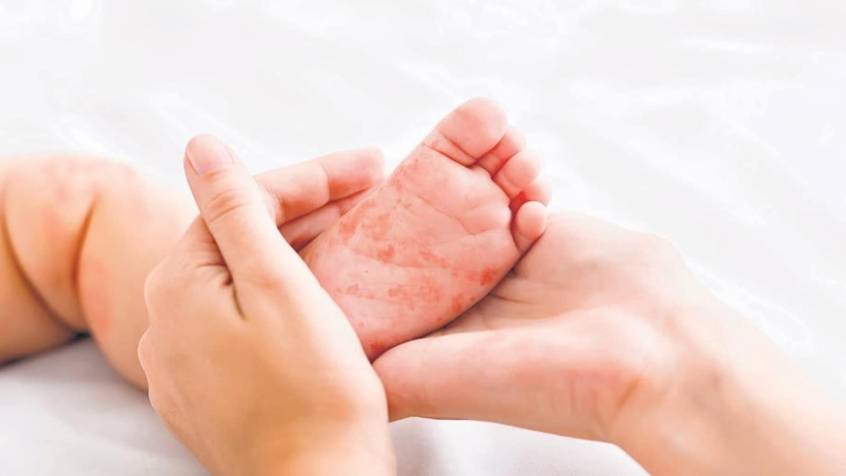
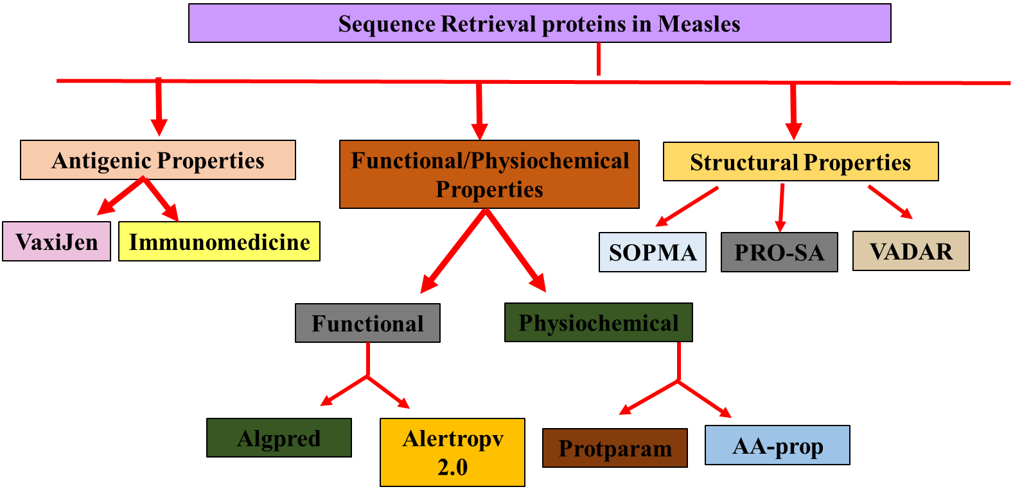
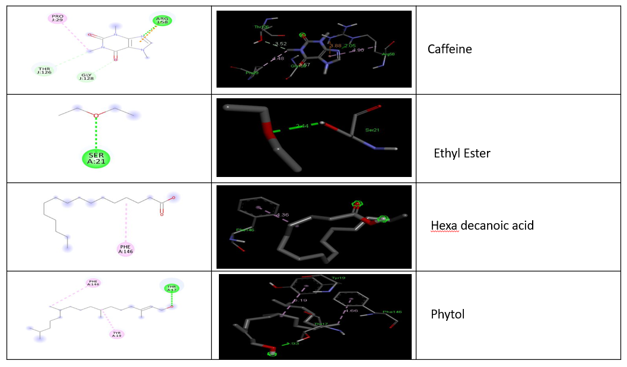
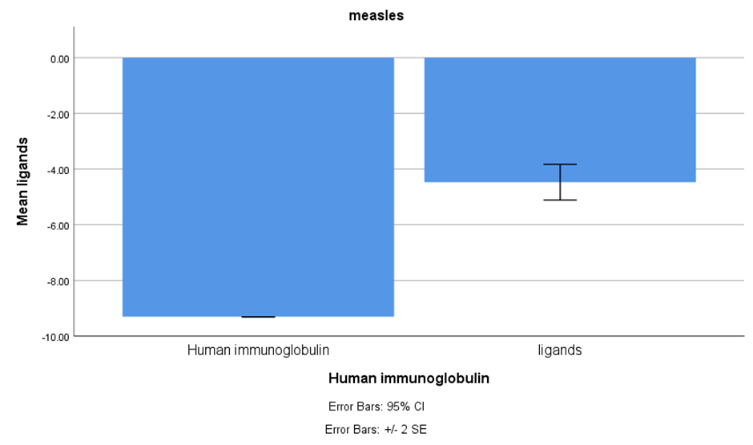
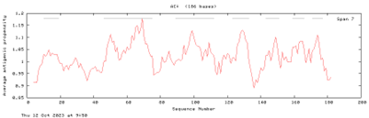
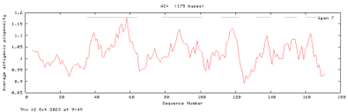
Name: Ms. Nellepalli Jahnavi Register Number: 192119043
Guided by Dr. K. Vaidhegi
Ms. Poorani.S
Guided by Dr. Mary Valantina. G
Insilico screening of Cissus quadrangularis phytochemical for inhibition of Measles virus
INTRODUCTION
The central focus of this study centers around epitope prediction utilizing the C protein, followed by docking studies involving four compounds isolated from Cissus quadrangularis.
Measles ranks among the world's most highly contagious diseases, primarily disseminated through direct contact with infected nasal or throat secretions resulting from coughing or sneezing or by inhaling air previously breathed by a measles-infected individual.
The virus can maintain its contagious nature in the air or on contaminated surfaces for up to two hours. Symptoms generally manifest 10-12 days after exposure to an infected person and endure for about 7-10 days.
This research delves into the realm of computational methods to investigate the phytochemical properties of Cissus quadrangularis and their potential in inhibiting the Measles virus.
Effect of measles vaccination in infants younger than 9 months on the immune response to subsequent measles vaccine.
MATERIALS AND METHODS
RESULTS
File No. | Protein sequence | Antigenic properties
 |  | VaxiJen |  | Immunomedicine
 |  | Antigenic score Threshold = 0.4 | Antigenic nature | Average antigenic propensity | Antigenic determinants | Antigenic plot sequence
1 | C-1 | 0.4844 | Probable antigen | 1.0199 | 6
2 | C-2 | 0.5142 | Probable antigen | 1.0161 | 7
3 | C-3 | 0.5033 | Probable antigen | 1.0166 | 5
DISCUSSION AND CONCLUSION
Based on T-test Statistical analysis, the significance value of p=0.028 (independent sample T - test p<0.05) is obtained and shows that there is a statistical significant between the group 1 and group 2.
This study explores the antigenic regions of the Measles C protein, crucial for infection initiation and immune response elicitation. Epitope characteristics were rigorously examined using structural and epitope modeling. The epitope identified by PDB ID 1GNH was deemed the most suitable receptor for targeting Measles with antiviral drugs.
Through GC-MS analysis, four compounds—phytol, hexadecanoic acid ethyl ester, and caffeine—were identified as ligands for docking studies, specifically chosen .
This comprehensive approach integrates computational docking studies, statistical analyses, and antigenicity assessments, contributing to a multifaceted understanding of the potential effectiveness of the ligands in combination with the HPV vaccine
This comprehensive visualization enhances the credibility of the study's findings regarding the potential impact of Cissus quadrangularis in combating Measles.
BIBLIOGRAPHY
Ahmed, S. S., M. O. Rahman, and M. A. Ali. 2023. “… Study In Gafargaon Sub-District And Unveiling Drug Candidates Through Molecular Docking And Dynamics Simulation ….” Bangladesh Journal..
Arnason, John T., Rachel Mata, and John T. Romeo. 2013. Phytochemistry of Medicinal Plants. Springer Science & Business Media.
Asindi, A. A., S. E. Efem, and M. E. Asuquo. 1992. “Clinical and Bacteriological Study on Childhood Empyema in South Eastern Nigeria.” East African Medical Journal 69 (2): 78–82.
Enders, John F., Samuel L. Katz, and Ann Holloway. 1962. “Development of Attenuated Measles Virus Vaccines: A Summary of Recent Investigation.” American Journal of Diseases of Children 103 (3): 335–40.
Hassan, Bassam. 2020. Medicinal Plants: Use in Prevention and Treatment of Diseases. BoD – Books on Demand.
Rosner, B. n.d. “Fundamentals of Biostatistics (The 7th Edition).” Boston, MA: Brooks/Cole.
Sen, Saikat, and Raja Chakraborty. 2019. Herbal Medicine in India: Indigenous Knowledge.

