Slide 1

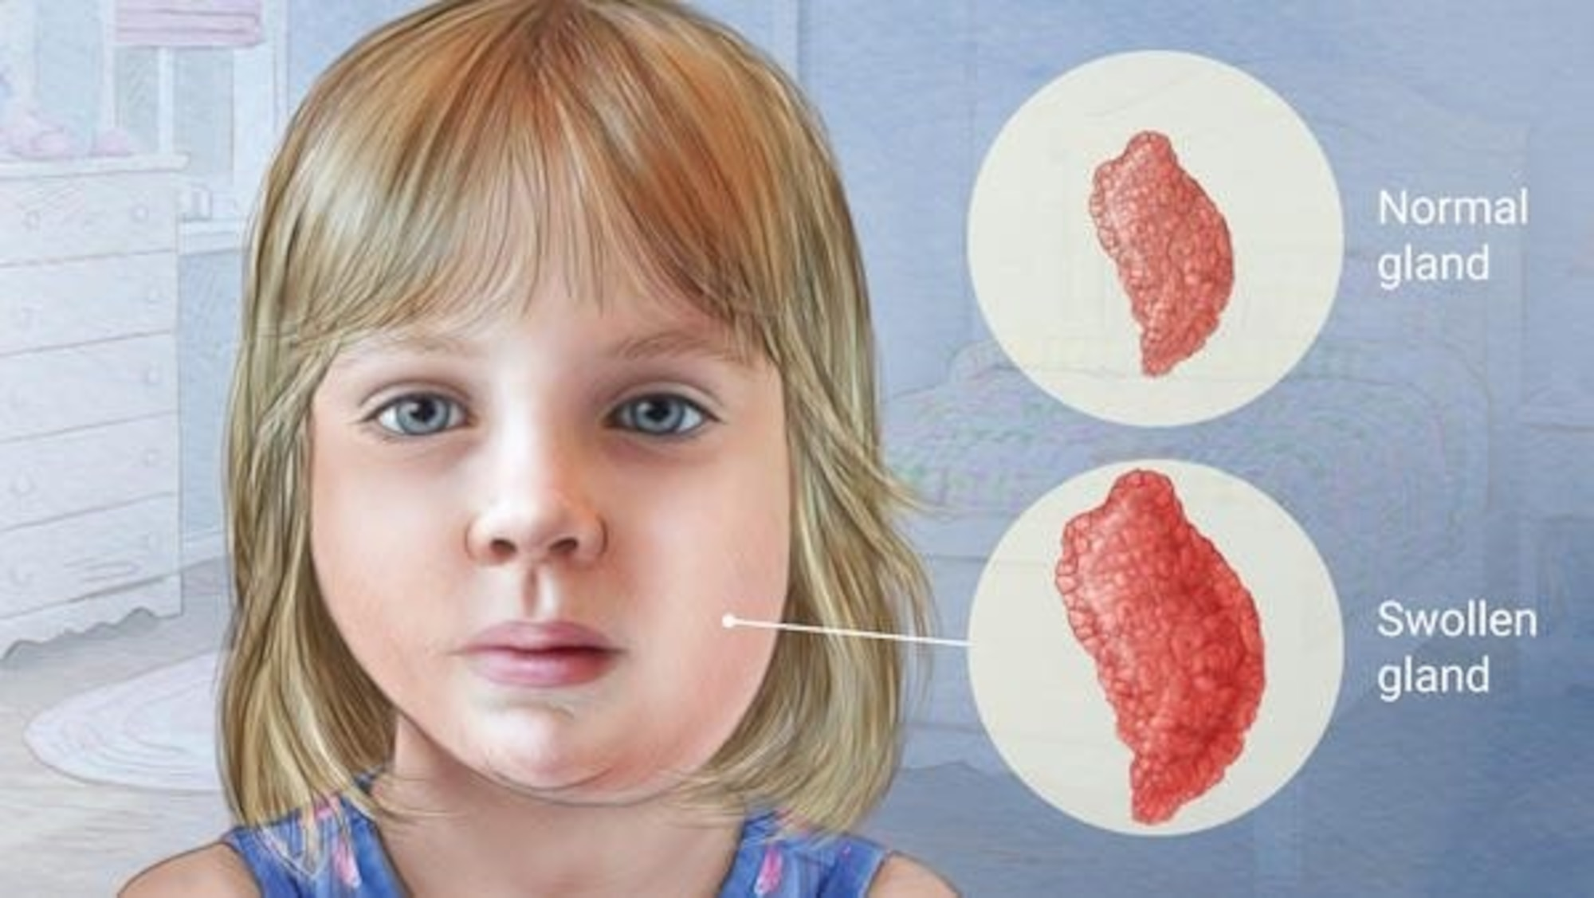
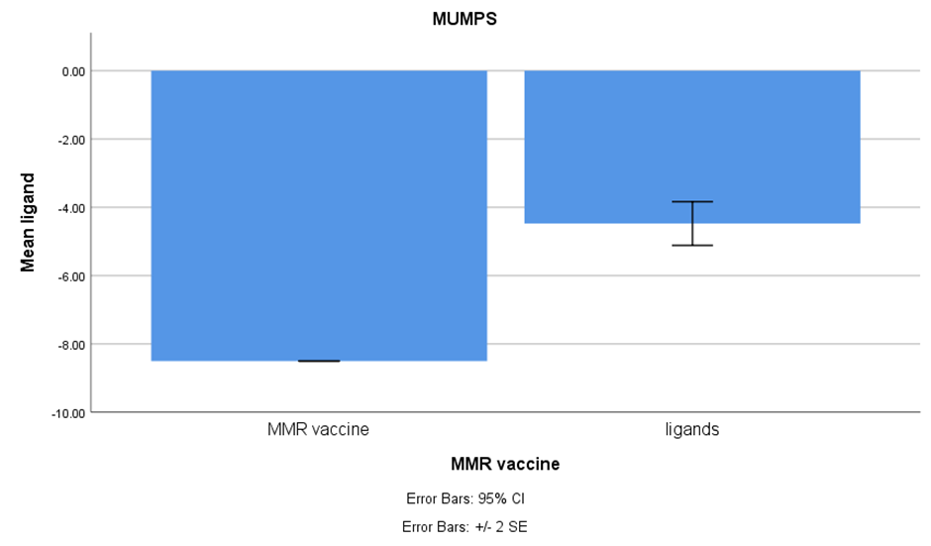
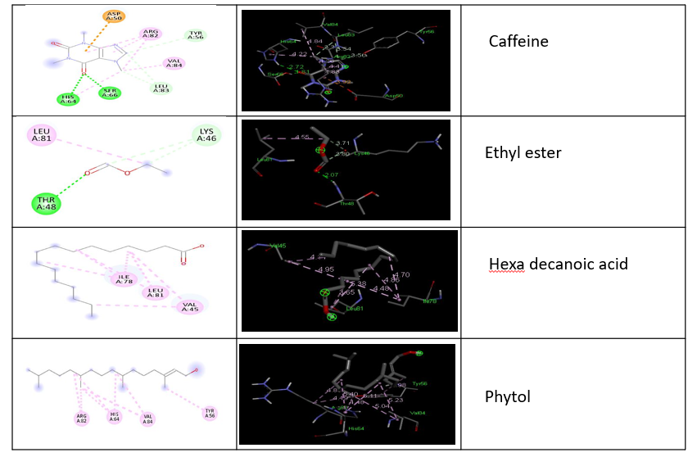
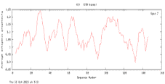
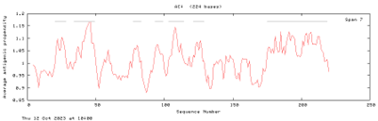
Name: Ms.Nellepalli Jahnavi Register Number: 192119043
Guided by Dr. K. Vaidhegi
Ms. Poorani.S
Guided by Dr. Mary Valantina. G
Comparison of phytochemicals in cissus quadrangularis for its potential activity against mumps virus infections through insilico analysis
INTRODUCTION
Mumps, caused by the mumps virus, belong to the Paramyxoviridae family of RNA viruses. This highly contagious virus primarily spreads through respiratory secretions like droplets and saliva, and close contact with an infected individual. In densely populated areas, mumps can disseminate rapidly.
Initial symptoms are nonspecific, encompassing fever, headache, malaise, muscle pain, and reduced appetite. Subsequently, the most common and distinctive sign of mumps infection emerges painful swelling of the parotid glands, known as parotitis.
These symptoms typically manifest 16 to 18 days after exposure to the virus and usually subside within two weeks. It's worth noting that about one third of mumps infections present with no symptoms.
The study utilizes a modest sample size (N=4) and executes an 80% power level power analysis.
The treatment for this ailment involves utilising plant extracts, particularly through a process known as docking analysis targeting the V protein. Notably, an anabolic steroid derived from the Cissus quadrangularis plant.
MATERIALS AND METHODS
Sequence Retrieval proteins in Mumps
Functional/Physiochemical Properties
Functional
Algpred
SOPMA
Antigenic Properties
VaxiJen
2.0Alertropv
Structural Properties
Protparam
PRO-SA
Immunomedicine
Physiochemical
AA-prop
VADAR
RESULTS
File No. | Protein sequence | Antigenic properties
 |  | VaxiJen |  | Immunomedicine
 |  | Antigenic score Threshold = 0.4 | Antigenic nature | Average antigenic propensity | Antigenic determinants | Antigenic plot sequence
1 | V-1 | 0.3278 | Probable non antigen | 1.013 | 7
DISCUSSION AND CONCLUSION
Based on T-test Statistical analysis, the significance value of p=0.028 (independent sample T - test p<0.05) is obtained and shows that there is a statistical significant between the group 1 and group 2.
In this study, the focus is on exploring the antigenic regions of the Mumps V protein, which play a crucial role in initiating infection and eliciting an immune response. Rigorous examination of epitope characteristics was conducted using structural and epitope modeling techniques. The epitope identified by PDB ID 1VQB was determined as the most suitable receptor for targeting Mumps with antiviral drugs.
Through GC-MS analysis, four compounds including phytol, hexadecanoic acid ethyl ester, and caffeine were identified as ligands for docking studies.
The study highlights a notable distinction between the control group, which consists of the Mumps antiviral vaccine (MMR vaccine), and the study group featuring ligands from Cissus quadrangularis (p=0.028, p<0.05).
The use of the PyMol visualizer tool is highlighted, generating complex molecules to visualize docking results.
BIBLIOGRAPHY
Bowden, Raleigh A., Per Ljungman, and David R. Snydman. 2012. Transplant Infections. Lippincott Williams & Wilkins.
Center for Disease Control. 1972. Mumps Surveillance. U.S. Department of Health, Education, and Welfare, Public Health Service.
Curtis, Nigel, Adam Finn, and Andrew J. Pollard. 2010. Hot Topics in Infection and Immunity in Children VII. Springer Science & Business Media.
Gantait, Saikat, Sandeep Kumar Verma, and Amit Baran Sharangi. 2021. Biotechnology of Anti-Diabetic Medicinal Plants. Springer Nature.
Lambert, Bengt. 1951. The Frequency of Mumps and of Mumps Orchitis and the Consequences for Sexuality and Fertility.
Long, Sarah S., Charles G. Prober, Marc Fischer, and David Kimberlin. 2022. Principles and Practice of Pediatric Infectious Diseases E-Book. Elsevier Health Sciences.
Mches, Jennifer Hamborsky Mph, Andrew Kroger Md Mph, and Charles (skip) Wolfe. 2015. Epidemiology and Prevention of Vaccine-Preventable Diseases, 13th Edition E-Book: The Pink Book. Public Health Foundation.
Nair, K. N. 2017. The Genus Syzygium: Syzygium Cumini and Other Underutilized Species. CRC Press.

