Slide 1
Predictive Modeling of In Hospital Mortality followed by Elective Surgery
By
Jahnavi Jammula Jithendra Uppalapati Sai Teja Navanth Velagaturi

Slide 2
Introduction
The dataset is taken from a open public resource https://data.cms.gov/.
This data set includes provider-level data for the hip/knee complication measure, the CMS Patient Safety Indicators, and 30-day death rates. All this data has been recorded between 2020 to 2024.
The dataset is a csv file which consists of 90,801 instances and 18 features. Some of the features are - Facility name, city, state, address, start date, end date, lower estimate, higher estimate.
Features like facility name, city, state, compared to national are categorical.
Features like Facility ID, Telephone, Denominator, Score, lower estimate are numerical.
Feature Facility ID - A unique identifier for each facility, Measure ID - specific measure being evaluated etc..

Slide 3
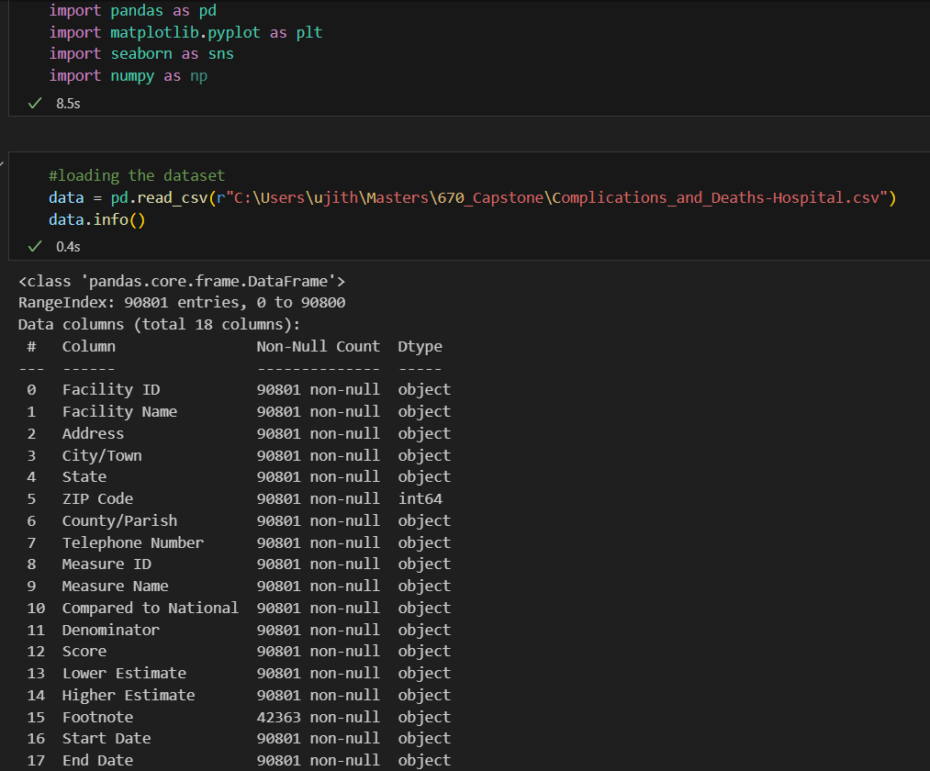
EDA (Exploratory Data Analysis)
For the Initial Data Preprocessing We have imported the necessary libraries and loaded the data. Along with Inspecting it.

Slide 4
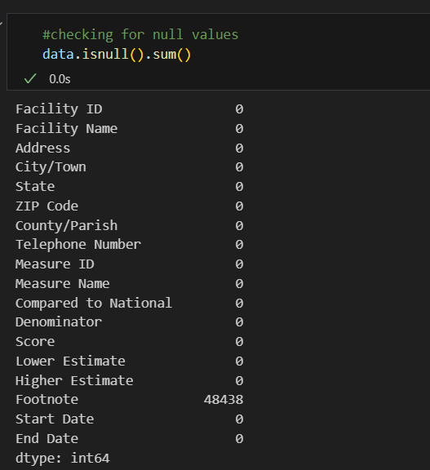
Imputation of Missing Values
We found that half the values in the footnote (additional notes) We have removed the feature footnote in the next step

Slide 5
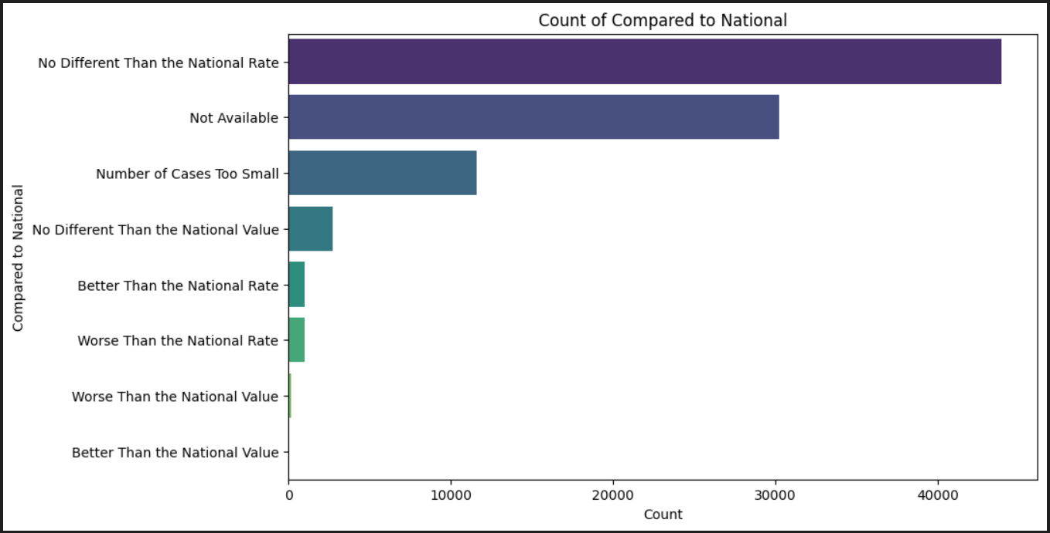
Analyzing the categorical data for Compared to National

Slide 6
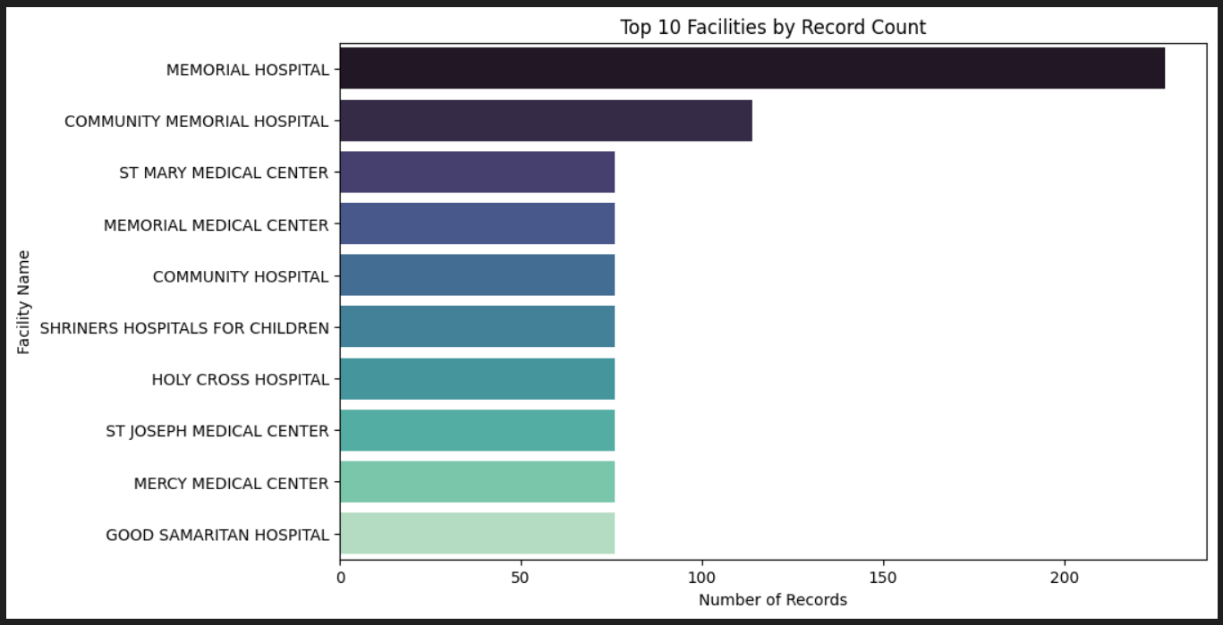
Analysing the top 10 facilities by record count

Slide 7
Feature Engineering
Definition: Enhancing machine learning models by creating or modifying features.
Category Encoding:
Convert text-based columns (Measure Name, Compared to National) into numerical formats using:
Feature Transformation:
Normalize numerical columns (Score, Lower Estimate, Higher Estimate).
Extract time-based features from Start Date and End Date (E.g. Year, Month).
Creating New Features:
Derive Mortality Range: Higher Estimate−Lower Estimate
Combine performance measures to create composite ratings (Facility).
Handling Missing Data:
Use imputation or drop irrelevant columns(Footnote).

Slide 8
Addressing Imbalanced Data
Definition: Unequal target class distributions can affect model performance (e.g., hospital mortality rates).
Resampling Techniques:
Oversampling: Create synthetic samples for minority classes (e.g., SMOTE).
Undersampling: Reduce samples from overrepresented classes.
Hybrid Techniques: Combine oversampling and undersampling.
Cost-Sensitive Training : Assign higher weights to underrepresented classes during training.
Evaluation Metrics : Replace accuracy with metrics like F1-score,precision,Recall and Balanced accuracy.

