Slide 1
Storify
Group3

Slide 2
Write stories
Authors get a platform to write stories.
They get recognition.
They also get paid based on readership

Slide 3
Read stories
Readers get 1000s of stories.
They can follow their favorite authors.
Customized and personalized feed based on preferences

Slide 4
Story Auto-complete
Authors will have story autocomplete feature.
They can give some prompt and out generative model will create stories for them.
This will be a paid service.

Slide 5
Auto tagging
Stories will be automatically tagged into gernes.
Authors also have option to manually set tags.

Slide 6
Problems solved
1)Problem: Amateur authors struggle for ideas
Importance :Helping amateur authors who are stuck with half baked stories. Solution: Our model auto completes the story based on a few lines of the input received from the authors.

Slide 7
Problems solved
2)Problem: Amatuer authors don’t get recognised easily
Importance: Connecting authors, publishers and readers across the globe Solution: By providing a free platform, authors from any part of the world can showcase their work, which can get them recognized by publishers.

Slide 8
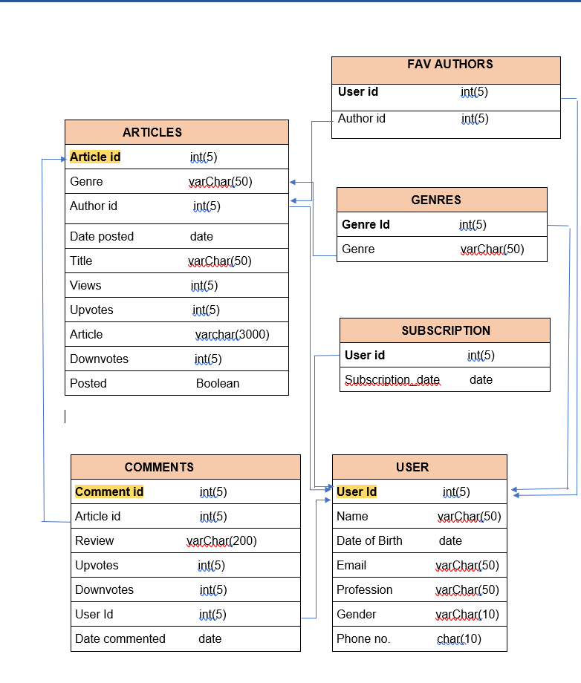

Slide 9
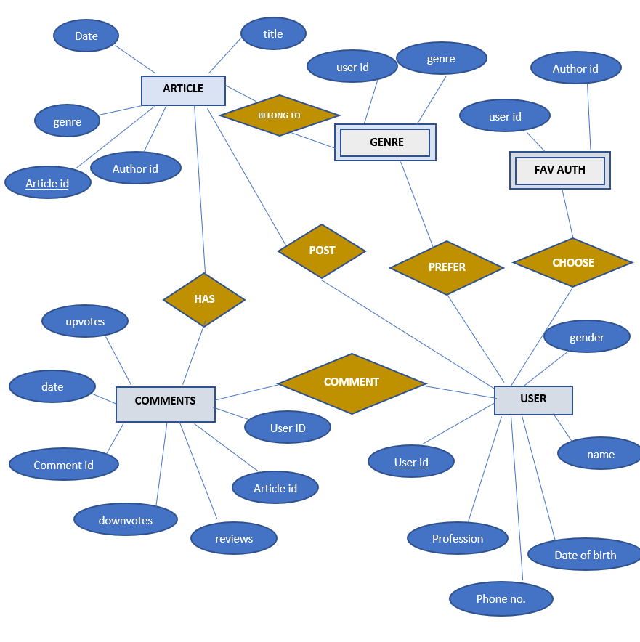

Slide 10
Problems solved
3) Problem: Readers don’t have a single platform for reading free short stories
Importance: Varied collections are all provided at one place Solution: Readers are provided with a medley of genres, with thousands of collections.

Slide 11
Problems solved
4) Problem: Unrecognised authors don’t earn enough money
Importance: Encouraging new story tellers Solution: Authors will be paid based on readership.

Slide 12
Features exposed as a service
1. Story completion as a service: The auto-complete feature will be exposed as a service to publishing houses and other platforms which are used for writing.
2. Genre based stories as a service: Stories written on our platform will be provided to aggregator websites like medium based on genre.
3. Genre tagging

Slide 13
Business model
1. Authors will be paid based on readership. This will encourage more authors to come to our platform.
2. As more authors will write, more readers will read stories on our platform. Once we have a significant number of Daily active users, we will start monetizing by showing ads or premium features/ subscription.

Slide 14
Business model
3. Authors will have to pay to use autocomplete feature (after some free runs). This generative model will be again trained on the stories we get from authors, hence improving its quality. Once the model is well trained, it can also be provided to established authors at a high cost

Slide 15
Possible roadblocks
1) Cold start of the generative model.
2) Lack of computation to train the generative model.
3) Initial reluctance of readers and authors to switch to our platform.

Slide 16
Todos
User profile P1,P2
Read write comment upvote P1,P2
Payments P2
Frontend, integration P1,P2, P3
Auto-tag P1
Auto-complete P2
Personalize feed P3
Restify P2
Search P2
Clients to consume rest services P2,P3

Slide 17
Tech Stack
Python
HTML/CSS
JS
Django
Rest api
Sklearn
keras/tensorflow

Slide 18
Roles and Responsibilities
Parth - Machine Learning, Data Science,
Bhavana - user profile, payments, write
Keerti - Personalization, read
Jahnavi - user profile, write, Personalization
Gayatri - Frontend , search
Vidya - read, Client Web apps

Slide 19
Thank you

