Slide 1
TASK - 2 :
Title : Cross Site Scripting
Domain : vulnweb.com
SubDomain : http://testasp.vulnweb.com/
Cross-Site Scripting (XSS) is a type of security vulnerability found in web applications that allows attackers to inject malicious scripts into content from otherwise trusted websites. These scripts are then executed in the context of the victim's browser, allowing the attacker to steal data, hijack user sessions, deface websites, or perform other malicious activities.
In the given above website we have to explore the website and try to find the Vulnerabilities in the website. The steps to follow are,
Steps To Reproduce :
step-1 : Visit the given website http://testasp.vulnweb.com/
step-3 : Open the website and search <script>alert("XSS")</script> to find vulnerabilities.
step-4 : Next click on the search posts.
step-5 : Then it shows the XSS. Then click on ok.
step-6 : Now some of the posts are available. Those are founded.

Slide 2
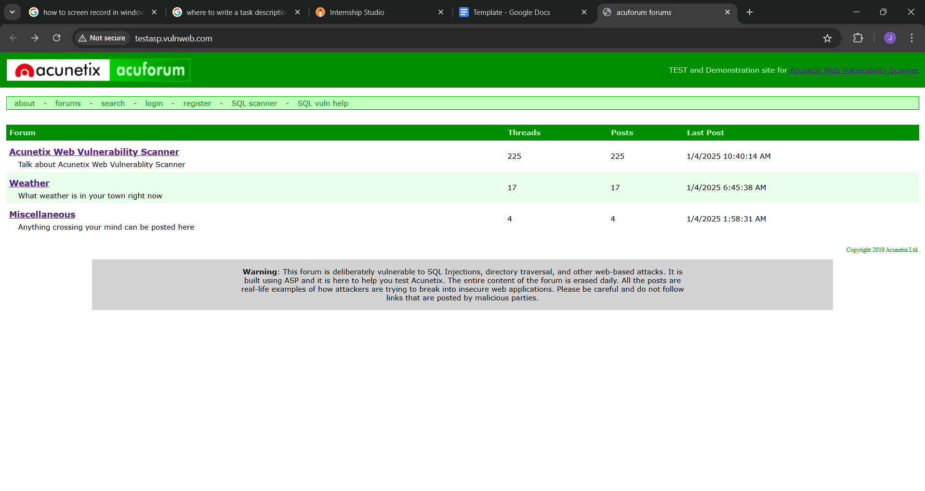
step-2 : From these website we have to find the vulnerabilities with search option. Click on it and you you will
Be promoted with the search box.

Slide 3
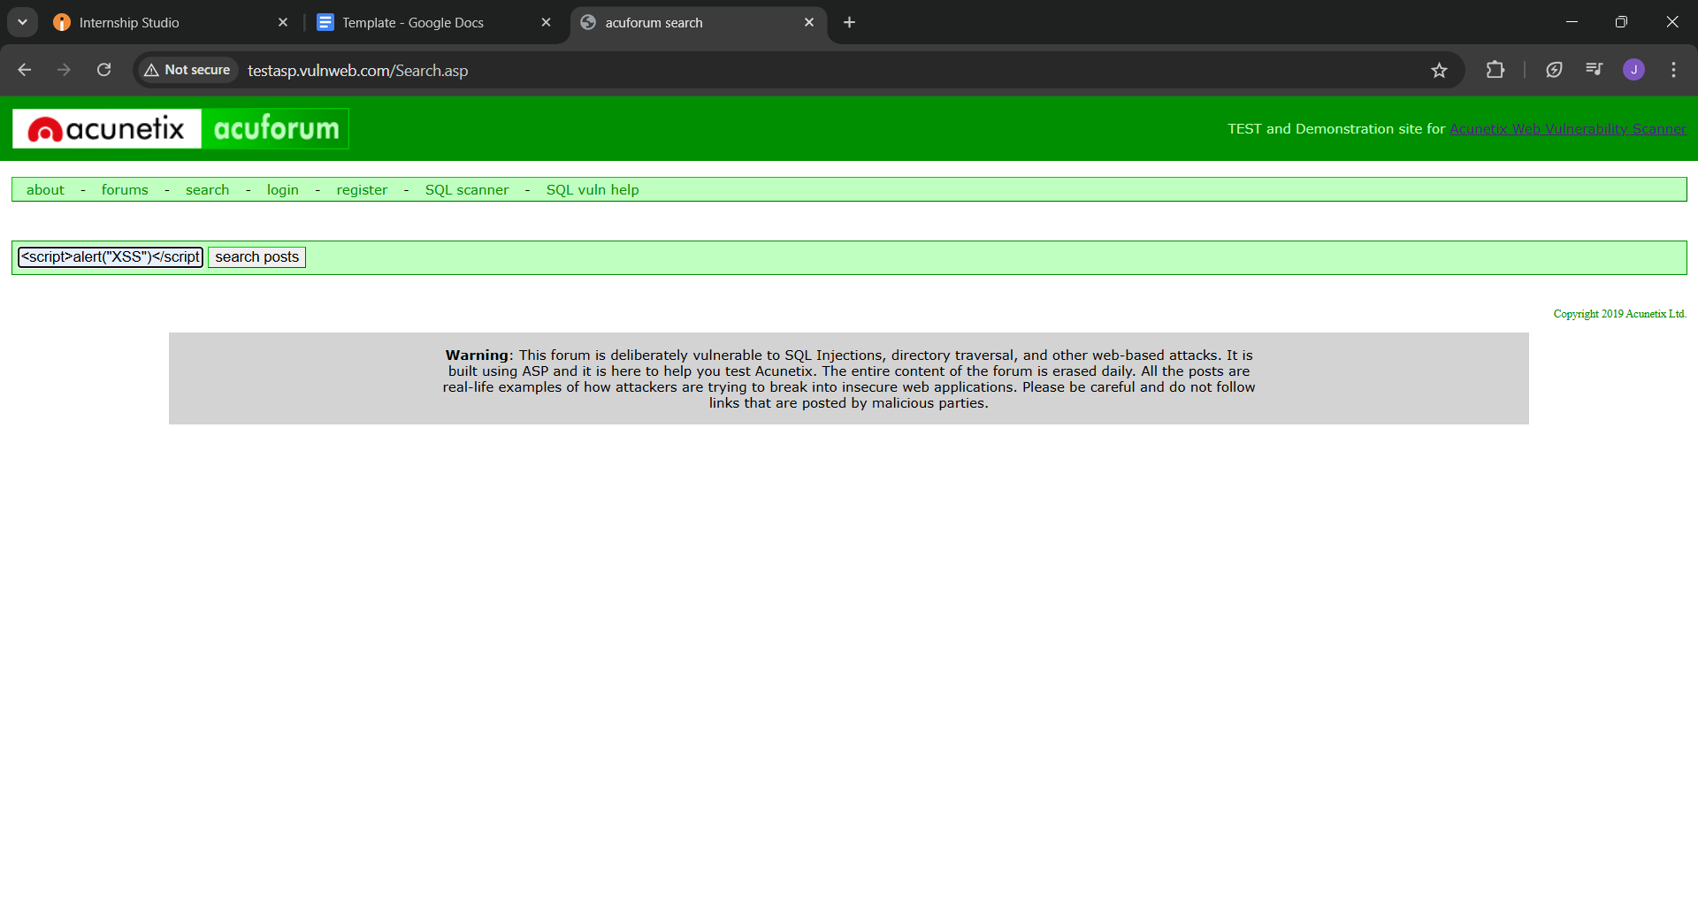
step-3 : Open the website and search <script>alert("XSS")</script> to find vulnerabilities . Now you can find different payloads for XSS.
step-4 : Next click on the search posts.

Slide 4
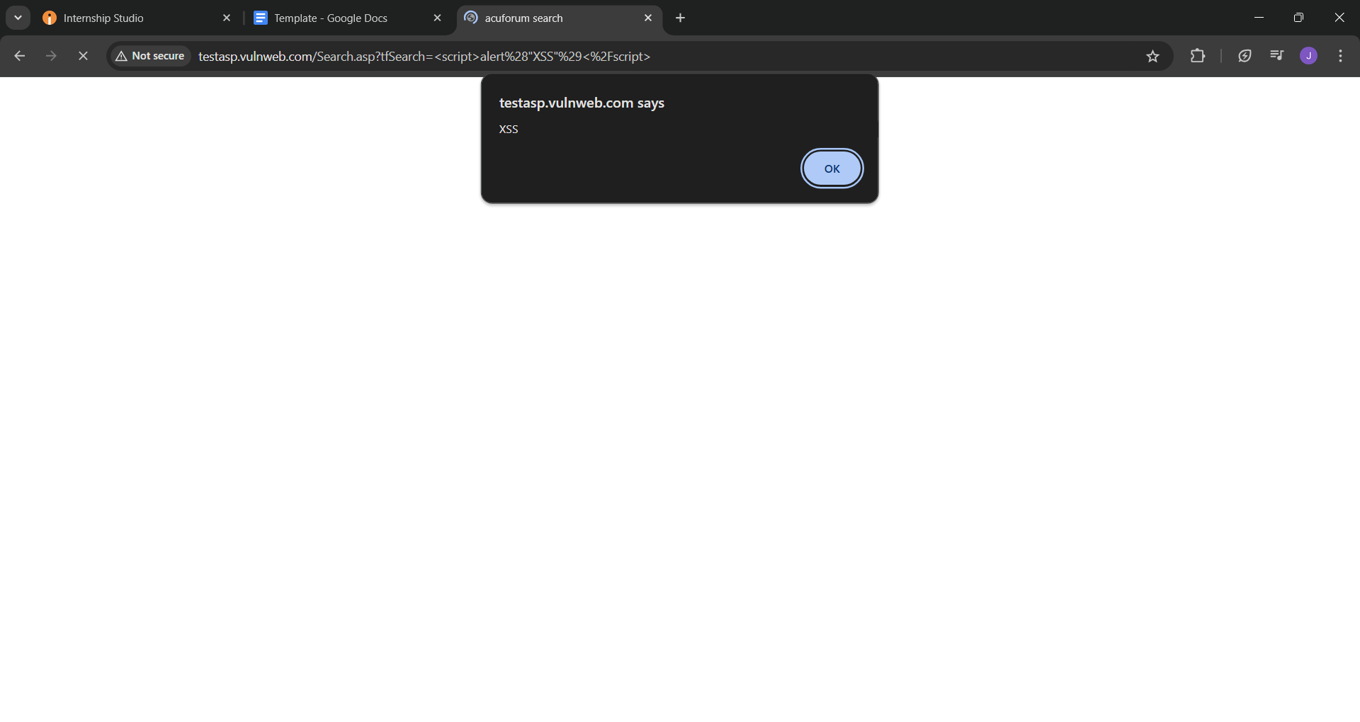
step-5 : You can intercept the request in Burp Suite . Then it shows the XSS. Then click on ok.

Slide 5
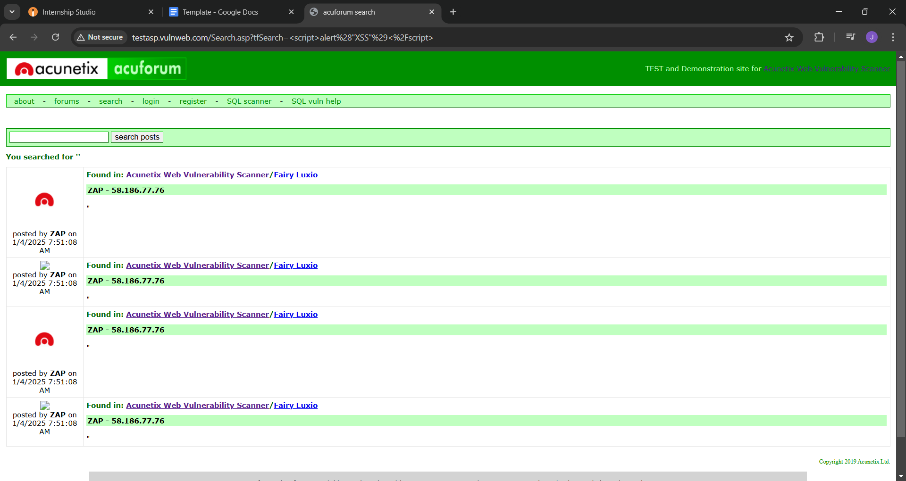
step-6 : Now you can find different payloads for XSS. Now some of the posts are available. Those are founded.

Slide 6
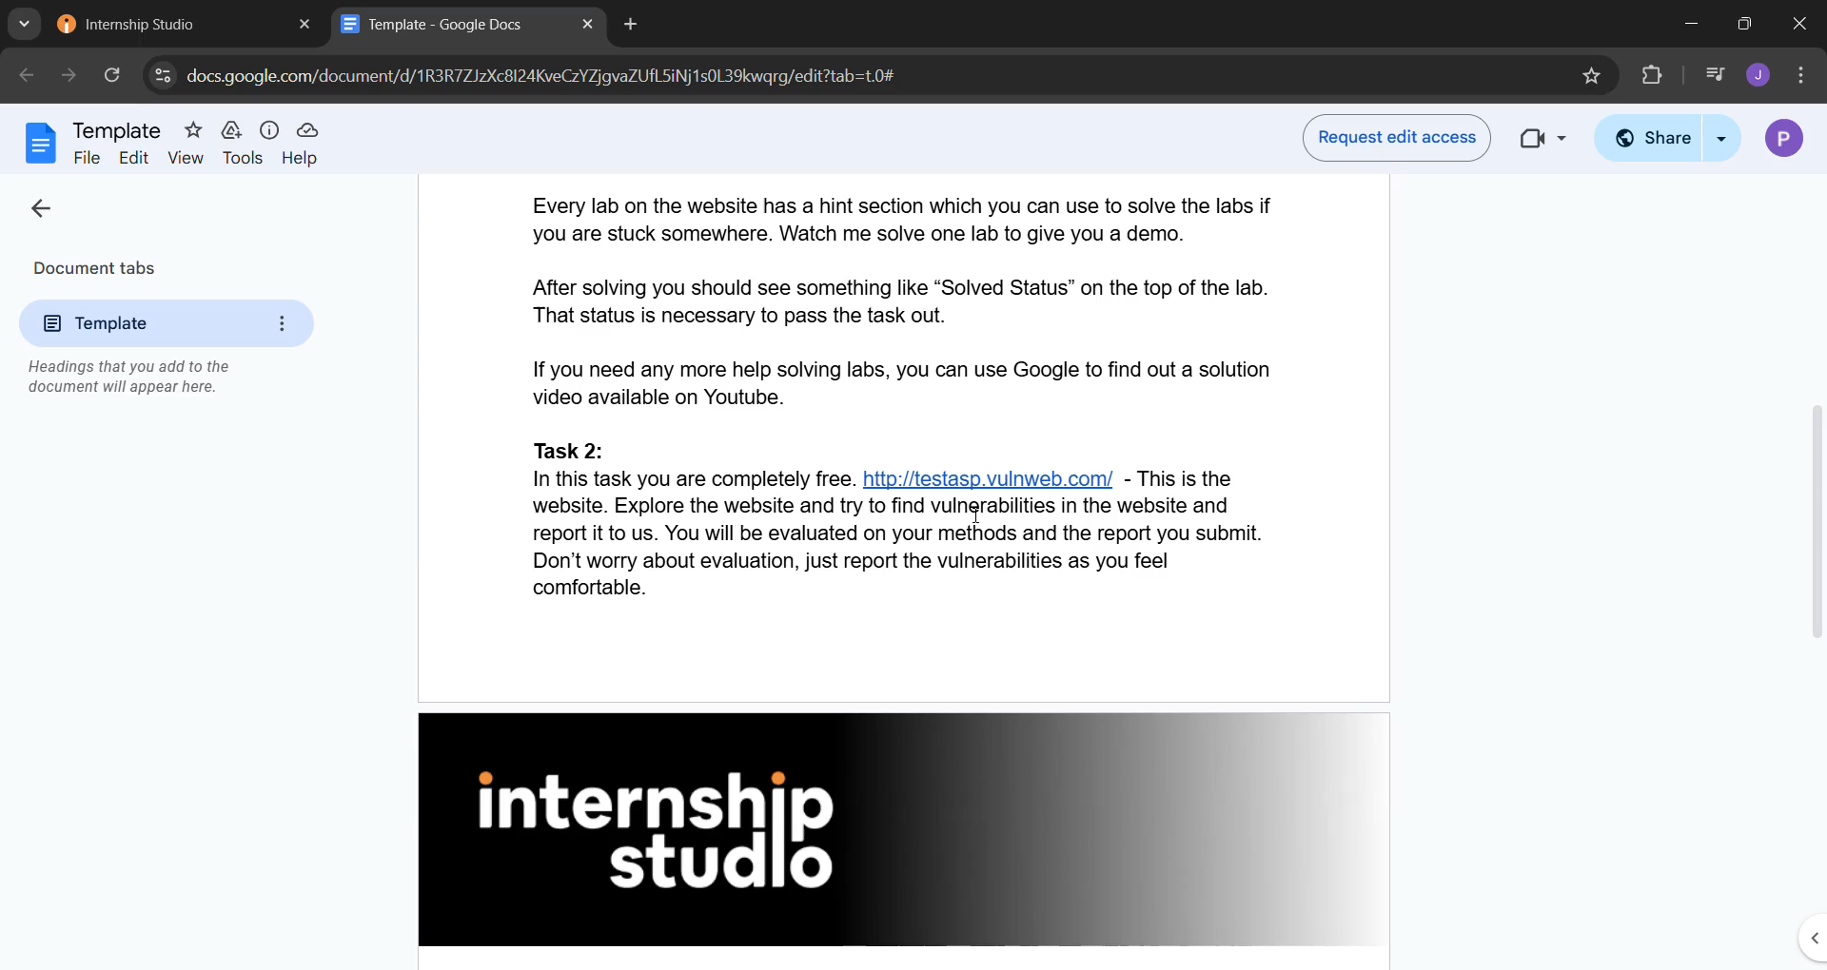
The video can be represented as shown below ,

Slide 7
Impact :
Cross-Site Scripting (XSS) is a common web security vulnerability that can have significant consequences for users, organizations, and web applications. It allows attackers to inject malicious scripts into websites that are viewed by other users. The impact of XSS can vary based on the type, severity, and context of the vulnerability but often includes the following consequences:
1. User Data Theft -
Description: Attackers can steal sensitive information such as session cookies, credentials, or personal data by injecting malicious scripts.
Impact:
Unauthorized account access.
Identity theft.
Exposure of private user data.
2. Account Hijacking -
Description: By stealing session cookies or other authentication tokens, attackers can impersonate users and gain control of their accounts.
Impact:
Unauthorized transactions.
Email, social media, or system compromise.

Slide 8
Mitigation techniques in Cross Site Scripting :
Input Validation: Ensure that all user inputs are validated to prevent malicious data from being processed.
Output Encoding: Encode output data to ensure that it is treated as data, not executable code. This includes HTML encoding, JavaScript encoding, and URL encoding.
HTML Sanitization: Use libraries or frameworks that automatically sanitize HTML content to remove potentially dangerous elements.
Content Security Policy (CSP): Implement CSP to restrict the sources from which scripts can be executed, reducing the risk of XSS attacks.
Use Secure Frameworks: Modern web frameworks often have built-in protections against XSS. Ensure you use them correctly and stay updated with security patches.
Regular Security Testing: Conduct regular security testing, including automated scans and manual code reviews, to identify and fix XSS vulnerabilities

