Slide 1

Title: SMART COLLEGE CANTEEN PRE-ORDER SYSTEM
Student Name: G Jahnavi
Student ID: 2520030483
Cluster: 4
Section: 14
Under the Guidance
of
Supervisor Name: NM DEEPIKA
Assistant Professor
Department of CSE

Slide 2
OUTLINE
Abstract
Existing System
Proposed System
System Architecture
Project Modules
Objectives
Co’s Attainments - FWD
Co1
Co2 …….. 5. Co5
Co’s Attainments - DSA
Co1
Co2 …….. 5. Co5
Screen Shots for FWD & DSA
Conclusion
Geo-Tagged Photos

Slide 3
Abstract
The Smart College Canteen Pre-Order System is a web-based application developed to improve the efficiency and convenience of ordering food in college canteens. The system allows students to view the available menu, select food items, and place orders online before reaching the canteen. It includes features such as user login and registration, categorized menu display, cart management, digital token generation, and QR-based payment support. The application is built using web technologies such as HTML, CSS, and JavaScript to create an interactive and user-friendly interface. Additionally, the system provides an order summary and live queue tracking so that students can monitor the status of their orders. The system also helps canteen staff manage orders more efficiently and reduces crowding at the service counter. By integrating digital ordering, payment, and queue tracking, the Smart College Canteen Pre-Order System enhances the overall dining experience and modernizes the traditional canteen management process.

Slide 4
Existing System
In the traditional college canteen system, food ordering is usually done manually at the counter where students must stand in long queues to place their orders and make payments.
During peak hours such as lunch breaks, this often leads to overcrowding, delays, and inefficient service.
The manual process also increases the chances of order mistakes, miscommunication between staff and students, and difficulty in managing multiple orders simultaneously.
Additionally, there is no proper system to track order status, which causes confusion and unnecessary waiting time for students.
Overall, the existing system lacks automation, time efficiency, and effective order management.

Slide 5
Proposed System
The proposed Smart College Canteen Pre-Order System is a web-based solution designed to modernize the food ordering process in college canteens.
In this system, students can log in, view the digital menu, select food items, and place their orders online in advance.
The system generates a digital token for each order and allows students to track the status of their order in a live queue, reducing the need to wait in long lines.
It also supports digital payments using QR codes and provides an order summary for better transparency.
By automating the ordering and queue management process, the proposed system improves efficiency, reduces crowding, and enhances the overall experience for both students and canteen staff.

Slide 6
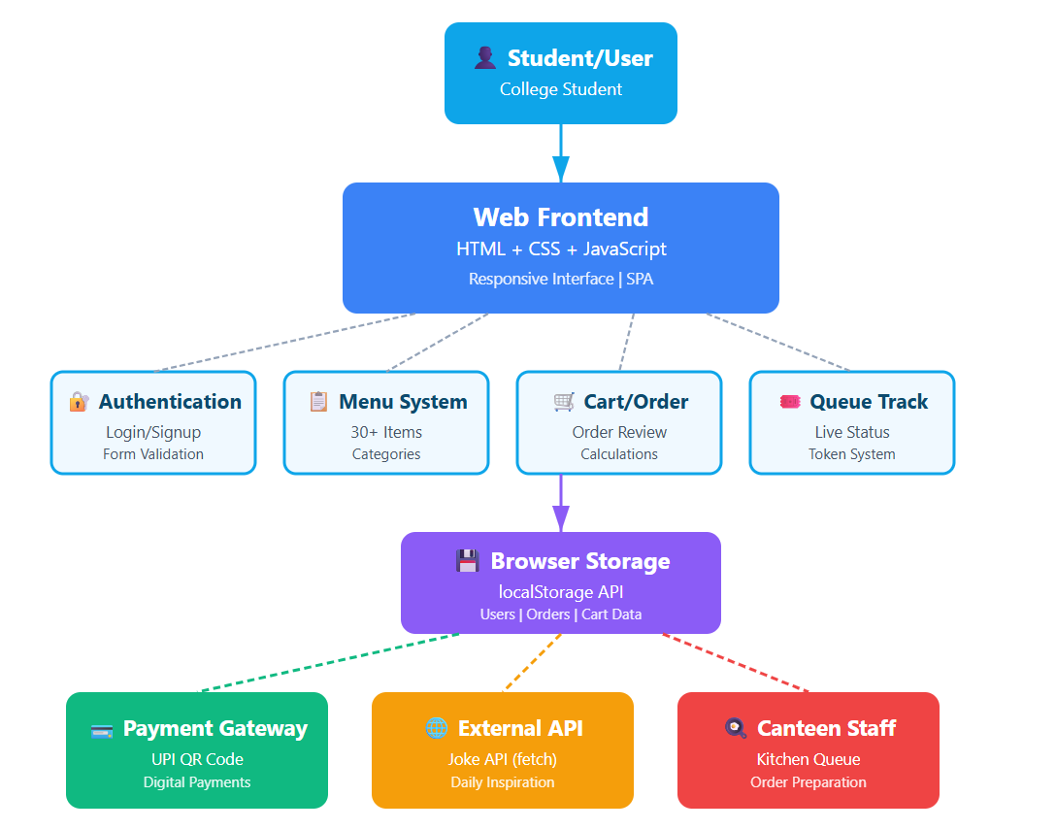
System Architecture

Slide 7
Project Modules
1. Authentication Module This module manages user login and registration by accepting user credentials such as email and password. The entered data is validated and stored using local Storage for basic user authentication. After successful verification, the system grants access to the application by creating a session or access token.
2. Menu Module The menu module displays all available food items for the user to browse and select. When the user clicks on items, the system retrieves the details from a JavaScript object containing menu data. Based on user selections, the cart state is updated dynamically.
3. Cart Module This module manages the items selected by the user and their quantities. The selected items are stored in an array of objects, where each object contains item name, price, and quantity. The system automatically calculates and displays the grand total for the order.

Slide 8
Project Modules
4. Payment Module The payment module allows users to complete transactions by scanning a QR code or clicking the payment confirmation button. Payment details and order confirmation are temporarily stored using local Storage. After successful payment, the system generates a unique token number (e.g., ST-123) for the order.
5. Queue Module The queue module manages order processing after payment is completed. The generated token ID is stored in memory and used to track the order in the preparation queue. Once the order is prepared, the system updates the status and shows a “Ready” notification to the user.

Slide 9
Objectives
Eliminate Physical Queues and Overcrowding – Digitize the canteen ordering process so students can browse the menu and place orders from their devices, reducing peak-hour congestion.
Implement a Real-Time Digital Token System – Generate a unique token for each order and update its status from “Preparing” to “Ready” for organized order pickup.
Provide a User-Friendly and Responsive Interface – Design an interactive interface that works smoothly on both mobile and desktop devices using modern web technologies.
Integrate QR-Based Digital Payment Simulation – Enable QR-based UPI payment simulation to make the checkout process faster and reduce cash handling.
Ensure Efficient Data Management Without Backend – Store and manage user data, cart details, and order history using client-side storage like local Storage.

Slide 10
Co’s Attainments - FWD
CO1 – Internet Fundamentals, HTML & Introductory CSS:
• Developed the webpage using HTML document structure with headings, paragraphs, links, and navigation elements. • Applied CSS styling techniques such as color variables, typography, spacing (margin & padding), and layout design to enhance the user interface.
CO2 – HTML Forms, Semantic Tags & CSS Layouts:
• Implemented HTML forms with input fields, validation attributes, and semantic tags like header, main, section, and footer for structured content. • Designed responsive layouts using CSS Grid, media queries, and CSS animations to create an interactive and adaptive webpage.

Slide 11
CO3 – JavaScript Programming Essentials:
• Used JavaScript functions, conditions, loops, and arrow functions to implement menu selection, cart management, and order processing. • Implemented arrays, objects, and array methods such as map(), filter(), reduce(), and find() for efficient data handling.
CO4 – JavaScript Interactivity, DOM & Events:
• Performed DOM manipulation and event handling to dynamically update menu quantities, cart items, and order status. • Implemented browser storage using localStorage and asynchronous programming with Fetch API, async/await, and promises.
CO5 – Advanced Web Development & Deployment:
• Integrated JavaScript form validation and API integration to enhance user input handling and dynamic content loading. • Implemented SEO-friendly meta tags and persistent data storage to improve web accessibility and maintain user data.

Slide 12
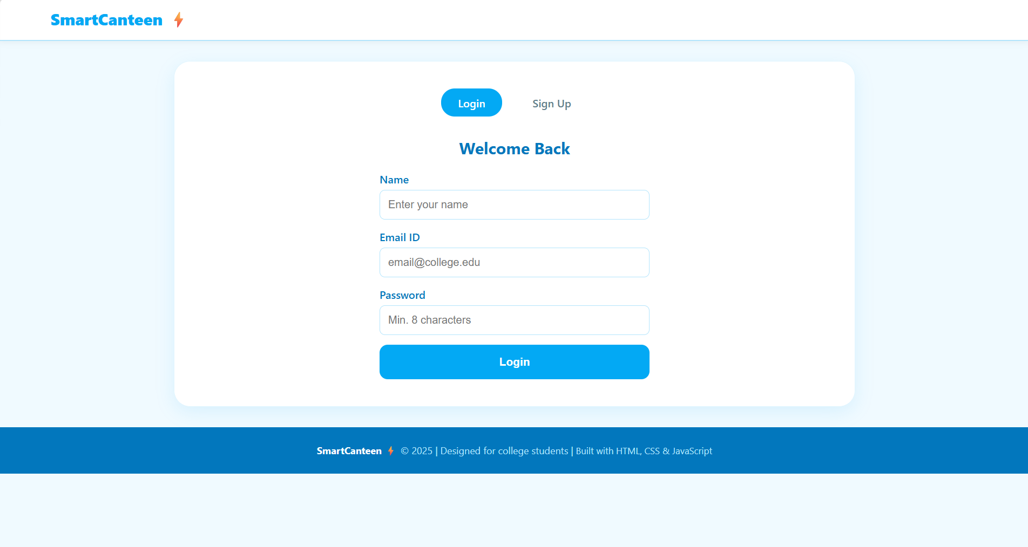
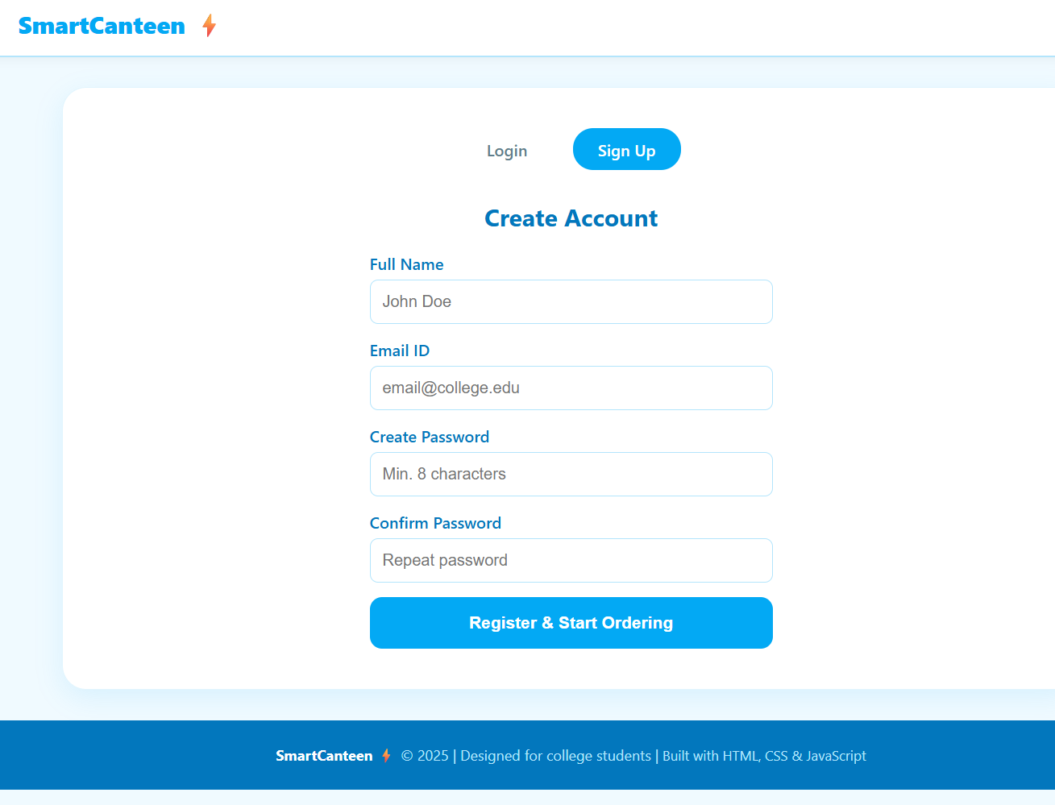
Screenshots for FWD

Slide 13
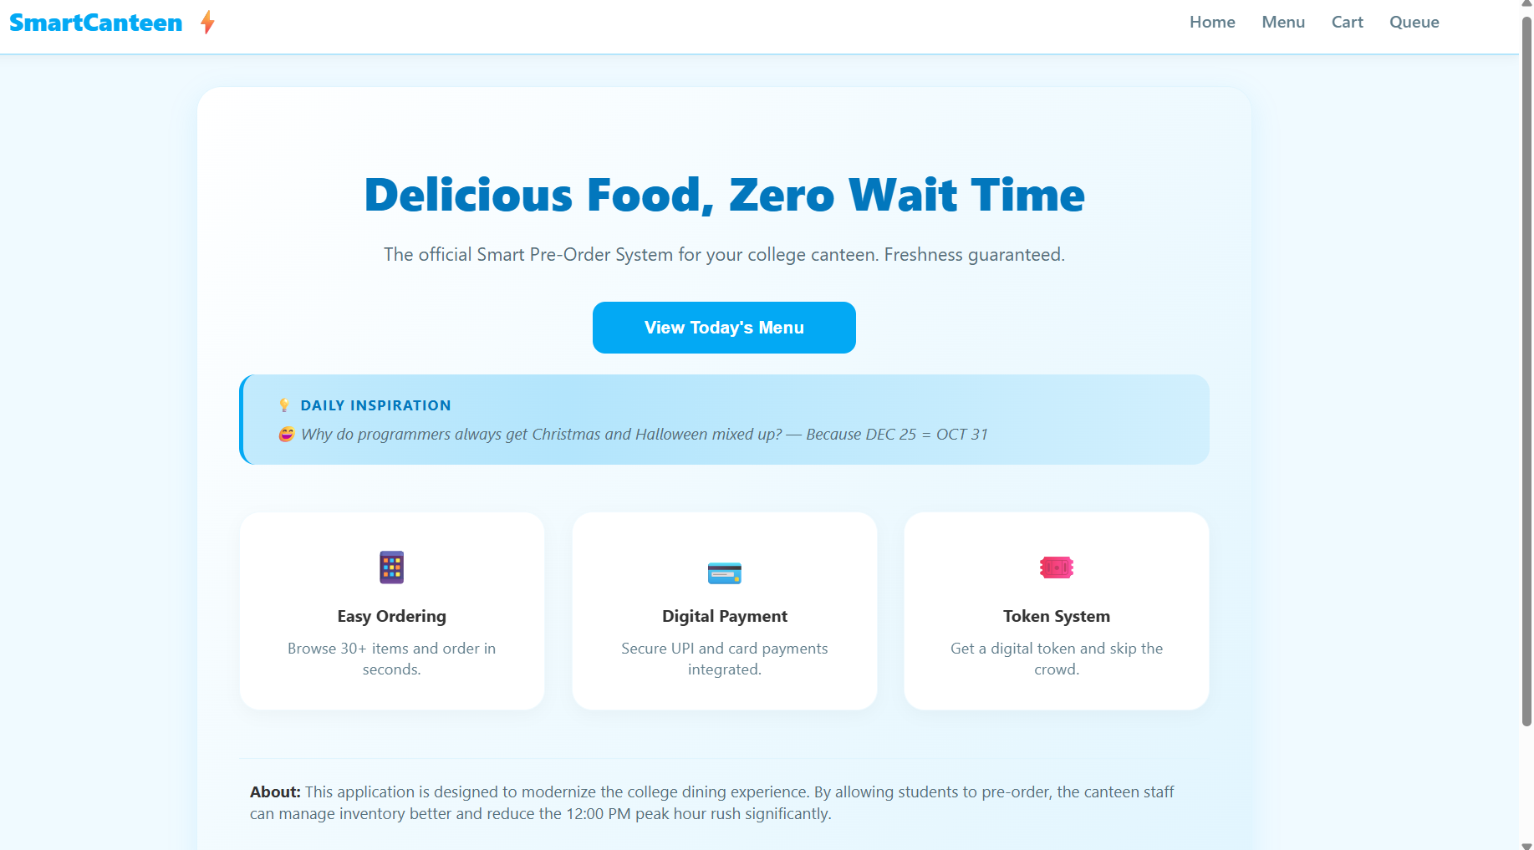
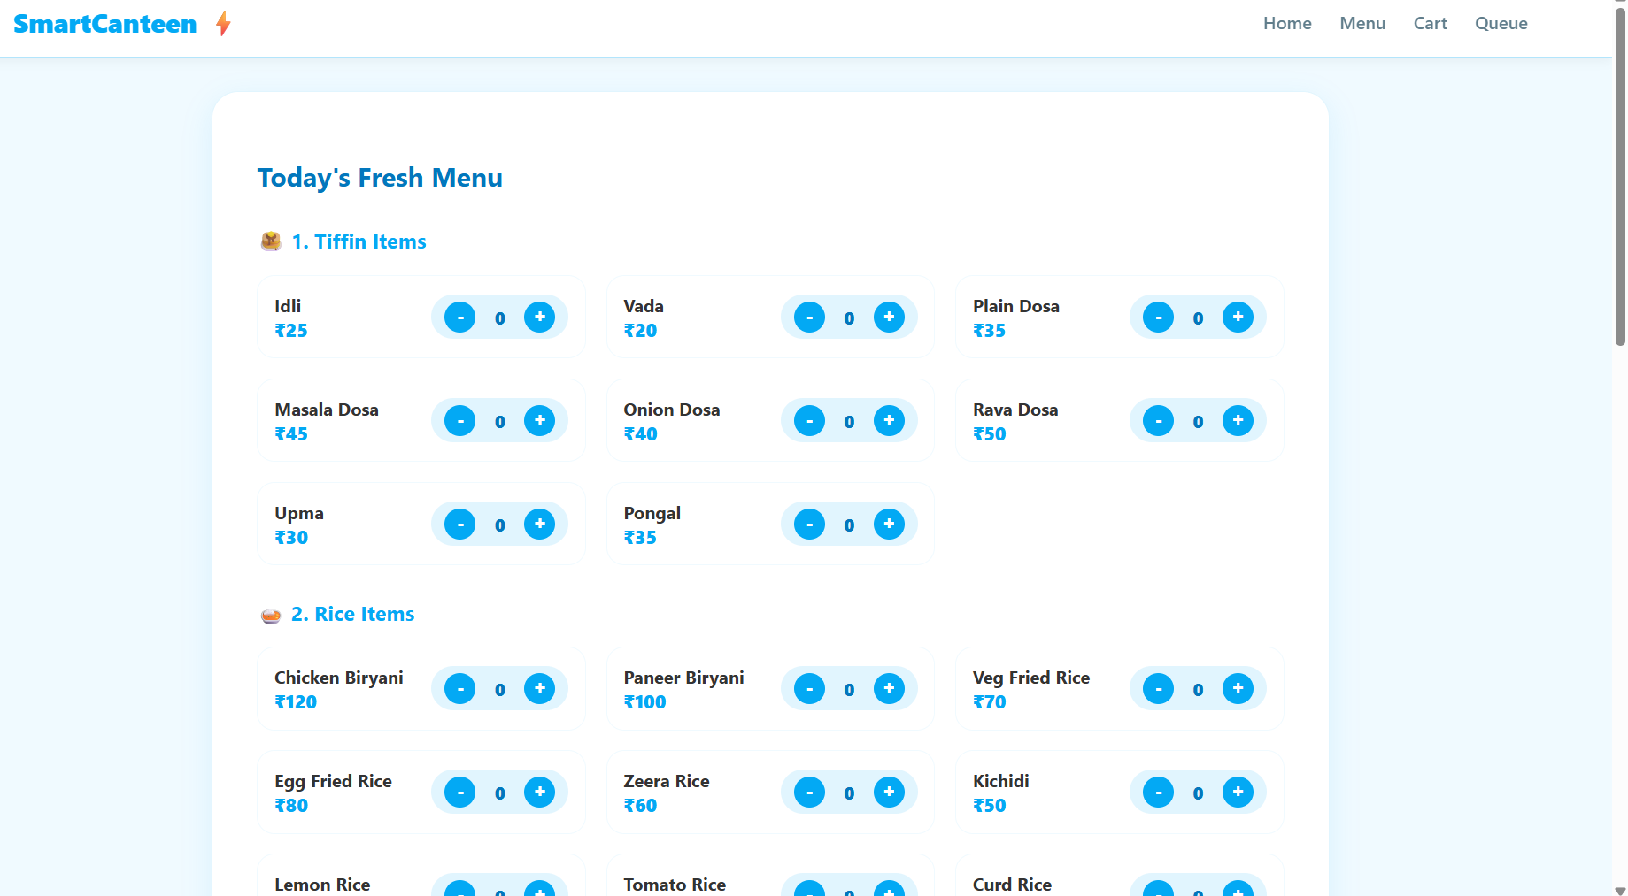

Slide 14
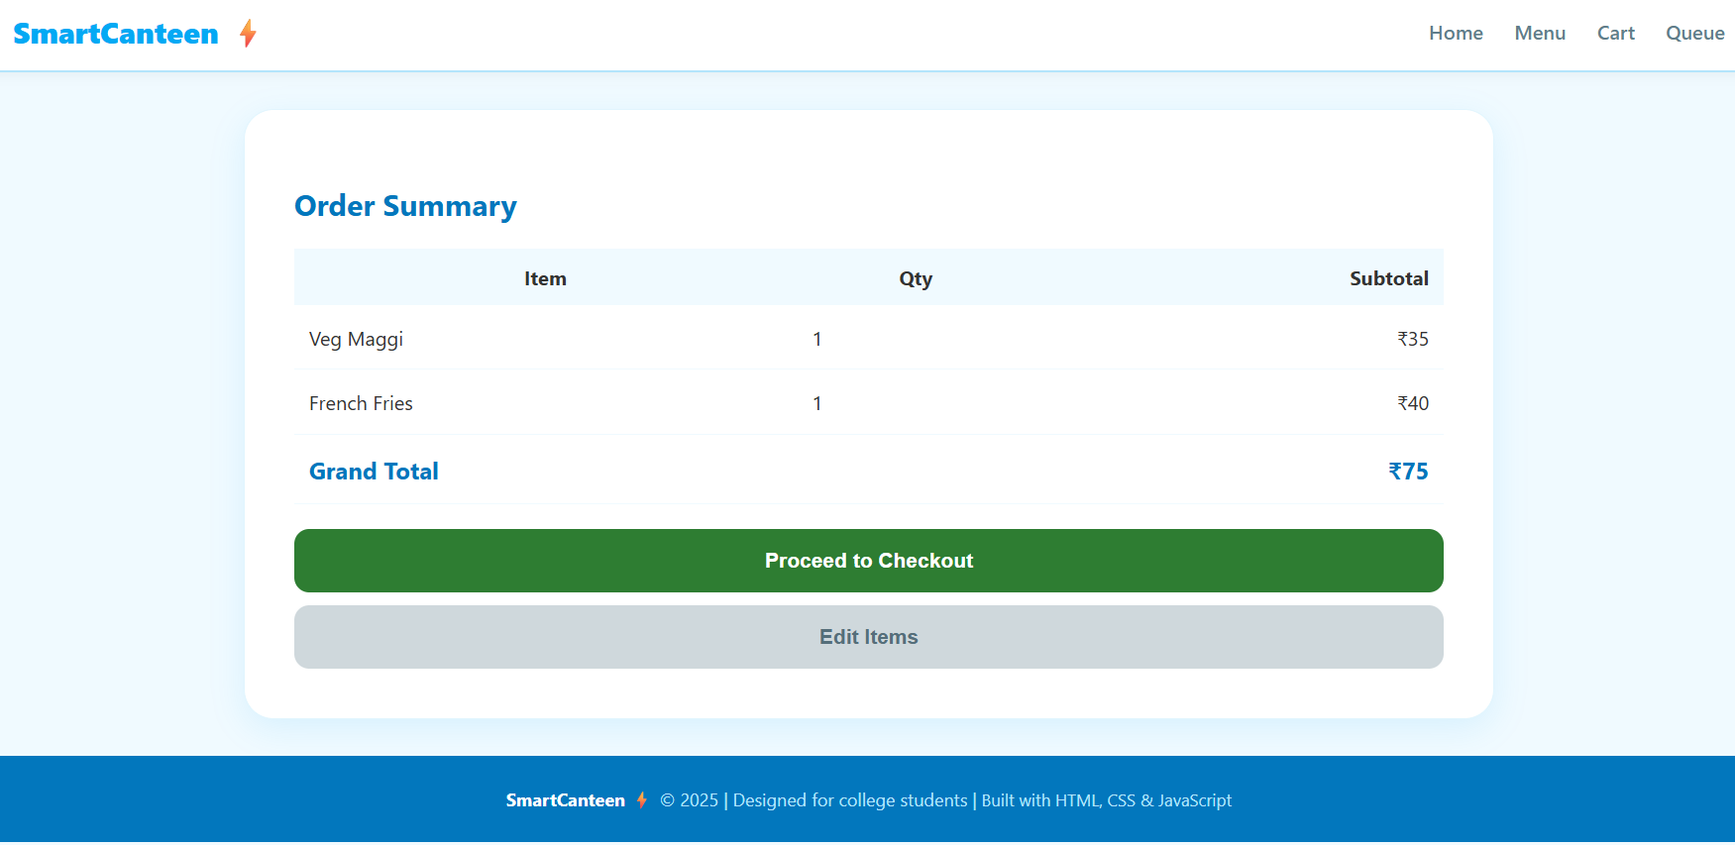
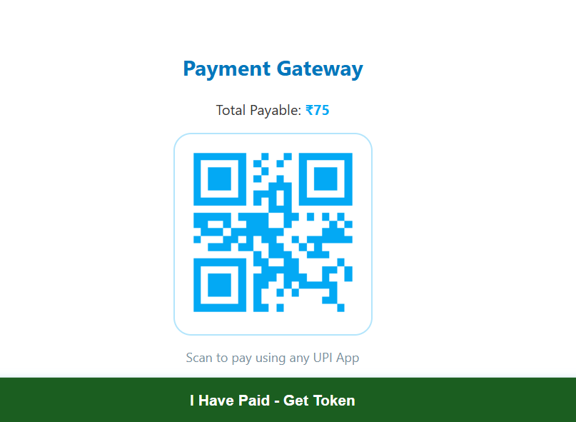
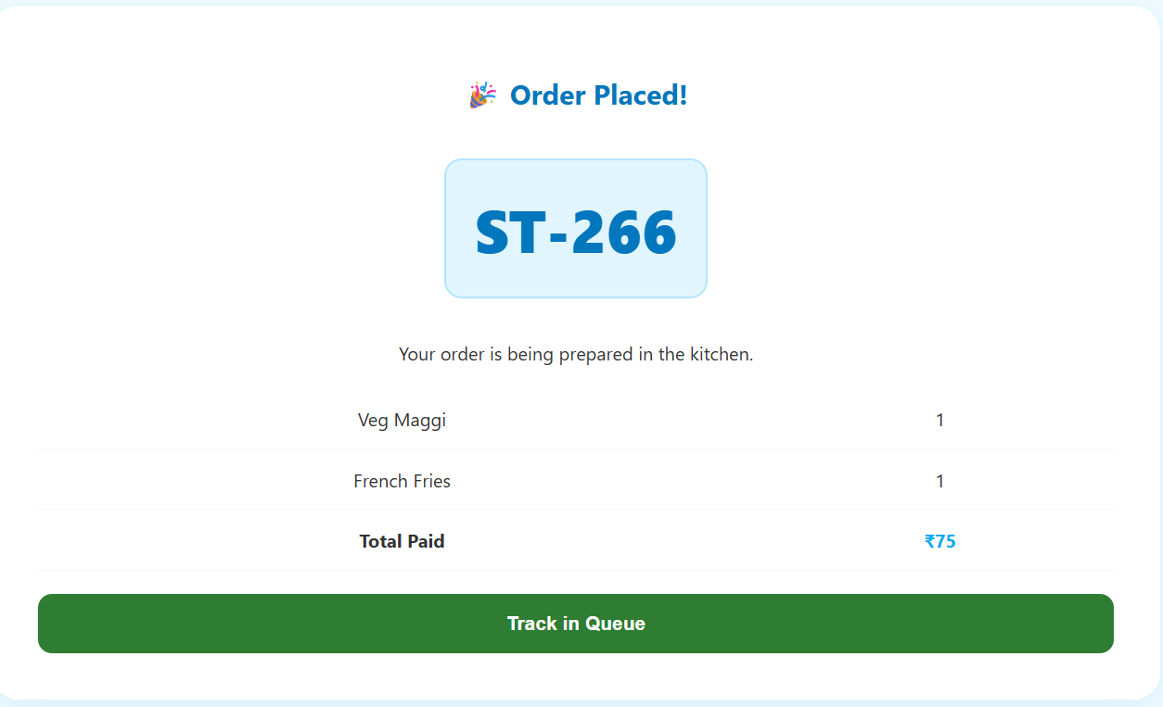
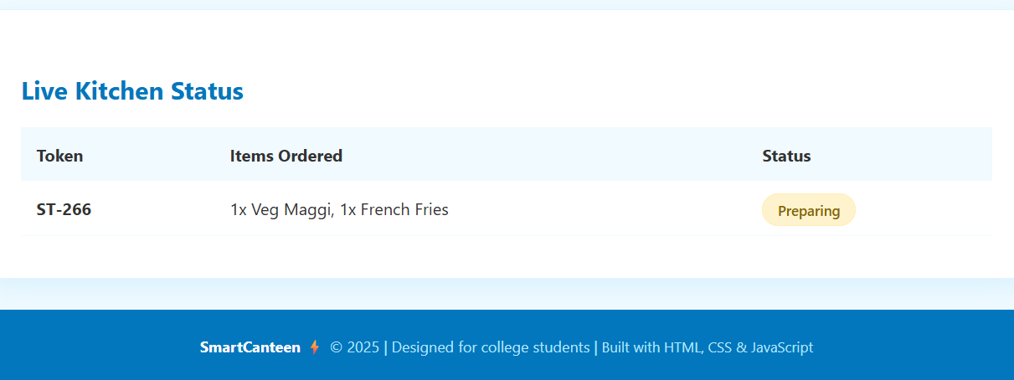

Slide 15
Conclusion
The project successfully demonstrates the use of HTML, CSS, and JavaScript to build an interactive web application.
It provides a user-friendly interface for viewing menu items and placing orders efficiently.
The system shows how JavaScript can be used for dynamic features like cart management and order processing.
Proper use of structured design and styling improves the overall user experience and responsiveness.
This project helps in understanding practical web development concepts and their real-world applications.

Slide 16
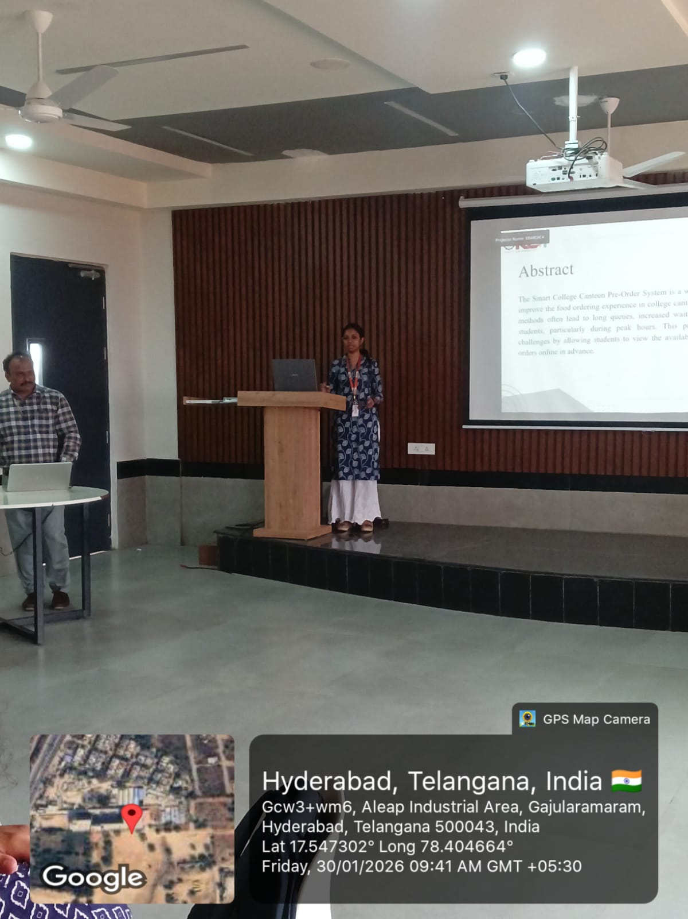
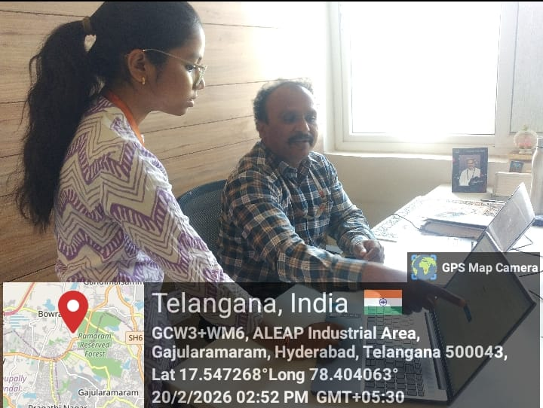
Geo- Tag Photos

Slide 17
THANK YOU

