Slide 1
KL UNIVERSITY • BACHUPALLY CAMPUS, HYDERABAD
Department of Computer Science & Engineering
MovieVerse: A Movie Recommendation Engine
Content-based and rating-based movie recommendations
PRESENTED BY
UNDER THE GUIDANCE OF
2520030373 Yasasri Pabbisetty
2520030483 Jahnavi Goka
[Dr. Raghavendra]
Department of CSE | KLH Bachupally Campus
B.Tech II Year | Minor Project Review | Academic Year 2026–27 | Date: 12-10-2026
Notes:
Model template - Minor Project review presentation for B.Tech II year. Replace every placeholder in angle brackets. Title slide: speak for 30 seconds - greet the panel, state the title, introduce the team and the guide. Do not read the slide word for word.

Slide 2
AGENDA
Contents
1
Introduction & Domain Background
7
Methodology & Modules
2
Problem Statement & Motivation
8
Tools and Technologies
3
Literature Survey
9
Work Completed / Demo
4
Research Gap Identified
10
Timeline & Review Plan
5
Objectives of MovieVerse
11
Expected Outcome & Conclusion
6
Proposed System Architecture
12
References
Dept. of CSE | KLH Bachupally Campus
2
Notes:
Keep the agenda to one slide. In a 10-12 minute review, spend the most time on literature survey, objectives and work completed.

Slide 3
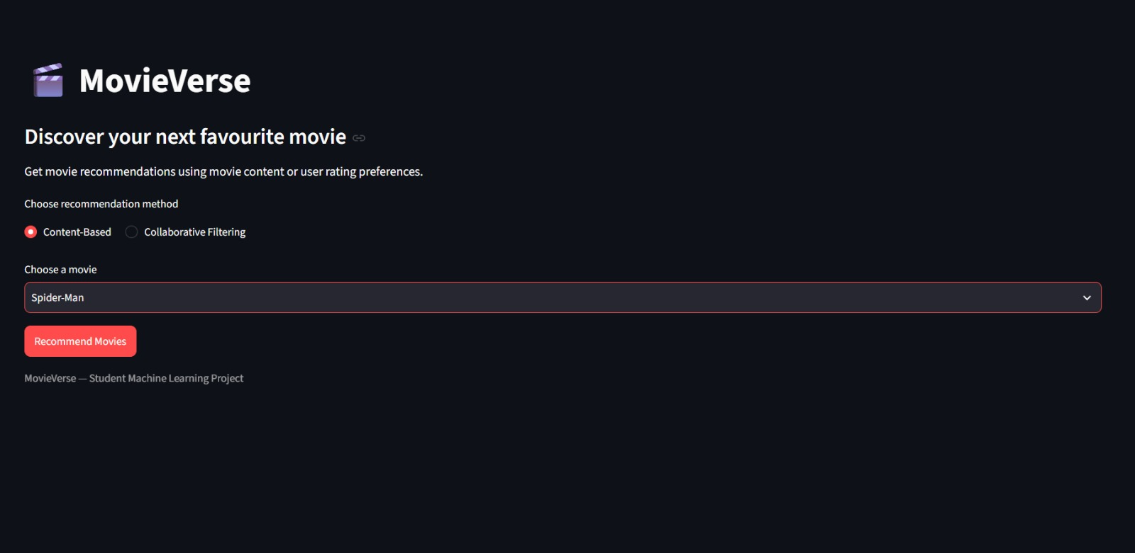
SECTION 1
Introduction & Domain Background
CineMatch workflow
Movie metadata + user ratings → recommendation models → top-five movie suggestions
What is the domain?
Movie recommendation systems help users discover films from large catalogues by using movie attributes and rating patterns.
Why is it relevant?
The MovieLens small dataset used here contains 100,836 ratings across 9,742 movies, illustrating how rating data can support recommendations [1].
Where does MovieVerse fit?
MovieVerse provides two selectable approaches: content similarity and rating-based recommendations.
Project scope
Recommendations are candidate suggestions, not a guarantee of personal preference; output quality depends on dataset coverage.
Dept. of CSE | KLH Bachupally Campus
3
Notes:
60-90 seconds. Start broad (the domain), end narrow (your specific task). Avoid definitions copied from Wikipedia - the panel will ask for the source.

Slide 4
SECTION 2
Problem Statement & Motivation
PROBLEM STATEMENT
“Movie discovery is time-consuming because large catalogues provide more choices than users can easily compare, making it difficult to find relevant films.”
1
2
3
Who is affected?
What is the cost of the problem?
Why solve it now?
Movie viewers who want to discover films similar to a title they already like.
Users may spend extra time browsing unrelated titles; this project does not claim a measured time-saving value.
A lightweight, local web application can demonstrate two common recommendation approaches using public movie metadata and rating data.
Dept. of CSE | KLH Bachupally Campus
4
Notes:
The problem statement must be ONE sentence. If you need two sentences, the scope is too wide for a minor project. The panel's first question is usually: who exactly benefits?

Slide 5
SECTION 3
Literature Survey
Selected literature relevant to content-based, collaborative and hybrid recommendation methods.
S.No | Author & Year | Title / Technique Used | Dataset / Tools | Key Findings | Limitation / Gap
1 | Patel & Patel (2020) | State-of-the-art survey of recommender systems | Survey of recommendation approaches | Reviews content-based and collaborative filtering; discusses sparsity and cold-start challenges. | Survey-level findings; performance depends on dataset and use case.
2 | Kulkarni & Rodd (2020) | Review of context-aware recommendation systems | Literature review | Explains content, collaborative and hybrid approaches and the role of context. | Context changes over time and may not be captured by basic recommenders.
3 | Li & Han (2021) | Time-aware hybrid recommendation scheme | Content-based + collaborative filtering | Combines item content and collaborative signals with time-aware information. | More complex than the two independent baseline models in CineMatch.
4 | Roy & Dutta (2022) | Systematic review and research perspective on recommender systems | Systematic literature review | Summarises methods, application areas and open research challenges. | Evaluation and practical usefulness still need to be checked for each application.
MovieVerse uses a lightweight baseline and demonstrates both approaches separately. Its current results are functional but have not been evaluated with formal ranking metrics.
Dept. of CSE | KLH Bachupally Campus
5
Notes:
Do not read the table aloud. Speak about the trend: what most papers did, what results they reached, and what all of them left unsolved. Row 1 is a worked example - delete it and put your own paper there.

Slide 6
SECTION 4
Research Gap Identified
GAP 1
OUR PROJECT ADDRESSES
Movie metadata and user ratings are stored in separate datasets, so title matching and coverage can be inconsistent.
MovieVerse implements two simple, selectable models in a Streamlit interface and exposes their limitations for future evaluation.
GAP 2
A basic content model can return similar-looking titles without proving recommendation relevance; collaborative results can be sparse for some movies.
GAP 3
These are project-specific implementation gaps and limitations, not a claim that no existing recommender system addresses them.
A working interface is needed so users can select a movie and switch between recommendation methods.
The literature motivates the chosen baseline methods; formal comparison and quality evaluation remain future work.
Dept. of CSE | KLH Bachupally Campus
6
Notes:
This is the slide that separates a good review from an average one. State 2-3 gaps only, and make sure each one maps to a paper you listed.

Slide 7
SECTION 5
Objectives of the Project
Objectives are tied to features implemented and testable in the current prototype.
Load the TMDB 5000 movie metadata and MovieLens latest-small ratings datasets.
1
Build a content-based model using TF-IDF vectors and cosine similarity.
2
Implement a rating-based collaborative recommendation baseline and inspect sample outputs; formal ranking metrics are not yet reported.
3
Deploy both methods in a Streamlit interface that displays up to five recommendations.
4
Dept. of CSE | KLH Bachupally Campus
7
Notes:
Avoid vague verbs - study, understand, analyse. Use build, classify, detect, compare, deploy. Four objectives is the right number for a minor project.

Slide 8
SECTION 6
Proposed System Architecture
INPUT
PRE-PROCESSING
CORE MODULE
OUTPUT
TMDB movie metadata
Genres, keywords, cast, overview
MovieLens ratings
User ID, movie ID, rating
Clean missing overview text
Parse genres, keywords and cast
Match titles to rating data
Content-based:
TF-IDF + cosine similarity
Collaborative:
Users with high ratings → other rated movies
Streamlit UI
User selects method and movie
Top-five recommendations (when data supports them)
Data flow: TMDB / MovieLens CSVs → preprocessing → selected recommendation function → Streamlit results
Label every arrow
The two models are selectable alternatives; the current prototype does not combine their scores into a single hybrid ranking.
Dept. of CSE | KLH Bachupally Campus
8
Notes:
Walk the panel through the diagram left to right in under a minute, naming the input and the output first. Be ready to say where your contribution sits.

Slide 9
SECTION 7
Methodology & Modules
1
Module 1 - Data
2
Module 2 - Processing
TMDB 5000 movies and credits CSVs; MovieLens latest-small movies and ratings CSVs. Data is loaded locally.
Parse JSON-like metadata fields; fill missing plot overviews; combine genres, keywords, cast and overview into one text field.
3
Module 3 - Core Logic
4
Module 4 - Interface
Content-based: TF-IDF with cosine similarity. Collaborative baseline: find users who rated the selected movie ≥4, then rank other movies they rated by mean rating and count.
Python modules are called by a Streamlit interface. Users choose a method and title; the app displays up to five recommendations.
Dept. of CSE | KLH Bachupally Campus
9
Notes:
One module per team member works well - it also answers the panel question 'who did what'.

Slide 10
SECTION 8
Tools and Technologies
SOFTWARE
HARDWARE / PLATFORM
Language: Python | Libraries: pandas, NumPy, scikit-learn, Streamlit
Content model: TfidfVectorizer, cosine_similarity
Interface: Streamlit
Data: CSV files (TMDB and MovieLens)
IDE: Visual Studio Code
Platform: local Windows laptop
Python environment: virtual environment (.venv)
GPU / sensors: not required
Deployment: local Streamlit server (localhost)
Version control: GitHub repository link to be added if used
Dept. of CSE | KLH Bachupally Campus
10
Notes:
Name versions where you know them. If you have a GitHub repository, show the link here - it is strong evidence of real work.

Slide 11
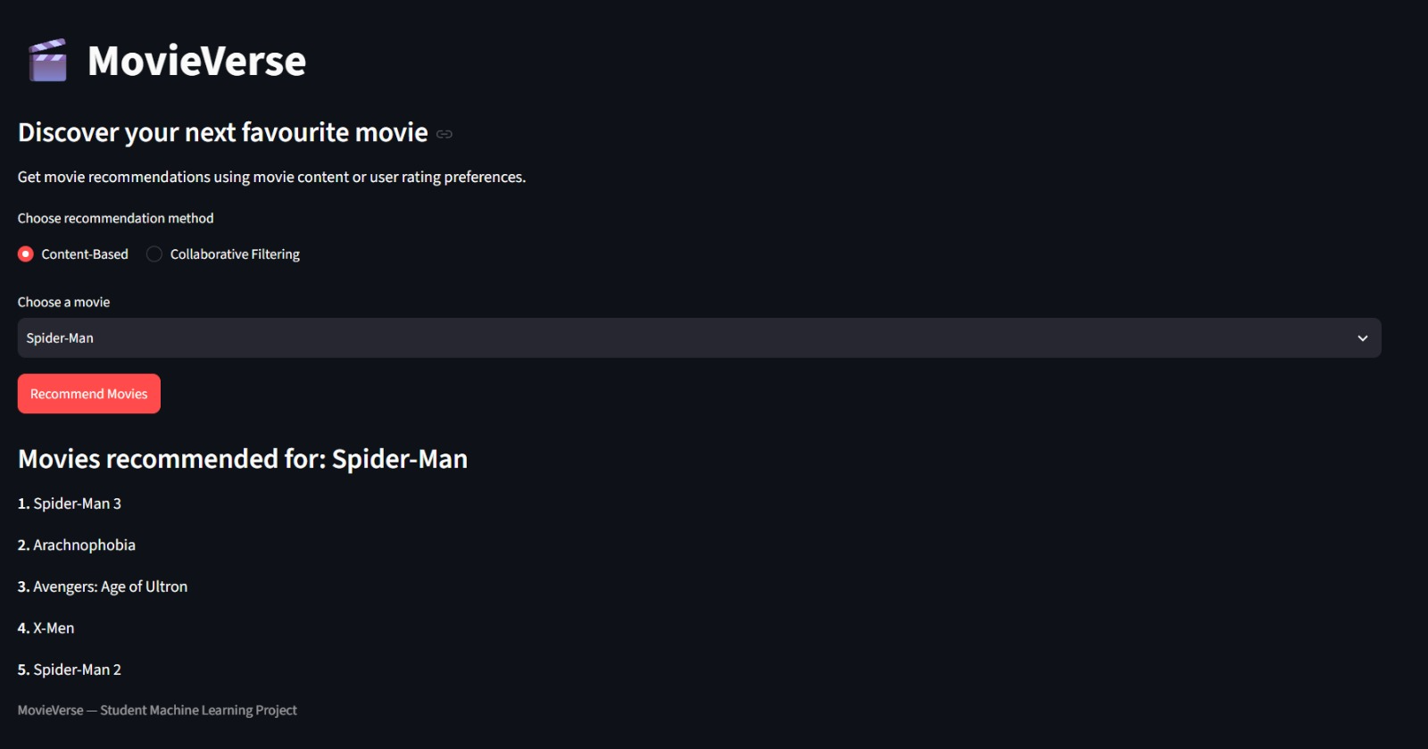
SECTION 9
Work Completed / Demo
Dataset collection and loading
Completed
Demo evidence: Streamlit interface tested with Avatar (content-based) and Toy Story (1995) (collaborative). Some selected movies may have no collaborative results because rating coverage is limited.
Metadata cleaning and feature extraction
Completed
TF-IDF and cosine similarity model
Completed
Collaborative filtering baseline
Implemented; quality varies by movie
Streamlit interface and method selection
Completed
Manual smoke tests on sample movies
Completed; formal metrics pending
Current demo proves execution, not benchmark accuracy. Add a screenshot of the live interface if the review requires visual evidence.
Dept. of CSE | KLH Bachupally Campus
11
Notes:
Be honest about status. Panels reward accurate self-assessment and penalise claims that fall apart under one question.

Slide 12
SECTION 10
Timeline & Review Plan
Review 0
Review 1
Review 2
Final
Completed
Completed
Current phase
Next
Project title, scope and team roles established
Datasets, literature background, objectives and architecture prepared
Prototype implemented; testing and quality improvements ongoing
Validate on both team laptops; finish report, presentation and repository handover
Update this timeline to match the actual departmental review dates.
Remaining priorities: test reproducibility, describe limitations honestly, and complete the final report and demo.
Dept. of CSE | KLH Bachupally Campus
12
Notes:
Adjust week numbers to your academic calendar. Showing a plan for the remaining weeks is what the panel wants to hear at Review 1.

Slide 13
SECTION 11
Expected Outcome & Conclusion
DELIVERABLE
MEASURABLE TARGET
BEYOND THE LAB
A local web app that returns up to five movie suggestions using content-based or rating-based methods.
Functional smoke tests passed for selected movies. No formal precision, recall, NDCG or accuracy benchmark has been measured yet.
A prototype for movie viewers and a foundation for later deployment; currently runs locally through Streamlit.
CONCLUSION
MovieVerse addresses movie discovery by providing two recommendation approaches over public movie metadata and rating data. The prototype demonstrates TF-IDF/cosine similarity and a simple collaborative baseline in one interface. Current limitations include sparse rating coverage, title matching and unmeasured recommendation quality. Future work can add a true hybrid ranker and evaluate Precision@K, Recall@K and NDCG.
Dept. of CSE | KLH Bachupally Campus
13
Notes:
Do not introduce anything new here. The conclusion restates the problem, the gap and the promise - nothing else.

Slide 14
SECTION 12
References
Selected research and technical sources used to frame the project. Confirm the cited papers against your final literature survey before submission.
[1] F. M. Harper and J. A. Konstan, “The MovieLens Datasets: History and Context,” *ACM Transactions on Interactive Intelligent Systems*, vol. 5, no. 4, 2015. doi: 10.1145/2827872.
[2] B. Sarwar, G. Karypis, J. Konstan, and J. Riedl, “Item-Based Collaborative Filtering Recommendation Algorithms,” *Proceedings of the 10th International Conference on World Wide Web*, 2001, pp. 285–295. doi: 10.1145/371920.372071.
[3] G. Salton and C. Buckley, “Term-Weighting Approaches in Automatic Text Retrieval,” *Information Processing & Management*, vol. 24, no. 5, pp. 513–523, 1988. doi: 10.1016/0306-4573(88)90021-0.
[4] C. C. Aggarwal, *Recommender Systems: The Textbook*. Springer, 2016. doi: 10.1007/978-3-319-29659-3.
[5] Scikit-learn Developers, “TfidfVectorizer Documentation.” Available: https://scikit-learn.org/stable/modules/generated/sklearn.feature_extraction.text.TfidfVectorizer.html
[6] Scikit-learn Developers, “Cosine Similarity Documentation.” Available: https://scikit-learn.org/stable/modules/generated/sklearn.metrics.pairwise.cosine_similarity.html
[7] Streamlit, “Streamlit Documentation.” Available: https://docs.streamlit.io/
These references cover the datasets, recommendation techniques, text processing methods, and software tools relevant to the CineMatch prototype. The system implements content-based filtering and collaborative filtering as separate recommendation approaches.
Dept. of CSE | KLH Bachupally Campus
14
Notes:
Use Google Scholar's 'Cite' option and pick MLA/IEEE, then fix the formatting by hand. Never cite a blog, a YouTube video or a paper you have not opened.

Slide 15
Thank You
Questions & Suggestions
Notes:
Keep the deck open on the architecture slide during questions - most panel questions point back to it.

