Slide 1
Machine Learning-Based Smart Campus Energy Consumption Prediction and Anomaly Detection
Jahnavi Kallolini | Navya Menon | Keshav Agrawal
B.Tech CSE (AI&ML), School of Computer Engineering, Manipal Institute of Technology
Mentors: Dr. Narendra V. G., Dr. Ashwath Rao
Notes:
Mini-project based on the submitted synopsis. All numbers in this deck come from the project's saved result tables.

Slide 2
Problem, data and objectives
Objectives
Data (I-BLEND)
Predict hourly power of seven campus building feeders
Compare Linear Regression, KNN, Decision Tree and SVR
Flag potential anomalous consumption from prediction residuals
Explore patterns with PCA and K-Means
Aug 2013 to Dec 2017; seven main feeders
Power every minute (W); Wi-Fi occupancy every 10 min; daily academic calendar
Target: hourly mean power
Weather excluded: only Mar-Jun 2018, no overlap
Hostel UPS (backup) feeders excluded
Buildings: Academic, Boys Hostel, Facilities, Girls Hostel, Lecture, Library, Mess
Notes:
Objectives follow the synopsis. The weather file covers only March-June 2018, after the last energy reading, so it cannot be used; backup feeders are excluded to keep seven buildings.

Slide 3
Preprocessing and features
Hour valid if at least 45/60 power readings (occupancy: 4/6)
Long outages kept missing (hostels and library: 200+ days); never filled
Each building modelled on its own valid data
Features: hour, weekday, weekend, month, working day, activity H/L; power lags 1, 2, 24; 24 h rolling mean/std; occupancy lags 1, 2, 24
No current-hour occupancy or future information
Building | Valid hours | Primary rows
Academic | 37,805 | 28,894
Boys Hostel | 27,668 | 18,385
Facilities | 34,039 | 23,739
Girls Hostel | 27,482 | 18,392
Lecture | 37,806 | 22,738
Library | 28,547 | 18,831
Mess (Dining) | 33,513 | 25,353
Primary rows need an observed target and all lag features, including occupancy.
Notes:
Missing occupancy stays missing: the released occupancy never reports zero. Short gaps in lag inputs use causal carry-forward of at most one hour; targets are never filled.

Slide 4
Evaluation protocol and leakage control
Period | Dates | Rows
Train | 2014-02-17 to 2016-06-30 | 90,640
Validation | 2016-07-01 to 2016-12-31 | 28,428
Primary test | 2017-01-01 to 2017-07-07 | 20,231
Sensitivity (after break) | 2017-07-11 to 2017-11-04 | 16,885
Chronological split, no shuffling
Encoding and hyper-parameters chosen on validation only
One model per building, same procedure for all
Scalers and one-hot categories fitted on training rows
Metrics: MAE, MSE, RMSE, R2 per building; nRMSE = RMSE / training std for comparison across scales
Persistence and seasonal-naive baselines for reference
The primary test period ends before a timestamp discontinuity (slide 7).
Notes:
Models are fitted on training rows only and evaluated once on validation and test. The tuning code never loads test rows; automated tests check lags, rolling windows, scalers, encodings and the split.

Slide 5
Model comparison: SVR lowest error, margin over Linear Regression small
Validation R2: SVR 0.892, Linear 0.877
Primary test R2: SVR 0.850, Linear 0.845
Decision Tree and KNN are close to persistence on test
SVR training 56 s vs 0.2 s for Linear (7 buildings)
Full original test period: Linear Regression ranks first (confounded by the break)
Notes:
Macro average over seven buildings of RMSE divided by each building's training standard deviation (lower is better). SVR was selected on validation. On the primary test period it is still best; after the break all time-of-day dependent models degrade.

Slide 6
Per building results and role of occupancy
R2 | SVR val | SVR test | Linear val | Linear test
Academic | 0.960 | 0.956 | 0.936 | 0.928
Boys Hostel | 0.852 | 0.814 | 0.844 | 0.821
Facilities | 0.910 | 0.910 | 0.897 | 0.890
Girls Hostel | 0.831 | 0.776 | 0.848 | 0.799
Lecture | 0.915 | 0.744 | 0.878 | 0.793
Library | 0.933 | 0.938 | 0.906 | 0.892
Mess (Dining) | 0.842 | 0.811 | 0.834 | 0.791
Energy-only vs energy + lagged occupancy (matched rows): SVR 0.379 vs 0.382 on test; KNN 0.447 vs 0.464
Lagged power already carries the occupancy-driven pattern
Lecture: 82.5% of minutes at exactly 0 W (79.3% of hours), seasonal and long runs; zeros kept, not removed
Lecture mixes an off and an on regime: R2 is driven by on/off transitions; results reported separately
Notes:
R2 of the selected SVR and Linear Regression per building. Lagged occupancy gave no measurable gain on identical rows; Lecture reads exactly 0 W in most hours.

Slide 7
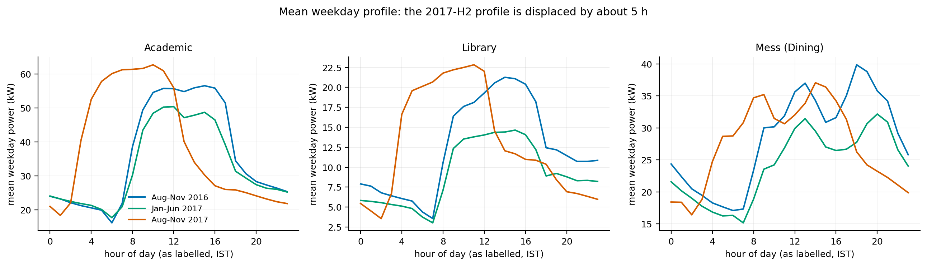
Timestamp discontinuity from July 2017 (unresolved)
Monthly profile alignment: about 0 h until June 2017, 4-6 h in July-December 2017, all buildings
Against occupancy the best energy offset is 0-70 min before and 250-330 min after the break; not identical across buildings, so no exact correction can be justified
Raw data untouched. Primary test ends 2017-07-07; later rows reported only as sensitivity
SVR macro nRMSE rises from 0.382 (before) to 0.503 (after the break)
Notes:
Daily profiles of all seven energy series move earlier by 4-6 h from about 2017-07-08, right after logging gaps; occupancy does not shift. The authors' reader script applies a fixed +05:30 conversion and documents no break. Nothing was corrected.

Slide 8
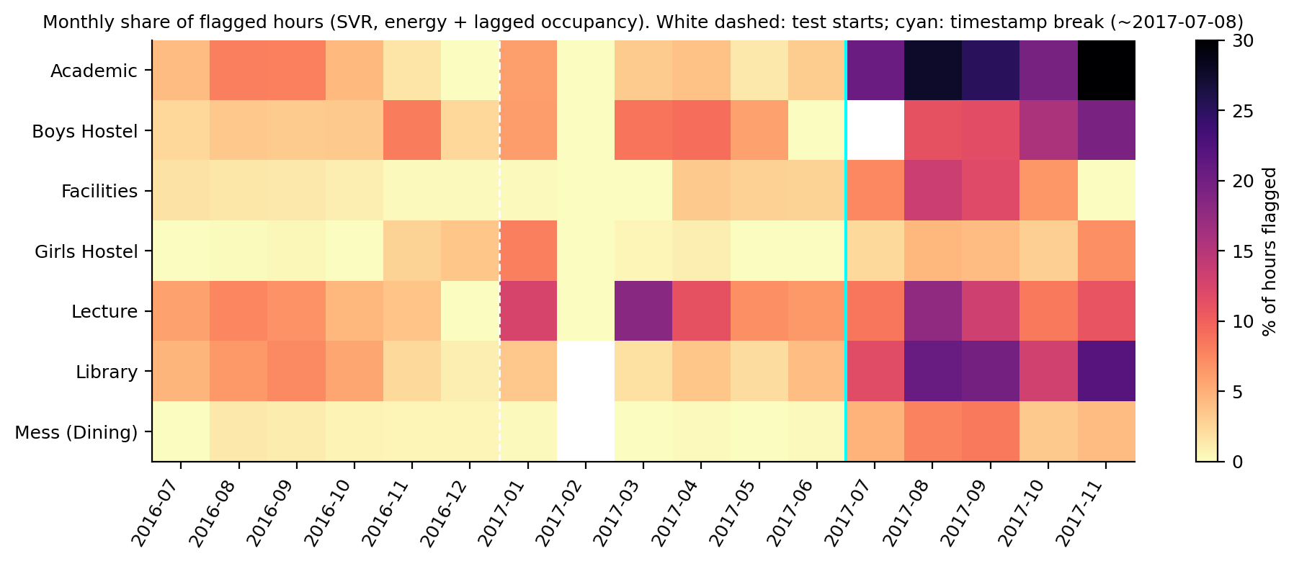
Residual-based anomaly detection
Residual = actual - expected (SVR, primary features)
Flag if |modified z| > 3.5; median and MAD from validation residuals per building, day-part and regime
Validation 3.0% flagged; primary test 3.7% (747 hours); after the break 12.3% (timestamp effect)
With vs without occupancy: flags overlap strongly (Jaccard 0.80); SVR vs Linear overlap less (0.51)
Output = potential anomalous consumption periods, not diagnosed faults
Notes:
Flagged hours are statistical outliers relative to the model; there is no ground truth for faults. Thresholds use validation residuals only.

Slide 9
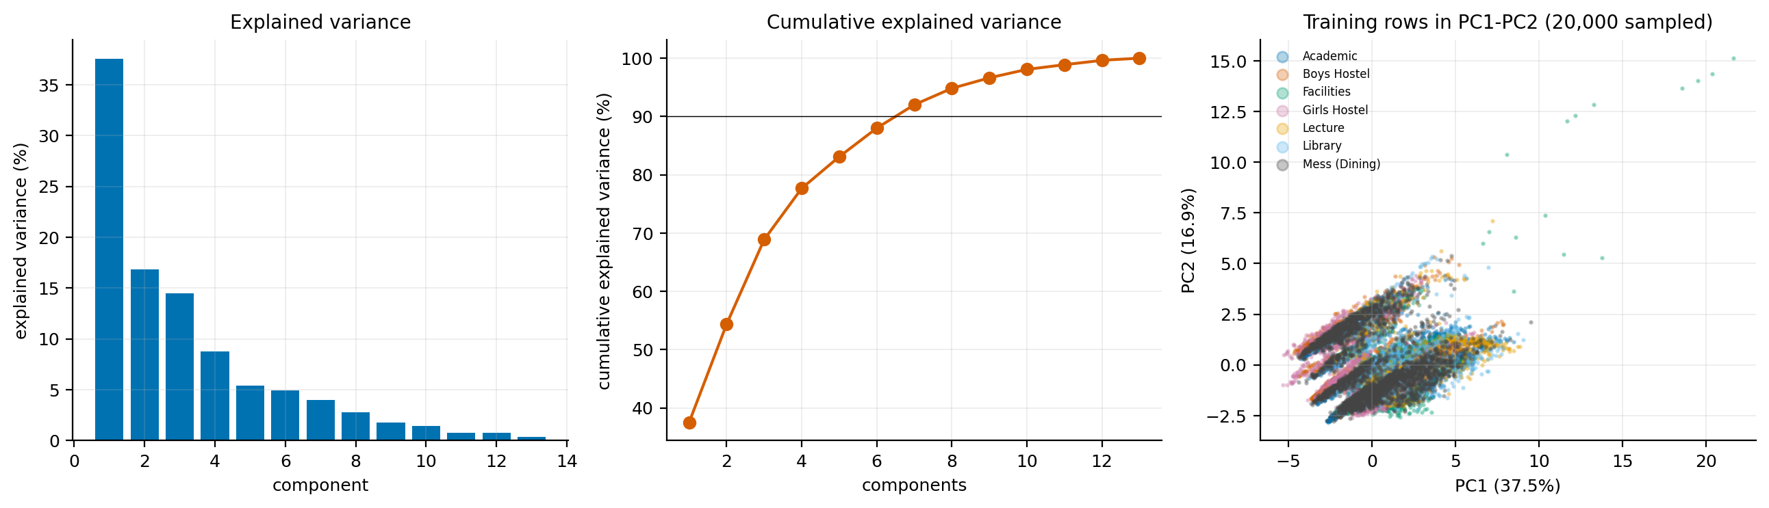
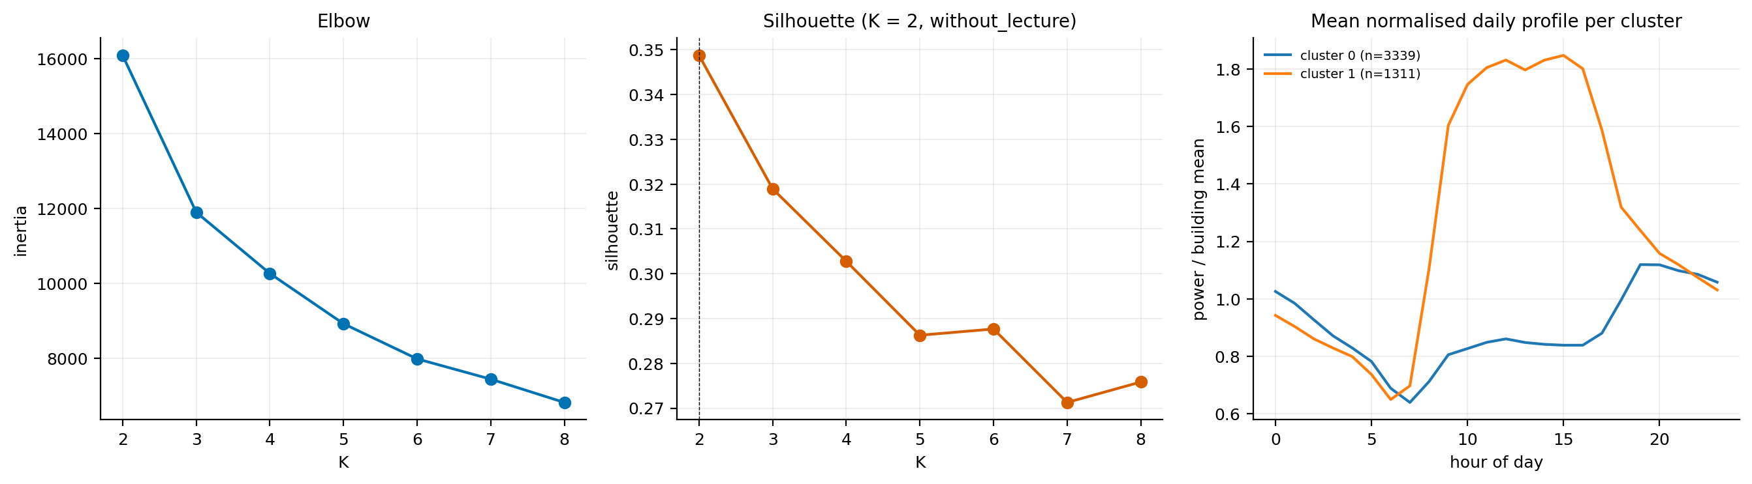
PCA and K-Means (exploratory)
PC1-PC3 explain 37.5%, 16.9%, 14.5%; 7 components for 90%
PC1: lagged power and occupancy level; PC2: calendar regime
K-Means, seven buildings: K=3 (silhouette 0.71), two of three clusters are Lecture-only
Without Lecture: K=2 (silhouette 0.35): weekday daytime-heavy days vs flatter low-load days
Clusters are descriptive; no efficiency labels
Notes:
PCA is not used as a modelling step. K-Means on all seven buildings is dominated by Lecture's two regimes; without Lecture the structure is moderate.

Slide 10
Dashboard, limitations and conclusion
Dashboard (Streamlit)
Limitations
Conclusion and next steps
Filters: building, model, feature set, dates
Actual vs expected power, metrics, anomaly timeline and events
CSV export of selection and events
Banner states timestamp issue and that flags are not faults
Batch viewer of saved results, not real-time
Timestamps from July 2017 displaced (unresolved)
No ground truth for anomalies
Occupancy is a Wi-Fi proxy; absent values not read as zero
Lecture is zero-inflated; weather unavailable
SVR vs Linear margin small; SVR grid edge
One campus only
SVR selected on validation; best on primary test
Lagged occupancy adds no predictive skill here
Anomaly flags transfer to test with similar rate
Next: resolve the timestamp issue with the data authors, re-evaluate, regime-aware Lecture model, validate flags against maintenance records
Notes:
Dashboard run: streamlit run app/streamlit_app.py. It reads saved outputs only. The deck has no dashboard screenshot; the dashboard was tested headlessly.

