Slide 1

LeafGuard AI:Predictive Modeling of Plant Stress Using Multisensor Data
[Batch No: 42 ]
Team Members :
227004039 –k.Jahnavikrishna
227004020 –G.poojitha Guide:Dr.A.Subramanian
Department of ECE
SRC, SASTRA University

Slide 2
INTRODUCTION:
Environmental stress parameters like impedance, humidity, and temperature
play an important role in plant health monitoring.
Accurate prediction of these parameters helps in improving precision
agriculture and smart farming systems
This project uses machine learning models to predict environmental
stress conditions using sensor-based data.
A Hybrid-AdapTree model with feature selection is proposed to improve prediction accuracy and reduce training time.
The system provides efficient stress analysis and supports real-time agricultural monitoring applications.

Slide 3
Problem Statement :
Traditional plant stress monitoring methods are slow and less accurate.
Single machine learning models give lower prediction performance.
High training time increases computational complexity.
Important parameters like impedance, RH, and temperature need accurate prediction.
An efficient hybrid model is needed for better accuracy and faster results.

Slide 4
Objectives of the Project :
To collect and preprocess environmental and impedance data.
To select important features using Mutual Information.
To implement machine learning models for prediction.
To develop a Hybrid-AdapTree model for better accuracy.
To reduce training time using feature selection.
To predict plant stress using Environmental Stress Index (ESI).

Slide 5
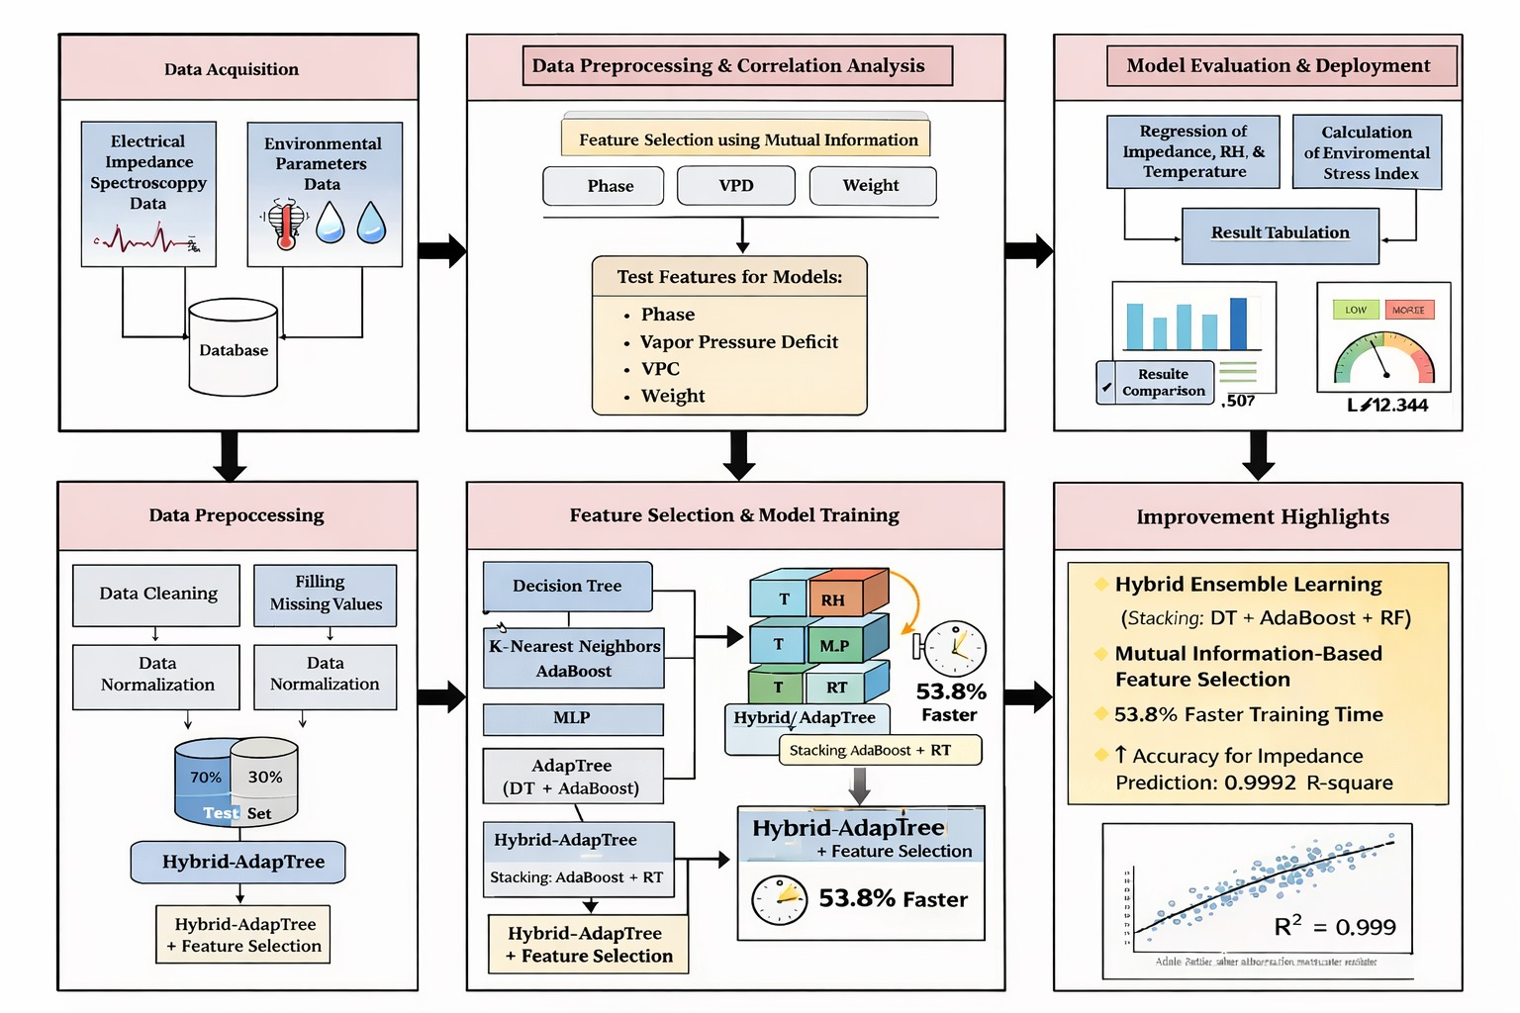
SYSTEM ARCHITECTURE :

Slide 6
Implementation details:
Mutual Information is applied for feature selection to measure the importance of each feature in prediction. Based on the results, Frequency is removed and Phase, VPD, VWC, and Weight are selected.
Several machine learning models such as Decision Tree (DT), KNN, MLR, AdaBoost, and MLP are implemented for comparison. These models help in analyzing prediction performance for impedance, RH, and temperature.
AdapTree is developed by combining Decision Tree and AdaBoost using a boosting approach. This improves prediction accuracy by reducing bias and variance in the model.
A Hybrid-AdapTree model is created using a stacking-based ensemble method with DT, AdaBoost, and Random Forest. This model captures both linear and nonlinear relationships more effectively.
Feature selection is integrated with the Hybrid-AdapTree model to reduce dimensionality and computational complexity. This improves efficiency and reduces training time without affecting accuracy.
All models are evaluated using R², MSE, RMSE, MAE, and PCC to compare their performance. The best-performing model is selected for final environmental stress prediction.

Slide 7
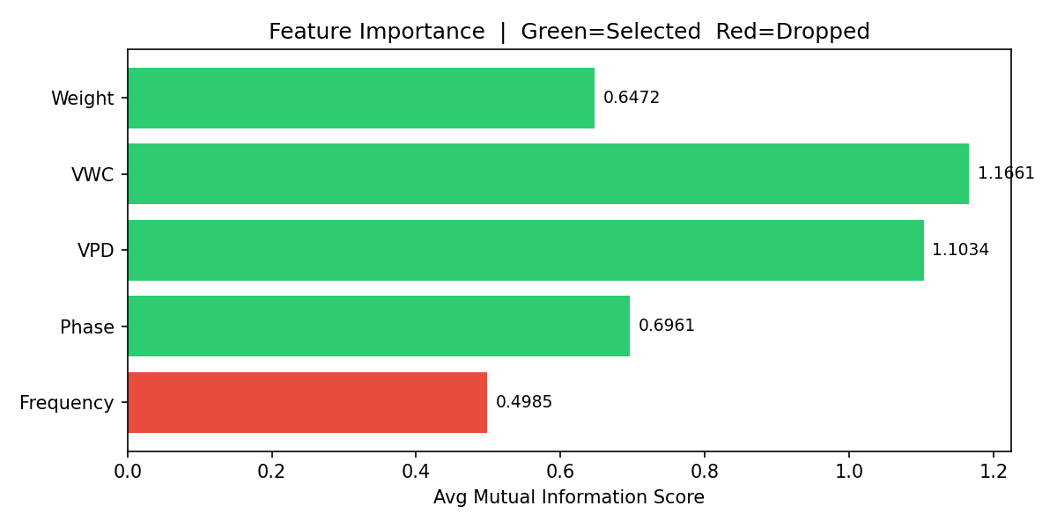
OPTIMIZATION RESULTS :
Mutual Information (MI) analysis showed that VWC and VPD are the most important features, while Phase and Weight also contribute significantly to predicting impedance, RH, and temperature.
Frequency had the lowest MI score, so it was removed, reducing redundancy and training time while improving model efficiency with the final selected features: Phase, VPD, VWC, and Weight.

Slide 8
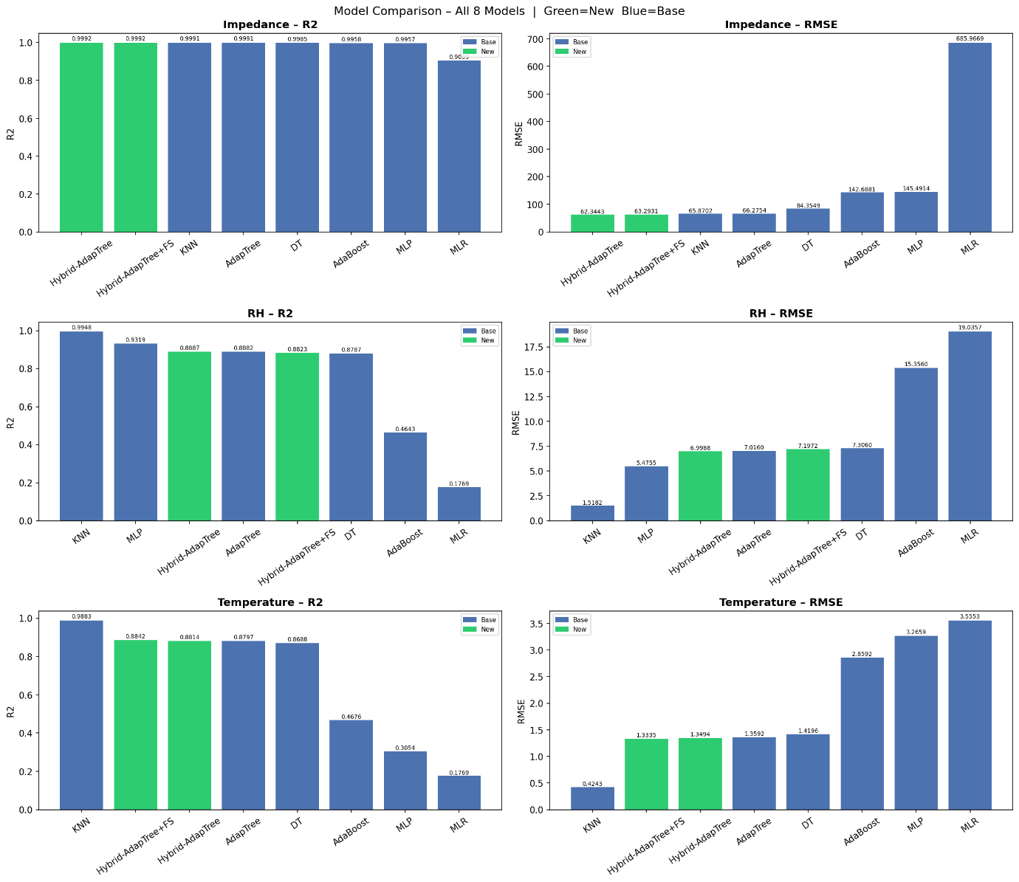
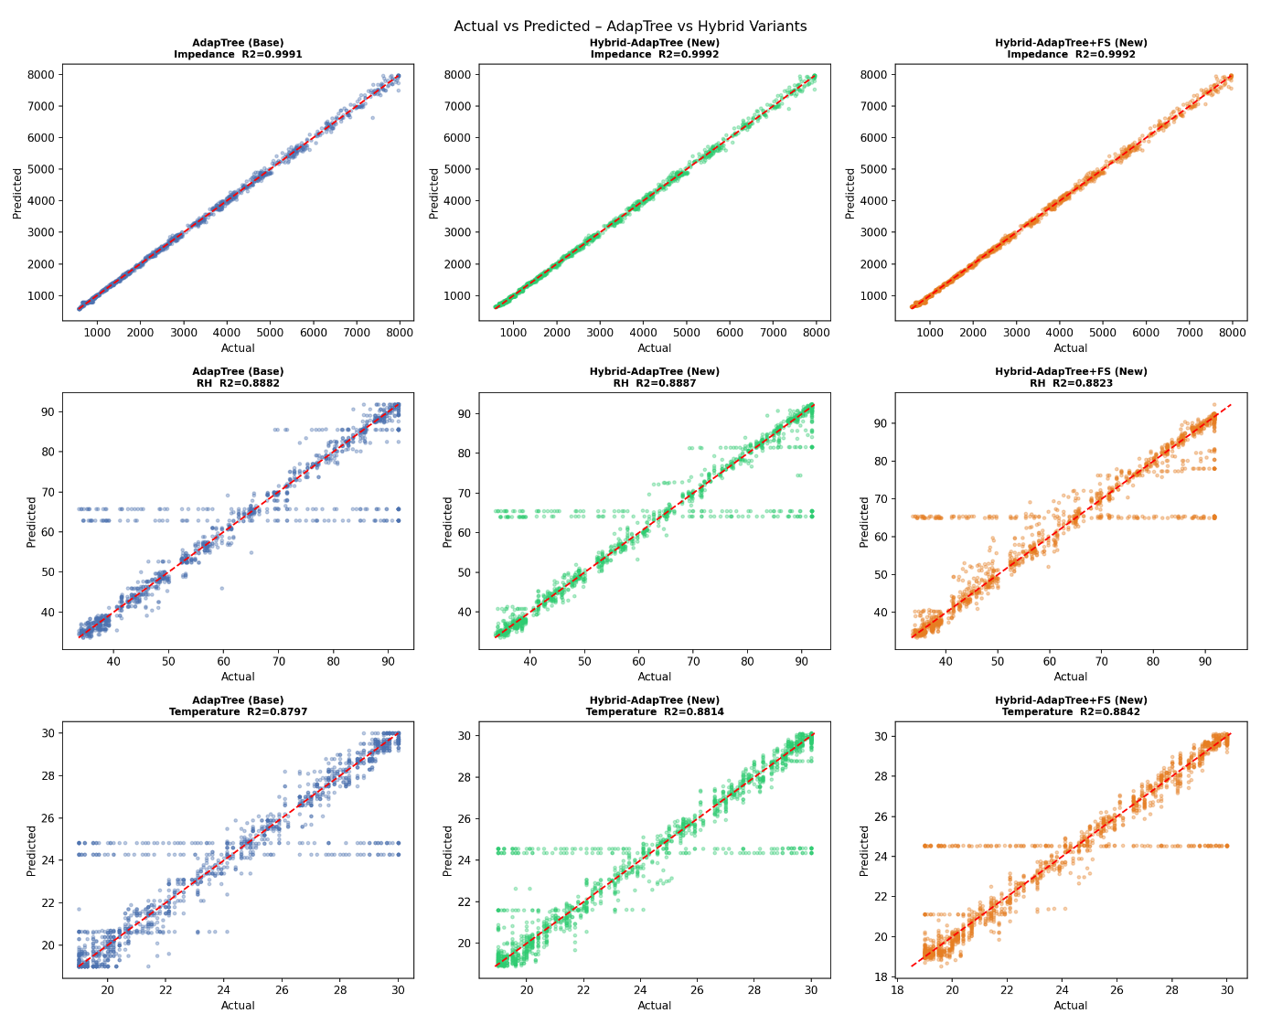
OPTIMIZATION RESULTS :

Slide 9
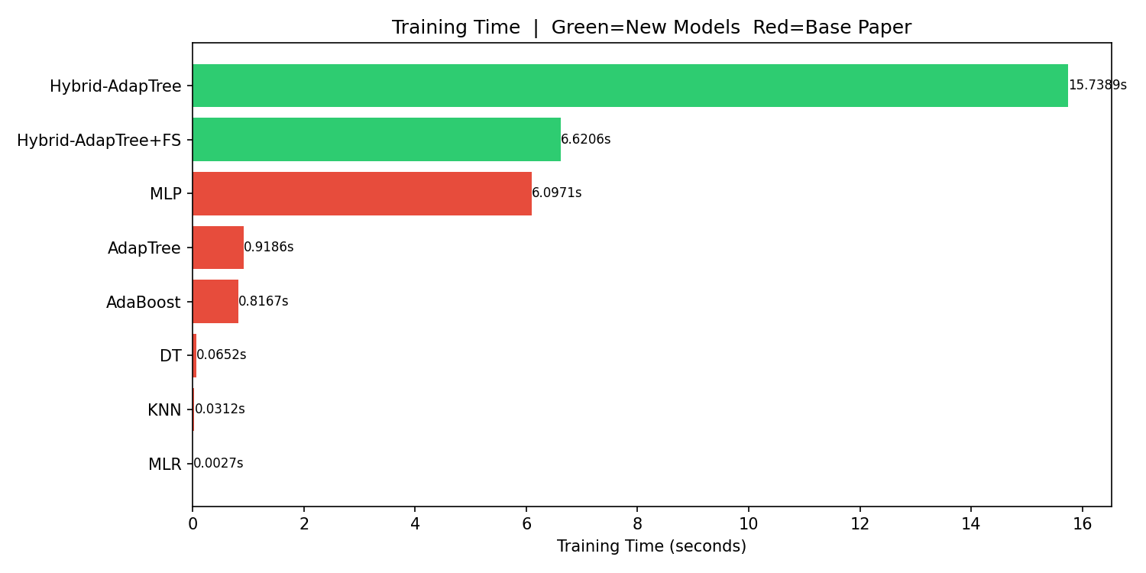
OPTIMIZATION RESULTS :
The Hybrid-AdapTree model takes the highest training time (15.7 s) because it uses multiple learners, while simpler models like KNN, DT, and MLR train much faster but give lower accuracy.
Hybrid-AdapTree with Feature Selection reduces training time to 6.6 s (about 53% faster) while maintaining similar accuracy, making it more efficient for real-time applications.

Slide 10
Observations :
The Hybrid-AdapTree model achieved the highest accuracy for impedance prediction with R² close to 0.999.
Feature selection removed Frequency and reduced training time significantly without affecting accuracy.
The Hybrid-AdapTree with Feature Selection reduced training time by nearly 53.8%.
MLR showed the lowest performance with high error values and lower accuracy.

Slide 11
The proposed Hybrid-AdapTree model improved the prediction of environmental stress parameters such as impedance, RH, and temperature using sensor-based data. It achieved very high accuracy, especially for impedance prediction (R² ≈ 0.999).
The Hybrid-AdapTree model provided consistent and reliable performance across all parameters, showing the strength of ensemble learning.
Feature selection using Mutual Information removed less important features, reduced dimensionality, and decreased training time significantly while maintaining strong prediction accuracy.
The Environmental Stress Index (ESI) helped classify plant stress levels effectively, making the system useful for precision agriculture, smart farming, and real-time plant health monitoring.
CONCLUSION :

Slide 12
References :
[1] H. M. Jawad, R. Nordin, S. K. Gharghan, A. M. Jawad, and M. Ismail, 'Energy-efficient wireless sensor networks for precision agriculture: A review,' Sensors, vol. 17, no. 8, p. 1781, 2017.
[2] K. G. Liakos, P. Busato, D. Moshou, S. Pearson, and D. Bochtis, 'Machine learning in agriculture: A review,' Sensors, vol. 18, no. 8, p. 2674, 2018.
[3] S. Adla, N. V. Rai, K. Karumanchi, S. Tripathi, A. Disse, and S. Pande, 'Laboratory calibration and performance evaluation of low-cost capacitive and very low-cost resistive soil moisture sensors,' Sensors, vol. 20, no. 2, p. 363, 2020.
[4] A. Sharma, E. Jain, P. Gupta, and V. Chowdary, 'Machine learning applications for precision agriculture: A comprehensive review,' IEEE Access, vol. 9, pp. 4843–4873, 2021.
[5] H. R. Bogena, J. A. Huisman, H. Schilling, A. Weuthen, and H. Vereecken, 'Effective calibration of low-cost soil water content sensors,' Sensors, vol. 17, no. 1, p. 208, 2017.
[6] F. Kizito et al., 'Frequency, electrical conductivity and temperature analysis of a low-cost capacitance soil moisture sensor,' Journal of Hydrology, vol. 352, no. 3–4, pp. 367–378, 2008.
[7] U. Rosenbaum, J. A. Huisman, J. Vrba, H. Vereecken, and H. R. Bogena, 'Correction of temperature and electrical conductivity effects on dielectric permittivity measurements with ECH2O sensors,' Vadose Zone Journal, vol. 10, no. 2, pp. 582–593, 2011.

