Slide 1
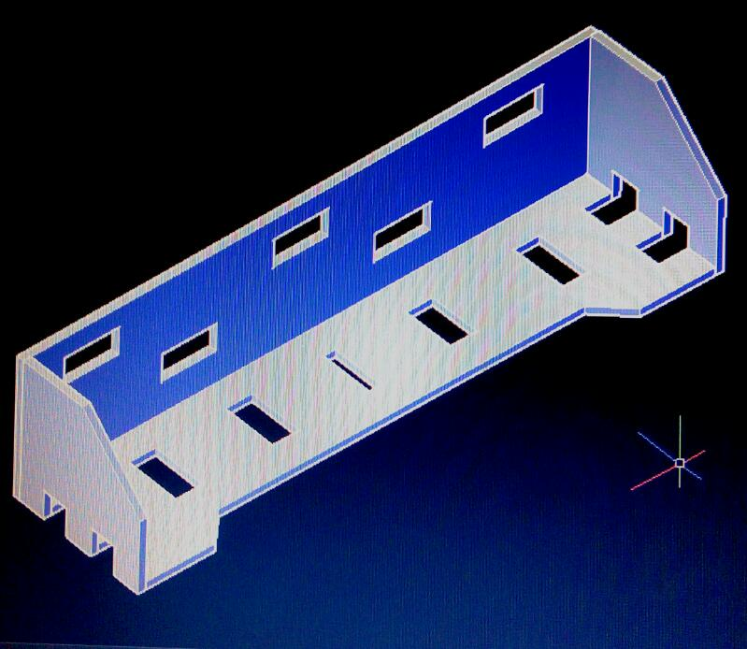
Designing of water bottle container
By team A1.1
Sai sree (155) : ppt
Jahnavi : 3d models & ppt
Ruthvik : prototype

Slide 2
User requirements
User: Households
Mounted on the Door
Should be able to retain four 1 litre Kinley water bottles
Should be resistant to heavy weights(max weight =4kg)
Replaceable
Ease of cleaning
The container should also hold other objects
It should appear aesthetically good

Slide 3
Study of different 1lit water bottles
S.No | Name of Company | Diameter of bottle bottom d(cm) | Height of the bottle h(cm)
1 | Aquafina | 7.6 (max) | h1=25.7
2 | Bislery | 7.2(approx.) | 24.4(approx.)
3 | Tupperware | 7.5 | h2 = 23.5
4 | Kinley | 7.0 | h3(max) =26.0

Slide 4
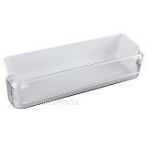
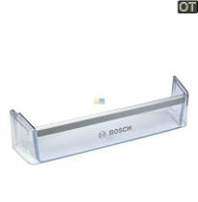
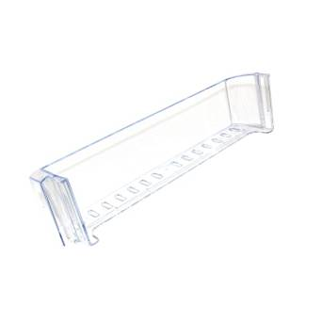
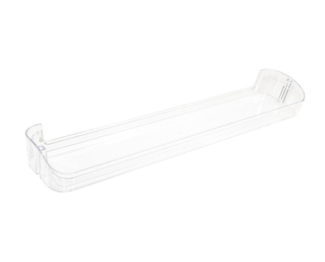
Market research :
Name of the Company | Model | Length(cm) | Width (cm) | Height(c)
Samsung |  | 42 | 13 | 9.5
Bosch |  | 47.2 | 14.8 | 10.6
Beko |  | 44.6 | 12 | 8.6
Smeg |  | 47.5 | 10 | 6.5

Slide 5
Dimensions of the bottle container
Let us take the length of box 0.5cm more than the diameter of the bottle so that it can fit easily.
Therefore for 4 bottles to fit we add 2cm to the actual length i.e 30.4cm
Since our length = 7.6*4 = 30.4cm
But designing length would be 30.4+2 = 32.4
Let us assume that the size of the refrigerator be 40cm
Since centre of mass of 26cm high water bottle is 13 cm we can take the height of shelf as 9.5cm so that we can put our bottles easily.

Slide 6
That is Depth (t) = 11
Height (h) =9.5
Length (l) = 4*(max diameter)
= 4*(7.6)+2cm
= 32.4cm
Therefore Width (t) =11.0(+or-)0.4cm,
Height (h) = 9.5(+or-)0.4 cm,
Length (l) =32.4(+or-)0.4 cm

Slide 7
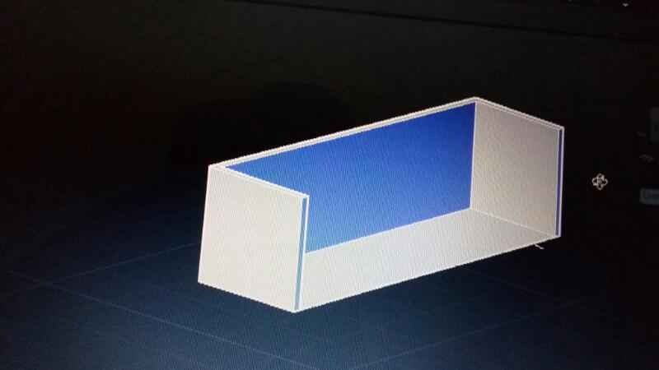
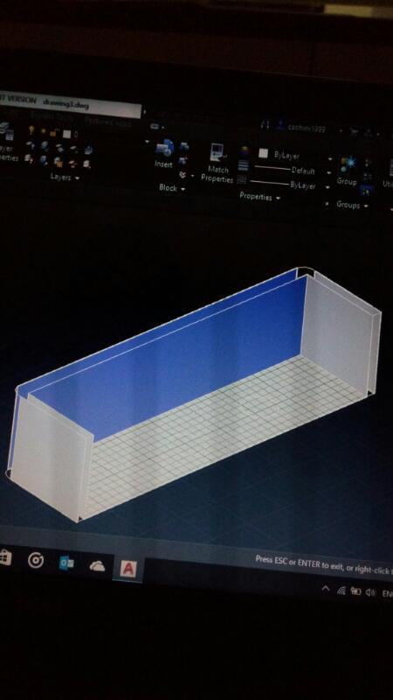
Concept generation
The ideas are generated through 7 way concept method. User requirements are taken into account for generating the ideas
Concept design(auto cad design) | Advantages | Disadvantages
 | It fits into the groove easily | Hard to clean
 | No sharp edges , easily fits to the fridge door | Curves are difficult to make , hard to clean

Slide 8
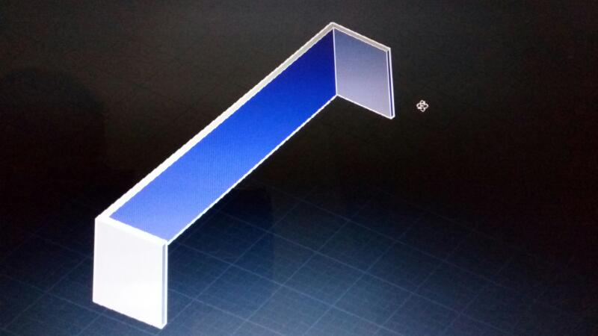
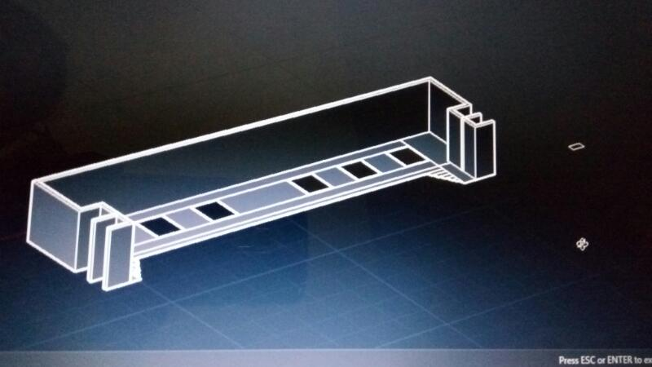
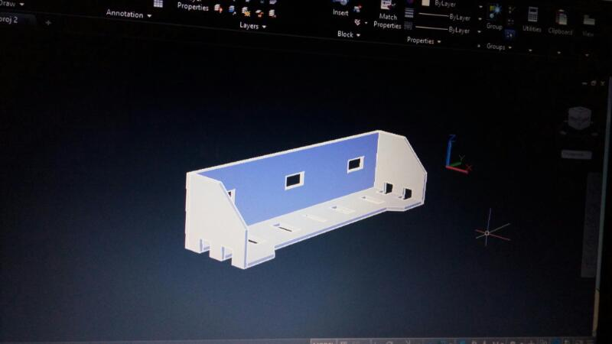
 | Easy cleaning(since there will be space between this shelf and the fridge tray ) | Not aesthetically good
 | Easy cleaning , aesthetically looks good , can easily fit into the grooves that are attached to the fridge. | sharp edges
 | Easy cleaning , aesthetically looks good , can easily fit into the grooves that are attached to the fridge , more air circulation | sharp edges

Slide 9
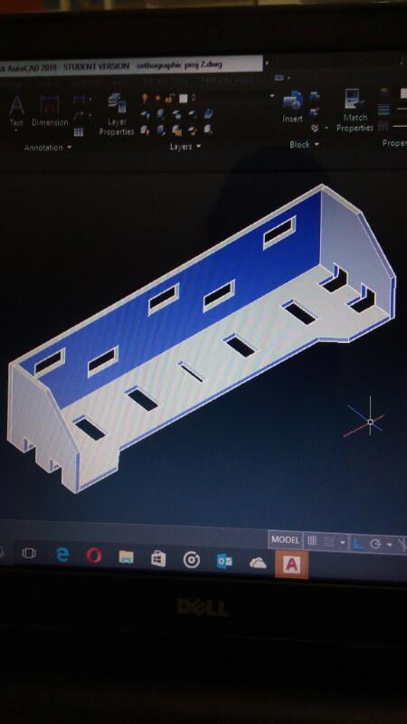
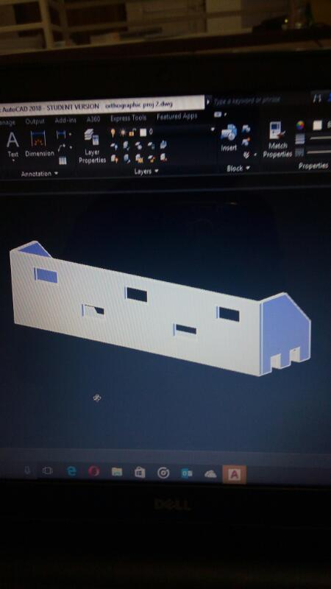
Final model :
There fore from the 7 way method the top two ideas are the last two ideas in the above table.
From those we designed our final sketch i.e (here the holes on the front wall are mainly designed to increase the air circulation)

Slide 10
Functional block diagram
S.no | Component | Function
1 | Base of the container | Holding the weight of the bottles
2 | Front part of the container | Preventing the bottle from falling off
3 | Holes towards the side | To fit the container into refrigerator
4 | Bottom Holes of the container | Ease of Cleaning

Slide 11
FMEA(failure mode effect analysis)
Inputs to the FMEA is FBD
The bottle shelf may break if heavy weights are placed on it.
If the shelf is removed occasionally its holder may loose its stiffness.
It may fall down and break as the material is designed to tolerate weights but not for misuse. To avoid this a material can be chosen which wont break even after falling from a height.

Slide 12
Product | Component | Potential failure mode | Primary Potential cause of failure | occurence | severity | detection | Rpn
Water bottle container | Base of the container | Breaking because of heavy weights | Material strength not sufficient | 5 | 10 | 7 | 350
 | Front part of the container | May break if mishandled | Material strength not sufficient | 4 | 10 | 5 | 200
 | Holes towards the side | May break if put inappropriately | Inappropriate fitting | 2 | 10 | 3 | 60
 | Bottom Holes of the container | Cleaning becomes difficult if anything is accumulated | Mishandling | 1 | 3 | 1 | 3

Slide 13
Features and cost
Features:
Can hold four 1 liter water bottles
Holes so that cleaning becomes easy
Appropriate shape to fit into the refrigerator door
Smart design to fit into the refrigerator door appropriately(can be seen in the design)
Material of bottle container retains the temperature for longer time.

Slide 14
Tolerances:
The tolerances of the container can only be taken into account based on the water bottle tolerances as the dimensions of refrigerator are unknown.
The tolerance of the bottle is taken to be +0.1 or -0.1 cm, hence, the tolerance of container is 0.4 or -0.4 cm.
Make Vs buy decision:
It was decided to make the container.
Other features(not added because of cost):
weighing machine , timer , barcode scanner which informs user about the products to buy, a strip which will change color according to temperature.

