Slide 1
CLEARING FEED GENERATION
TEAM NO. - 18
MEMBERS :
Janhavi Pandey
Shruti Surve
MENTOR :
Vaishnavi Iyer

Slide 2
OUTLINE
01
ABOUT THE PROBLEM STATEMENT
CLEARING FEED SYSTEM
WHAT
02
TECHNOLOGIES USED
FLOW DIAGRAM
FUNCTIONALITIES ACHIEVED TILL DATE
HOW
03
ASSUMPTIONS & DEMONSTRATIONS
FUTURE SCOPE
WHY

Slide 3
PROBLEM STATEMENT
Generate the feed file towards clearing system in a specific format based on the input transactions to the system.

Slide 4
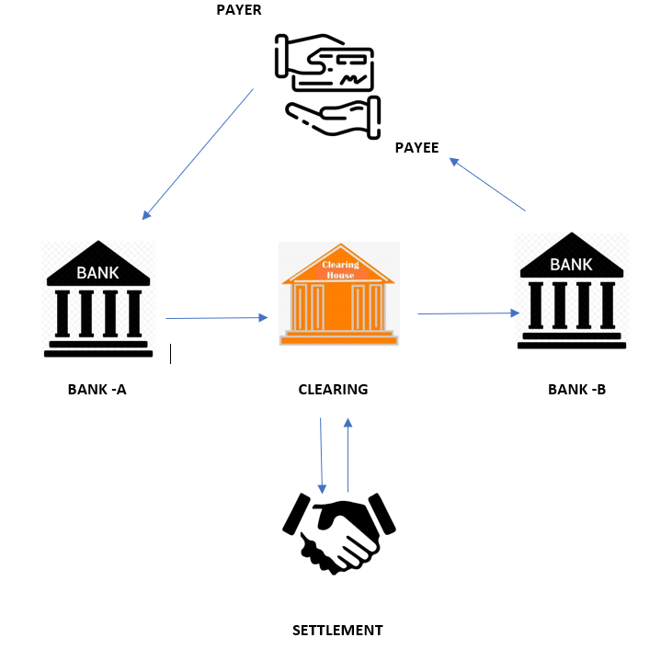
CLEARING FEED SYSTEM
A clearing feed system acts as an intermediary that oversees transaction between payer and payee from bank-A to bank-B and generates a feed file indicating whether or not the transaction is valid.
Some of the key benefits of the system include the increase in the efficiency.

Slide 5




TECHNOLOGIES
BACK-END
FRONT- END

Slide 6
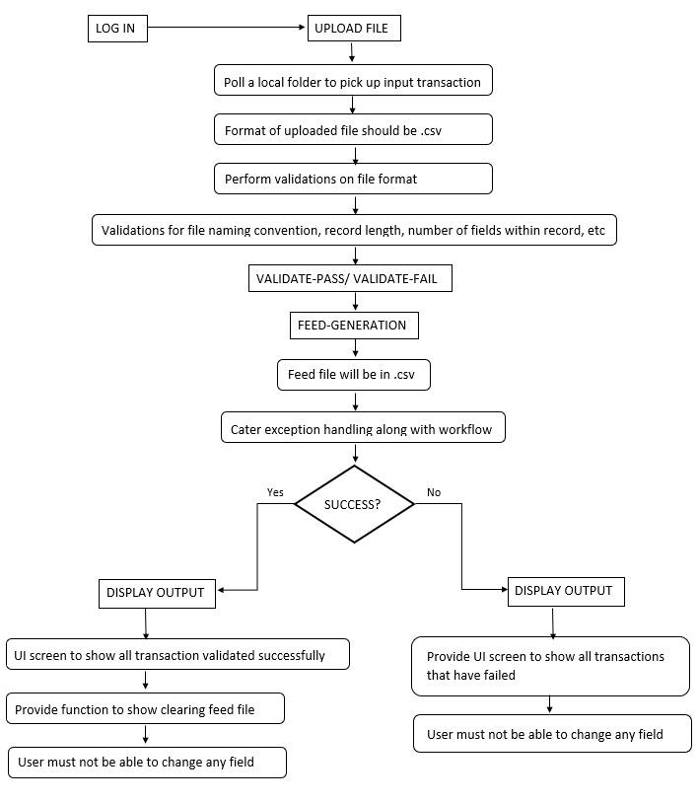
FLOW DIAGRAM

Slide 7
FUNCTIONALITIES DEVELOPED TILL DATE
Selecting file from local folder.
Validating file properties.
Validating every transaction.
Indicating transaction status to user.

Slide 8
ASSUMPTIONS
User is already logged in.
User uploading .csv file only.
User is uploading file less than 2 MB.

Slide 9
DEMONSTRATION

Slide 10
FUTURE SCOPE
Accepting multiple file formats.
Storing user transaction history.
Accepting large file size.
Send notification email to stakeholders after feed generation.
Creating Authentication mechanism for file upload
Add report download feature after feed generation
Apply cryptographic algorithm for data transfer over the network

Slide 11
THANK YOU!

