Slide 1

Cloud-Native Logistics and Supply Chain Management Platform
CNAD Project Review-1
27-08-2026(3:00pm)
TEAM-17
 | Under the Guidance of Mr. Madhu Guda Assistant Professor Department of CSE, KLH CSE Bowrampet Campus
Team Members 2420030173-R Jahnavi 2420030330-T Mounitha 2420030424-M Sahithi

Slide 2
Outline of Project Work
Focus
Introduction
Literature Survey
Challenges
Research Objectives
Conclusion & Future Work
References
Publications Details

Slide 3
Problem Statement
Limited real-time visibility into shipments, inventory, and deliveries across the supply chain.
Manual, paper-based processes that slow down operations and increase the chance of errors.
Disconnected systems that make it difficult to coordinate shipments, inventory, and deliveries effectively.
Rising operational costs and reduced efficiency without a scalable, transparent solution.
A clear need for a cloud-native platform that improves transparency, automation, and decision-making.

Slide 4
Objectives
Design and build a cloud-native platform to modernize logistics and supply chain operations.
Enable real-time shipment tracking with live GPS updates, delivery status, and instant notifications.
Automate inventory management to reduce stock shortages and overstock situations.
Optimize delivery routes to reduce travel time, fuel consumption, and operational costs.
Ensure secure, reliable, and scalable deployment using Docker, Kubernetes, and AWS.

Slide 5
Literature Survey
Authors | Title of the Paper | Methodology | Inferences | Limitation/Future work
N. Garg, R. Vijay | Cloud Architecture for the Logistics Business | Cloud-based real-time logistics tracking. | Improves visibility and information sharing. | Add route optimization and inventory automation.
A. Aljumah et al. | IoT-enabled Path Optimization for Smart Logistics Using Ant Colony Algorithm | IoT + fog-cloud with Ant Colony Algorithm. | Improves route selection and reduces delays. | Integrate tracking and inventory management.
P. K. Singh et al. | An IIoT Based Secure and Sustainable Smart Supply Chain System Using Sensor Networks | IIoT sensors for tracking and monitoring. | Improves visibility and detects shipment issues | Add scalable cloud and automated inventory.

Slide 6
Problem Gap Identification
Existing logistics tools track shipments and inventory in separate, disconnected systems.
Manual processes leave gaps in real-time visibility, causing delays and inefficiencies.
Traditional on-premise systems struggle to scale with growing business demand.
Route planning is rarely automated, leading to higher fuel costs and slower deliveries.
Our platform closes these gaps with integrated real-time tracking, smart inventory, route optimization, and scalable cloud infrastructure.

Slide 7
Innovation, Creativity, and Novelty
Cloud-native architecture built with React.js, Spring Boot, MySQL, Docker, Kubernetes, and AWS.
Real-time GPS tracking with live delivery status and instant notifications for complete visibility.
Intelligent route optimization that reduces travel time, fuel consumption, and operational costs.
Automated, smart inventory management that minimizes shortages and overstock situations.
Strong security with user authentication, data encryption, role-based access control, and protected REST APIs.
Future scope includes AI-based predictive analytics, IoT-enabled smart logistics, and blockchain integration.

Slide 8
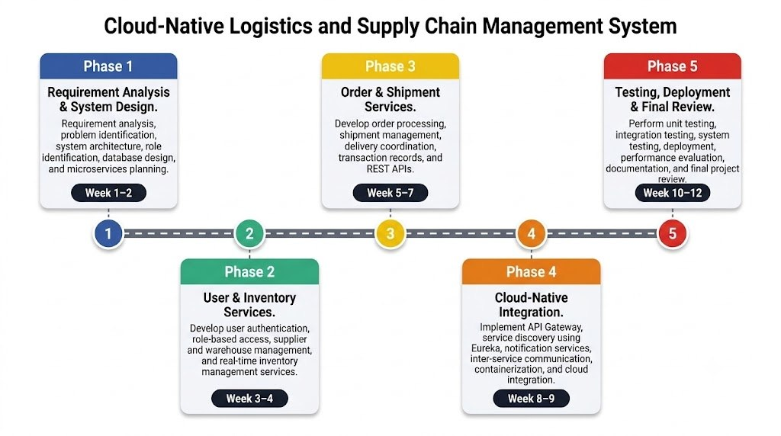
Feasibility and Project Plan
Technology stack: React.js (frontend), Spring Boot (backend), PostgreSQL (database), and Docker, Kubernetes, AWS (cloud and DevOps).
Project workflow: Order Processing, then Inventory and Route Management, then Delivery and Tracking.
Built on mature, widely supported cloud-native tools, making the project technically and operationally feasible.

