Slide 1

Cloud-Native Logistics and Supply Chain Management Platform
CNAD Project Review-2
16-09-2026
TEAM-17
 | Under the Guidance of Mr. Madhu Guda Assistant Professor Department of CSE, KLH CSE Bowrampet Campus
Team Members 2420030330-T Mounitha 2420030173-R Jahnavi 2420030424-M Sahithi

Slide 2
Outline of Project Work
Problem Definition
System Architecture
Module Design
Module Integration
Conclusion & Future Work

Slide 3
Problem Definition
Limited real-time visibility into shipments, inventory, and deliveries across the supply chain.
Manual, paper-based processes that slow down operations and increase the chance of errors.
Disconnected systems that make it difficult to coordinate shipments, inventory, and deliveries effectively.
Rising operational costs and reduced efficiency without a scalable, transparent solution.
A clear need for a cloud-native platform that improves transparency, automation, and decision-making.

Slide 4
Objectives
Design and build a cloud-native platform to modernize logistics and supply chain operations.
Enable real-time shipment tracking with live GPS updates, delivery status, and instant notifications.
Automate inventory management to reduce stock shortages and overstock situations.
Optimize delivery routes to reduce travel time, fuel consumption, and operational costs.
Ensure secure, reliable, and scalable deployment using Docker, Kubernetes, and AWS.

Slide 5
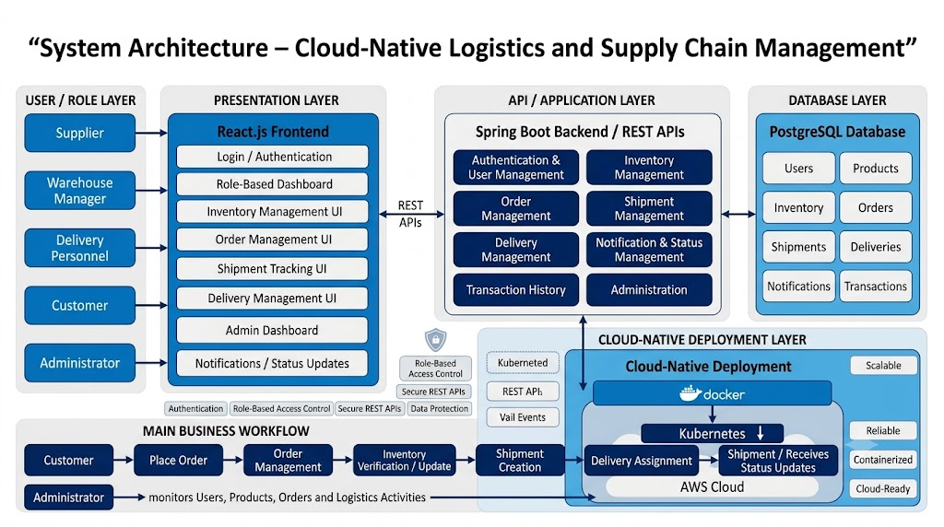
System Architecture

Slide 6
Module Design
1. Authentication & User Management
Secure user login and authentication
Role-based access for different users
Separate functionality for Supplier, Warehouse Manager, Delivery Personnel, Customer and Admin
2. Inventory Management
Manage products and stock levels
Monitor available inventory
Update stock based on order processing
Helps reduce stock shortages and overstock
3. Order Management
Customers place orders through the platform
Orders are processed through the backend
Order status is maintained throughout the process
Inventory is updated according to orders
4. Shipment Management
Create and manage shipments
Track shipment progress
Maintain shipment status for visibility

Slide 7
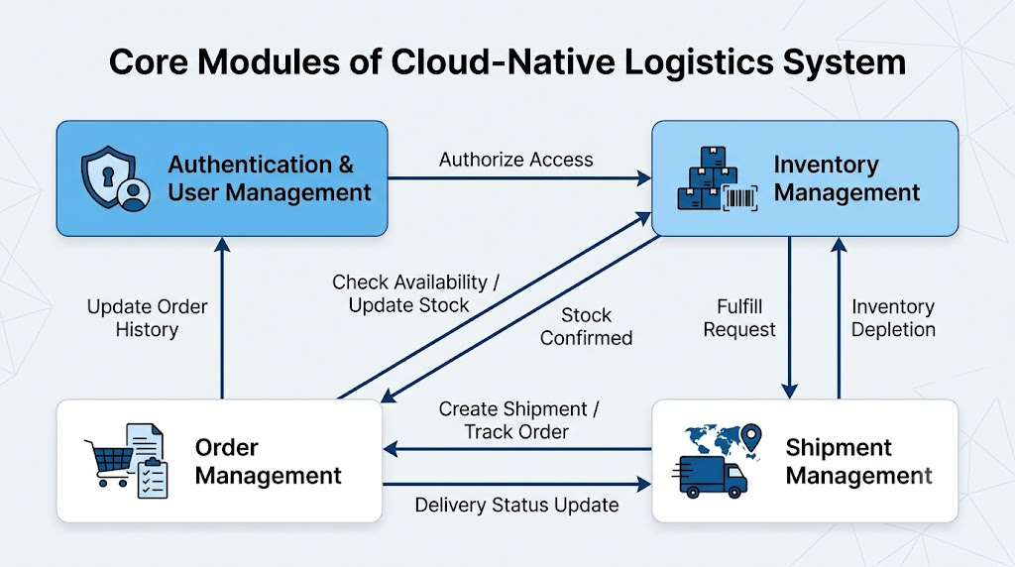
Module Design

Slide 8
Module Design
5. Delivery Management
Assign deliveries to delivery personnel
Update delivery status
Coordinate the final delivery process
6. Notification & Status Management
Provide shipment and delivery status updates
Notify relevant users about important changes
Improves real-time visibility
7. Transaction History
Maintain records of completed logistics activities
Provides historical information for tracking and monitoring
8. Administration
Monitor users, products and orders
Monitor logistics activities
Supports centralized system management

Slide 9
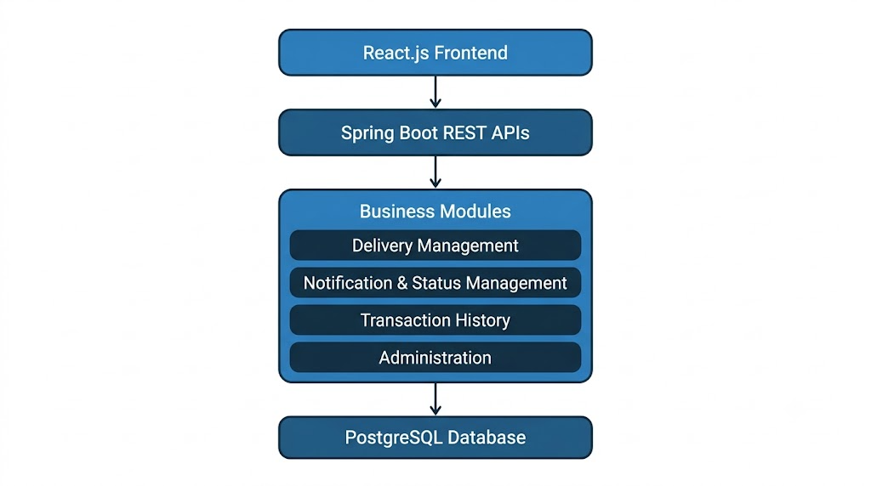
Module Design

Slide 10
Module Integration
Module Integration
The modules are integrated to create a complete logistics workflow.
Order-to-Delivery Flow
Customer
↓
Order Management
↓
Inventory Verification
↓
Inventory Update
↓
Shipment Creation
↓
Delivery Assignment
↓
Shipment / Delivery Tracking
↓
Customer receives status updates
Integration Benefits
Connects order, inventory, shipment and delivery operations
Reduces disconnected manual processes
Provides better supply-chain visibility
Enables coordinated logistics activities
Supports real-time status updates

Slide 11
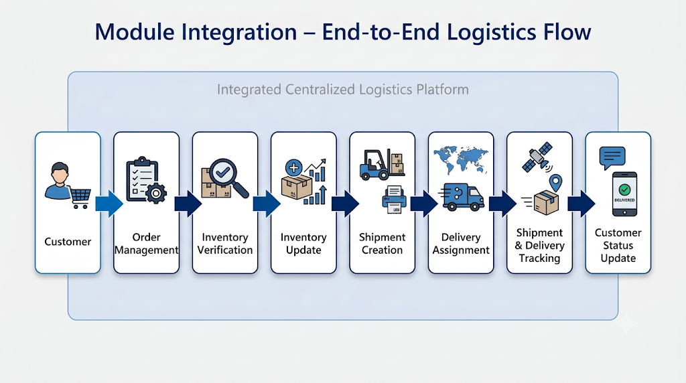
Module Integration

Slide 12
Module Integration
Frontend–Backend Integration
React.js provides the user interface
User actions are sent to Spring Boot through REST APIs
Backend processes business operations
Responses are returned to the frontend
Backend–Database Integration
Spring Boot communicates with PostgreSQL
User, product, inventory, order, shipment and delivery information is stored
Modules share required data through the backend
Cloud-Native Integration
Application components are containerized using Docker
Kubernetes manages containerized application deployment
AWS provides the cloud environment
Supports scalable and reliable deployment

Slide 13
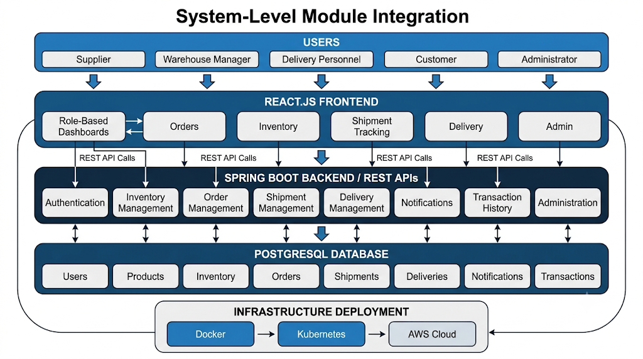
Module Integration

Slide 14
Conclusion & Future Scope
The proposed platform integrates logistics operations through a centralized cloud-native system, connecting suppliers, warehouses, delivery personnel, customers, and administrators.
Real-time shipment tracking, inventory management, and coordinated delivery improve supply-chain visibility and operational efficiency.
The system reduces dependence on manual and disconnected processes, helping minimize delays, errors, and coordination gaps.
Docker, Kubernetes, and AWS provide a scalable, reliable, and flexible environment for deploying and managing the application.
The modular architecture allows the system to be incrementally developed and enhanced as requirements evolve and new features are introduced.
Future scope: AI-based predictive analytics, IoT-enabled smart logistics, and blockchain integration can further improve prediction, monitoring, security, and transparency.

Slide 15
THANK YOU !!

