Slide 1
Grammar to LL(1) Parser Generator
SriHansika Saraf — 2420030556
Thirumala Reddy Sagar Mounitha — 2420030330
Raavi Jahnavi — 2420030173
24CS2235F | A.Y. 2026–2027
Guide: Ms. E Uma Shankari
Department of CSE

Slide 2
Background
A Context-Free Grammar (CFG) is used to describe the syntax of a programming language. Converting a CFG into an LL(1) parser requires several manual steps such as grammar transformation, FIRST and FOLLOW computation, and parsing-table construction.
Our project develops a web-based LL(1) Parser Generator that automates these operations and presents the parsing process interactively.
Main Idea
CFG → Grammar Transformation → FIRST/FOLLOW → LL(1) Table → Parsing

Slide 3
Project Goals
01.
Automate Parser Generation
Develop a web-based system that:
Accepts a Context-Free Grammar
Eliminates left recursion
Performs left factoring
Computes FIRST and FOLLOW sets
02.
Demonstrate LL(1) Parsing
Generate the LL(1) parsing table
Detect parsing conflicts
Process a user-provided input string
Display whether the input is Accepted or Rejected

Slide 4
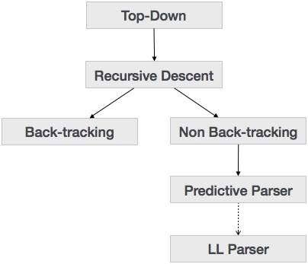
Methodology
1. Grammar Input
User enters the Context-Free Grammar.
2. Grammar Transformation
Left recursion is eliminated and left factoring is performed.
3. FIRST & FOLLOW
The system computes the required sets.
4. LL(1) Table
The parsing table is generated and checked for conflicts.
5. Predictive Parsing
The input string is parsed using the generated table.

Slide 5
Grammar Transformation
Left Recursion
Input:
E → E + T | T
After elimination:
E → T E'
E' → + T E' | ε
Left factoring is then applied when productions contain common prefixes.

Slide 6
FIRST & FOLLOW Computation
Non-Terminal | FIRST | FOLLOW
E | { id } | { $ }
E' | { +, ε } | { $ }
T | { id } | { +, $ }
FIRST determines the terminals that can begin a derivation.
FOLLOW determines the terminals that can appear immediately after a non-terminal.
The system automatically computes these sets as part of LL(1) parser generation.

Slide 7
LL(1) Parser Construction
03
04
01
02
FIRST
Determines possible starting terminals.
FOLLOW
Determines valid symbols after non-terminals.
Parsing Table
Uses FIRST and FOLLOW to select productions.
Predictive Parsing
Processes the input string and produces the final result.

Slide 8
Analysis
• Grammar Analysis
The input CFG is analyzed and transformed to remove structures that prevent predictive parsing.
• Set Computation
FIRST and FOLLOW sets are calculated for the transformed grammar.
• Conflict Analysis
The generated LL(1) table is checked for conflicting entries.
• Parsing Analysis
The parser uses the table and stack operations to process the input string step-by-step.

Slide 9
Result
Generated Output
Parsing Result
  Input String
  Stack Operations
  Parsing Steps
  Accepted / Rejected
  Transformed Grammar
  FIRST Sets
  FOLLOW Sets
  LL(1) Parsing Table

Slide 10
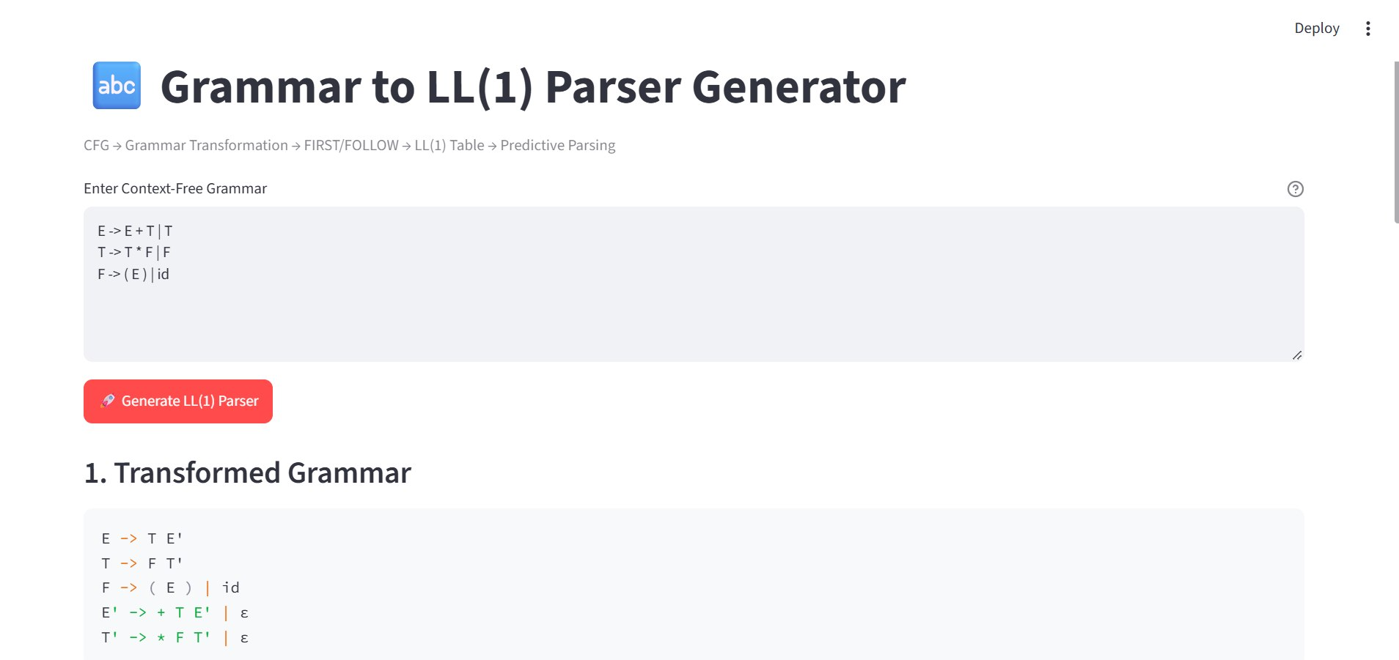
Result

Slide 11
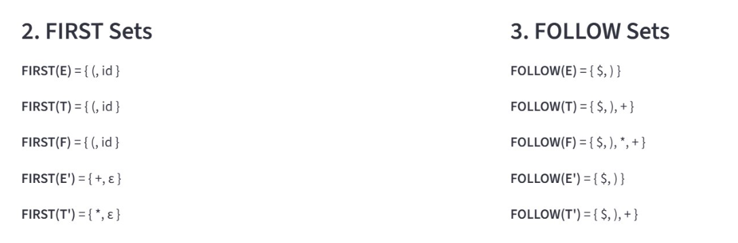
Result

Slide 12
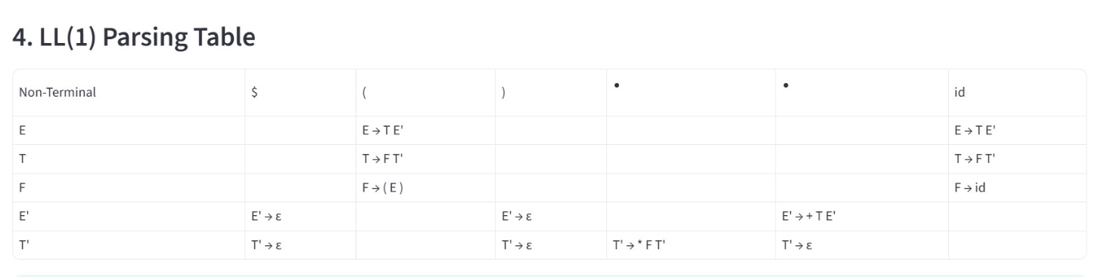
Result

Slide 13
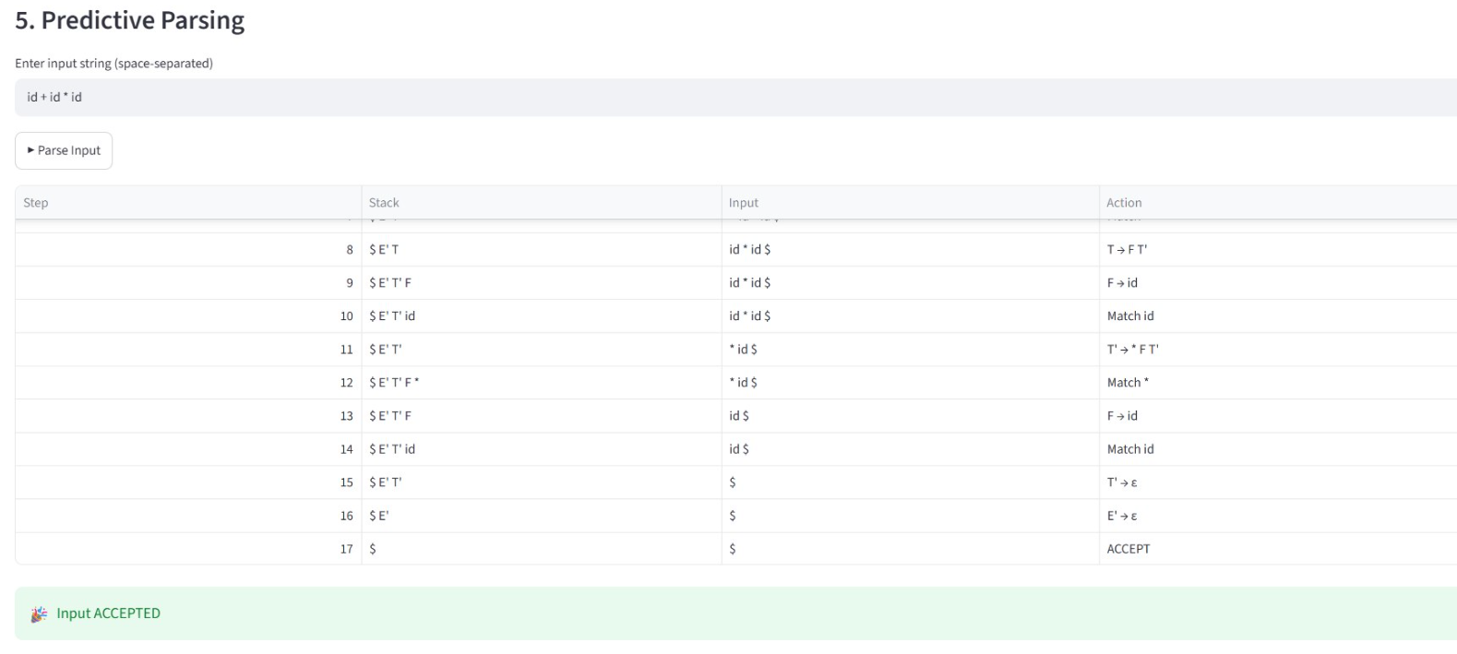
Result

Slide 14
Conclusion
The Grammar to LL(1) Parser Generator automates the construction of an LL(1) predictive parser from a Context-Free Grammar.
The system performs:
  Grammar transformation
  Left recursion elimination
  Left factoring
  FIRST and FOLLOW computation
  LL(1) parsing table generation
  Conflict detection
  Predictive parsing

Slide 15
Thank You

