Slide 1
Sales Performance Dashboard – Power BI
Objective:
To design an interactive sales dashboard using Power BI that helps business stakeholders analyze overall sales performance, profitability, and trends across time, regions, and product categories for informed decision-making.

Slide 2
Dataset Used:
Sample Superstore – Sales & Financial Dataset
Sample Sales Data
Dataset Description:
The dataset contains historical sales transaction data including order date, sales amount, profit, product category, and regional information.
Key Fields Used:
Order Date
Sales
Profit
Category
Region

Slide 3
KEY PERFORMANCE INDICATORS (KPIs)
KPIs Selected:
Total Sales: Measures overall revenue generated
Total Profit: Measures total profitability
Profit Margin (%): Indicates business efficiency and profitability ratio
These KPIs provide a high-level summary of business performance.

Slide 4
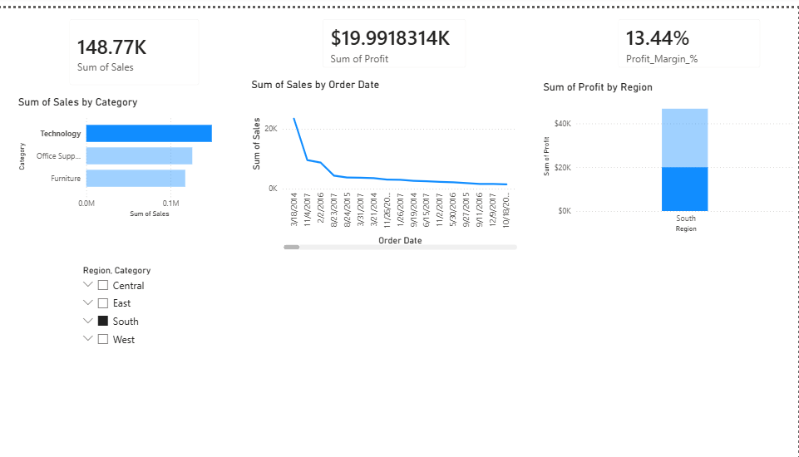
Dashboard

Slide 5
DASHBOARD FEATURES
Dashboard Components:
KPI Cards for Total Sales, Total Profit, and Profit Margin
Line Chart showing Monthly Sales Trend
Bar Chart showing Sales by Product Category
Column Chart showing Profit by Region
Interactive slicers for Region and Category filtering
The dashboard updates dynamically based on user selections.

Slide 6
BUSINESS INSIGHTS & CONCLUSION
Key Insights:
Overall sales show a declining trend over time
The West region contributes the highest profit
Technology category generates the highest sales
Profit margin is approximately 12%, indicating moderate profitability
Conclusion:
The interactive dashboard enables quick identification of trends, high-performing regions, and product categories, supporting data-driven business decisions.

