Slide 1

LIC Database Management

Slide 2
GROUP MEMBERS:
PROJECT GUIDE:
1. JAHNVI SINGH (19BCE10429)
2. AKASH RAI(19BCE10356)
DR. VIKAS PANTHI
SANSKAR
CHAW LA(19BCE10308)
TANAY AGARWAL(19BCE10091)

Slide 3
INTRODUCTION
LIC Database system will help both customers and their agents to know about the current policies and enabling customers to select policies as per their choice. To start this projects, users have to just run the project and its user friendly menu items will help both its customers and agents to handle this LIC database management system easily.

Slide 4
Existing work
Existing LIC Database system do not provide facility to select the particular policy by going through each
with limitations
policy details. Customers has to be dependent on agent to get details on particular policy. W hile taking any particular policy, customers do not able to get information what will be the minimum installment to be made and in what mode. Agent are also not able to check their account any time as per their requirement and the details of customers who have taken policy from them along with their policy maturity date. The present system do not provide the correct medium for the agents to know their commissions which has been made while selling any particular policy. Also the present system do not uses the concept of OOP’S by which changes can be made easily to any particular section within the program code easily.

Slide 5
Proposed
work and methodology
The current system stored all data in particular file in the binary format which is not able to read by others. Its command prompt will not able its users to know about the background details thus providing the feature of extra security and reliability. Customers will have the option to review any policy as per their choice and select particular policy if they like it. Each customers and agent will have unique id by which they will able to check their accountat any time.

Slide 6









Computerize the information about registration, reservation,
places, temples, Wiches etc.
Enhance the efficiency of day-to-day operation.
Provide all the necessary & required security required by the system.
features
A solution, which is requires least amount of maintenance from the user point of theview.
Generate various outputs required of the system.
The design accommodates any future requirements.

Slide 7
Due the evolution of Database management system, companies are getting more from their work because they can keep records of everything. Also it makes them faster to search information andrecords about any people or product that makes them more
effective in work. So here we are sharing some of the applications and uses of database management
Real time
system (DBMS).
usage
Those days have gone far when information related to money was stored in registers and files. Today the time has totally changed because there are lots f thing to do with finance like storing sales, holding information and finance statement management etc

Slide 8
One of the key features of a data warehouse is the orientation it follows. Data warehouses focus on past subjects, like for example, sales, revenue, and not on ongoing and current organization data. This enables it to be used for data analysis which is a key element of decision-making. Adding on as another feature for ease of analysis of data, a data warehouse’s core is its integration of data from several different sources which aren’t homologous in nature, for example, flat files, relational databases, and other such sources. This plays a key role in enhancing theefficacy of data analysis

Slide 9
HARDWARE REQUIREMENTS
Type of CPU - PC-AT
Memory(RAM) - 256 MB minimum
Disk - HARD DISK 40 GB minimum
VDU - MONO MONITOR
Keyboard - Any of currently being used keyboard
Printer - Any printer(L&T, Winpro, Panasonic)

Slide 10
SOFTWARE REQUIREMENT
This project has been developed with the helpof fifth generation language .
Operating System - Windows 10
Software Used - Turbo C++ , Codeblocks

Slide 11
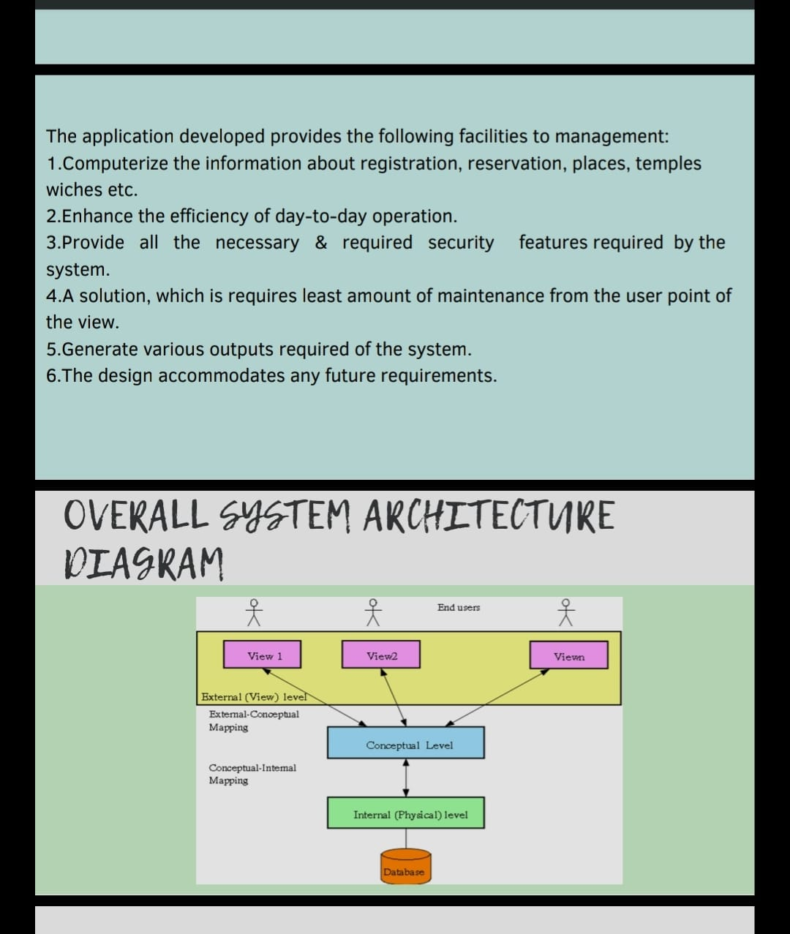

Slide 12
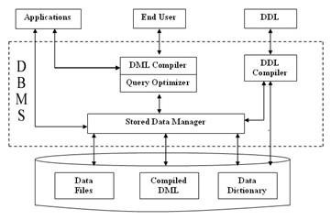
OVERALL SYSTEM ARCHITECTURE DIAGRAM

Slide 13



To start this projects, users have to just run the project and its user friendly menu items will help both its customers and agents to handle this LIC database management system easily. Whenever you run the program, it will start with loading screen,
Whenever loading completes, the next screen will be the LIC welcome screen where they are given choice to select the correct options as per their need.

Slide 14
If you want to go the customer section then you have to select its option and if you want to be logged in as agent of LIC Database system then you have been provided with other option. These options are entered at the current cursor position and after which its screen will be appear, where they will required to enter their id to use their particular account. Existing customers will able to check their policy details under which they have made investment.

Slide 15
Module description
policies
Exit
Agent Menu
New agent/ Customer Form
Old Agent/Customer Detail
Terms And Condition ForAgent
Display Feedback Form

Slide 16
1.Policies
A contract provided for the payment of a sum of money
to the person assured or failing him, to the person entitled to receive the same, on the happening of certain event for the consideration. In our database there are 5 types of policies available:
Endowment Policy
Money Back Policy
Jeevan kishore
Jeevan Anand
Jeevan Surabhi

Slide 17
2-exit
The Life Insurance Corporation of India (LICI) offers a range of life insurance plans. These plans come with a range of policy tenures so that individuals can choose a coverage term as per their requirement. Once the term is selected, the policy runs for the chosen term providing life insurance coverage. But what if the policyholder wants to close LIC policy before the chosen tenure comes to an end? Can it be done?
Yes, it is possible for policyholders to close their LIC policy before the term is complete. This closing is called surrendering. Let’s understand the meaning of surrender of LIC plans and how such surrender can be done –

Slide 18
What is exit of a LIC policy?
Exit of a LIC policy means giving up the policy before the term of the policy is over. The policyholder can opt to surrender the policy any time that he/she wants to. When the policy is surrendered, the company pays the surrender value and the coverage is terminated.

Slide 19
Agent Menu
All the Agents who do not have Password can now contact the SDM Secretariat of their Divisions for the passwords. The Agent portal is available only for Agents with inforce status i.e. where exit code in the Agency Master is zero. If the license has expired or the Agent has resigned the Portal will not be available. The Agent portal should be used on the lines of the Privacy Policy mentioned on the website and if it is found that the portal is used in any other manner then the particular login will be immediately disabled. For some of the portal users the status report is not displayed when policy no is keyed in. This happens because the popups are blocked. You can either press control key(Ctrl) while keying in Policy no or follow the steps to allow popups from the site. The status report is available only for policies belonging to that particular Agency and not for all Policies.

Slide 20
Module
Workflow
Basically the workflow depends on three parameters-
Input
Transformation
Output
Our project about LIC Database management system helps to create a simple workflow development .

Slide 21
Overview of Workflow
Development
Database Server-A relational database provides the set of data that workflow policies act against.
Client- Workflow process and workflow policies are administered through the administered through the administration-Business Process views in the client
Server-The Manager in the server manages the workflow process componenets that automate business policies.

Slide 22
Overview of Invoking a
Workflow process
A workflow process can be invoked from an event in the external system.The ways in which a workflow process can be invoked includes
From a workflow policy.
From an event, such as insert of a record or button click.
By a server component.

Slide 23
Terms and
conditions
There were some terms and conditions for lic which customer and agent has to follow like-
Responsibility of Contributors.
Payment and Renewal
Responsibility of Website Visitors 4-Content posted on other websites
5-Copyright Infringement and DMCA Policy

Slide 24
Display
feedback form
As a good lic agent and customer feedback is necessary from both the sides.LIC offers feedback form along it

Slide 25
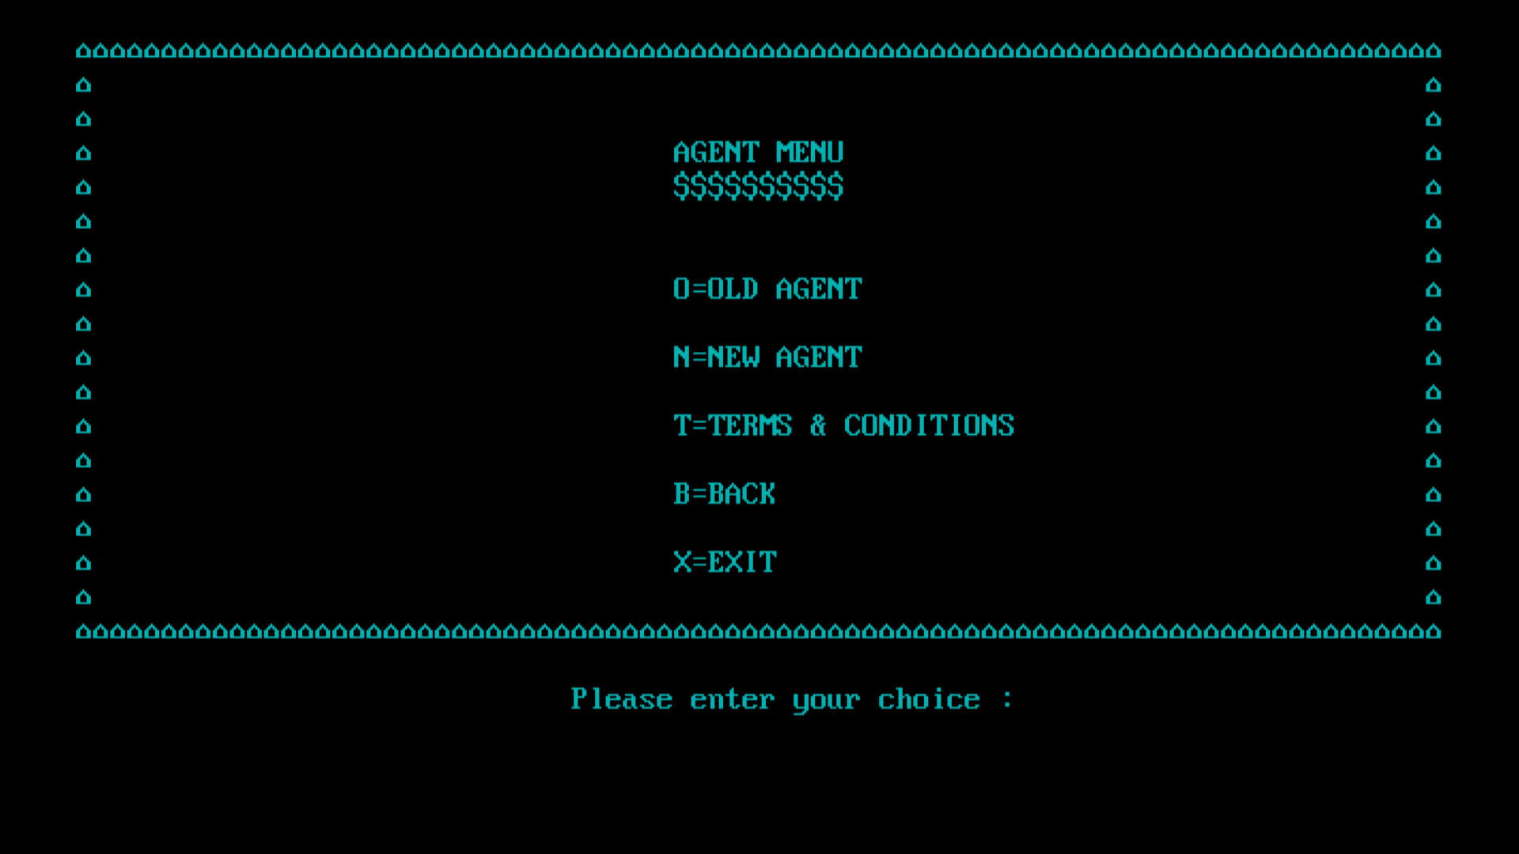
Snap shot of your
project.

Slide 26
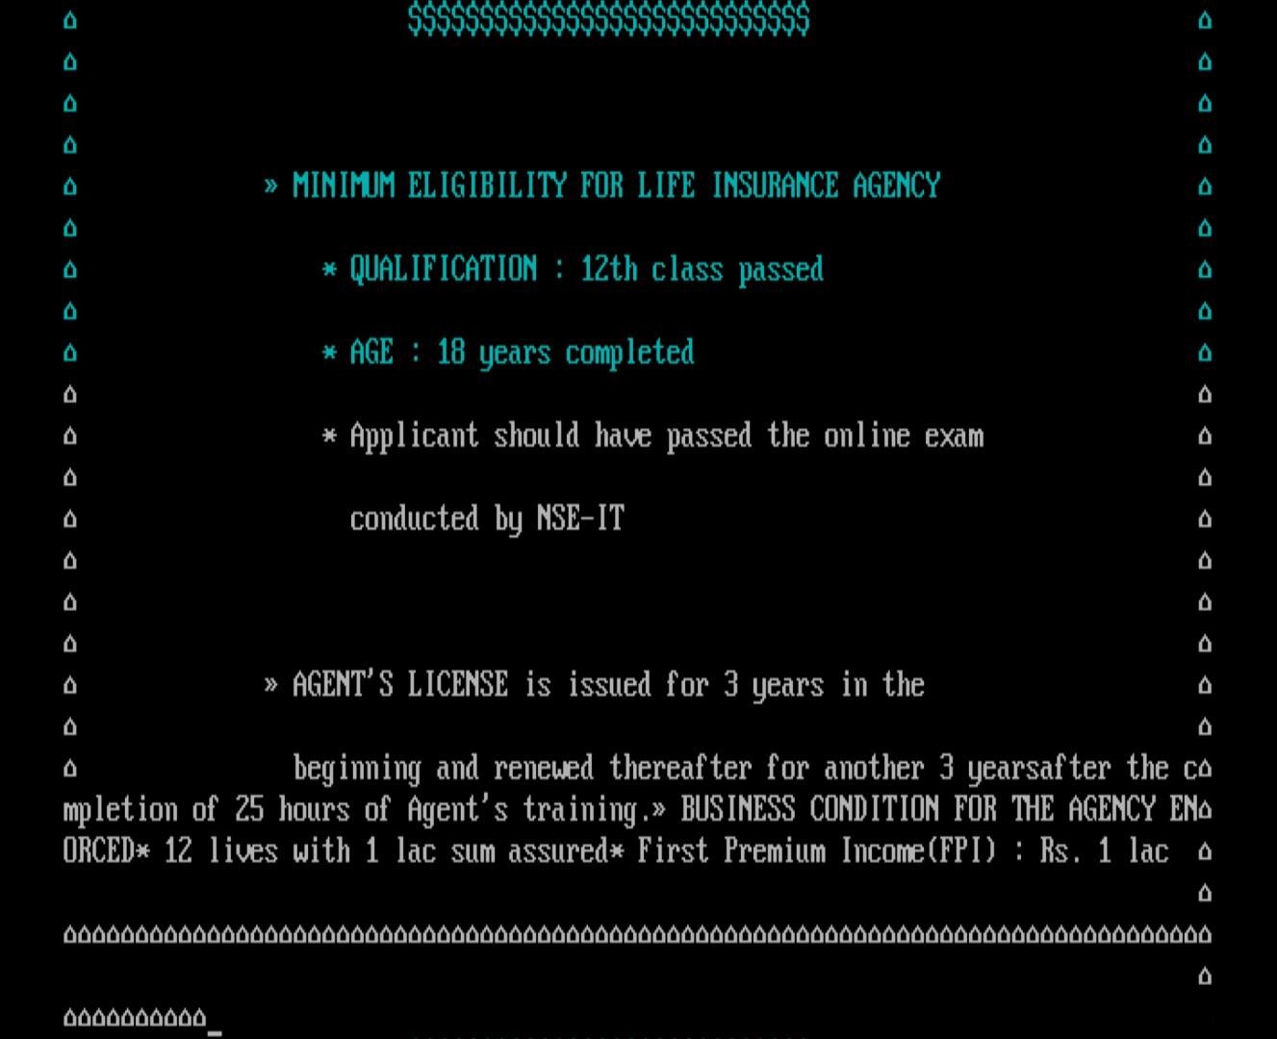
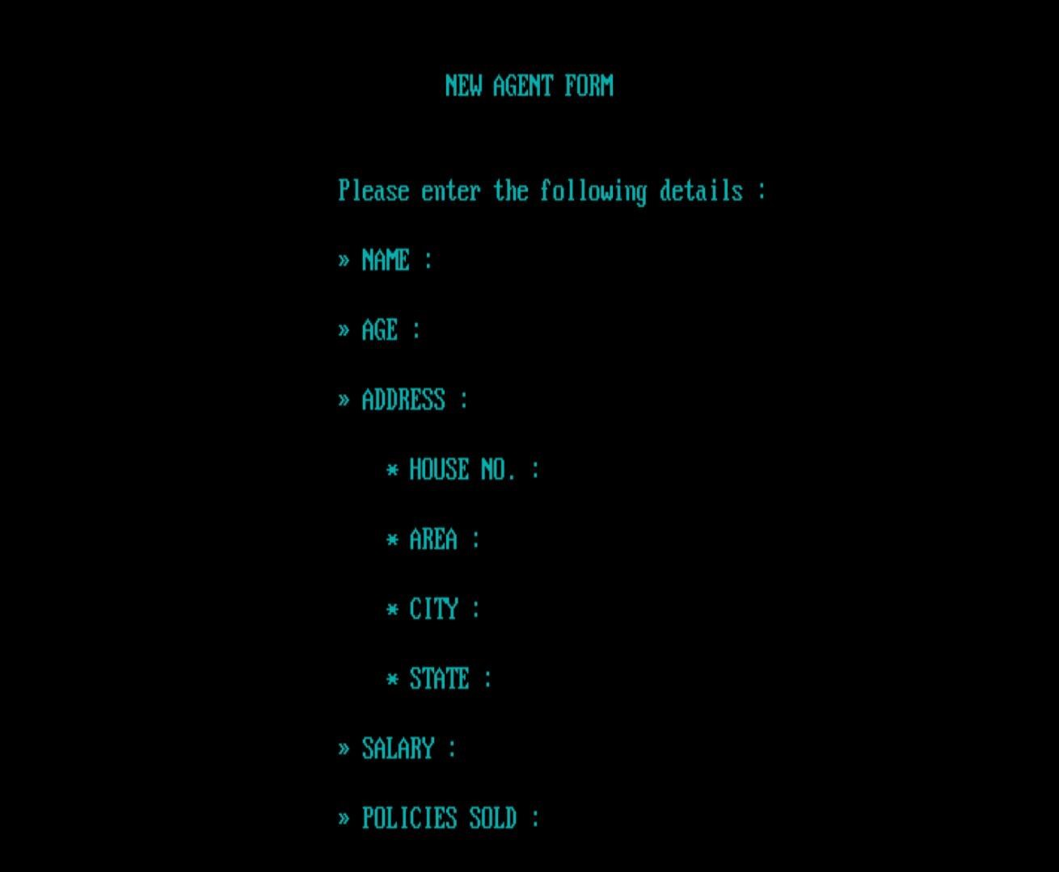

Slide 27
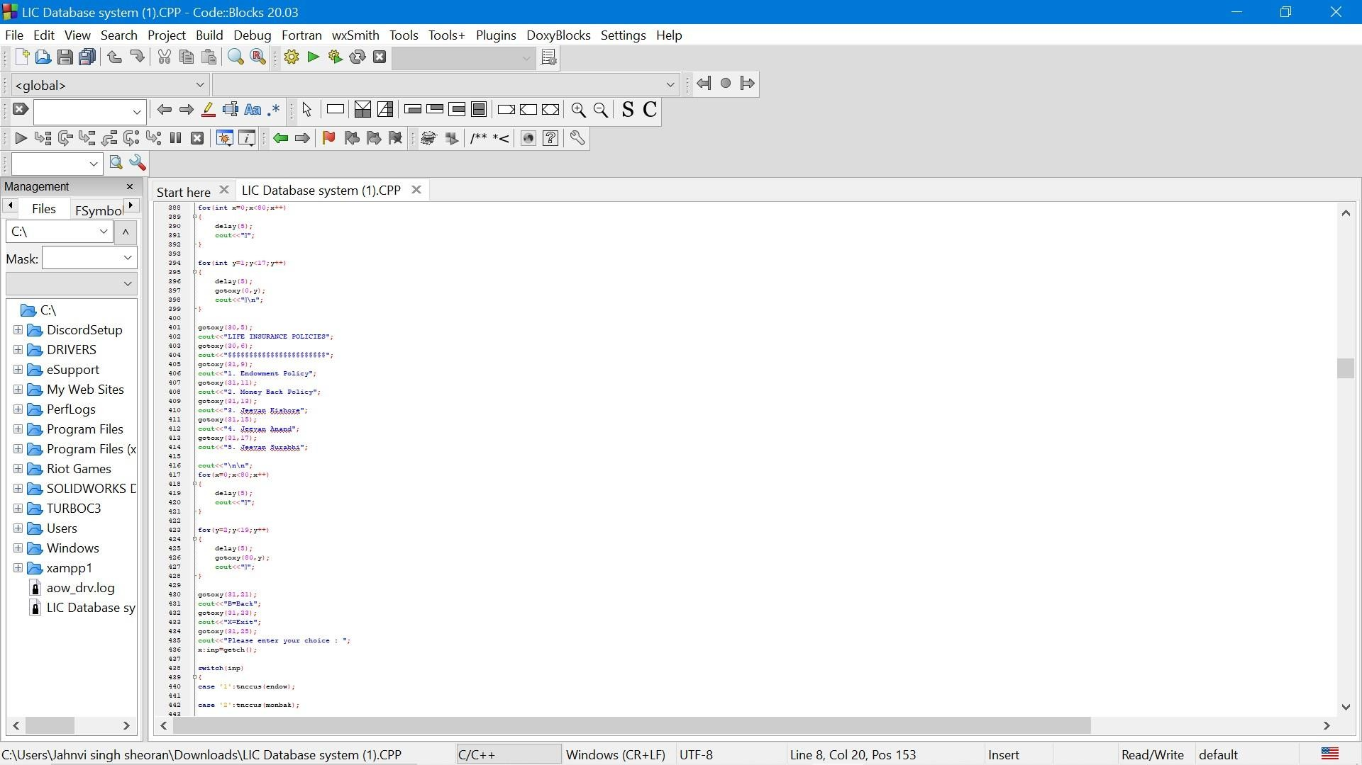
Implementation and coding.

Slide 28
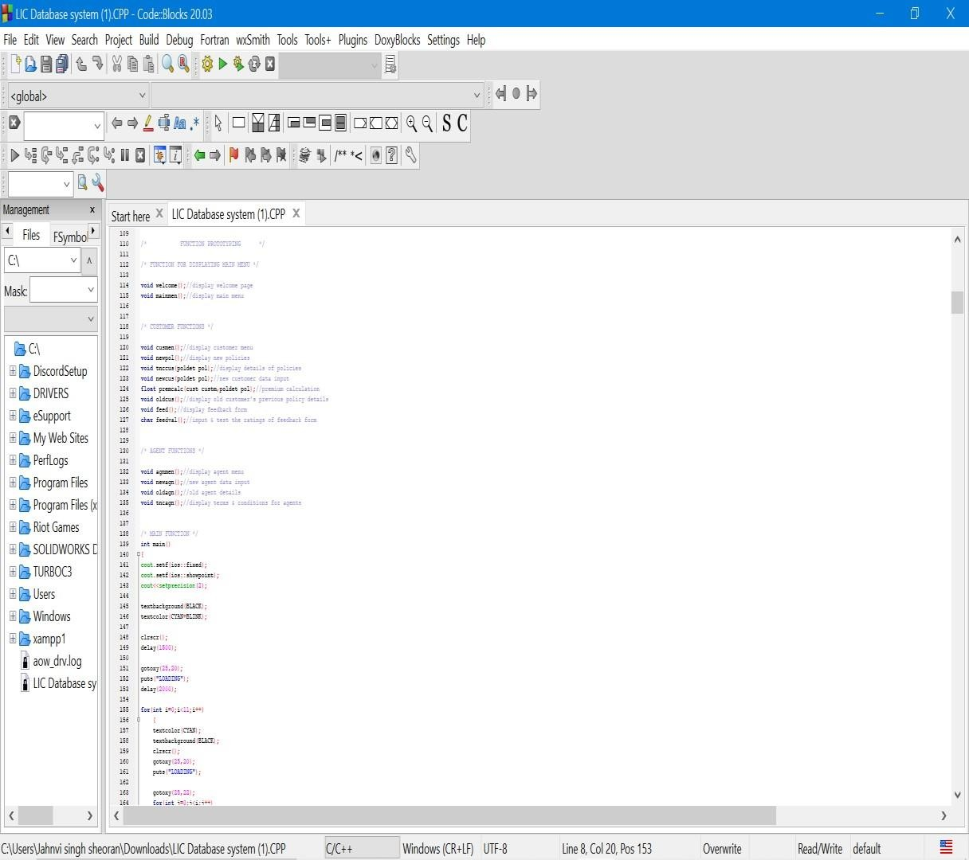
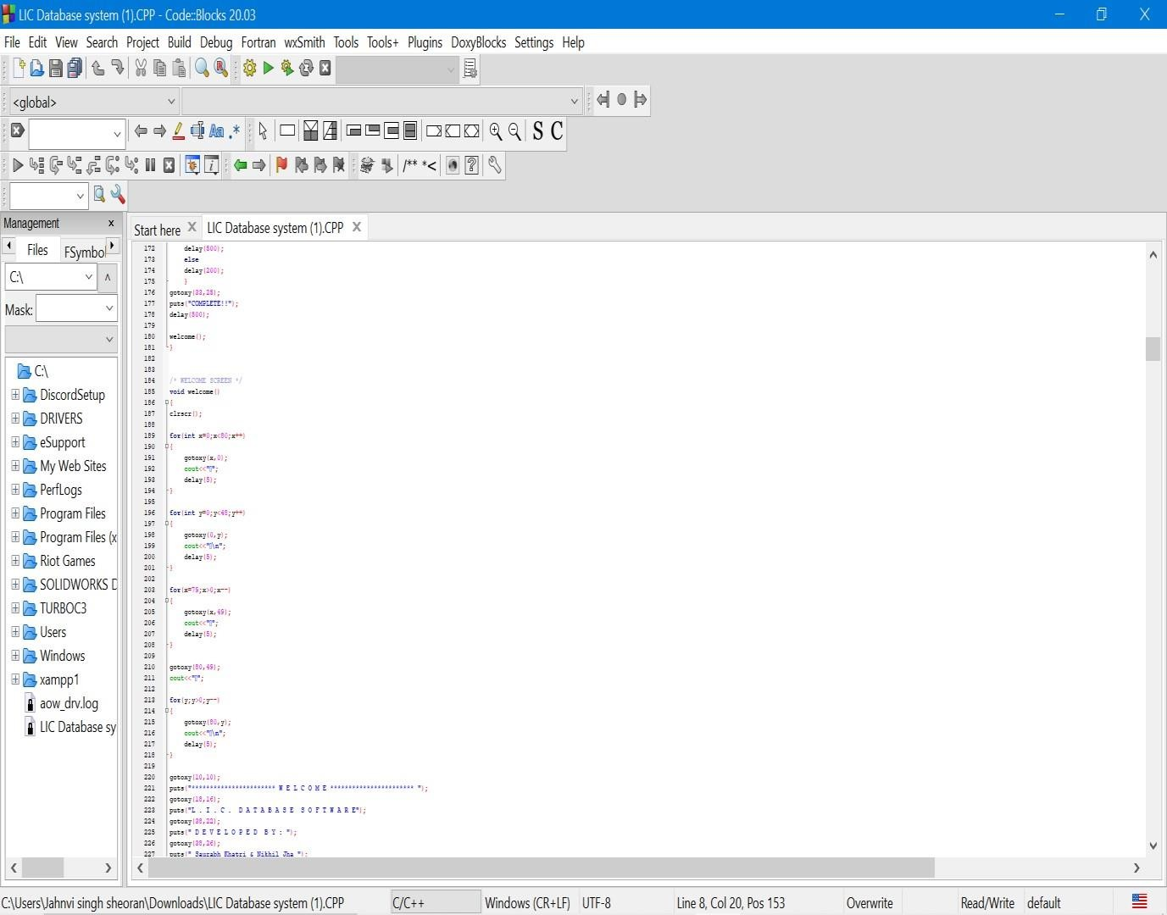

Slide 29
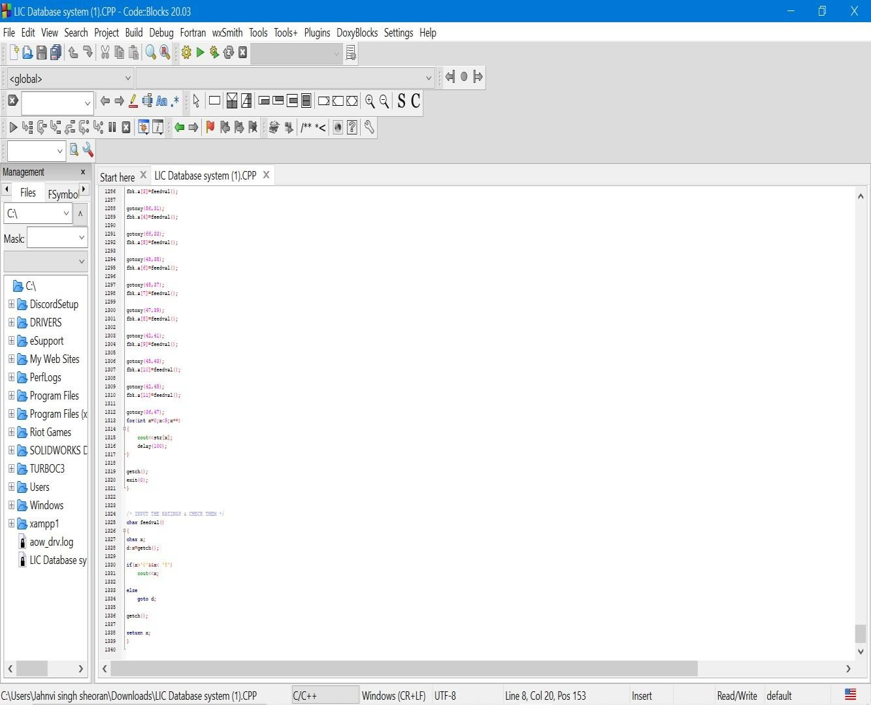
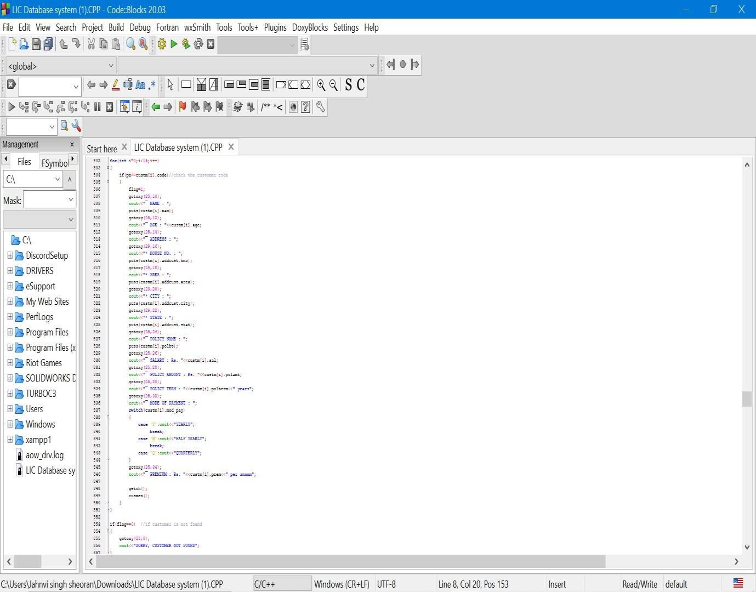

Slide 30
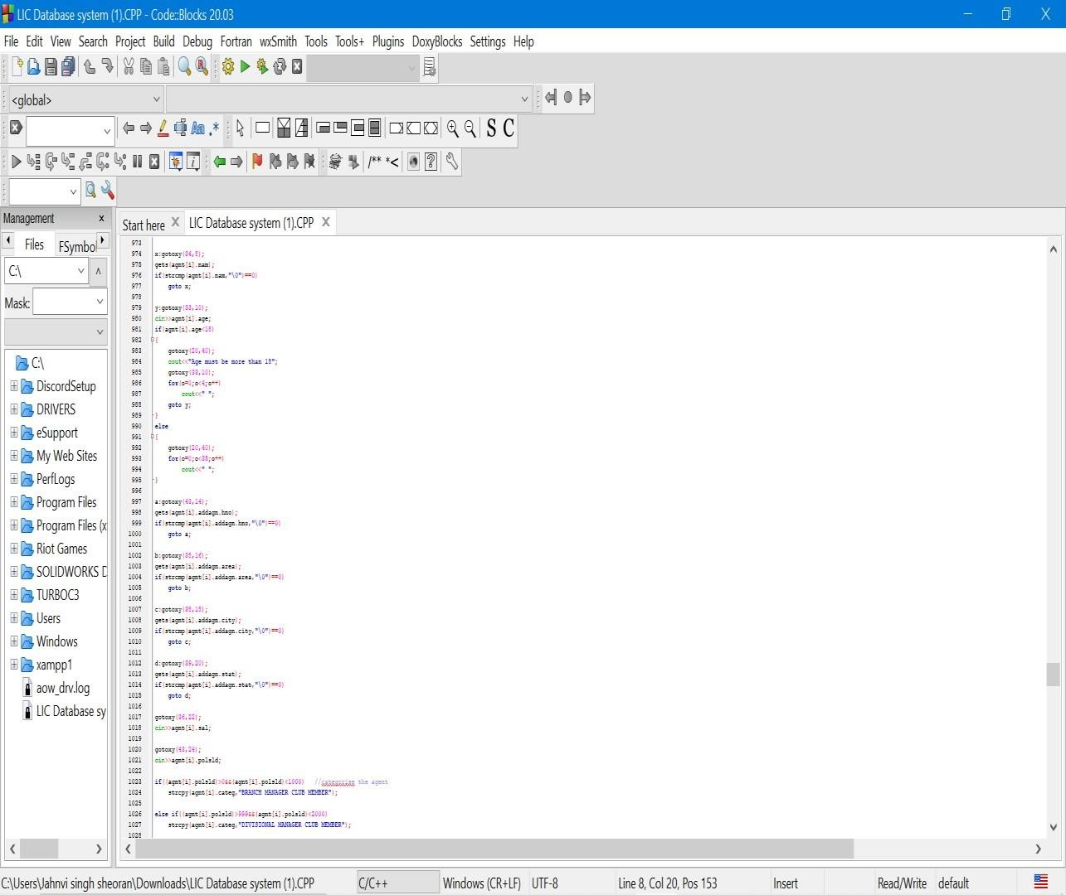

Slide 31
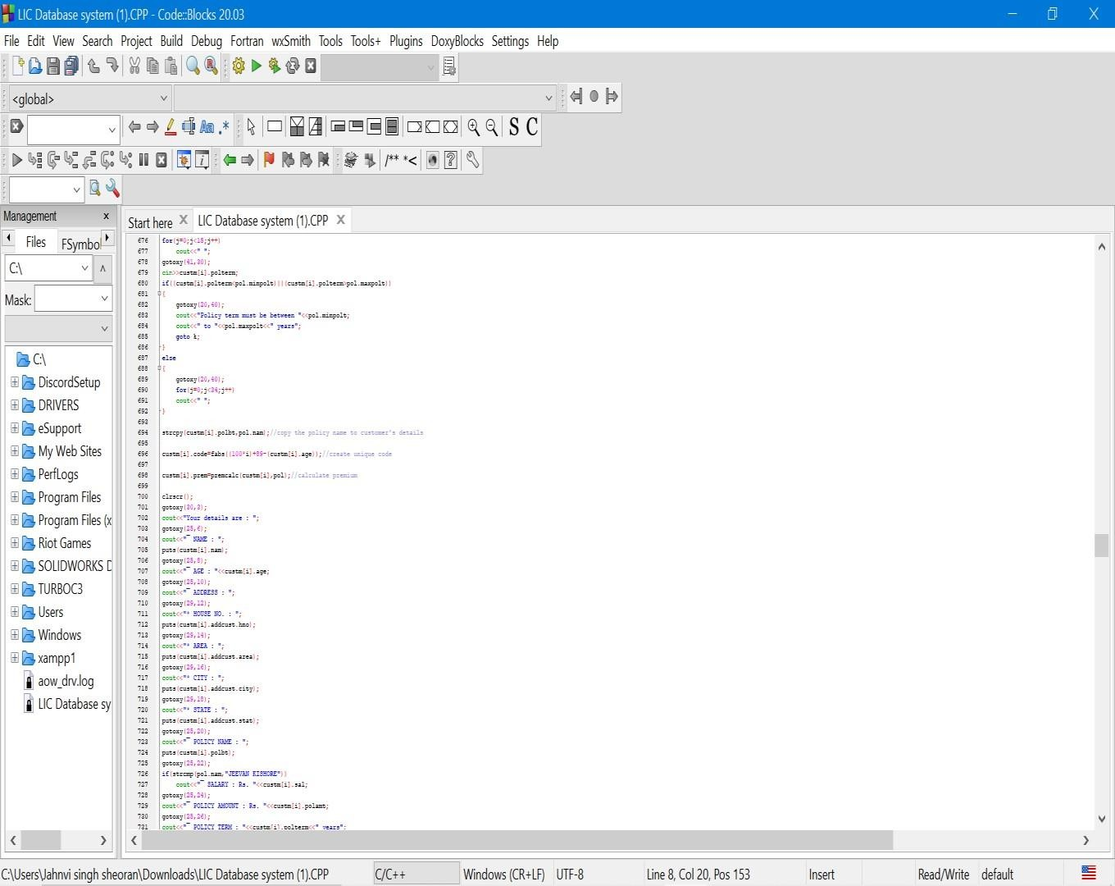
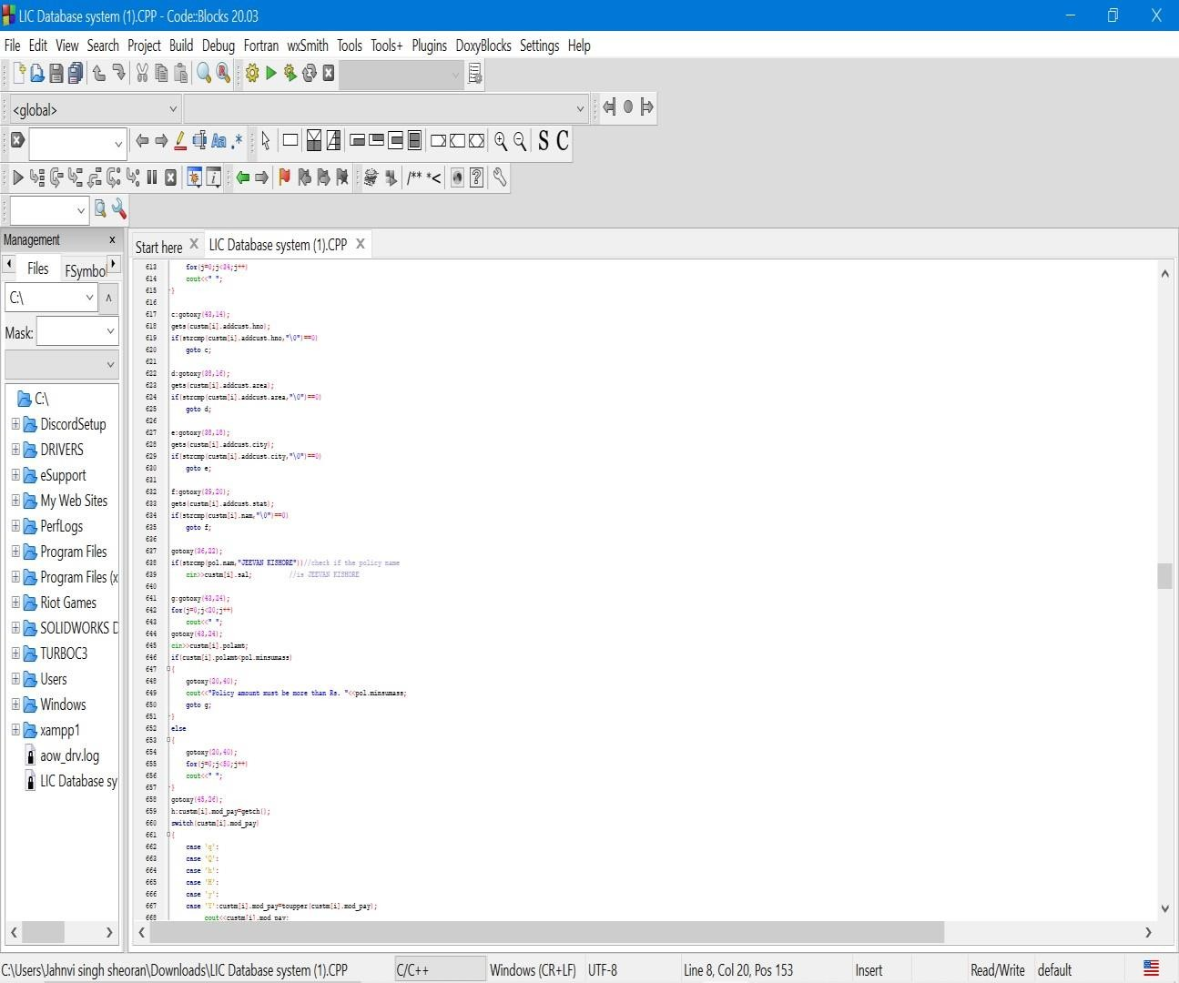

Slide 32
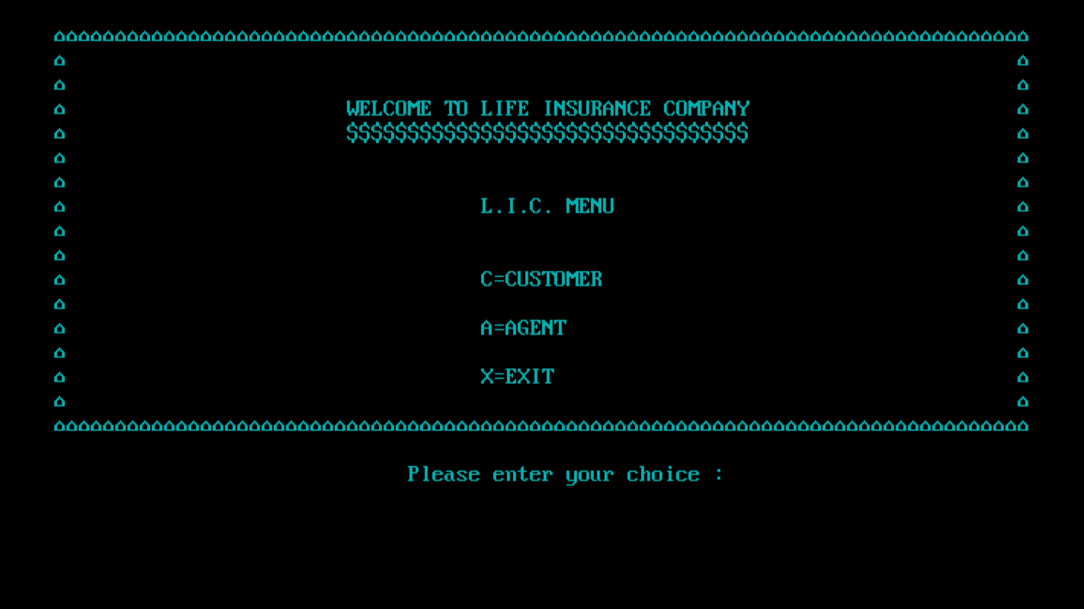
Result and Discussion. (Input and output)

Slide 33
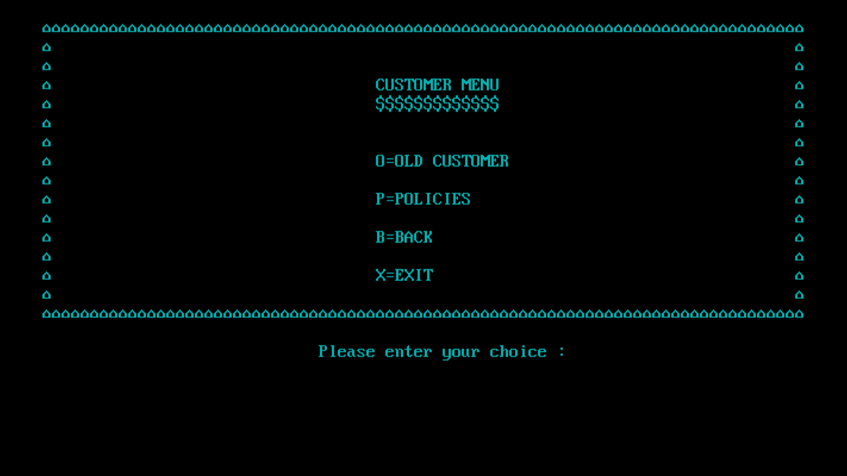
On pressing C

Slide 34
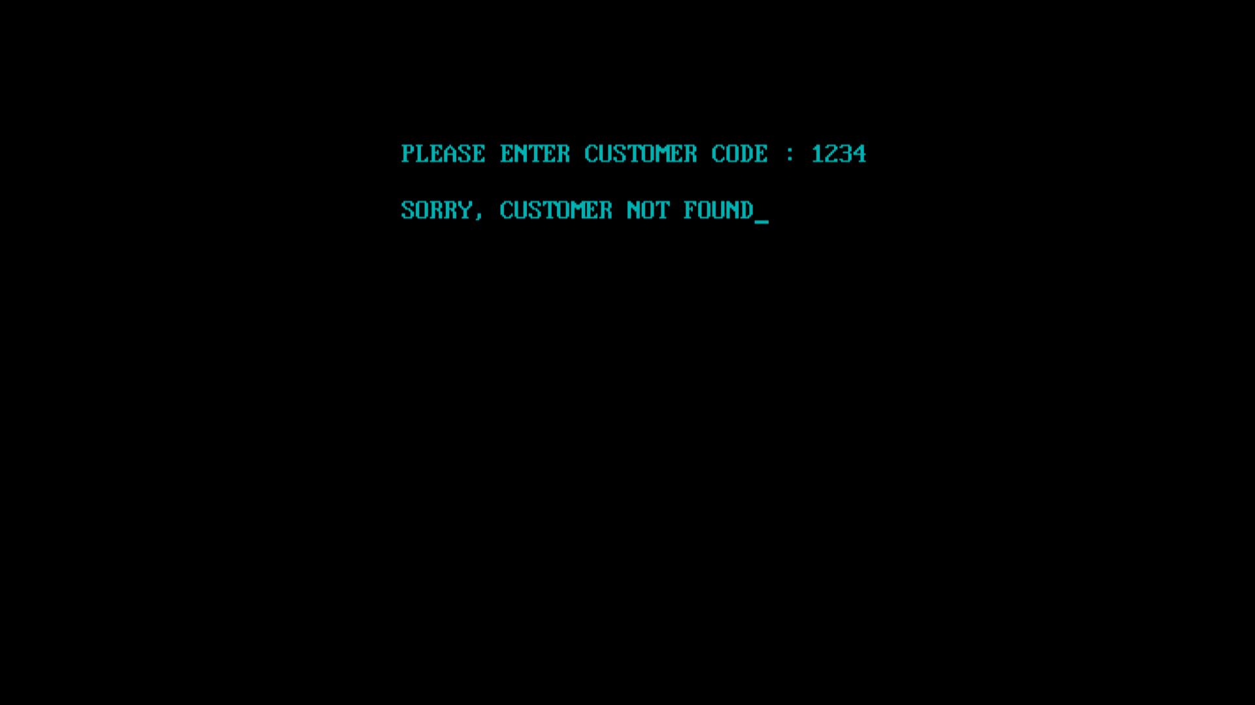
On pressing O

Slide 35
Conclusion
This study has analyzed the data collected from the policy holders and has brought out the expectations of the policy holders and their preferences. It has also offered suggestions that can be implemented for the benefit of the common public and the Government. After overhauling the all situation that boosted a number of Pvt. Companies associated with multinational in the Insurance Sector to give befitting competition to the established behemoth LIC in public sector, we come at the conclusion that :

Slide 36
There is very tough competition among the private insurance companies on
the level of new trend of advertising to lull a major part of Customers.
The entry of the Pvt. Players in the Insurance Sector has expanded the product segment to meet the different level of the requirement of the customers. It has brought about greater choice to the customers
Bank assurance - that allows life insurers to leverage on the risk product through bank network, was adopted by private players

Slide 37
Reference
1. “Database System Concepts” by Abraham Silberschatz and SSudarshan.
2. “Database Management Systems” by Raghu Ramakrishnan
3. “An Introduction to Database Systems” by Bipin Desai.
4. “Principles of Database Systems” by J D Ullman.
5. “Fundamentals of Database Systems” by R Elmasri and S Navathe

