Slide 1


Credit Card Customer Analysis Reports
Insights into Weekly Performance and Customer Behavior
Himanshu Tiwari
Date: April 17, 2025

Slide 2
Project Objective
To develop a comprehensive credit card weekly dashboard that provides real-time insights into key performance metrics and trends, enabling stakeholders to monitor and analyze credit card operations effectively.

Slide 3
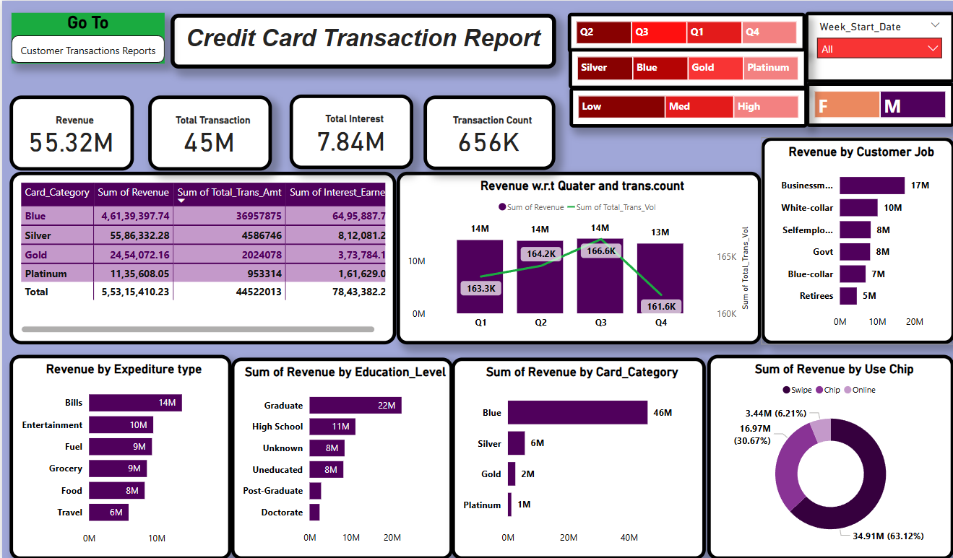
Credit Card Transaction Report

Slide 4
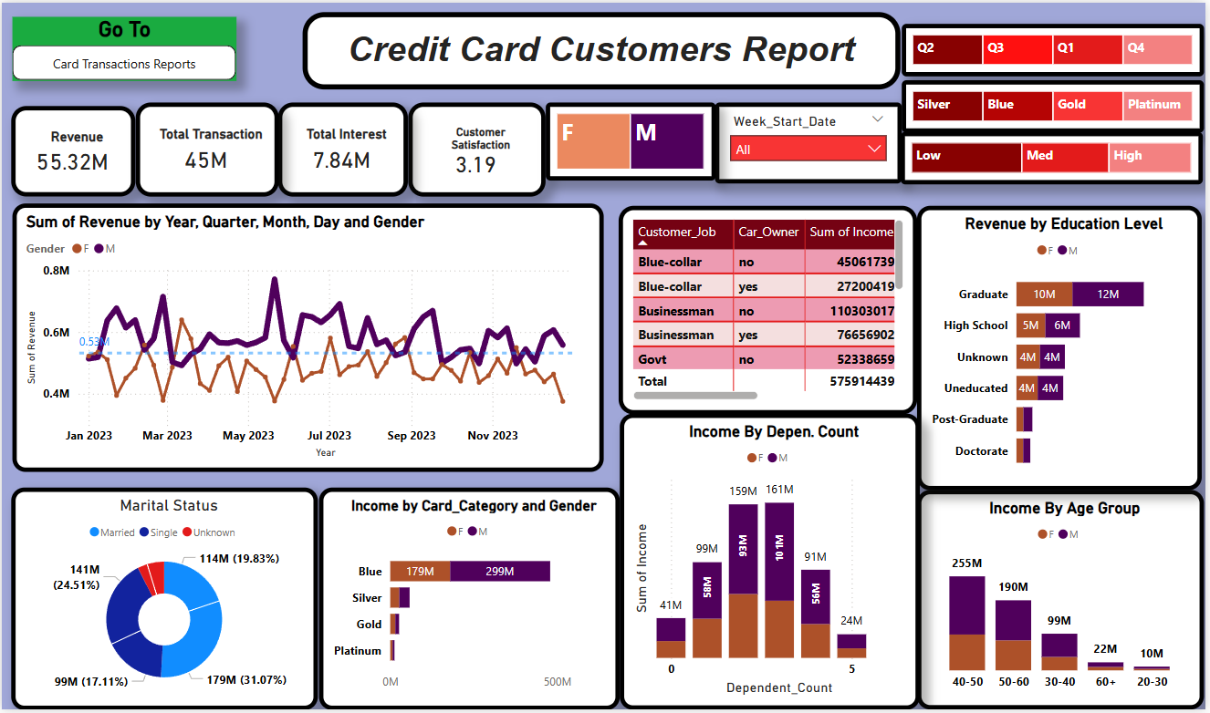
Credit Card Customers Report

Slide 5

Overall Performance Snapshot
Revenue: ₹55.32 Million
Total Transactions: 45 Million
Total Interest: ₹7.84 Million
Customer Satisfaction: 3.19

Slide 6
Used DAX Queries
Previous_week_Revenue =
CALCULATE(
SUM('public cc_detail'[Revenue]),
FILTER(
ALL('public cc_detail'),
'public cc_detail'[week_num2] = MAX('public cc_detail'[week_num2]) - 1
)
)
AgeGroup =
SWITCH(
TRUE(),
'public cust_detail'[customer_age] < 30, "20-30",
'public cust_detail'[customer_age] >= 30 && 'public cust_detail'[customer_age] < 40, "30-40",
'public cust_detail'[customer_age] >= 40 && 'public cust_detail'[customer_age] < 50, "40-50",
'public cust_detail'[customer_age] >= 50 && 'public cust_detail'[customer_age] < 60, "50-60",
'public cust_detail'[customer_age] >= 60, "60+",
"Unknown"
)

Slide 7
IncomeGroup =
SWITCH(
TRUE(),
'public cust_detail'[income] < 35000, "Low",
'public cust_detail'[income] >= 35000 && 'public cust_detail'[income] < 70000, "Med",
'public cust_detail'[income] >= 70000, "High",
"Unknown"
)
week_num = WEEKNUM('public cc_detail'[week_start_date])
Revenue =
'public cc_detail'[annual_fees] +
'public cc_detail'[total_trans_amt] +
'public cc_detail'[interest_earned]
Current_week_Revenue =
CALCULATE(
SUM('public cc_detail'[Revenue]),
FILTER(
ALL('public cc_detail'),
'public cc_detail'[week_num2] = MAX('public cc_detail'[week_num2])
)
)

Slide 8

Income by Customer Job and Car Ownership
• "Businessman" with car ownership contributes the highest income.
• "Blue-collar" customers also represent a significant income segment.
• Potential Insights: Tailor marketing and product offerings based on job profiles and car ownership. Consider risk assessment strategies based on these segments.

Slide 9

Transaction Distribution by Marital Status
• "Married" individuals account for the largest share of transactions.
• "Single" individuals also represent a substantial portion.
• Potential Insights: Understand the spending behavior of different marital status groups to personalize card benefits and communication.

Slide 10
Income Contribution by Card Type and Gender
• "Blue" cardholders generate the most income, with a strong male contribution.
• Other card categories contribute significantly less.
• "Platinum" card income appears minimal.
• Potential Insights: Focus on the "Blue" card segment. Investigate the low performance of "Platinum" cards. Explore gender-specific strategies for different card tiers.

Slide 11
Income Based on Dependency Count and Gender
• Individuals with no dependents contribute the highest income.
• Income generally decreases with an increasing number of dependents.
• Potential Insights: Understand household financial structures and spending patterns related to dependency.

Slide 12
Revenue Generation by Education Level
• "Graduate" individuals contribute the most revenue.
• Higher education levels generally correlate with higher revenue.
• Potential Insights: Target marketing efforts towards higher education segments. Consider offering products or benefits that appeal to these demographics.

Slide 13
Income Distribution Across Age Groups
• The 40-50 age group generates the highest income.
• Significant contributions from the 30-40 and 50-60 age groups.
• Potential Insights: Tailor marketing campaigns and card features to the spending habits and needs of different age segments, particularly the high-income generating groups.

Slide 14
Leverage Interactive Filters for Deeper Insights
• Highlight the available filters: Gender, Week Start Date, Card Type, Customer Satisfaction Level.
• Explain how these filters allow for granular analysis (e.g., "Analyze revenue for 'Gold' cardholders with 'High' satisfaction in Q3").
• Emphasize the ability to identify specific trends and patterns within targeted customer segments.

Slide 15
Summary of Key Insights
• "Blue" card is a major revenue driver.
• Significant gender-based differences in spending across various segments.
• Age (40-50) and education (Graduate) are strong indicators of higher income generation.
• Potential to optimize the "Platinum" card offering.
• Customer satisfaction is a crucial metric to monitor in relation to spending.
Recommendations:
• Further investigate the success factors of the "Blue" card.
• Develop targeted marketing campaigns based on gender, age, and education profiles.
• Re-evaluate the value proposition and marketing strategy for the "Platinum" card.
• Analyze the correlation between customer satisfaction and spending behavior.
• Continuously monitor weekly trends to identify emerging patterns.

