Slide 1
What is Management Consulting?
October 22, 2026
8:00 pm, KJ 202

Slide 2


J. Hunter Howard ’27
GMP
Devon de Vries ’27
Partner

Slide 3
Structured Advice without the Decision
A friend says something feels wrong in their relationship and asks for help.
Your process:
Clarify the problem
Separate facts from reactions
Identify patterns and causes
Compare options, trade-offs, and risks
Your recommendations
“Here’s what I think is happening, and here are your strongest options”
You provide an objective recommendation. They decide.
INTRODUCTION – WHAT IS MANAGEMENT CONSULTING – WHO THRIVES & WHY HAMILTON – HOW DO YOU BREAK IN – NEXT STEPS

Slide 4
What is Management Consulting?
The definition & function of consulting, what the work looks like, what a consulting career looks like, and the industry landscape.

Slide 5
Consulting Sells Clarity Under Uncertainty
Consultants are external advisors hired to structure ambiguity and inform high-stakes decisions.
Uncertainty
Profits are declining
Structured Analysis
Diagnose root cause
Quantify financial impact
Executive Recommendation
Clear position: “we recommend..."
Risks, tradeoffs, implementation path
Respond to a competitive threat
How to enter a new market
Test strategic options
“Consultants advise. Management decides.”
INTRODUCTION – WHAT IS MANAGEMENT CONSULTING – WHO THRIVES & WHY HAMILTON – HOW DO YOU BREAK IN – NEXT STEPS

Slide 6
Engagements Vary by Scope
Engagement: a time-bound client project with a clearly defined problem, workplan, and deliverables
Defined Scope
Small Teams
Executive Deliverables
Fixed Timeline
Clear problem statement with explicit boundaries and agreed upon deliverables
A few weeks to multiple months. Regular milestones and consistent check-ins.
2-6 consultants, heavy collaboration and ownership, strong feedback culture.
Recommendations to executives, presenting findings and way forwards.
Strategy
Market entry
Growth strategy
Portfolio decisions
PE diligence
Operation
Cost reduction
Pricing optimization
Supply chain redesign
Margin improvement
Transformation
Org redesign
Digital overhaul
Turnaround strategy
Culture shifts
Due Diligence
Investment recs
Operational diligence
Commercial diligence
Financial investigation
INTRODUCTION – WHAT IS MANAGEMENT CONSULTING – WHO THRIVES & WHY HAMILTON – HOW DO YOU BREAK IN – NEXT STEPS

Slide 7
Work: Structured, Fast, and Collaborative
Strategy (~6-12 weeks) | Operations (~3-9 months) | Transformation (~12-24 months)
Diagnose
Align on the real decision
Analyze
Break problems into MECE components
Recommend
Take a clear position
Define scope + success metrics
Form an initial hypothesis
Run targeted analyses
Iterate with client feedback
Quantify the impact and risks
Outline implementation roadmap
INTRODUCTION – WHAT IS MANAGEMENT CONSULTING – WHO THRIVES & WHY HAMILTON – HOW DO YOU BREAK IN – NEXT STEPS

Slide 8
Careers in Consulting Accelerate Early
Early Responsibility
Y1 Client Exposure
Skill Compression
Hypothesis-driven thinking
Exit Optionality
Private equity & investing
Venture / startups
Corporate strategy & leadership
Public sector / policy
Grad school / academia
Direct interactions with senior leadership
Ownership of workstreams
Small-team accountability
MECE approach
Professional communication
Quantitative rigor
High-frequency feedback
Up or out culture is real.
INTRODUCTION – WHAT IS MANAGEMENT CONSULTING – WHO THRIVES & WHY HAMILTON – HOW DO YOU BREAK IN – NEXT STEPS

Slide 9
Lifestyle and Benefits
Work-Life Balance
50-65 hours/week, varies.
Comp and Benefits
$100K+ starting base salary at many leading firms.
Travel
Monday-Thursday client-site model.
Weekends generally protected.
Demanding weekdays, balanced by PTO and on-the-beach.
Performance bonuses, signing bonuses, salary progression.
Healthcare coverage, retirement, PTO.
Visit new places and environments.
Firm-paid business travel; airline and premium hotel loyalty.
High demand, high reward.
INTRODUCTION – WHAT IS MANAGEMENT CONSULTING – WHO THRIVES & WHY HAMILTON – HOW DO YOU BREAK IN – NEXT STEPS

Slide 10
















The Industry, Tiers and Designations
Boutiques
MBB
Strategy Firms
Boutiques
Large Platform/Non-Business
INTRODUCTION – WHAT IS MANAGEMENT CONSULTING – WHO THRIVES & WHY HAMILTON – HOW DO YOU BREAK IN – NEXT STEPS

Slide 11
Who Thrives & Why Hamilton
What firms select for, the growing liberal arts edge, how Hamilton specifically positions you, and what resources there are here.

Slide 12
Selection is Structural
Structured Thinkers
Problem Solving
Collaboration
Ownership
Break ambiguity into components
Take ownership and move the work forwards.
Internal and external communication that builds trust.
Entrepreneurial Drive
Client-Ready Teammates
Consultant
INTRODUCTION – WHAT IS MANAGEMENT CONSULTING – WHO THRIVES & WHY HAMILTON – HOW DO YOU BREAK IN – NEXT STEPS

Slide 13
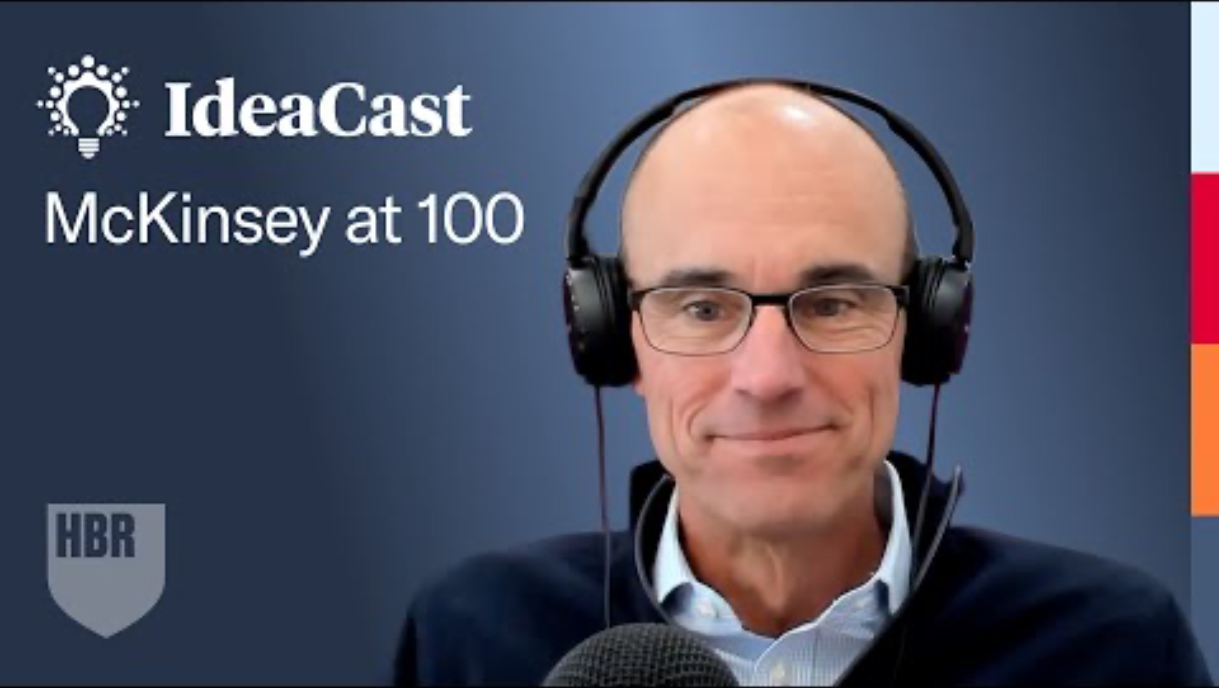
Bob Sternfels on Liberal Arts' Edge vs AI
15:44
Truly novel thinking
Unique education background
Creativity

Slide 14
Hamilton Trains the Untrainable
Communication
Intellectual Rigor
Drive
  Writing-intensives, etc.
  Seminar & discussions
  Collaboration through athletics, orgs, clubs
  Open curriculum
  Quantitative and qualitative
  Defending arguments
  Direct accountability
  Independent opportunities
  Leadership & impact
INTRODUCTION – WHAT IS MANAGEMENT CONSULTING – WHO THRIVES & WHY HAMILTON – HOW DO YOU BREAK IN – NEXT STEPS

Slide 15
Institutional Infrastructure
Hamilton
Alumni Connections
Hamilton Consulting Group
The Career Center
Admissions
Athletics
INTRODUCTION – WHAT IS MANAGEMENT CONSULTING – WHO THRIVES & WHY HAMILTON – HOW DO YOU BREAK IN – NEXT STEPS

Slide 16
Hamilton Consulting Group
HCG
Career Preparation
Industry Knowledge
HCG Quill
Casing Series
Peer Practice
Overviews
Special sessions
Client Work
Collaboration
Conceptual
Applied
Open to everyone
Limited spots

Slide 17
How do You Break In?
What access exists at Hamilton, recruiting timelines, experience, and the case interview.

Slide 18
Access Exists at Hamilton
Explore
Career Center Exposure
Info Sessions
Alumni Conversations
Prepare
HCG Case Training
Management Consulted
Opportunities
Consulting Advisor
Convert
Alumni Referrals
Promoters
Formal Recruiting Timelines
The learning, tools, and opportunities are here — their value depends on you.
INTRODUCTION – WHAT IS MANAGEMENT CONSULTING– WHO THRIVES & WHY HAMILTON – HOW DO YOU BREAK IN – NEXT STEPS

Slide 19
Recruiting is Timeline-Driven
Internship
Now
Sophomore spring
Junior summer
Junior fall
Feb-April
  Explore & Plan
  Start networking
May-June
  Network more & Foundations
July-August
  Engage & Prepare
  Applications
September-October
  Decisions
  Interview
November-December
  Offer Decisions
March-June
  Build Better
    Connections + skills
July-September
  Summer Internship
  Network & Apply
September-October
  Interview
November-December
  Decisions
Junior Spring
Senior summer
Senior fall
Fulltime
INTRODUCTION – WHAT IS MANAGEMENT CONSULTING– WHO THRIVES & WHY HAMILTON – HOW DO YOU BREAK IN – NEXT STEPS

Slide 20
Firms Select for Experience
Resume Signals (before)
Experience Narratives (during)
What firms can see before meeting you.
Measurable, quantifiable impact (revenue, growth, efficiency)
Leadership scope
Selectivity / rigor
Sustained commitment
Brand associations
What emerges once you speak in person
Clear “why consulting” logic
Consistent career arc
Self-awareness
Judgment under ambiguity
Confidence without arrogance
INTRODUCTION – WHAT IS MANAGEMENT CONSULTING– WHO THRIVES & WHY HAMILTON – HOW DO YOU BREAK IN – NEXT STEPS

Slide 21
The Case Interview.
Clarify
Define the problem
Choose success metrics
Structure
Break into its components
Develop hypothesis
Analyze
Evidence processed into insights
Iterate hypothesis
Synthesize
Ideate
Brainstorm solutions
Evaluate feasibility
Deliver hypothesized answer
Propose next steps
INTRODUCTION – WHAT IS MANAGEMENT CONSULTING– WHO THRIVES & WHY HAMILTON – HOW DO YOU BREAK IN – NEXT STEPS

Slide 22
Succes is Trained
Now
Map target firms
Next
Future
Case interview reps
Work on resumes and applications
Review recruiting timelines
Draft 3-4 leadership/impact stories
Reach out to alumni
Practice core skills
Get involved in HCG
INTRODUCTION – WHAT IS MANAGEMENT CONSULTING– WHO THRIVES & WHY HAMILTON – HOW DO YOU BREAK IN – NEXT STEPS

Slide 23
Q&A
Email: hconsult@hamilton.edu

