Slide 1
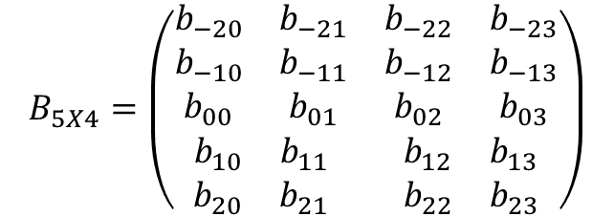
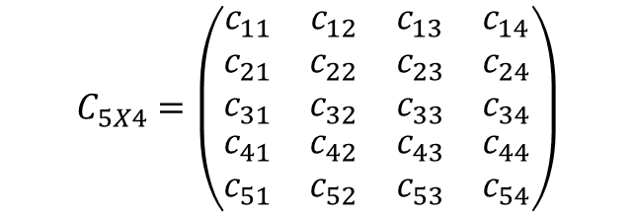
real :: C(5,4)
real :: B(-2:2,0:3)
$$B_{5X4}=\left(\begin{matrix}\begin{matrix}b_{−20} & b_{−21} \\ b_{−10} & b_{−11} \\ b_{00} & b_{01}\end{matrix} & \begin{matrix}b_{−22} & b_{−23} \\ b_{−12} & b_{−13} \\ b_{02} & b_{03}\end{matrix} \\ \begin{matrix}b_{10} & b_{11} \\ b_{20} & b_{21}\end{matrix} & \begin{matrix}b_{12} & b_{13} \\ b_{22} & b_{23}\end{matrix}\end{matrix}\right)$$
B(-2,:)
$$C_{5X4}=\left(\begin{matrix}\begin{matrix}c_{11} & c_{12} \\ c_{21} & c_{22} \\ c_{31} & c_{32}\end{matrix} & \begin{matrix}c_{13} & c_{14} \\ c_{23} & c_{24} \\ c_{33} & c_{34}\end{matrix} \\ \begin{matrix}c_{41} & c_{42} \\ c_{51} & c_{52}\end{matrix} & \begin{matrix}c_{43} & c_{44} \\ c_{53} & c_{54}\end{matrix}\end{matrix}\right)$$
C(2:3,3:4)
B(2,1:2)
C(:,2)

Slide 2
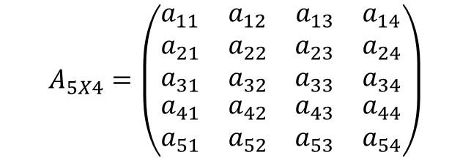
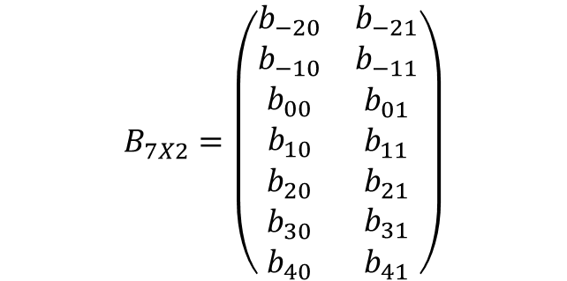
real :: A(5,4)
real :: B(-2:2,0:3)
$$B_{5X4}=\left(\begin{matrix}\begin{matrix}b_{−20} & b_{−21} \\ b_{−10} & b_{−11} \\ b_{00} & b_{01}\end{matrix} & \begin{matrix}b_{−22} & b_{−23} \\ b_{−12} & b_{−13} \\ b_{02} & b_{03}\end{matrix} \\ \begin{matrix}b_{10} & b_{11} \\ b_{20} & b_{21}\end{matrix} & \begin{matrix}b_{12} & b_{13} \\ b_{22} & b_{23}\end{matrix}\end{matrix}\right)$$
B(-2,:)
$$A_{5X4}=\left(\begin{matrix}\begin{matrix}a_{11} & a_{12} \\ a_{21} & a_{22} \\ a_{31} & a_{32}\end{matrix} & \begin{matrix}a_{13} & a_{14} \\ a_{23} & a_{24} \\ a_{33} & a_{34}\end{matrix} \\ \begin{matrix}a_{41} & a_{42} \\ a_{51} & a_{52}\end{matrix} & \begin{matrix}a_{43} & a_{44} \\ a_{53} & a_{54}\end{matrix}\end{matrix}\right)$$
A(2:3,3:4)
B(2,1:2)
A(:,2)
real :: B(-2:4,0:1)
$$B_{7X2}=\left(\begin{matrix}b_{−20} & b_{−21} \\ b_{−10} & b_{−11} \\ \begin{aligned}b_{00} \\ b_{10} \\ b_{20} \\ b_{30} \\ b_{40}\end{aligned} & \begin{aligned}b_{01} \\ b_{11} \\ b_{21} \\ b_{31} \\ b_{41}\end{aligned}\end{matrix}\right)$$
B(-2:4:3,:)

