Slide 1
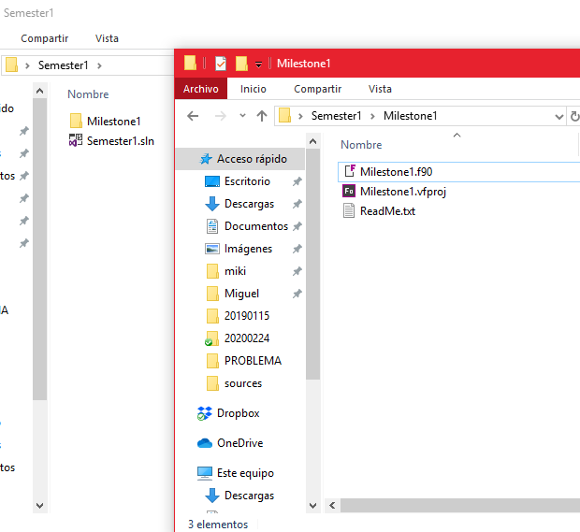
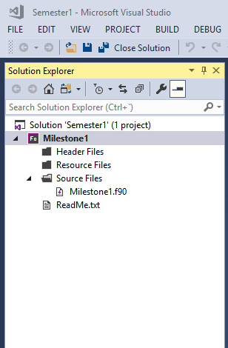
FILE EXPLORER (Windows)
SOLUTION EXPLORER (VS)

Slide 2
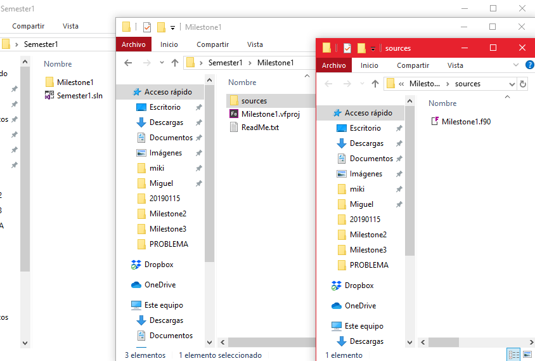
FILE EXPLORER (Windows)

Slide 3
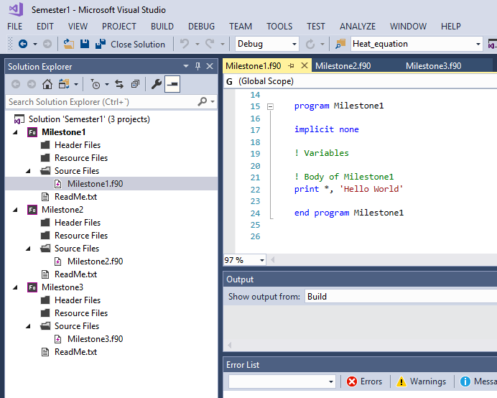
SOLUTION EXPLORER (VS)

Slide 4
