Slide 1


AI-POWERED SCHOOL OPERATING SYSTEM
Modernizing African K-12 Education with AI
All-in-one B2B SaaS platform unifying school administration, automated grading, pedagogical AI assistance, and parental engagement.
🌐 https://eduman.africa | GITEX Nigeria Pitch Deck

Slide 2
EXECUTIVE OVERVIEW
EduMan at a Glance
The Market Pain
• 100K+ African schools rely on manual paper records and spreadsheets.
• Teachers burn 6+ hours weekly drafting lesson notes and tests from scratch.
• High fee default rates due to manual paper receipt reconciliation.
• Parents receive academic feedback only at term end.
The EduMan Solution
• All-in-one cloud OS for K-12 primary & secondary schools.
• Built-in EduMan AI for lesson notes, quizzes, & Scheme of Work reviews.
• Automated Continuous Assessment (CA) & 1-click report cards.
• Real-time Parent Portal for fee statements and attendance.
Traction & Market Opportunity
• Live in production at eduman.africa with zero downtime.
• Validated across active pilot schools in Nigeria.
• 75% reduction in teacher prep time; 90% faster report processing.
• $1.2B Sub-Saharan Africa EdTech addressable market.

Slide 3
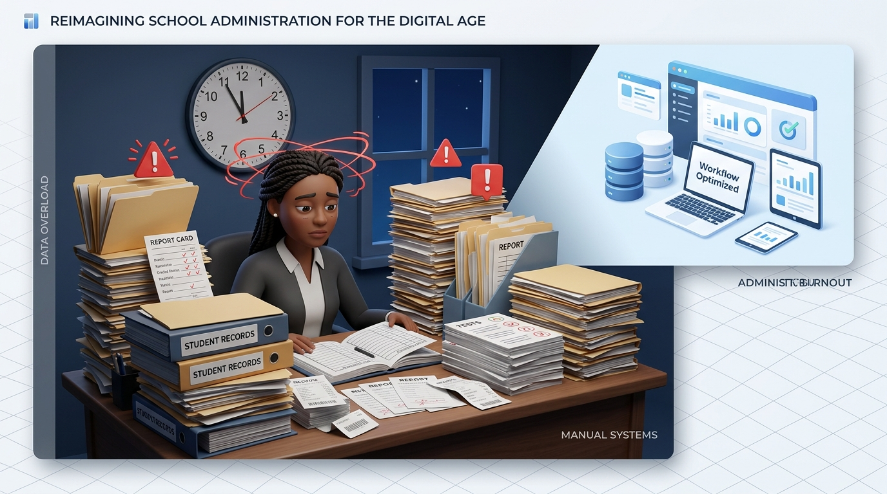
THE CHALLENGE
Severe Administrative & Instructional Friction in African Schools
❌ Administrative Overload & Human Error
End-of-term report card compilation takes 1-2 weeks of manual arithmetic, resulting in grading errors and delayed distributions.
❌ Teacher Fatigue & Large Class Sizes
Educators manage 40+ students with zero assistants, spending late nights drafting weekly notes and exam questions.
❌ Lack of Curriculum Governance
School leadership cannot easily verify if weekly syllabi align with national curriculum standards (NERDC/WAEC) or maintain pedagogical pacing.
❌ Revenue Leakage & Uncollected Fees
Manual paper billing leads to unrecovered tuition fees, untracked debts, and financial strain for school proprietors.

Slide 4
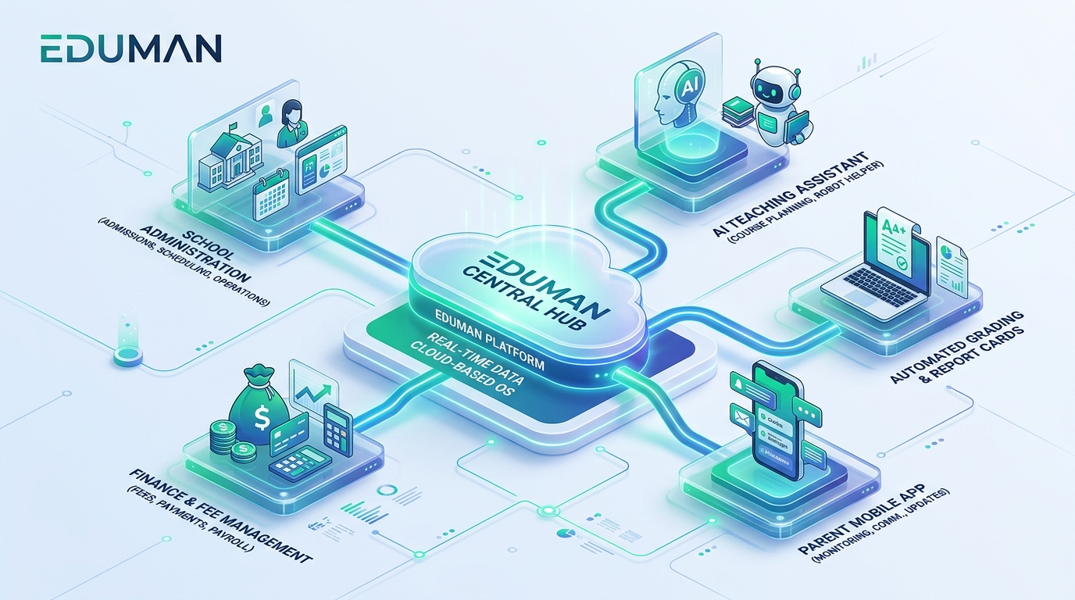
THE SOLUTION
EduMan: The Unified School Operating System
✓ 🤖 Instructional AI Engine
Generates lesson notes, interactive quizzes, and audits multi-week Schemes of Work for quality and pacing.
✓ 📊 Automated Academic Engine
Calculates weighted Continuous Assessments (CA) and generates beautiful, one-click terminal report cards.
✓ 🏫 Complete School Operations
Dynamic class scheduling, attendance tracking, homework management, and digital announcements.
✓ 💳 Integrated Billing & Finance
Invoicing, automated receipt logging, and live parent debt balances to ensure zero revenue leakage.
✓ 📱 Unified Multi-Role Portals
Custom tailored workspaces for 8 distinct roles: Admins, Teachers, Students, Parents, and Accountants.

Slide 5
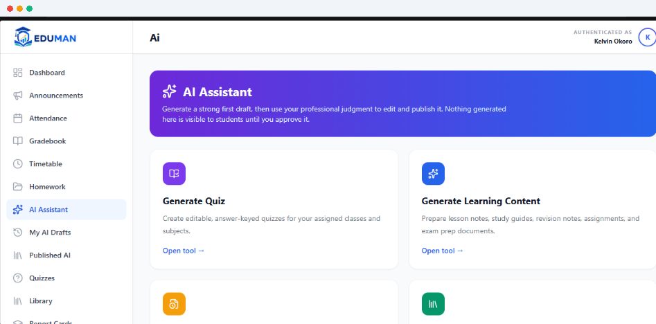
LIVE PRODUCT
EduMan AI: Real Classroom Teaching Assistant in Production
✓ ⚡ 1-Click Quiz Generation
Creates classroom-ready multiple-choice and true/false assessments with answer keys & explanations.
✓ 📝 Automated Learning Content
Drafts detailed, age-appropriate lesson notes, study guides, and revision sheets matching the school curriculum.
✓ 🔍 Scheme of Work Reviewer
Audits 10-14 week syllabus breakdowns for pedagogical progression, pacing, and SMART learning objectives.
✓ 🛡️ Strict Subject Domain Guardrails
Proprietary validation prevents cross-subject hallucinations, ensuring academic accuracy.
✓ 👨‍🏫 Teacher In-Control Workflow
Generates draft materials that teachers review, refine, and publish directly to students.

Slide 6
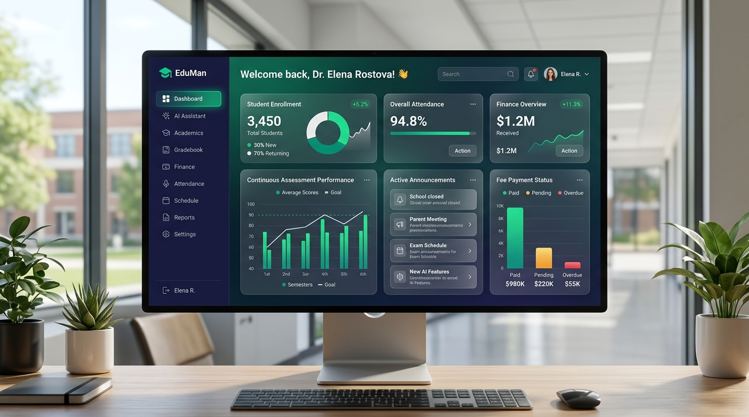
PRODUCT EXPERIENCE
Intuitive Cloud Dashboard for School Leadership
📌 Real-Time School Analytics
Live KPIs for student enrollment, staff attendance, fee collection velocity, and academic performance.
📌 Automated Continuous Assessment
Configurable CA1, CA2, Exam weights conforming to national educational standards with automated grade computation.
📌 Timetable & Schedule Matrix
Conflict-free class and teacher schedules with room allocations and instant timetable publishing.
📌 Financial Health & Audit Trail
Complete bursary records: fee templates, payment receipts, invoice dispatch, and debtor tracking.

Slide 7
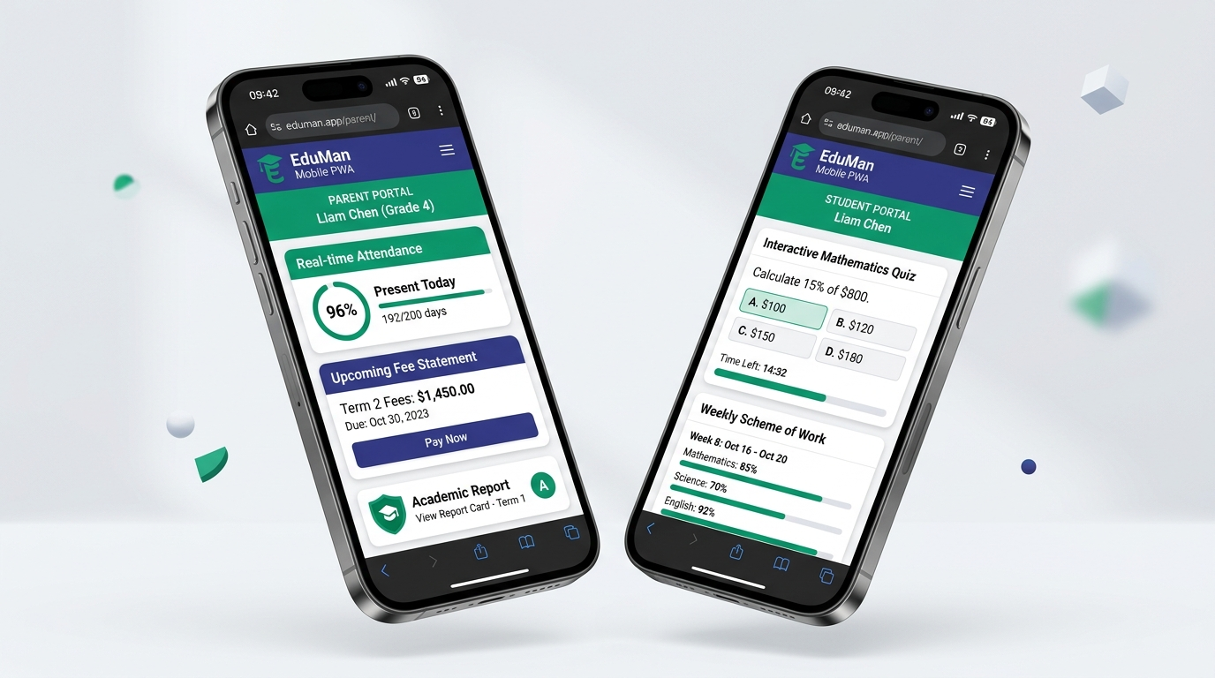
ACCESSIBILITY & REACH
Mobile PWA: Empowering Parents & Students on Any Device
📱 Zero App Store Barrier
Progressive Web App (PWA) installs instantly from the browser on entry-level Android and iOS smartphones without large download sizes.
📱 Optimized for Low-Bandwidth Networks
Smart offline asset caching and ultra-light API payloads ensure fluid performance even on 2G/3G mobile connections.
📱 Active Parental Transparency
Parents view real-time daily attendance, terminal grades, homework, and make fee payments directly from their phones.
📱 Student Interactive Portal
Students take timed online quizzes, track syllabus roadmap progress, and view weekly learning objectives.

Slide 8
MARKET SIZE & OPPORTUNITY
Massive, Underserved Basic Education Sector
100,000+ Schools
• K-12 primary and secondary schools in Nigeria alone.
• Over 40% of urban students enrolled in private basic schools.
45M+ Students
• Enrolled in primary and secondary basic education across Nigeria.
• Rapidly growing youth population driving schooling demand.
$1.2B Market TAM
• Sub-Saharan Africa school management & EdTech addressable market.
• Projected 18.5% CAGR over the next 5 years.
High Willingness to Pay
• Private school proprietors actively invest in digital tools that guarantee fee recovery and attract parents.
• Parents prioritize schools offering modern digital academic transparency.
Strategic Expansion Route
• Phase 1: Private primary & secondary schools in key commercial hubs (Lagos, Abuja, Port Harcourt).
• Phase 2: Multi-campus school networks & state-wide education board deployments across West Africa.

Slide 9
MONETIZATION STRATEGY
Predictable B2B SaaS Recurring Revenue
Core School Subscription
• Tiered B2B SaaS pricing based on student enrollment count.
• Billed per academic term or annually.
• Includes complete administration, attendance, gradebook, and report card generation.
• Unifies all 8 user role portals.
AI Generation Quotas
• Base tier includes monthly AI generation tokens for teachers.
• Add-on token packs for high-volume lesson note and quiz generation.
• Automated Scheme of Work pedagogical auditing credits.
Enterprise & Custom Add-ons
• Multi-campus network centralized dashboards.
• Custom school domain & branded portal interfaces.
• Automated SMS/WhatsApp notification packages.
• Payment gateway transaction processing margin.

Slide 10
PROVEN RESULTS
Traction & Measurable Educational Impact
🚀 Live Production Deployment
• Live and operational at https://eduman.africa.
• Zero-downtime, scalable PostgreSQL cloud architecture.
• Active cross-role usage across administrators, teachers, and parents.
⏱️ 75% Teacher Time Saved
• Lesson note and quiz prep time reduced from 6+ hours to < 30 minutes.
• Teachers focus on individualized student instruction and mentoring.
⚡ 90% Faster Report Cards
• Replaced manual 2-week calculation cycles with instant 1-click generation.
• Eliminated arithmetic grading errors across Continuous Assessment.
💳 Zero Fee Leakage
• 100% digital fee schedule reconciliation and payment logging.
• Bursars gain real-time visibility into parent debt balances and receipts.

Slide 11
OUR MOAT
Why EduMan Wins in Emerging Markets
1. African Curriculum Native
• Built specifically for African educational frameworks (NERDC, WAEC, 3-term system, and 30/70 or 40/60 Continuous Assessment models).
• Unlike foreign tools that require complex custom hacks.
2. Pedagogical AI Guardrails
• Proprietary validation prevents cross-subject hallucinations and validates weekly Scheme of Work quality automatically.
• Grounded directly in classroom curriculum standards.
3. Radical PWA Accessibility
• Lightweight Progressive Web App that installs on budget $50 smartphones and operates reliably on fluctuating 2G/3G networks.
• No expensive school computer labs required.
4. End-to-End Stakeholder Synergy
• Connects all 8 school stakeholders under a single login rather than using 4 disconnected software products.
• Drives high institutional retention and low churn.

Slide 12
JOIN US IN TRANSFORMING AFRICAN EDUCATION
The Digital Operating System for Africa's Next Generation
EduMan is scaling across primary and secondary schools to empower teachers with AI, eliminate administrative waste, and give every student and parent transparent educational access.
🌐 Live App: https://eduman.africa | ✉️ Contact: info@eduman.africa | 📍 Lagos, Nigeria

