Slide 1

Integral/derivative calculator
Python
Marek Vacula, 2023

Slide 2
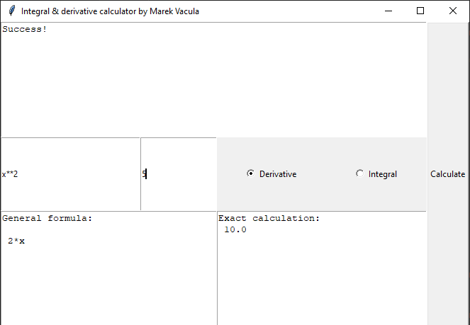
GOal
Symbolic input
Symbolic general and numeric exact output
Derivative in point x0
Definite integral a=>b
Compact GUI

Slide 3
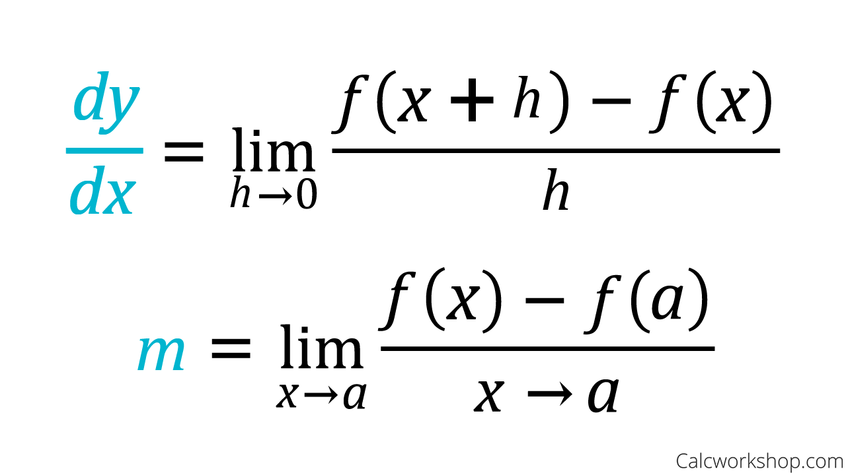
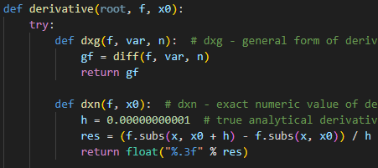
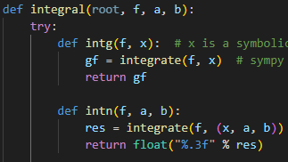


Mathematical principles
Code implementation
Derivative:
Set h to a very small number, since it can’t be 0
Substitute symbolic function into the modified limit formula
Integral:
Not one universal method
Independent calculation for indefinite and definite integral
SymPy integrate() uses various methods:
Antiderivative for integrand - table lookup
Risch-Norman algorithm
Meijer G-functions – general functions as particular cases
Etc.

Slide 4

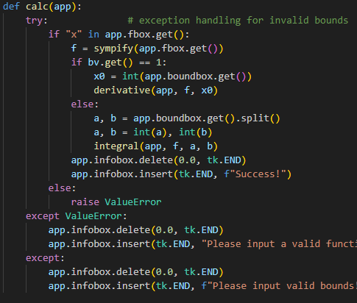
Algorithm
Inside derivative and integral function:
In a nutshell
GUI initialization
Mode selection (2 cases) radio buttons
Function input entry box
Bounds – specific to mode selected entry box
Derivative: 1 integer value
Integral: 2 integer values
separated by space
Calculate push button
Check if function valid inside d/i function
Symbolic notation conversion check
Non-constant function check (“x” in string)
Check if bounds valid for selected modes
If d/i function fully executed - success
Calculate general formula and exact value in d/I
Print formatted output text field
GUI element:
In calculate button’s command function:

Slide 5
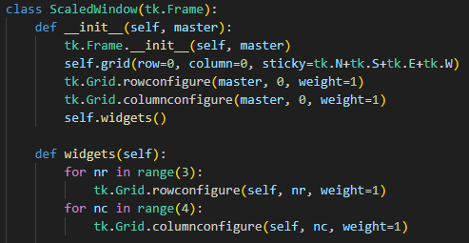

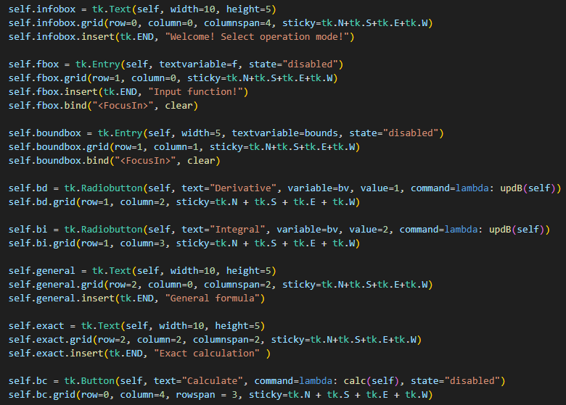
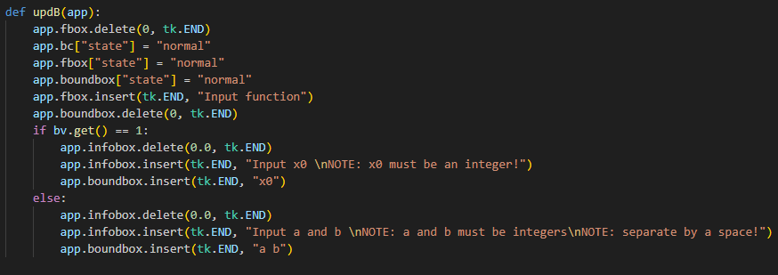
Gui features
Entire GUI is a custom class (OOP)
Scalable window – sticky = N+S+E+W
Creates grid
Creates widgets
Entry boxes
Disabled until mode is selected
Clear on click – bind function
Clear and insert text based on mode
Text fields
Clear and insert text
Radio buttons
Hold value to determine mode and update text fields
Push button – disabled at first
LAMBDA functions
Anonymous function
Short-term and simple
Single expression

Slide 6

assessment
Most difficult
Most interesting
Exceptions - hardest
Weren’t universal for d/i functions
Posed errors that I didn’t manage to trace in code and had to create a different exception for the same thing
I did not manage to make such an exception that would allow input of constant (number-only) functions or multivariable functions without compromising the functionality of code
The code still accepts invalid functions or syntax if it contains “x” as well – did not find a workaround
GUI – moderately difficult
Button callbacks
OOP – make it all a class, keep track of the layout
Figure out the specifics – I spent a lot of time researching individual details (i.e. resizability via sticky, Lambda functions, bind, …)
The math behind it all – I have learnt a lot of new things about methods of integration applicable to both elementary and special functions
SymPy implementation – ability to type in any function
GUI class – all in one place

Slide 7



THANK YOU!
Marek Vacula
246960
246960@vutbr.cz

