Slide 1


IDEA SUBMISSION · ROUND 1
The Gen Z Challenge.
A real product-innovation hackathon — from idea to MVP to startup. This is your one-page pitch for the Innovation Round.
TEAM NAME
COLLEGE
BRANCH · YEAR
Z-Vibers
BVRIT
CSE / 2nd Year
Ideas. Code. Impact.
01 / 07

Slide 2
WHAT CHALLENGE ARE YOU SOLVING?
Problem Statement
INDUSTRY / DOMAIN
Developer Tools / AI-Assisted Coding
PROBLEM DESCRIPTION & CONTEXT
We use Copilot daily. It's fast. But last month, our teammate pushed AI-generated auth logic that looked fine but had a JWT bypass. We caught it in production.
AI assistants write code. They don't critique it. No one checks if it's secure, fast, or well-architected before it hits the repo. So we're shipping faster than ever but the code quality is dropping. We need an AI that argues with itself before we commit.
TARGET CUSTOMERS
Student devs and small teams using Copilot/Cursor who keep shipping buggy AI-generated code.
The Gen Z Challenge
02 / 07

Slide 3
HOW WOULD YOU SOLVE IT?
Solution
1 / 2
YOUR SOLUTION
AgentForge : a coding environment where 6 AI agents review your code like a senior team before you push.
What it does:
You type a feature request
Six agents kick in: Architect, Coder, Security, Performance, Reviewer, Devil's Advocate
They debate in a live "War Room" you can watch
They vote. If Security + Performance reject it, back to Architect
Final code auto-generates a GitHub PR with full debate log
How it solves: Instead of one AI completing code blindly, you get six perspectives attacking it from different angles. Bugs get caught before commit, not in prod.
Key value prop: Ship faster and safer. Learn by watching senior-level AI debates.
The Gen Z Challenge
03 / 07

Slide 4
HOW WOULD YOU SOLVE IT?
Solution
2 / 2
MORE ROOM — OPTIONAL
You ask: "Build a Node.js login with JWT."
Architect designs the API contract
Coder writes the Express handler
Security flags: "No rate limiting. Brute force risk."
Performance adds: "bcrypt at 12 rounds = 300ms. Drop to 10."
Devil's Advocate: "Why JWT? Session cookies are safer."
Reviewer: "Missing validation and tests."
Coder fixes everything. Agents vote again. Consensus reached. PR generated with clean code + tests + full log.
This isn't code completion. It's code assurance.
The Gen Z Challenge
04 / 07

Slide 5
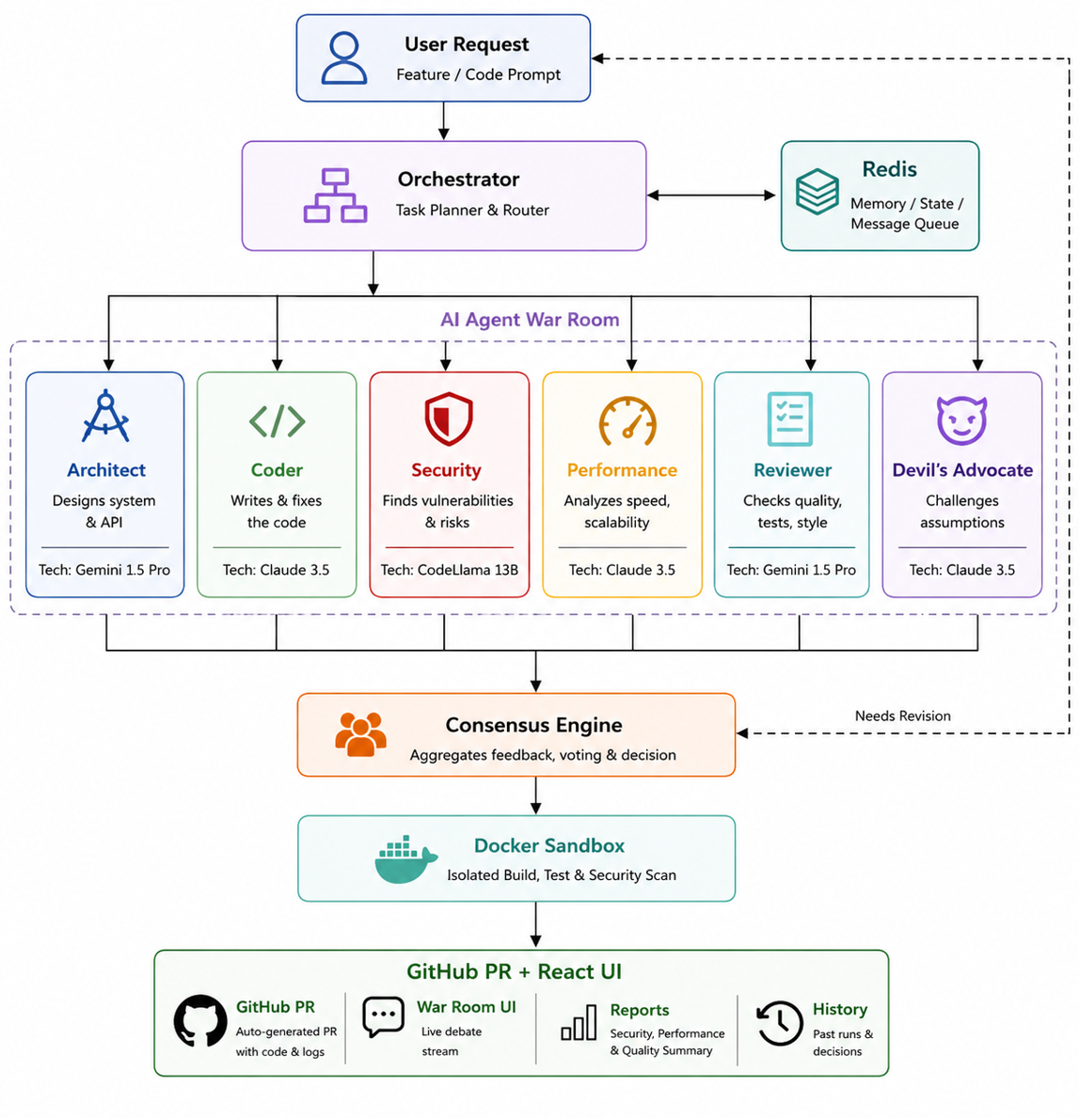
WHAT TECHNOLOGY POWERS IT?
Solution Components
TECHNOLOGY STACK
Layer | Tech
Agent Orchestration | CrewAI + LangGraph
LLMs | Gemini 1.5 Pro (architecture), Claude 3.5 (coding), CodeLlama 13B (security)
Sandbox | Docker for isolated testing
Frontend | React + WebSocket (live War Room)
Analysis | Tree-sitter (AST), custom OWASP engine
Integration | GitHub API for PRs
Backend | FastAPI + PostgreSQL + Redis
KEY ASSUMPTIONS
Users have GitHub repos and grant OAuth PR permissions
LLM costs keep dropping (~$0.50 per full run for 200 lines)
Agent consensus converges in 3-4 voting rounds
Devs prefer watching debates over reading static reports
Target users (students, indie devs) want to learn from agent explanations
Architecture Diagram
The Gen Z Challenge
05 / 07

Slide 6
HOW DO YOU STAND OUT?
Competitive Analysis
Existing Solutions
Gaps & Limitations
Your Differentiation
Current alternatives in the market
What they fail to address
Why your solution wins
AgentForge treats coding as a team sport.
Six agents catch what one misses
Pre-commit assurance, not post-mortem
Live War Room — learn from senior-level debates
GitHub-native — improves your PRs, doesn't replace workflow
Personality agents — "The Paranoid" security agent, "The Speed Demon" performance agent
Copilot asks: "How do I complete this line?" AgentForge asks: "Should we even write it this way?"
Copilot : Inline suggestions. No review, no security check.
Cursor : Chat in IDE. Still one assistant, no benchmarking.
SonarQube : Post-commit analysis. Too late.
CodeWhisperer : AWS-only security scans. No debate or architecture.
Single-assistant tools don't simulate team review
Security tools run after commit damage is done
None explain why in real-time
No tool combines architecture + coding + security + performance + critique in one loop
The Gen Z Challenge
06 / 07

Slide 7
THE GEN Z CHALLENGE
Thank you.
We're three devs who push AI-generated code daily — and we've been burned by it. AgentForge is the tool we wish we had last semester.
We don't want to slow down. We want to speed up confidence.
Ideas. Code. Impact.
07 / 07

