Slide 1

CS517 Digital Image Processing EndTerm Project Image Matching Challenge
Team Members:
Jai Anurag Y
Vaibhav Singla
Dr. Puneet Goyal
Indian Institute of Technology Ropar

Slide 2
References
Research Paper / Project:
ORB: Rublee et al., "ORB: An efficient alternative to SIFT or SURF", ICCV 2011
Dataset Source:
Kaggle: Image Matching Challenge 2025.

Slide 3
Problem Statement
Given two input images, determine whether they depict overlapping views of the same 3D scene or object. The goal is to accurately identify matching image pairs to support robust 3D reconstruction in real-world, diverse image collections
Find reliable keypoint correspondences between two images of the same scene.
Important for applications like 3D reconstruction, visual SLAM, AR, structure-from-motion.
Must work across changes in viewpoint, lighting, and occlusion.

Slide 4
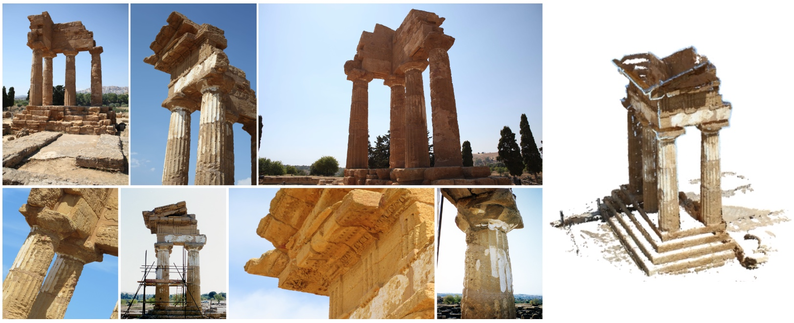
Motivation
Keypoint matching is a core low-level task in many CV pipelines.
Handcrafted descriptors like ORB are lightweight and fast – ideal for real-time use.
The Kaggle challenge simulates real-world complexity with high variation in scenes.

Slide 5

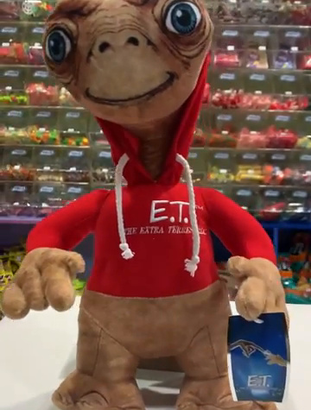
Input Description
Inputs:
Image pairs (.png) from scenes
Camera intrinsics/extrinsics (not used in ORB method)
Fig.: Images of the same object with viewpoint change

Slide 6
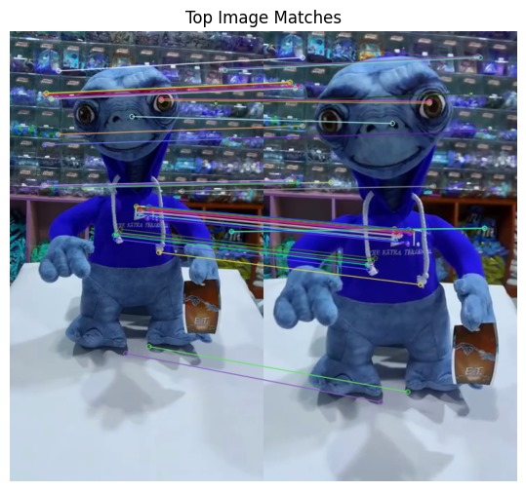
Output Description
Outputs:
Matched keypoints (index pairs)
Visualization of N top matches
Uses OpenCV’s drawMatches() for visualization
Fig.: Result of drawMatches() with lines connecting features

Slide 7
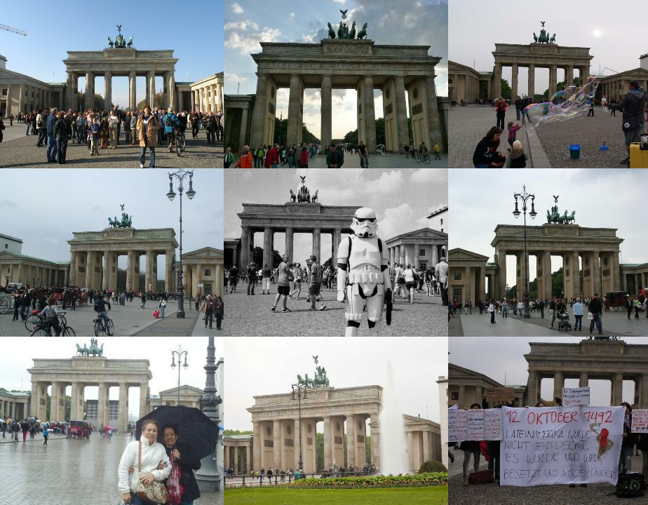
Dataset for Image Matching
The dataset is divided into:
Training Set
Includes labeled images with camera pose information.
Test Set
Contains similar image groups without labels.
Used for evaluation of generalization capability.
Each set contains images from one or more real-world scenes, including possible outlier images.

Slide 8
Dataset for Image Matching
Key Files in the Dataset
train_labels.csv
dataset: Dataset identifier.
scene: Unique scene ID within the dataset.
image: Filename of the image.
rotation matrix: 3×3 camera orientation (flattened).
translation vector: Camera position in 3D space.
dataset/*.png
Raw images grouped by dataset folders.

Slide 9
Dataset for Image Matching
Dataset Challenges
Mixed Scenes: Datasets may contain images from multiple locations.
Outliers: Presence of unrelated images increases complexity.
Generalization: Models must infer scene structure and camera poses without direct labels in the test set

Slide 10
Evaluation Metric Process
The evaluation focuses on two main tasks:
partitioning images from each dataset into clusters representing scenes or outliers
(2) reconstructing camera poses for each image.
Each dataset may contain multiple scenes, and images that do not belong to any scene are treated as outliers. For each image, we must estimate its camera pose, defined by a 3×3 rotation matrix R and a 3D translation vector T.

Slide 11

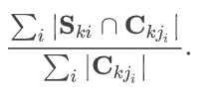
Scoring Metrics – mAA and Clustering Score
The evaluation score combines two components: the mean Average Accuracy (mAA) and the clustering score. The mAA measures how accurately the predicted camera poses match the ground truth. Below C is camera center
The clustering score measures the quality of the image grouping, calculated as the ratio of correctly assigned images in a predicted cluster C to its total size
Overall mAA score and clustering score of a dataset are computed by aggregating the individual values. For the clustering score this is equal to
And analogously for the mAA score

Slide 12

Final Score Computation
Once each predicted cluster is assigned to a ground-truth scene, the mAA and clustering scores are aggregated across all scenes in the dataset. These two scores are then combined using the harmonic mean, producing a final score for each dataset:
The final evaluation score is the average of these combined scores across all datasets,
balancing both pose estimation accuracy and scene clustering quality.

Slide 13
Approaches Used

Slide 14
Pipeline Summary and Architecture
Load two images
Extract ORB features
Match descriptors using BFM
Visualise top matches
Clustering with DBSCAN

Slide 15
Feature Extraction using ORB
Feature detection and description are performed using the Oriented FAST and Rotated BRIEF (ORB) algorithm, chosen for its speed and rotation invariance. ORB detects keypoints and computes binary descriptors for each image:
ORBfeatures = ORB create(n = 1000)
Keypoints and descriptors are obtained using orb.detectAndCompute(image, None), which provides a compact representation of salient regions in the image.

Slide 16
Image Matching using Brute-Force Matcher
Pairwise image matching is performed using the Brute-Force matcher with Hamming distance metric, suitable for binary descriptors:
matches = BFMatcher(cv2.NORM HAMMING, crossCheck=True).match(des1, des2)
The matches are then sorted by descriptor distance, and top-N matches are visualized using cv2.drawMatches() to validate visual correspondence. This step aids in detecting strong visual overlaps between image pairs, which serves as a proxy for scene similarity.

Slide 17
Scene Similarity Analysis
To evaluate which images belong to the same scene, the similarity between images is inferred from the number and quality of feature matches. A higher number of consistent matches indicates higher likelihood of shared scene content

Slide 18
Clustering with DBSCAN
To group images into scenes, the density-based spatial clustering algorithm DBSCAN is employed. Since the direct feature vectors are not used for clustering due to their high dimensionality, a similarity matrix or derived spatial descriptors can be constructed and passed to DBSCAN. The algorithm groups images that exhibit high mutual feature correspondence and flags outliers that fail to match consistently:
DBSCAN(ε, minPts) → Clusters + Outliers
DBSCAN is well-suited to this task as it does not require the number of clusters in advance and can effectively handle noise and outliers.

Slide 19
Pose Estimation (Planned)
Although the current implementation does not include pose estimation, the overall pipeline is structured to integrate camera pose recovery using Structure-from-Motion (SfM) techniques in future iterations. Once scene-level grouping is stable, pose estimation can be applied independently per cluster.

Slide 20
Evaluation Alignment
The pipeline is aligned with the competition’s evaluation strategy. Matching and clustering aim to maximize both mean Average Accuracy (mAA) and clustering score by ensuring correct image-to-scene assignment while maintaining high internal coherence within clusters.

Slide 21
Visualization and Validation
Matched keypoints between pairs of images are visualized using matplotlib and OpenCV, enabling qualitative validation of matching accuracy and scene consistency. This step is critical for identifying poor-quality matches or scenes with visual ambiguity.
This modular pipeline offers flexibility in experimenting with different feature extractors (e.g., SIFT, SuperPoint), matching strategies (e.g., FLANN), and clustering techniques (e.g., Agglomerative Clustering), facilitating iterative improvements in both grouping accuracy and geometric reconstruction.

Slide 22
INBUILT functions used

Slide 23
cv2.ORB create(nfeatures=1000)
ORB (Oriented FAST and Rotated BRIEF) is a fast and efficient feature detector and descriptor that combines the strengths of two techniques:
• FAST (Features from Accelerated Segment Test) is used to detect keypoints quickly. It detects corners in the image by comparing the brightness of a pixel with its surrounding pixels arranged in a circle. If a set of contiguous pixels are significantly brighter or darker, the pixel is marked as a corner.
• BRIEF (Binary Robust Independent Elementary Features) is used to compute descriptors for the detected keypoints. BRIEF produces binary strings by comparing pixel intensities within a local image patch, making it extremely compact and fast for matching

Slide 24
cv2.ORB create(nfeatures=1000)
ORB enhances BRIEF by adding rotation invariance and orientation compensation. It also uses the Harris corner measure to rank keypoints and selects the top n features based on response strength, where nfeatures=1000 specifies the maximum number of features to retain.
Working:
• Internally, ORB detects keypoints using FAST, then computes orientation based on image moments.
• The descriptors are generated using BRIEF after aligning them based on the orientation.
• The result is a set of keypoints and corresponding binary descriptors that are compact and rotation invariant.
This makes ORB a practical alternative to SIFT and SURF, especially when computational efficiency and licensing (ORB is free and open-source) are critical.

Slide 25
cv2.BFMatcher(cv2.NORM HAMMING, crossCheck=True)
BFMatcher stands for Brute-Force Matcher, a matching algorithm that compares each descriptor from one set with every descriptor from another set to find the best matches based on a distance metric.
In the context of ORB, the descriptors are binary (consisting of 0s and 1s), so the appropriate distance metric is cv2.NORM HAMMING, which computes the Hamming distance between two binary strings — the number of differing bits.
The parameter crossCheck=True enforces a two-way match condition: a descriptor Ai from image A must find Bj in image B as its best match, and Bj must also return Ai as its best match in reverse. This bidirectional constraint improves the reliability of the matches by filtering out asymmetric and spurious correspondences.

Slide 26
cv2.BFMatcher(cv2.NORM HAMMING, crossCheck=True)
Working:
• For every descriptor in the first image, it finds the closest descriptor in the second image (based on Hamming distance).
• If crossCheck=True, only mutual best matches are retained, reducing false positives.
• The returned matches are typically sorted by distance (shorter distances imply better matches)
Using BFMatcher with crossCheck=True ensures that the resulting matches are highly reliable, which is essential for constructing accurate image similarity graphs and clustering scenes effectively.
Together, these functions form the backbone of the image correspondence pipeline by providing robust keypoints and reliable pairwise matches — critical for solving the two-part problem of image grouping and 3D pose estimation in the challenge.

Slide 27
RESULTS

Slide 28
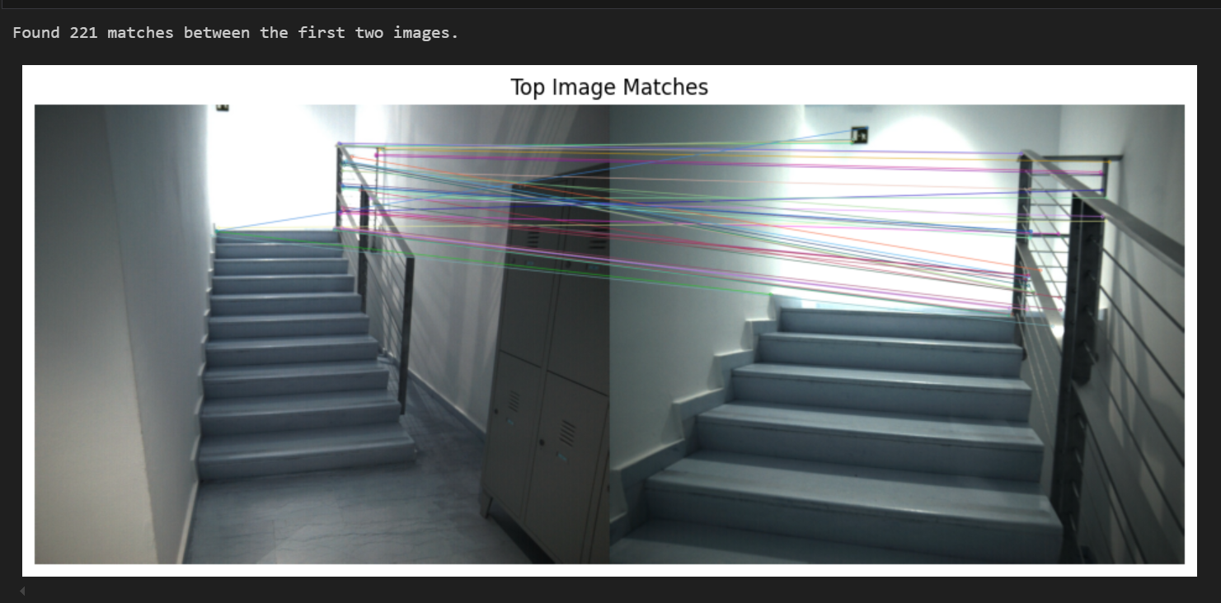
INDOOR TEST 1

Slide 29
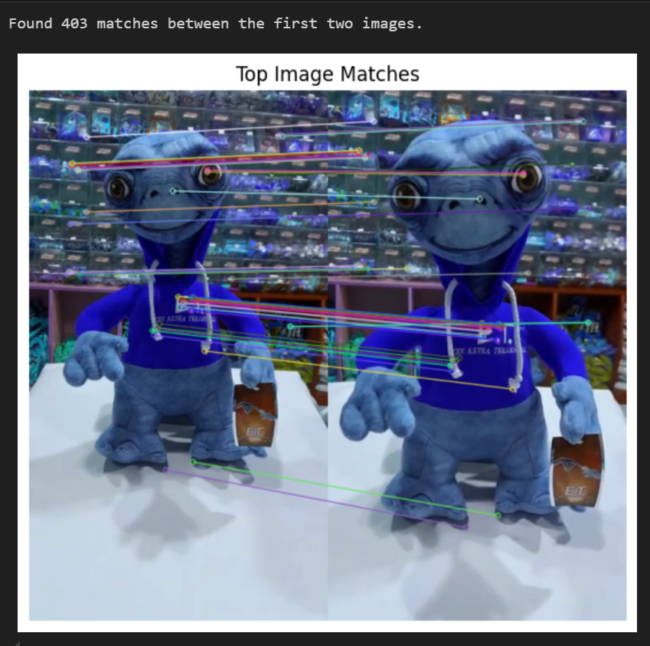
ARTIFICIAL LIGHT TEST 2

Slide 30
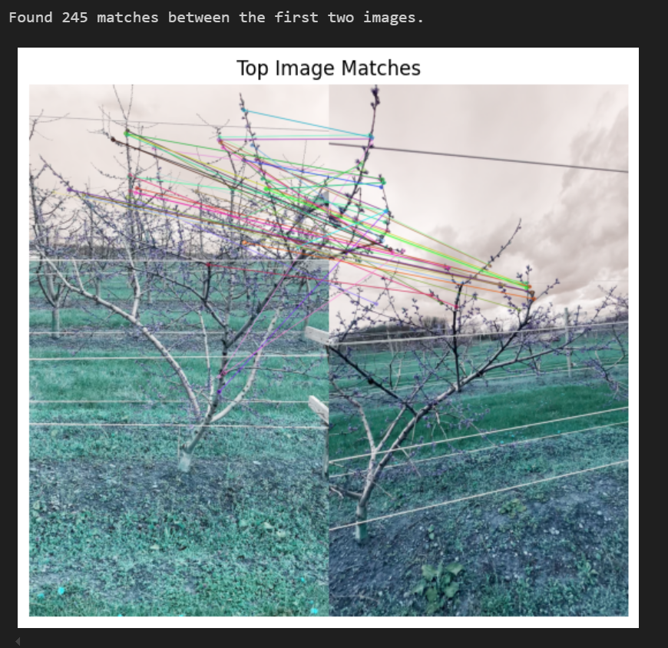
NATURAL LIGHT TEST 3

Slide 31
CODE SNIPPETS

Slide 32
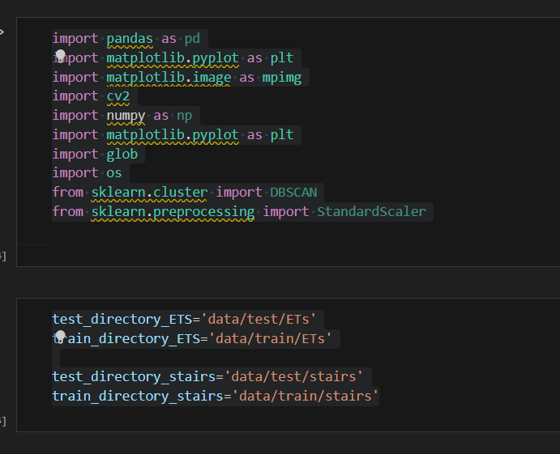
Library Imports & Directory Setup
Purpose: Set up the environment by importing required libraries and defining dataset paths for processing and analysis. Key Points:
pandas, numpy: Data manipulation and numerical computation.
matplotlib.pyplot, matplotlib.image: Visualization and image plotting.
cv2: OpenCV library for image processing (ORB feature extraction, matching).
glob, os: File system navigation and path handling.
sklearn.cluster.DBSCAN: Clustering algorithm for grouping matched features.
sklearn.preprocessing.StandardScaler: Feature normalization before clustering.
Dataset Paths Defined:
ETS and stairs image datasets are split into training and test sets.
Four variables store directory paths:
test_directory_ETS, train_directory_ETS
test_directory_stairs, train_directory_stairs

Slide 33
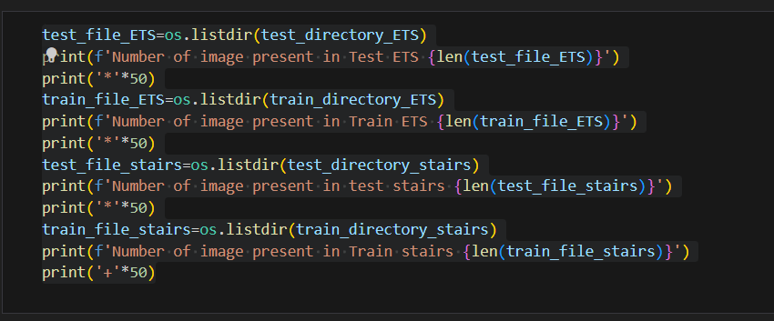
Dataset Image Count Logging
Purpose: Verify the number of images available in each dataset directory for both classes (ETS, stairs) and splits (train, test).
Key Points:
os.listdir(path): Lists all image files in the specified directory.
len(...): Calculates the total number of images in each folder.
print(...): Outputs counts to ensure data availability and balance.
Output:
Helps confirm dataset integrity before proceeding to feature extraction or training steps.

Slide 34
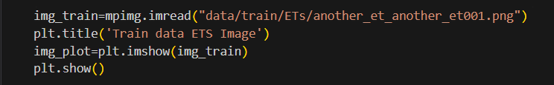
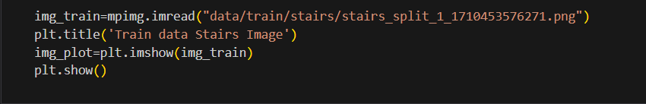
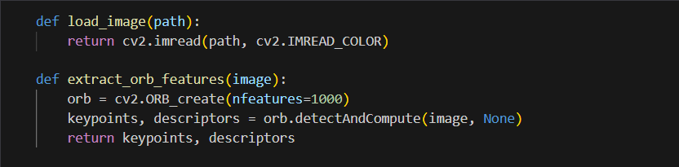
Image Loading & ORB Feature Extraction
Purpose: Load sample images and extract ORB features to prepare for feature-based matching and analysis.
Key Points:
Image Visualization:
mpimg.imread(...): Loads image using matplotlib for visualization.
plt.imshow(...): Displays the loaded image for visual verification.
Used for ETS and Stairs training examples.
Image Loading for Processing:
cv2.imread(path, cv2.IMREAD_COLOR): Loads images in color for further processing using OpenCV.
ORB Feature Extraction:
cv2.ORB_create(nfeatures=1000): Initializes ORB detector with up to 1000 keypoints.
orb.detectAndCompute(...): Detects keypoints and computes binary descriptors.
Output: Keypoints and descriptors essential for image matching and similarity evaluation.

Slide 35
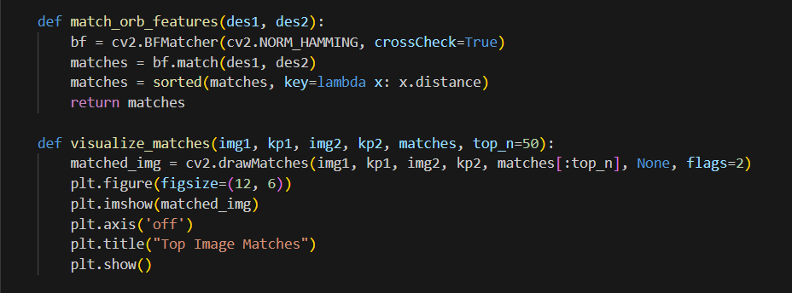
ORB Feature Matching & Visualization
Purpose: Match ORB descriptors between images and visualize the most relevant matches.
Key Points:
Feature Matching (match_orb_features):
Uses cv2.BFMatcher with cv2.NORM_HAMMING for binary descriptor matching.
crossCheck=True: Ensures mutual best matches, increasing accuracy.
Matches are sorted by distance (match quality).
Match Visualization (visualize_matches):
cv2.drawMatches(...): Draws lines between matching keypoints.
top_n=50: Displays the top 50 matches by distance.
matplotlib.pyplot: Used for clear visual representation.
Output: Enables visual inspection of keypoint correspondences to validate feature similarity between image pairs.

Slide 36
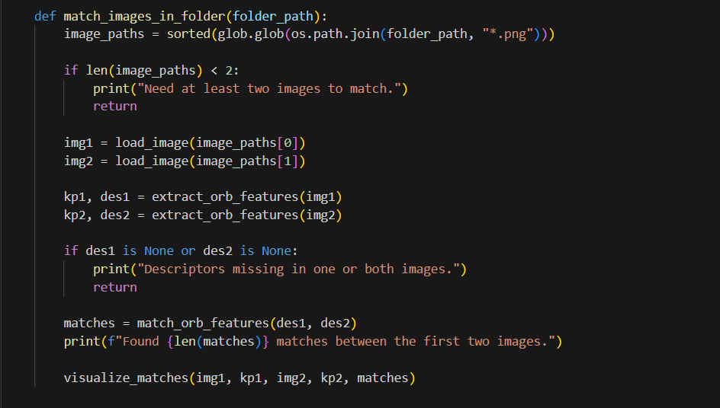
ORB Matching Across Image Folder
Purpose: Automate feature extraction and matching between the first two images in a folder.
Key Points:
Image Collection:
glob.glob(...): Retrieves .png files from the folder.
sorted(...): Ensures consistent order of image pairs.
Validation:
Checks for minimum 2 images.
Skips matching if ORB descriptors are missing.
Process Flow:
Load first two images.
Extract ORB keypoints and descriptors.
Match features using Hamming distance.
Visualize top matches.
Output:
Prints number of matches.
Displays matching keypoints visually for manual inspection.

Slide 37



Function Execution on Image Folders
Purpose: Run ORB-based matching pipeline on different image datasets to evaluate similarity and structure.
Key Points:
Function Used: match_images_in_folder(<folder_path>)
Executed On:
'data/test/stairs/' → Tests image similarity in the stairs test set.
'data/test/ETs/' → Tests feature consistency in the ETs test set.
'data/train/amy_gardens/' → Tests generalization on a different training subset.
Outcome:
Displays top ORB matches between the first two images in each directory.
Helps visually verify spatial and structural similarity across same-class images.

Slide 38
Key Challenges
Sensitive to noise or texture less regions.
Works less effectively under extreme transformations
No use of geometric verification (like RANSAC) in current pipeline

Slide 39
Alternative Methods
Classical Feature Matching Use keypoint detectors like SIFT or ORB to match features between images. Simple and effective but
less robust to viewpoint or lighting changes.
Deep Learning-Based Matchers Models like SuperPoint + SuperGlue offer more accurate matching by combining learned keypoints with context
aware matching.
Image Embedding & Clustering Use models like CLIP or DINO to convert images into embeddings, then cluster them based on similarity. Fast for
large-scale grouping.
Graph-Based Methods Build a graph where images are nodes and similarities are edges. Use clustering algorithms to identify
scene groups.

Slide 40
Contribution
Jai Anurag Y and Vaibhav Singla Both equal contribution

Slide 41
Thank you

