Slide 1

A crew desk advisor
that never guesses
The model plans and explains. Deterministic code computes. A guard checks every figure against what the tools returned.
extroc-jpkcqxtlma-uc.a.run.app
dCortex, Agentic Crew Ops Advisor

Slide 2
THE PROBLEM
The bottleneck is not detecting that something broke
It is reasoning correctly, and fast, about what follows. A sick call at 05:00 breaks a pairing, strands downstream legs, and every fix creates the next problem.
Fragmented
Consequence blind
Exact, not approximate
One answer spans rosters, duty clocks, schedules, reserves, qualifications and the rulebook.
The broken flight is obvious. The four that break next are not.
Legality is arithmetic against a rulebook. An approximate answer is a violation.
Today that reasoning lives in one experienced controller's head. It degrades exactly when it matters most.
2

Slide 3
THE QUESTION ACTUALLY BEING ASKED
What should the language model do, what should deterministic code do, and how do you compose them into a system that is both conversational and correct?
Put the data in the prompt and let the model answer, and Tier 1 works. Tier 2 and Tier 3 fail. A model that approximates a duty hour calculation produces answers that are fluent, confident and wrong.
Operationally, that is worse than no answer.
3

Slide 4
OUR ANSWER
The model plans and explains.
It never produces a fact.
THE MODEL MAY
ONLY CODE MAY
• Decide which tools to call, with what arguments, in what order
• Decide when it has enough, and when it must decline
• Phrase the result for someone with a radio in one hand
• Compute any number, and show the arithmetic that produced it
• Decide that an assignment is legal or illegal
• Verify the drafted answer before a controller sees it
A turn crosses that boundary four times. The next slide is the shape of it.
4

Slide 5
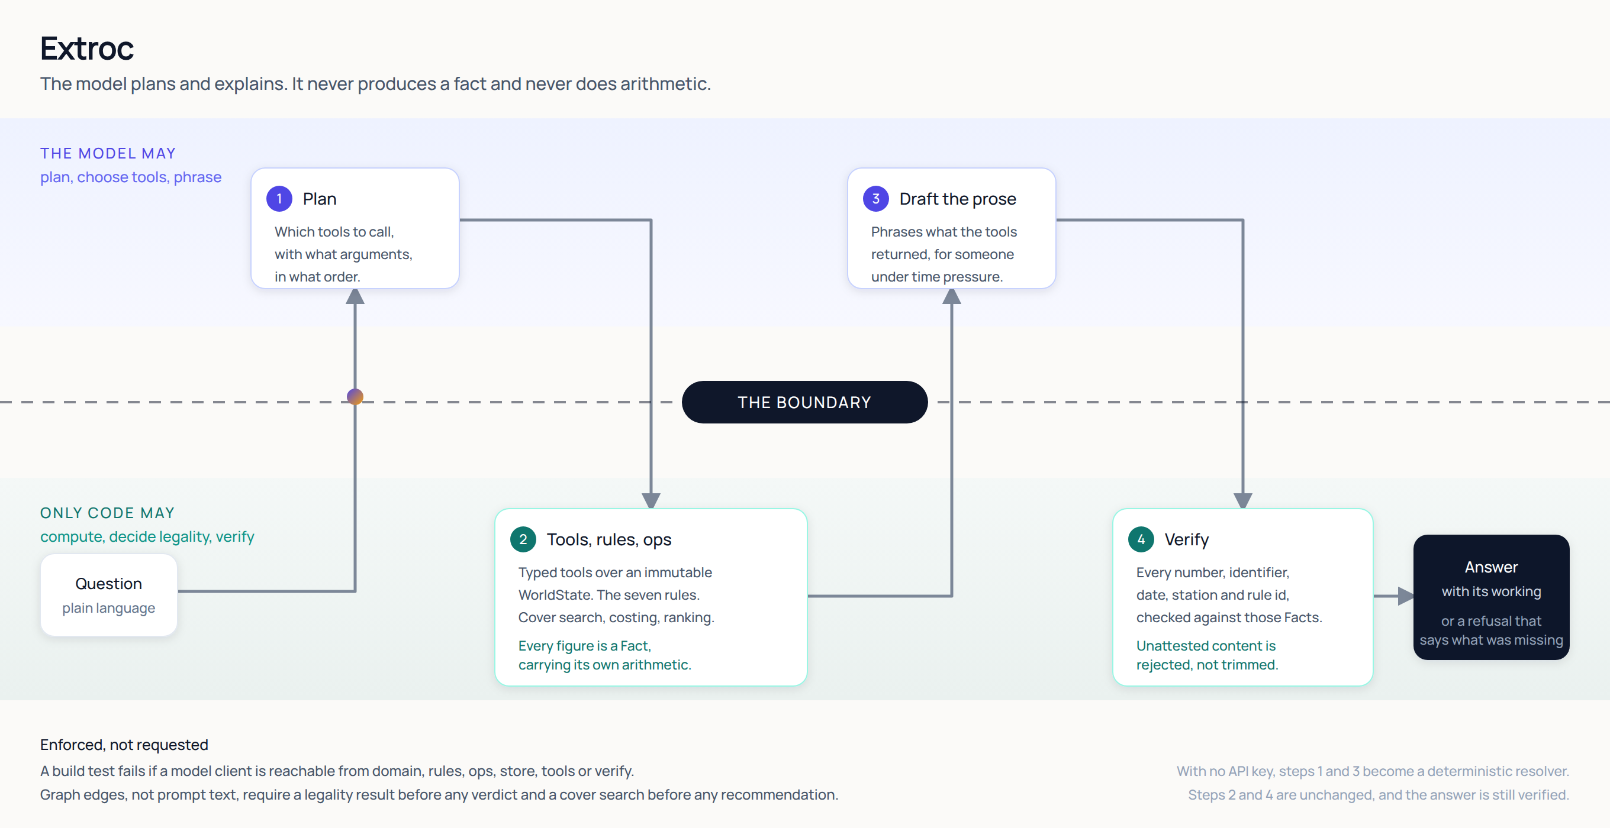
ARCHITECTURE
5

Slide 6
WHY IT HOLDS
Enforced, not requested
A guarantee written into a prompt is a request. These are the three places the boundary is actually held.
MECHANISM | WHAT IT STOPS
A build test walks the import graph of domain, rules, ops, store, tools and verify, and fails if a model client is reachable | Arithmetic drifting into the model's half
The verifier rejects any atom in the prose that no tool emitted as a Fact this turn | The model stating a plausible number nobody computed
Graph edges require a legality result before any verdict, and a cover search before any recommendation | The model inferring a verdict from context
The third matters most. A guarantee written as a graph edge is a guarantee.
6

Slide 7
EXPLAINABILITY
Every figure carries its own working
Fact(
key="C-2087.duty_7d.projected",
value=61.33,
unit="hours",
provenance=COMPUTED,
source="crewops.rules.duty.window",
derivation="51.83h prior + 9.50h from
P-2291 = 61.33h against a 60.00h
limit, over by 1.33h",
)
derivation is the point. A controller about to move a crew member and sign their name to it does not want to be told the answer. They want to check it and argue with it.
It is also what makes the verifier possible. If a number can appear in an answer, a tool must have emitted a Fact for it.
When verification fails, the fix is to add the missing fact to the tool. It is never to relax the check.
7

Slide 8
MEASURED
44 cases: 38 shipped questions, 6 worked scenarios
Tier | Cases | Correct | Abstained | Wrong | Accuracy when answered
Tier 1, lookup | 16 | 15 | 1 | 0 | 100%
Tier 2, consequence | 14 | 10 | 4 | 0 | 100%
Tier 3, recommendation | 14 | 10 | 4 | 0 | 100%
Overall | 44 | 35 | 9 | 0 | 100%
0
35
122ms
wrong answers, and no verdict inversions
of 44 answers passed grounding verification
p95 on the deterministic path
Reproduce with make eval. Deterministic path, which runs with no API key.
8

Slide 9
THE DESIGN CHOICE WE WOULD DEFEND HARDEST
Abstention is a feature, and it is scored as one
The evaluation harness counts abstentions separately from wrong answers and never treats one as a failure. A grader that scored refusal as failure would push the system toward confident guessing, which is the exact failure mode the brief warns about.
CORRECT OUTCOME
NEVER ACCEPTABLE
"I cannot answer that reliably." Then: what was missing, what was established anyway, and three questions that would work instead.
A fluent, confident figure nobody computed. The verifier rejects it rather than trimming it, so it cannot reach the screen.
9 of 44 cases abstained. Every one of them declined honestly rather than guessing.
9

Slide 10
BEYOND THE BRIEF
Voice is a peripheral, not a second brain
Speech in becomes a transcript. The transcript goes to the same endpoint, through the same tools, the same seven rules and the same verifier. Speech out reads prose the verifier has already passed.
• Nothing under agent/voice/ imports a model client. No speech provider ever sees the dataset.
• A draft that fails verification is never spoken: the selector returns nothing at all unless the reply is verified or repaired.
• Hands free, it reads the verified headline first and offers the detail, so a controller can keep their hands on the desk.
Also shipped: proactive alerting, multi turn memory, drafted crew notifications, chained disruptions.
10

Slide 11
HONEST LIMITS
What breaks, and how badly
Every failure is graded safe or unsafe. A safe failure declines. An unsafe failure answers wrongly. We treat the second as a different class of problem.
• Agent mode is not reproducible. Three identical passes scored 16, 15 and 16. We quote a range, never a single number.
• Nine cases abstain that a stronger router would answer. Each is a routing gap, not a reasoning error.
• The eighth rule problem. Answer keys exclude candidates for reasons the rulebook does not cover, most importantly double booking. Modelling it as a RULE- id would misrepresent the rulebook, so it is carried as an operational feasibility issue instead: blocking, but honestly labelled.
• Grounding is per atom, not per claim. It catches an invented figure. It would not catch a correctly quoted figure used in a wrong sentence.
Full analysis, failure by failure, in docs/FAILURE-ANALYSIS.md
11

Slide 12
IF THIS WERE REAL
Impact
Scale
Crew PII
The work is the cross referencing, not the decision. Collapsing that from minutes to seconds is the value, and the ranked options make the decision reviewable afterwards.
WorldState is loaded once and immutable, with a SQLite projection for lookups. The rules engine is pure arithmetic over typed records, so it scales with crew count, not with prompt size.
The model never needs identity. It plans over ids and receives Facts. Names can stay behind the tool boundary and be joined at render time, so PII need never enter a prompt.
Reasoning and arithmetic behind each of these in docs/PRODUCTION.md
12

Slide 13
LIVE
Ask it something it cannot answer
That is the demo we would run first. A system that says "I cannot answer that reliably, and here is what was missing" is the one worth having at 06:00 on a bad day.
extroc-jpkcqxtlma-uc.a.run.app
Runs with no API key. The deterministic path answers through the same tools, rules and verifier.
13

