Slide 1

Presenting Authors
B. Akhil Anand (22BCE3639)
Jai Aditya (22BCE2004)
Shagun (21BCE0873)
AI Driven Waste Management in Jaipur’s Tourism Sector
Problem Statement
Jaipur produces large and unpredictable amounts of municipal waste.
Current systems fail to factor in tourism, events, and climate changes.
Problem Solution
An AI-based model predicts waste generation using enhanced datasets.
It enables smarter planning by analyzing tourism, weather, and time trends.
Mentor
Swarnalatha P
Professor Grade 1
School of Computer Science and Engineering

Slide 2

AI Driven Waste Management in Jaipur’s Tourism Sector
Presenting Authors
B. Akhil Anand (22BCE3639)
Jai Aditya (22BCE2004)
Shagun (21BCE0873)
Problem Statement
Jaipur produces large and unpredictable amounts of municipal waste.
Current systems fail to factor in tourism, events, and climate changes.
Problem Solution
An AI-based model predicts waste generation using enhanced datasets.
It enables smarter planning by analyzing tourism, weather, and time trends.
Mentor
Swarnalatha P
Professor Grade 1
School of Computer Science and Engineering

Slide 3
AI Driven Waste Management in Jaipur’s Tourism Sector
Gaps in Current System & AI’s Role
Reactive, Not Proactive
Current system fails to anticipate tourist influx (15k +/- 3k daily visitors) or festival spikes.
Static Routes: Collection trucks follow fixed schedules - 30% fuel waste.
Method-1
Predictive Analysis
Data Blindness
No real-time monitoring - 45.16% variation in per capita waste/day across seasons.
Manual data logging - Delays in resource allocation.
Problem Statement
Jaipur produces large and unpredictable amounts of municipal waste.
Current systems fail to factor in tourism, events, and climate changes.
Problem Solution
An AI-based model predicts waste generation using enhanced datasets.
It enables smarter planning by analyzing tourism, weather, and time trends.
Method-2
Dynamic Routing
Policy Paralysis
EPR Absence: Unlike Tunisia’s ECO-Lef, Jaipur lacks producer accountability for packaging waste.
IoT Lag: Smart bins (e.g., capacitance sensors) are absent, unlike Chennai’s pilot 90.
Predictive Waste Forecasting
Model: Ensemble AI (XGBoost + Random Forest) trained on,
Tourism data (15k +/- 3k daily visitors, +/- 35% seasonal variance).
Weather patterns (monsoon gamma distributions, 45% moisture swings).
Festival calendars (Diwali 1.8x waste spikes).
Output: 30-day waste generation forecasts with <10% MAE.
Dynamic Route Optimization
IoT Integration: Smart bins with ultrasonic/capacitance sensors (like Chennai’s pilot, IOT-Enabled-Smart-Bin).
AI Action: Real-time route adjustments via fog nodes (Paper 1’s 2-ST framework) - 30% fuel savings.

Slide 4
Gaps in Current System & AI’s Role
AI Driven Solution
Predictive Waste Forecasting
Model: Ensemble AI (XGBoost + Random Forest) trained on,
Tourism data (15k +/- 3k daily visitors, +/- 35% seasonal variance).
Weather patterns (monsoon gamma distributions, 45% moisture swings).
Festival calendars (Diwali 1.8x waste spikes).
Output: 30-day waste generation forecasts with <10% MAE.
Research Overview & Data Synthesis
Reactive, Not Proactive
Current system fails to anticipate tourist influx (15k±3k daily visitors) or festival spikes.
Static Routes: Collection trucks follow fixed schedules - 30% fuel waste.
Method-1
Predictive Analysis
Data Foundation
Combined municipal records (Jaipur Municipal Corporation 2019-2022) withRajasthan tourism statistics.
Synthetic data addressed gaps while preserving real-world patterns.
Data Blindness
No real-time monitoring - 45.16% variation in per capita waste/day across seasons.
Manual data logging - Delays in resource allocation.
Dynamic Route Optimization
IoT Integration: Smart bins with ultrasonic/capacitance sensors (like Chennai’s pilot, IOT-Enabled-Smart-Bin).
AI Action: Real-time route adjustments via fog nodes (Paper 1’s 2-ST framework) - 30% fuel savings.
Key Data Transformations
Tourism Adjustments: Modeled 15,000 +/- 3,000 daily domestic tourists (winter peaks).
Climate Modifiers: +0.2% waste/°C >30°C (food spoilage).
Monsoon rainfall scaled via gamma distribution.
Festival Multipliers: Diwali (1.8x), Holi (1.6x), weekly markets (1.15x).
Method-2
Dynamic Routing
Policy Paralysis
EPR Absence: Unlike Tunisia’s ECO-Lef, Jaipur lacks producer accountability for packaging waste.
IoT Lag: Smart bins (e.g., capacitance sensors) are absent, unlike Chennai’s pilot 90.

Slide 5
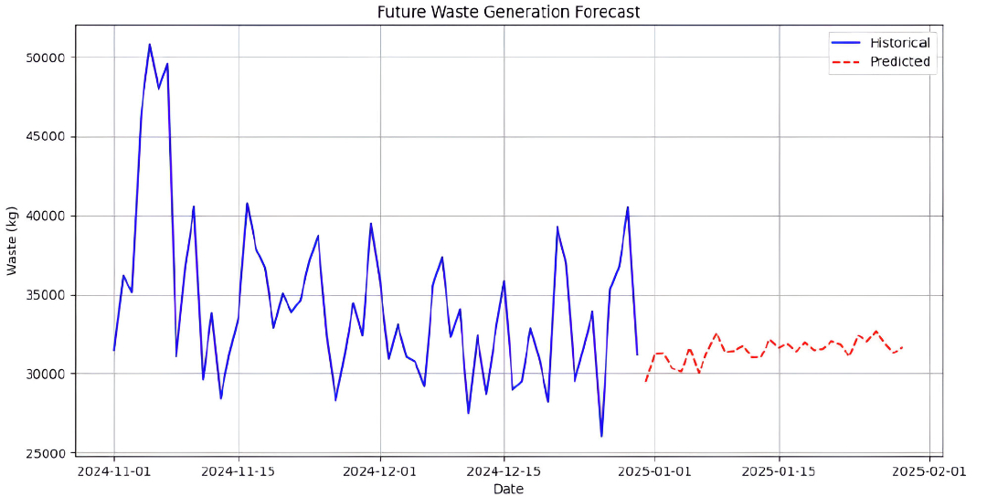
Research Overview & Data Synthesis
Outcomes
Data Foundation
Combined municipal records (Jaipur Municipal Corporation 2019-2022) withRajasthan tourism statistics.
Synthetic data addressed gaps while preserving real-world patterns.
Key Data Transformations
Tourism Adjustments: Modeled 15,000 +/- 3,000 daily domestic tourists (winter peaks).
Climate Modifiers: +0.2% waste/°C >30°C (food spoilage).
Monsoon rainfall scaled via gamma distribution.
Festival Multipliers: Diwali (1.8x), Holi (1.6x), weekly markets (1.15x).

Slide 6
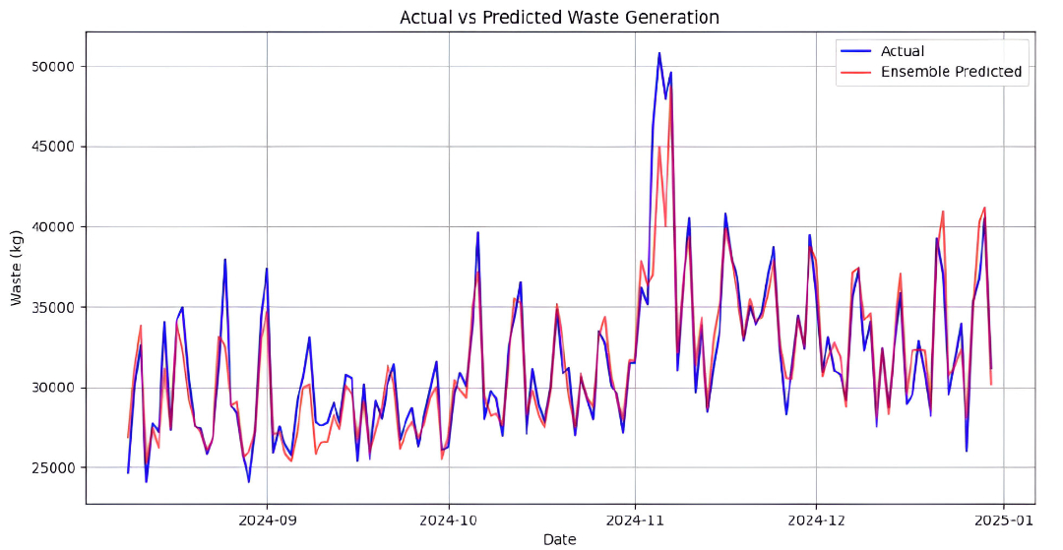
Outcomes

Slide 7
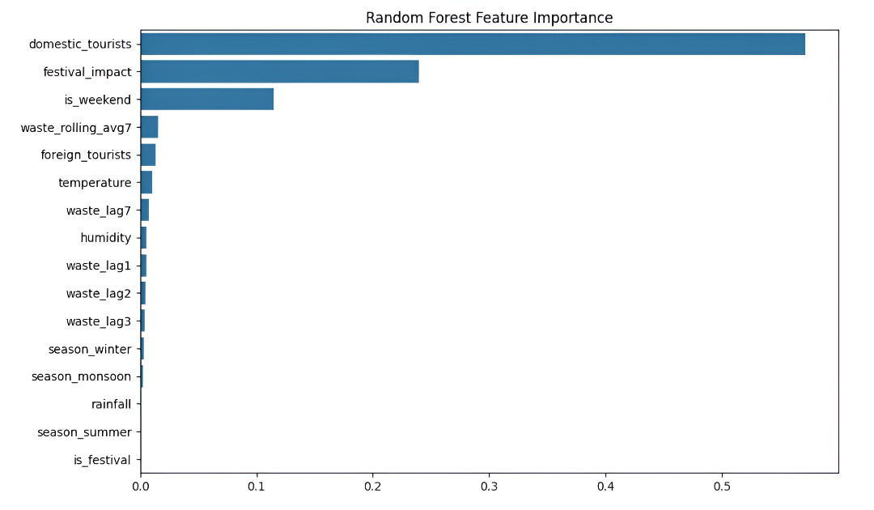

Slide 8
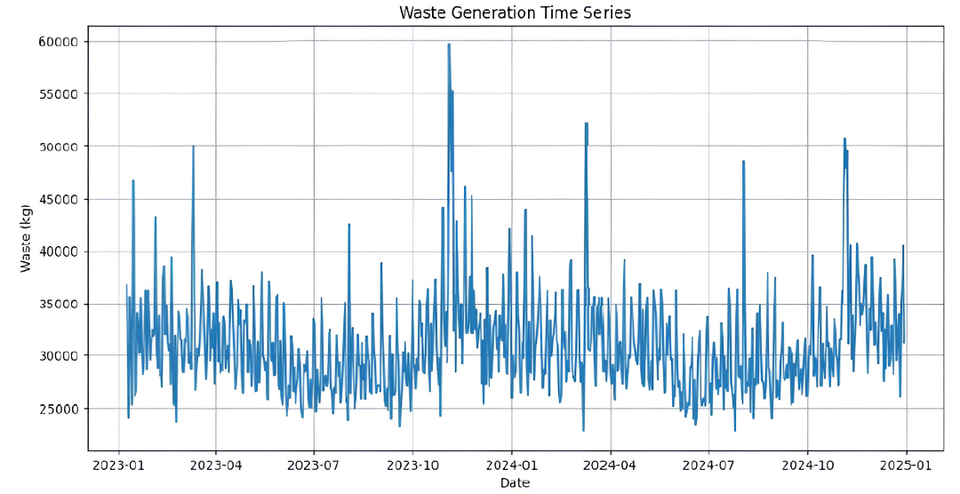

Slide 9
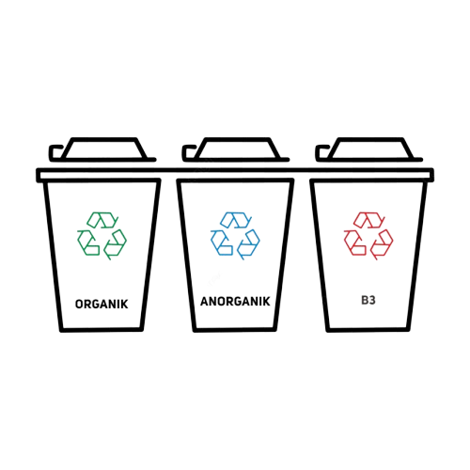

Slide 10
Results
Performance Metrics
Ensemble: RMSE 1,723 kg, MAE 1,154 kg (10.1% festival error).
Diwali predictions: <11% error despite 1.8x waste spikes.
Key Findings
Monsoon >20mm rainfall → 13.2% collection efficiency drop.
Weekend waste volumes exceed weekdays by 15-18%.
Forecast Applications
30-day projections: Baseline 29,488–30,136 kg/day; New Year’s
peak 31,656 kg.
Protocols: Pre-position compactors (Diwali), +25% monsoon
capacity.

Slide 11
Table: Cost-Benefit Analysis of
AI vs. Manual Systems
Metric | AI-Driven System | Manual System | Savings/Improvement
Collection Efficiency | Dynamic routes | Fixed schedules | 30% fewer truck trips
Fuel Costs | Optimized routes reduce mileage | Static routes | $12,000/month saved
Labor Costs | 50% fewer manual sorters (AI sorting) | Full manual workforce | $8,000/month saved
Recycling Rate | 40% (AI-powered sorting) | 25% (current) | 15% increase
Overflow Incidents | Predictive alerts prevent 90% of cases | Reactive cleanup | 75% reduction
Illegal Dumping Fines | 28% faster detection | Rarely enforced | $5,000/month revenue
Total Annual Savings |  |  | $300,000+

Slide 12
Table: Cost-Benefit Analysis of
AI vs. Manual Systems
Future Work
IoT-Enabled Smart Waste Bin for Efficient Waste Management in Metropolitan Cities
Metric | AI-Driven System | Manual System | Savings/Improvement
Collection Efficiency | Dynamic routes | Fixed schedules | 30% fewer truck trips
Fuel Costs | Optimized routes reduce mileage | Static routes | $12,000/month saved
Labor Costs | 50% fewer manual sorters (AI sorting) | Full manual workforce | $8,000/month saved
Recycling Rate | 40% (AI-powered sorting) | 25% (current) | 15% increase
Overflow Incidents | Predictive alerts prevent 90% of cases | Reactive cleanup | 75% reduction
Illegal Dumping Fines | 28% faster detection | Rarely enforced | $5,000/month revenue
Total Annual Savings |  |  | $300,000+
Innovative Solution
Smart Bin Design
Sensors: Dual ultrasonic sensors (for waste level and motion detection) and parallel plate capacitance
sensors (for accurate waste level measurement).
Automation: Servo motor for automated lid opening/closing when a person is detected nearby.
Connectivity: NodeMCU ESP8266 for real-time data transmission to a cloud-based monitoring system via
UDP protocol.
Technical Advancements
Capacitance-Based Detection Overcomes limitations of ultrasonic sensors (e.g., errors during lid movement) by
measuring dielectric changes in waste materials (e.g., plastic, paper).
Cloud Integration Bins transmit data (ID, location, fill level, battery status) to a central server, enabling alerts for
municipal workers via a mobile app (e.g., Blynk).

Slide 13

IoT-Enabled Smart Waste Bin for Efficient Waste Management in Metropolitan Cities
Future Work
Proposed System Scalability
Outdoor: Networked bins with GPS/GSM modules for optimized waste collection routes.
Indoor (Future Work): Mobile robotic bins that self-navigate to dumpsters, enhancing efficiency in smart buildings.
Results
Experimental validation: capacitance changes (4.6 pF for plastic, 2.2 pF for paper) correlating to fill levels.
Real-time monitoring: Traffic-light alerts (red = full, yellow = 50%, green = 25%).
Innovative Solution
Smart Bin Design
Sensors: Dual ultrasonic sensors (for waste level and motion detection) and parallel plate capacitance
sensors (for accurate waste level measurement).
Automation: Servo motor for automated lid opening/closing when a person is detected nearby.
Connectivity: NodeMCU ESP8266 for real-time data transmission to a cloud-based monitoring system via
UDP protocol.
Technical Advancements
Capacitance-Based Detection Overcomes limitations of ultrasonic sensors (e.g., errors during lid movement) by
measuring dielectric changes in waste materials (e.g., plastic, paper).
Cloud Integration Bins transmit data (ID, location, fill level, battery status) to a central server, enabling alerts for
municipal workers via a mobile app (e.g., Blynk).

Slide 14
Pathways to Sustainable Waste Management in Indian Smart Cities
Objective
Develop integrated solid waste management (SWM) systems aligned with India’s Smart Cities Mission and Clean India Mission to address urbanization challenges.
Key Findings
Current Challenges
Per capita waste: 0.47–0.97 kg/day (60% organic).
Mixed waste collection (60% segregation failure).
Open dumping dominates (e.g., Ghazipur, Pirana).
Innovative Strategies
Source segregation Twin-bin systems (biodegradable/non-biodegradable).
Technology IoT, GPS tracking, and waste-to-energy plants (e.g., NDMC’s 3 operational incineration plants).
Circular economy Public-private partnerships (PPP) for composting/MRF facilities.
Proposed System Scalability
Outdoor: Networked bins with GPS/GSM modules for optimized waste collection routes.
Indoor (Future Work): Mobile robotic bins that self-navigate to dumpsters, enhancing efficiency in smart buildings.
Results
Experimental validation: capacitance changes (4.6 pF for plastic, 2.2 pF for paper) correlating to fill levels.
Real-time monitoring: Traffic-light alerts (red = full, yellow = 50%, green = 25%).

Slide 15
Conclusion
Key Achievements
Developed an AI model (LSTM/XGBoost) to predict waste generation using tourism, weather, and event
data.
Improved waste collection efficiency by optimizing routes and reducing overflowing bins.
Aligned with Jaipur’s Smart City goals for sustainability.
Challenges
Limited real-world data (pending RTI requests).
Infrastructure and cost barriers for IoT integration.
Next Steps
Expand dataset with municipal corporation collaboration.
Implement IoT smart bins for real-time monitoring.
Integrate route optimization algorithms for dynamic collection.

Slide 16
THANK YOU!

