Slide 1
IMAGE TRANSFORMATIONS - ROTATION
JAIPRAKASH S
2023510027

Slide 2
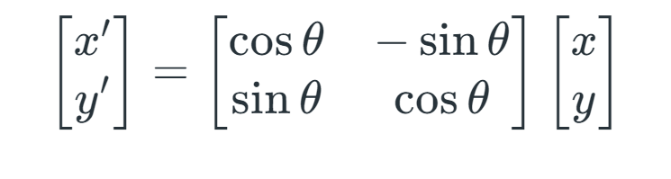
Rotation is a process in which a image is simply rotated around the origin or an image center by a given angle. This rotates the image or changes the orientation of an image depending on the angle it has been set to.
Its equation is:

Slide 3
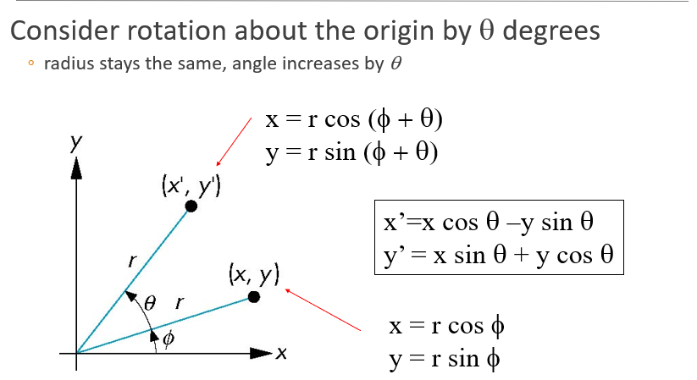

Slide 4
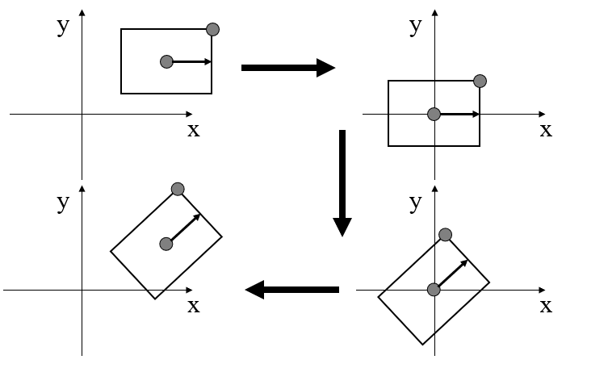
Rotation about arbitrary point
Translation:
x’ = x - p
Rotation:
x’’ = R(x’) = Rx - Rp
Translation Back:
x’’’ = x’’ + p = Rx - Rp + p

Slide 5
Translation:
x’ = x - p
Translate the center of rotation to the origin
Rotation:
x’’ = R(x’) = Rx - Rp
Rotate the object
Translation Back:
x’’’ = x’’ + p = Rx - Rp + p
Translate back to original location

Slide 6
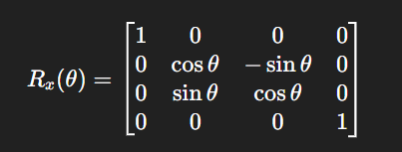
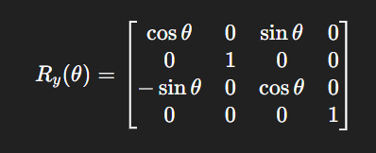
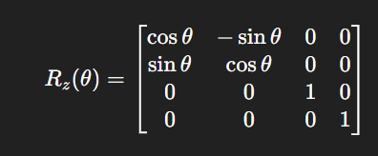
Rotation about x axis:
Rotation about y axis:
For about the axis, axis = 1
Rotation about z axis:

Slide 7
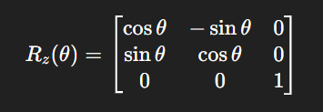
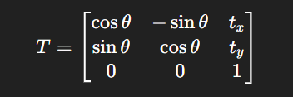
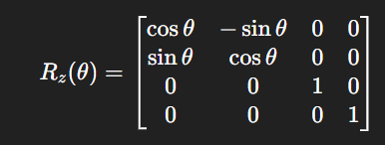
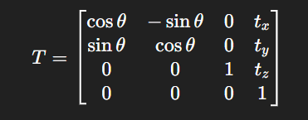
ROTATION AND OTHER TRANFORMATIONS
->
->

Slide 8
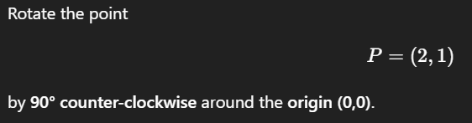
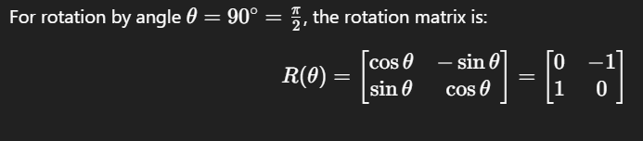
Rotate a Point in 2D Using a Rotation Matrix
Step 1: Write the Rotation Matrix

Slide 9


Step 2: Multiply Matrix with Point
Final Answer:

Slide 10
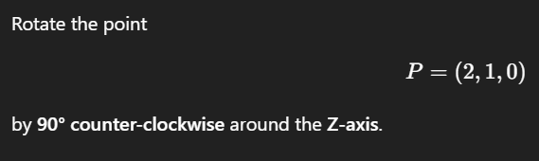
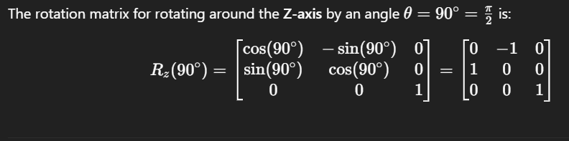
Rotate a Point in 3D Using a Rotation Matrix
Step 1: Write the 3×3 Z-axis Rotation Matrix

Slide 11
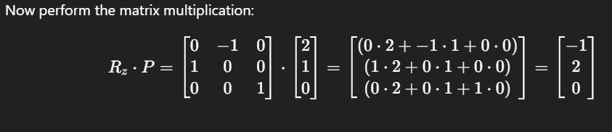
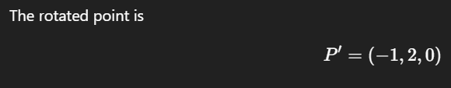
Step 2: Multiply the Matrix by the Point
Final Answer:

Slide 12
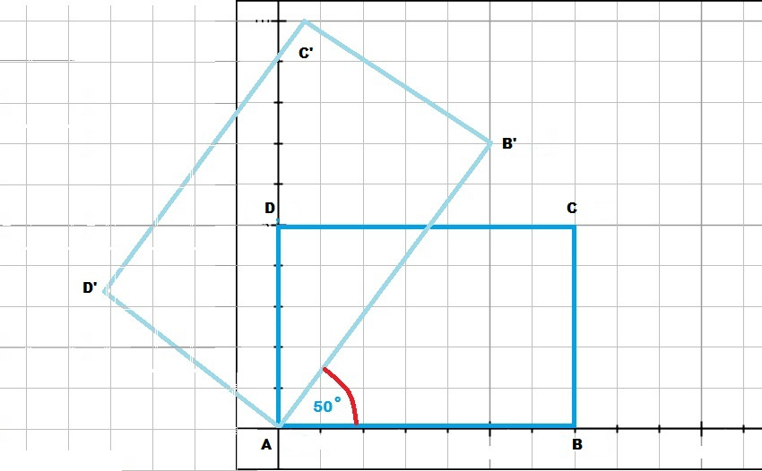

Slide 13
Thank you!

