Slide 1
APPLIED DATA SCIENCE CAPSTONE
SpaceX Falcon 9 First-Stage
Landing Prediction
Predicting first-stage recovery success from launch telemetry, using data collected via public API and web scraping, then modeled with classical ML classifiers.
Author: Jai M
Date: August 2026

Slide 2
PROJECT REPOSITORY
GitHub Repository
🔗
All notebooks, Python scripts, and SQL files for this project are available at: https://github.com/jai1116-lang/spacex-falcon9-capstone
• Data collection notebooks (API + web scraping)
• Data wrangling & labeling scripts
• EDA (SQL + visualization) notebooks
• Interactive visual analytics (Folium, Plotly Dash)
• Predictive analysis / classification notebook
2

Slide 3
EXECUTIVE SUMMARY
Executive Summary
SpaceX advertises Falcon 9 launches at ~$62M, versus $165M+ for competitors — largely because SpaceX reuses the first stage. If we can predict whether a landing will succeed before launch, we can estimate launch cost and better evaluate a competing bid.
90
66.7%
83.3%
3
Launches analyzed
Historical success rate
Best model test accuracy
Launch sites
Falcon 9 only, Falcon 1 excluded
First-stage recovery, all sites
Decision Tree classifier
CCAFS, KSC, VAFB
Key finding
Landing success correlates strongly with orbit type and launch recency: later flights (higher flight number), lighter payloads, and orbits like VLEO/LEO land more reliably than heavy GTO missions.
3

Slide 4
INTRODUCTION
Project Background & Questions
Background
Questions this project answers
SpaceX's reusable Falcon 9 first stage is the key driver of its low launch cost. Whether a first stage lands successfully depends on many factors — payload mass, orbit, launch site, booster generation, and more. This project builds a data pipeline and classification model to predict landing outcome from pre-launch data.
1
What features most influence landing success?
2
Does landing success improve over time / mission number?
3
Which launch sites and orbits have the best track record?
4
Can we predict landing outcome with a classifier — and how accurate is it?
4

Slide 5
METHODOLOGY
Data Collection and Data Wrangling Methodology
1
2
3
4
5
GET request
Normalize JSON
Web scraping
Filter & clean
Label outcome
Queried the SpaceX REST API for historical launch records.
→
Flattened nested response with pd.json_normalize into a DataFrame.
→
Parsed the Falcon 9 Launch Wikipedia page with BeautifulSoup for supplementary detail.
→
Removed Falcon 1 launches, leaving 90 Falcon 9 flights; handled missing PayloadMass and LandingPad values.
→
Derived a binary Class column (1 = successful landing, 0 = failure) from the raw Outcome text.
Result: a clean, labeled dataset of 90 Falcon 9 launches with 17 columns spanning payload, orbit, site, booster, and landing outcome.
5

Slide 6
METHODOLOGY
EDA and Data Visualization Methodology
📊
🗄️
Visual EDA (Seaborn / Matplotlib)
SQL EDA (Db2 / SQLite)
Scatter and bar plots: FlightNumber vs. PayloadMass, LaunchSite success rate, Orbit vs. Outcome, and yearly success-rate trend — used to spot which features correlate with landing success before modeling.
Loaded the cleaned launch data into a SQL table and queried launch-site counts, payload aggregates, orbit breakdowns, and outcome counts — cross-checking the pandas-based EDA with independent SQL results.
6

Slide 7
METHODOLOGY
Interactive Visual Analytics Methodology
🗺️
📈
Folium Map
Plotly Dash Dashboard
Plotted all 3 launch sites and every individual launch outcome (success/fail markers) on an interactive Leaflet-based map, with distance lines to the nearest coastline, railway, and city to assess siting constraints.
Built an interactive Dash app with a launch-site dropdown and a payload-mass range slider, driving a live pie chart (success share by site) and scatter plot (payload vs. outcome).
7

Slide 8
METHODOLOGY
Predictive Analysis (Classification) Methodology
1
Standardize features (StandardScaler) after one-hot encoding categoricals (Orbit, LaunchSite, LandingPad, Serial, GridFins, Reused, Legs) — 83 total columns.
2
Split into train/test sets (80/20), yielding 18 test samples.
3
Grid-search four classifiers — Logistic Regression, SVM, Decision Tree, KNN — with 10-fold cross-validation on the training set.
4
Select best hyperparameters per model by validation accuracy, then evaluate all four on the held-out test set.
5
Compare test accuracy and confusion matrices to choose the final model.
8

Slide 9
RESULTS
EDA with Visualization
Success rate by launch site
Launch count by orbit type
Landing success improves with mission experience
9

Slide 10
RESULTS
EDA with SQL Queries
SQL Query | Result
SELECT COUNT(*) FROM SPACEXTBL WHERE LaunchSite = 'CCAFS SLC 40' | 55 launches
SELECT SUM(Class)*1.0/COUNT(*) FROM SPACEXTBL | 66.7% success (60 of 90)
SELECT COUNT(*) FROM SPACEXTBL WHERE Orbit = 'GTO' | 27 launches
SELECT COUNT(*) FROM SPACEXTBL WHERE Outcome = 'True ASDS' | 41 drone-ship landings
SELECT DISTINCT LaunchSite FROM SPACEXTBL | CCAFS SLC-40, KSC LC-39A, VAFB SLC-4E
SELECT MIN(PayloadMass) FROM SPACEXTBL | 350 kg
Full query set (9 queries) is in sql/eda_queries.sql and notebooks/03_eda_sql.ipynb in the GitHub repo.
10

Slide 11
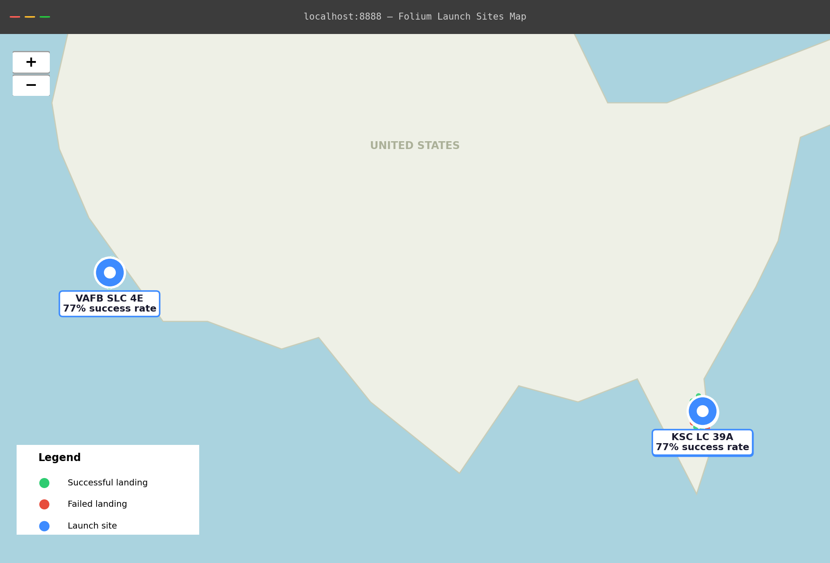
RESULTS
Folium Map — Interactive Results
What the map shows
Markers for all 3 launch sites, colored by aggregate success rate.
Individual launch markers (green = success, red = failure) clustered per site.
Distance lines from each site to the nearest coastline, railway, and city — used to assess siting constraints.
Confirms launch sites are built near the coast, away from population centers, consistent with safety practice.
11

Slide 12
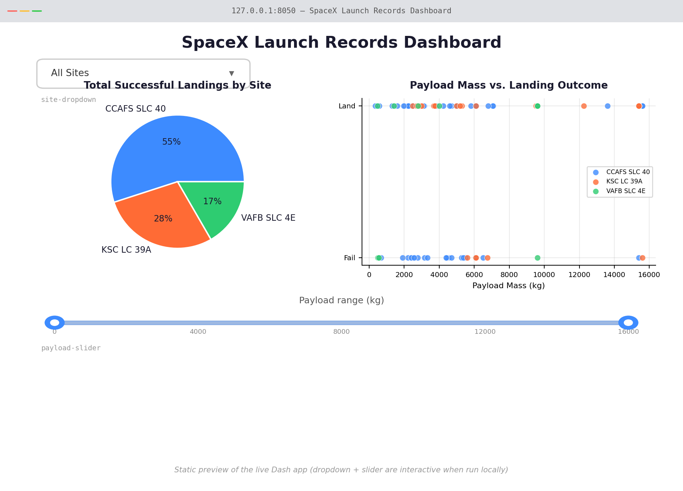
RESULTS
Plotly Dash — Interactive Dashboard
Dashboard features
Dropdown to filter by launch site or view all sites combined.
Pie chart of successful landings by site — KSC LC-39A leads at ~77%.
Range slider to filter by payload mass (kg), updating the scatter plot live.
Scatter plot of payload mass vs. landing outcome, colored by booster version.
Static preview — the live app (notebook 5) adds an interactive site dropdown and payload-mass range slider that filter both charts.
12

Slide 13
RESULTS
Predictive Analysis Results
Test-set accuracy by model
Best model — Decision Tree
Metric | Value
Test accuracy | 83.3%
Best criterion | gini
Best max_depth | 6
Test samples | 18 (20% holdout)
Confusion matrix (Decision Tree, test set)
 | Pred: Fail | Pred: Land
Actual: Fail | 5 | 1
Actual: Land | 2 | 10
All four models converge near the same test accuracy on this small (18-sample) held-out set — differences of 1–2 predictions shift the ranking, so cross-validation accuracy (below) is the more stable comparison.
13

Slide 14
CONCLUSION
Key Takeaways
1
Landing success is learnable. A Decision Tree classifier reached 83.3% test accuracy predicting first-stage landing outcome from pre-launch features.
2
Experience matters. Success rate rose from ~58% in the first 45 launches to ~76% in the most recent 45 — SpaceX's landing process improved measurably over time.
3
Orbit and site matter. KSC LC-39A and VAFB SLC-4E outperform CCAFS SLC-40 (~77% vs. 60%); heavy GTO missions land less reliably than lighter LEO/VLEO missions.
4
Practical value. This kind of model lets a buyer estimate whether a quoted Falcon 9 launch will reuse its booster — and therefore estimate the likely price — before the mission flies.
Creativity & innovative insights: reframing landing prediction as a learning-curve story (58%→76% success as the mission count grows), not just a classifier score, plus a from-scratch dark-themed design and cross-validated SQL/visualization/ML results.
Next steps: incorporate weather data, add booster-generation features, and test ensemble methods for a further accuracy gain.
14

