Slide 1
Financial Text Classification

Slide 2
Problem Statement
Financial investors might want to predict the change in stock price or identify companies that better fit their investment requirements.However, using previous financial text information, can increase their chance of finding the best company to invest in or predict the right change in stock price. In this will try to use deep learning in order to classify is given financial news headlines using FinBERT

Slide 3
Flow Diagram
Label Encoding
Text Pre-Processing
Tokenisation, Ecode data
Data Collection
EDA
Tokenisation, Ecode data
Train/ Test data preparation

Slide 4
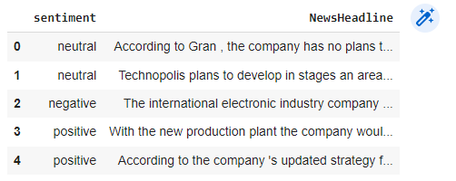
Dataset Explanation
Dataset holds the information of sentiments ,news headlines respectively.

Slide 5

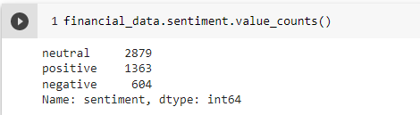
Dataset Information
Explains the information about on total number of rows,sentiment counts

Slide 6
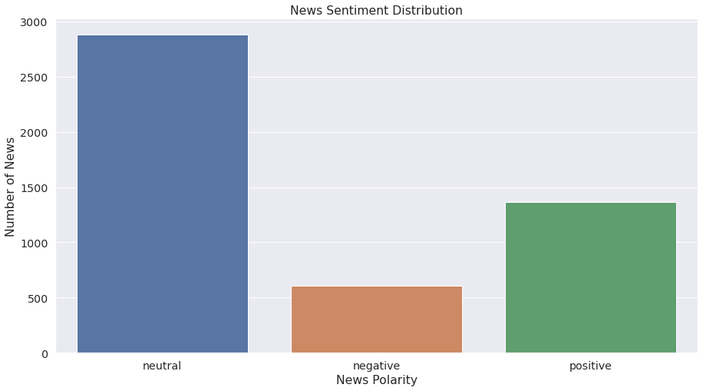
Sentiment polarity distribution
To analyse the distribution of sentiment polarity (positive,neutral or negative ).Imbalance in the dataset

Slide 7
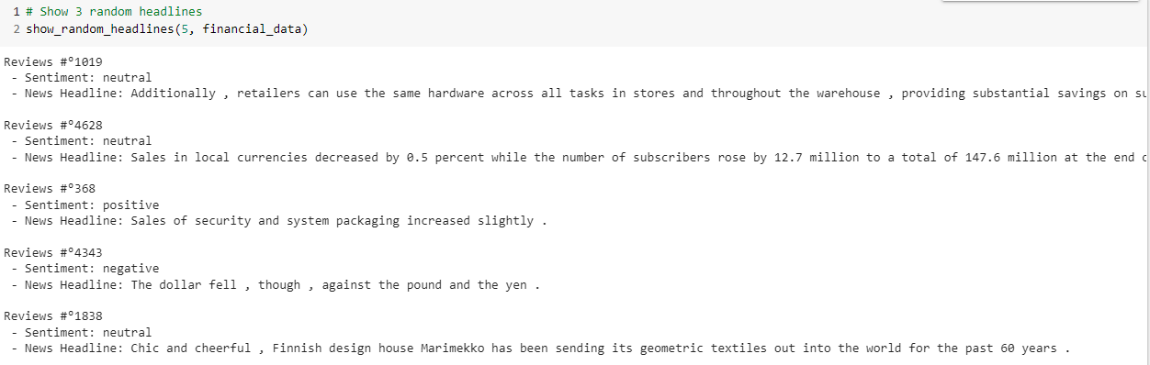
Text Pre-Processing
Removed the space based on the analysis of the output

Slide 8
Training Dataset Preparation

Slide 9
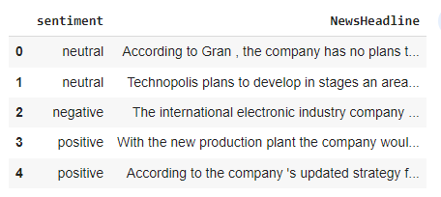
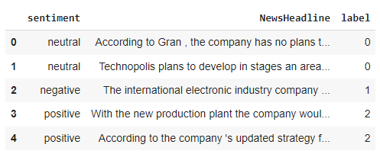
Sentiment Label Encoding
First 5 rows before encoding
First 5 rows after encoding
0 - neutral
1- negative
2- positive

Slide 10
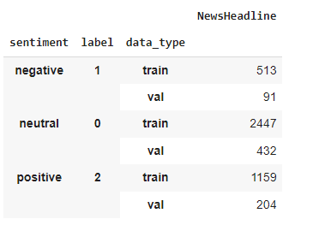
Train and Validation Data Creation
data type contains a significant number of occurrences for each type of sentiment value. Train is set as random and test size split to 15%
Notes:
split the dataset into train and test sets in a way that preserves the same proportions of examples in each class as observed in the original dataset

Slide 11
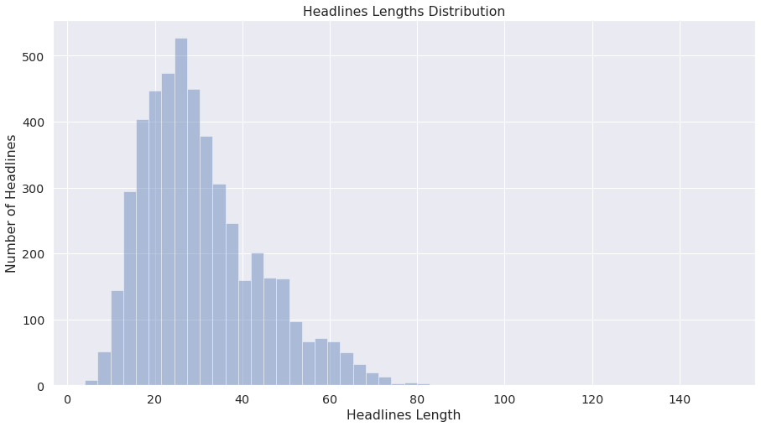
Headline Length Distribution
Maximum Sequence Length is 150

Slide 12
Tokenizer and encode data
Why we need tokenization ?
the model has a specific, fixed vocabulary
the BERT tokenizer has a particular way of handling out-of-vocabulary words.
The encode_plus method performs the following tasks:
split our news headlines into tokens,
add the special [CLS] and [SEP] tokens
convert these tokens into indexes of the tokenizer vocabulary,
pad or truncate sentences to max length, then finally
create an attention mask.
Notes:
Padding adds a special padding token to ensure shorter sequences will have the same length as either the longest sequence in a batch or the maximum length accepted by the model. Truncation works in the other direction by truncating long sequences.

Slide 13

Setup FinBERT pretrained model
ProsusAI/finbert is the Prosus finBERT pretrained model.
num_labelsm specifies the number of labels to be predicted (3 in our case).

Slide 14
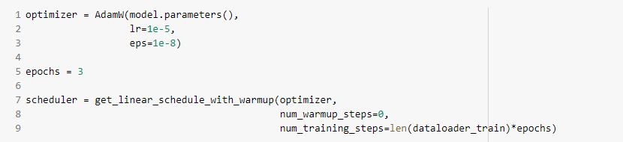
Set Up Optimizer and Scheduler
the optimizer is created using the model’s parameters, the learning rate, and the Adam epsilon value.
get_linear_schedule_with_warmupto create the learning rate scheduler.

Slide 15
Performance Metrics

Slide 16
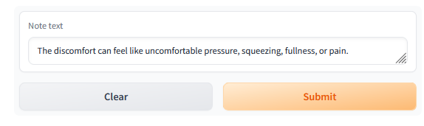
Test Case 1:
Example: bert-base-uncased_clinical-ner
Input:
Output

Slide 17
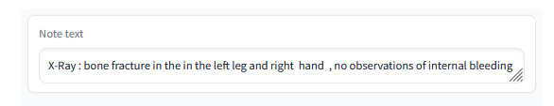
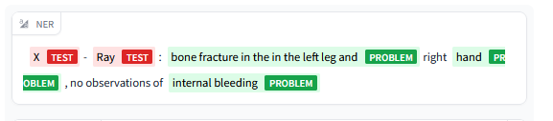
Output Examples
Example: bert-base-uncased_clinical-ner
Input:
Output

