Slide 1
WEB ANALYTICS - DASHBOARD

Slide 2
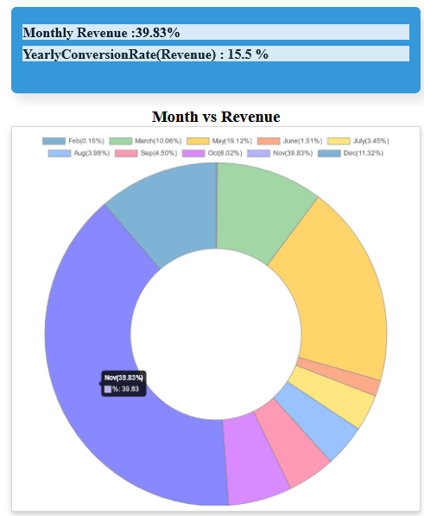
Revenue Representation - Monthly & Yearly

Slide 3
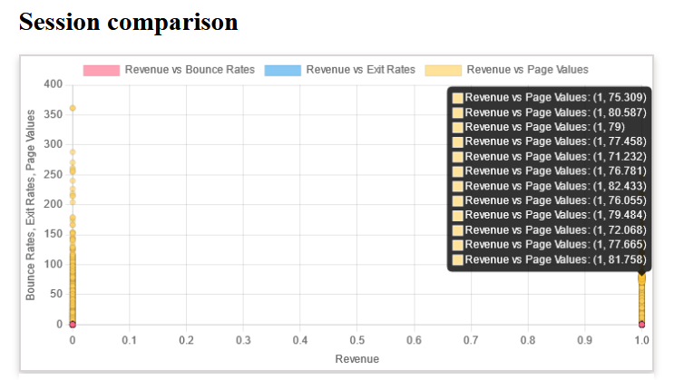
Revenue vs Page Value
Revenue conversion based on the page value
Page Value is the average value for a page that a user visited before landing on the goal page or completing an Ecommerce transaction (or both).

Slide 4
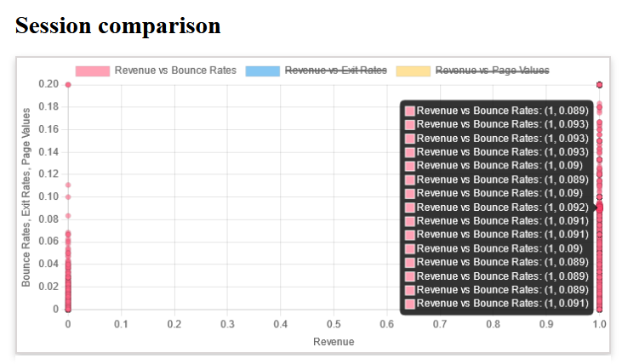
Revenue vs Bounce Rate
Revenue conversion based on bounce rate
Bounce rate measures how long the users are engaging with your website. It is highly relative to your ranking and, ultimately, your ad revenue.

Slide 5
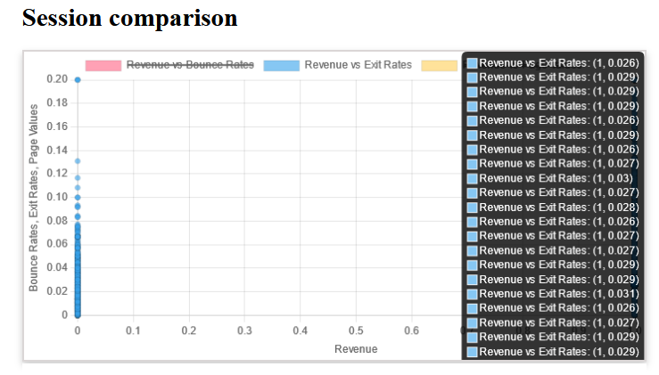
Revenue vs Exit Rate
Revenue conversion based on exit rate
Exit rate refers to the percentage of visitors who leave your website from any page after interacting with it

Slide 6
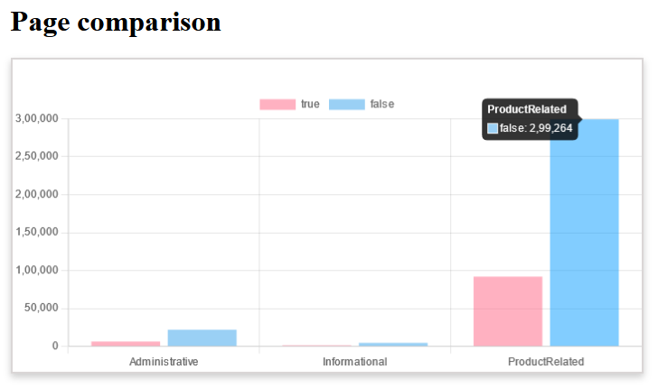
Revenue Generated Based On Pages
Revenue generated are high in product related pages

Slide 7
Ten Important Features For Predictive Model
Administrative
ProductRelated
ProductRelated_Duration
BounceRates
ExitRates
PageValues
Month_Mar
Month_May
Month_Nov
VisitorType_Returning_Visitor
Rest of the column are set in default as zero

Slide 8
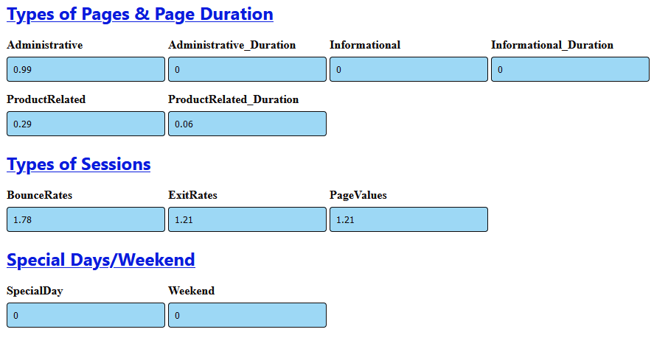
Web Predictive Model (Different Features)

Slide 9
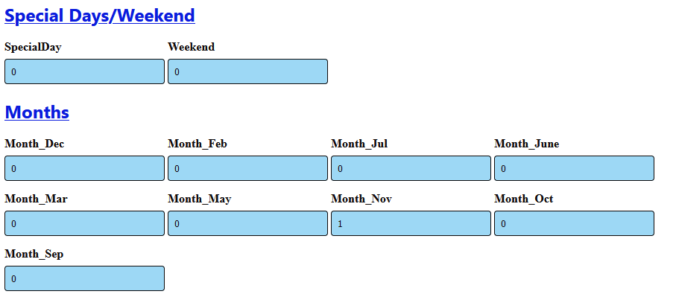

Slide 10
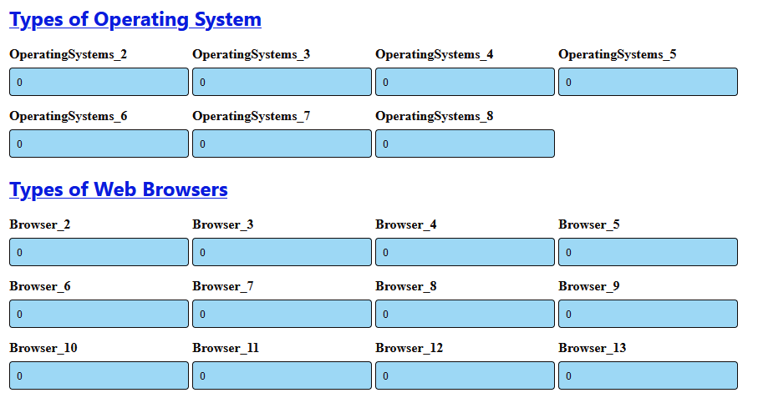

Slide 11
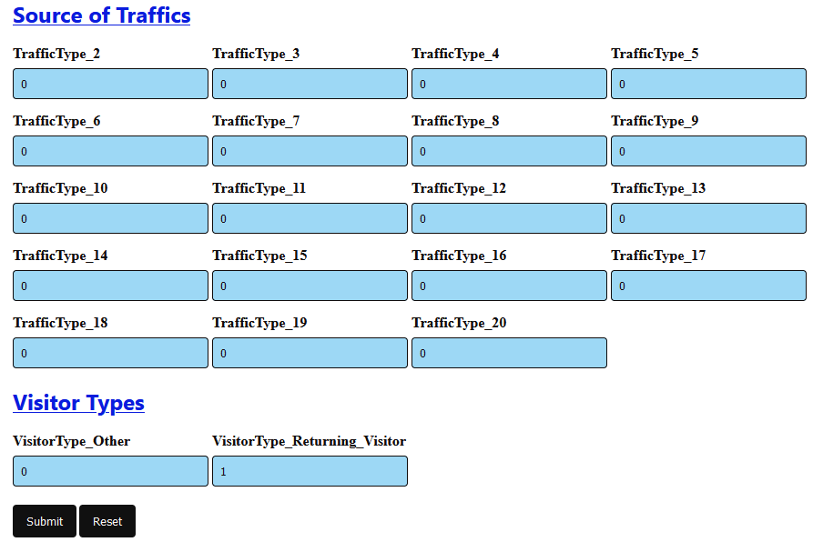

Slide 12
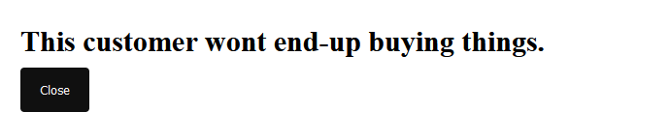
Predictive Model Result

Slide 14
PREDICTIVE WEB ANALYTICS

Slide 15
Steps to Analyse Offline Dataset
Data Collect
Data Cleaning and Data pre-processing
EDA, Feature selection, Model building and Evaluation
Completed Tasks
All the above steps are completed with business insights

Slide 16
Code - Libraries
Python 3.10
Pandas
Matplotlib,Seaborn for visualisation
Google Colab

Slide 17
What is predictive analytics ?
Reason why you should opt for Predictive Analytics ?
Predictive Analytics is a set of methodologies that assist us in anticipating customer behaviour.
Analytical models helps you understand the complex patterns between the various data points, which can become the basis of your decision-making process.
It helps you to prepare a data driven marketing plan, to allocate proper investments.

Slide 18
Examples of Predictive Web Analytics
The company uses predictions performed by a predictive model to maximize engagement rates for its content, by sending personalized messages to the target audiences, which helps to increase the ROI for its content marketing efforts.

Slide 19
CASE STUDY
Data Information
To build a Predictive Model using customer visits data over a website.
The dataset consists of data points belongs to 12,330 sessions of customer visits to the website. The dataset was formed so that each session would belong to a different user in a 1-year period to avoid any tendency to a specific campaign, special day, user profile, or period.

Slide 20
Attribute Information:
“Administrative”, “Administrative Duration”: Represent the Administrative pages visited by the visitor in that session and total time spent in each of this page category.
“Informational”, “Informational Duration”: Represent the Information related pages visited by the visitor in that session and total time spent in each of this page category.
“Product Related” and “Product Related Duration”: Represent the Product Related pages visited by the visitor in that session and total time spent in each of this page category.
“Bounce Rate” refers to the percentage of visitors who enter the site from that page and then leave without triggering any other requests to the analytics server during that session.

Slide 21
Attribute Information:
“Exit Rate” depicts the percentage of exits on a page.
“Page Value” feature represents the average value for a web page that a user visited before completing an e-commerce transaction.
“Special Day” feature indicates the closeness of the site visiting time to a specific special day.
The dataset also includes some other features such as operating system, browser, region, traffic type, visitor type as returning or new visitor, a Boolean value indicating whether the date of the visit is weekend, and month of the year.

Slide 22
Objective
To build a predictive model, which shall decide whether the customer will buy or not, means the variable
The target feature and class label in the dataset is called Revenue and contains either a True or False value, which correspond to whether or not the user made a purchase on the website during their visit, respectively and others are the Predictor Variables.

Slide 23
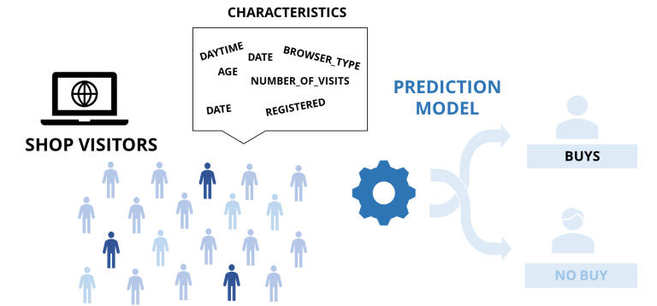
General Flow

Slide 24
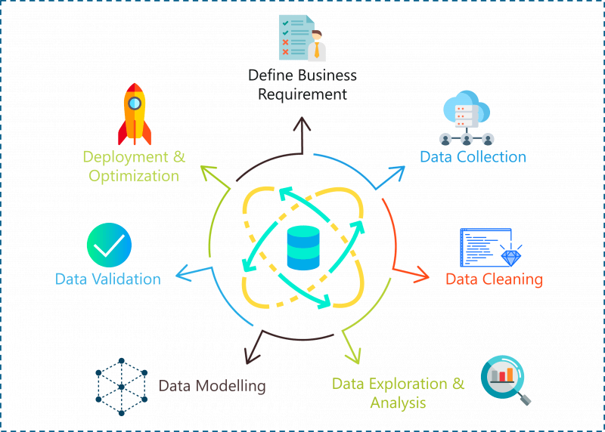
Process Flow Diagram

Slide 25
Exploratory Data Analysis

Slide 26
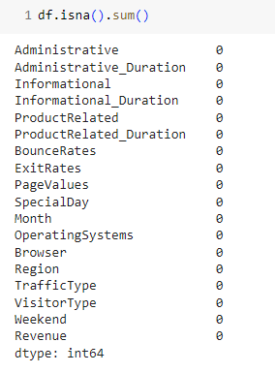
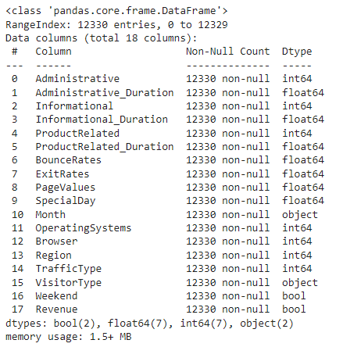

General dataset information
The dataset consists of 18 columns (15 numeric, 2 objects, and 2 booleans) and 12330 rows, where there is no blank data.
Notes:
Skewness tells us the direction of outliers. In a positive skew, the tail of a distribution curve is longer on the right side. This means the outliers of the distribution curve are further out towards the right and closer to the mean on the left.

Slide 27
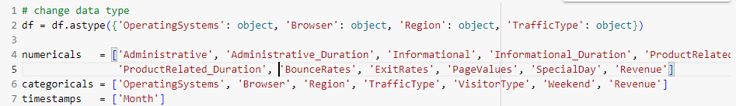
Change in Data Type
Changed the datatype, divided to three categories → categoricals,numericals,timestamps

Slide 28
Statistical Summary

Slide 29
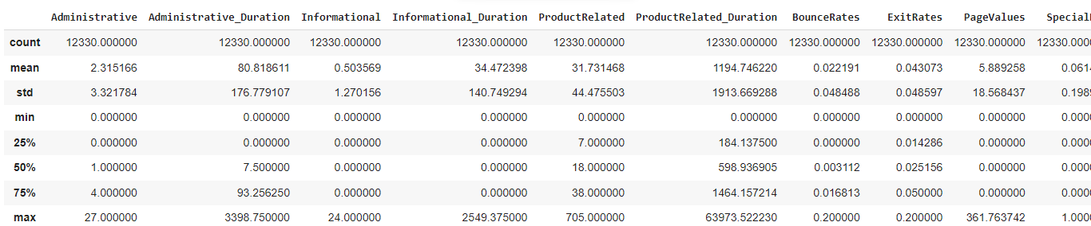
Numerical distribution
Skewness:
All features (columns) are positive skew.
There are several summary values ​​that need to be marked:
Q1, Q2, Q3 for Informational, Informational_Duration, and SpecialDay worth 0.
The maximum value for PageValues is very large, indicating an outlier.
Notes:
In a positively skewed distribution, most values on the graph are on the left side, and the curve is longer towards the right trail. In this distribution, the mean is greater than the median. In finance, it is the chance for more profits than the loss.

Slide 30
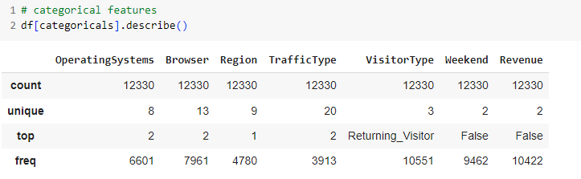
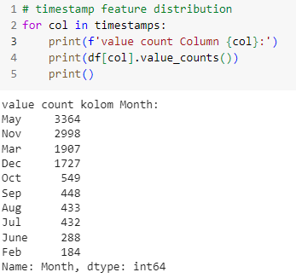
Categorical Distribution
Notes:
Most visiting customers:
Returning Visitors
On weekdays
No purchases
In May
There are 3 unique Visitor Types with returning visitor being the most common type; occuring 10,551 instances.*

Slide 31
Feature Distribution for Each Revenue Value

Slide 32
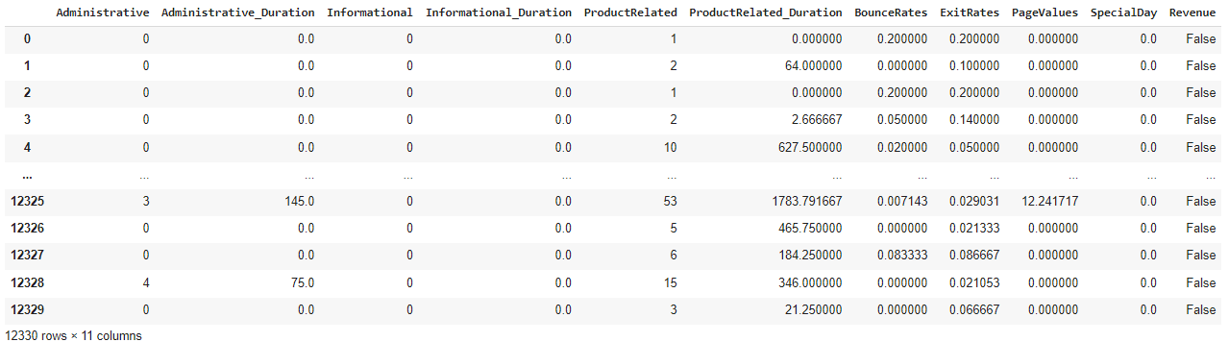
Numerical Features
df[numericals]

Slide 33
Univariate Analysis

Slide 34
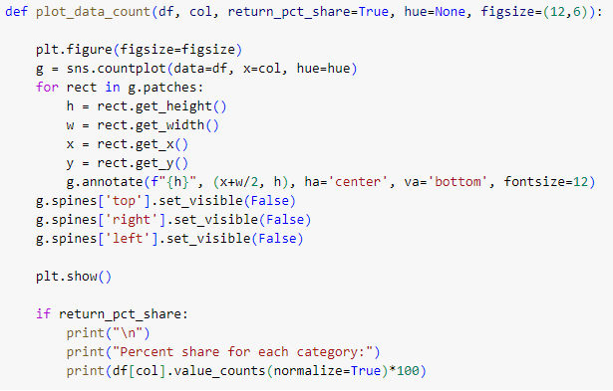
Count Plot Code
General function to plot the bar graph with sns , set the h,w,x,y
Annotate parameter to write text on graph
Spine to represents the border of the graph

Slide 35
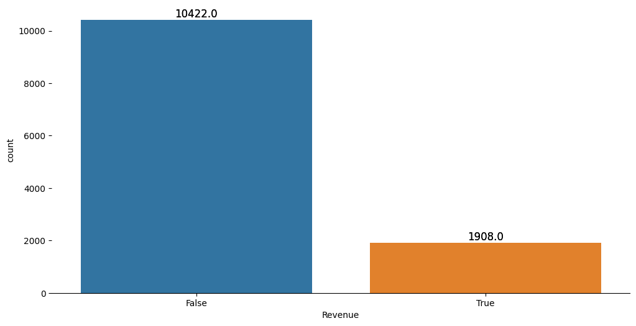
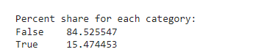
Count vs Sales
True: Made Purchase
False: Not purchased
Only 15.47% percent of customers ended up making purchase a or more.
So, the conversion rate is 15.47%

Slide 36
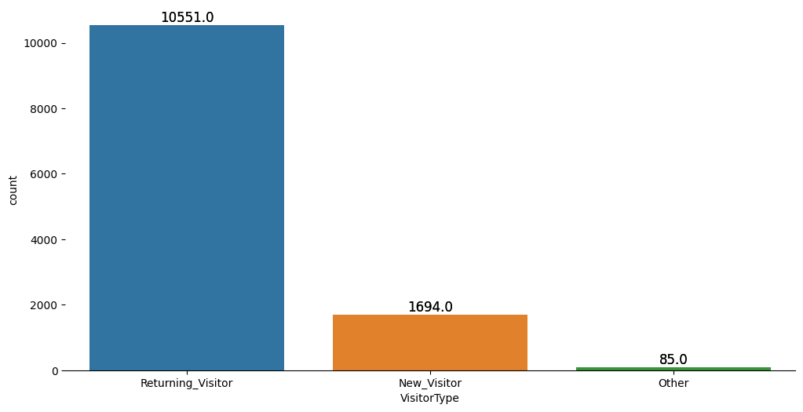
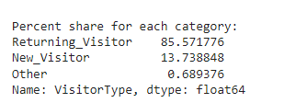
Count vs Visitor Type
85% of customers returns back to site, which is a good indication. Meaning that our customers are satisfied with what they are getting.
13.74% of customers are new customers.

Slide 37
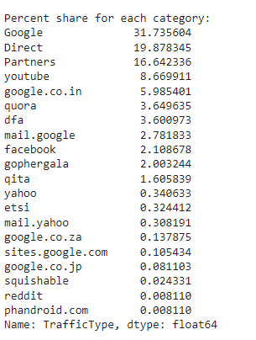
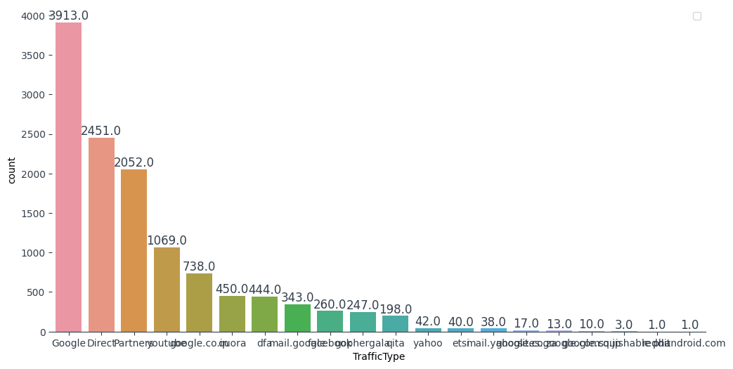
Count vs Traffic Type (After replacing value)
Most of our visitors are coming from traffic type google - around 32% (google traffic)

Slide 38
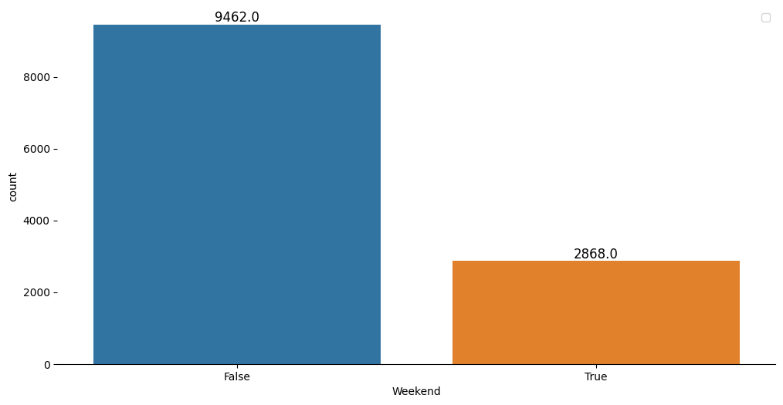

Count vs Weekend
True: Made Purchase
False: Not purchased
More visitors visit our site during weekdays than weekends

Slide 39
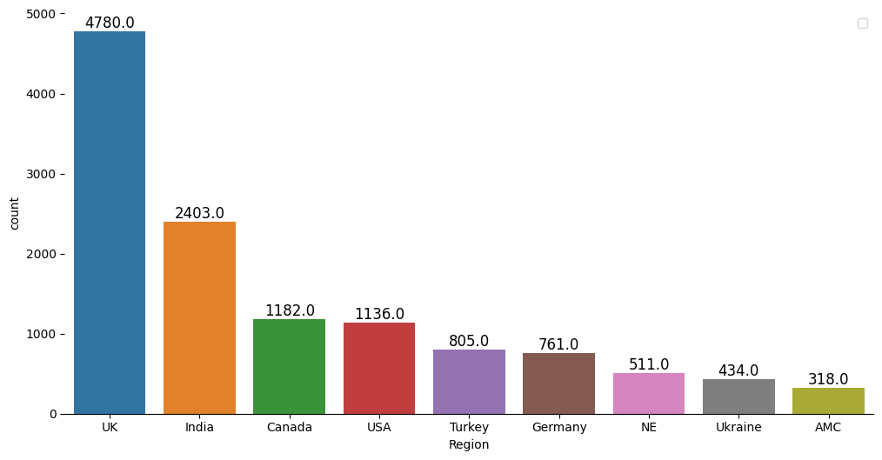
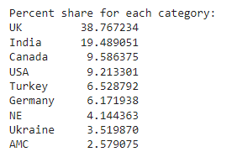
Count vs Region(replace numericals with Region names)
Around 39% of visitors come from UK region followed by 19.5% from region India

Slide 40
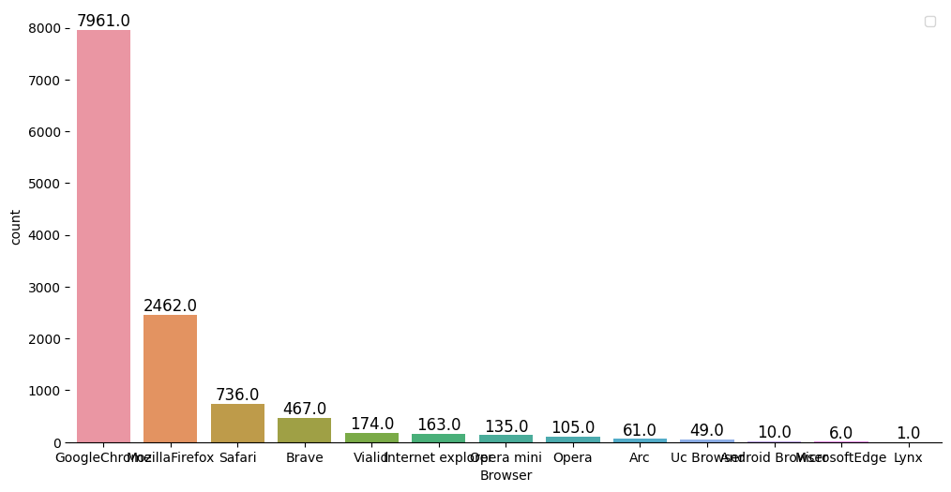
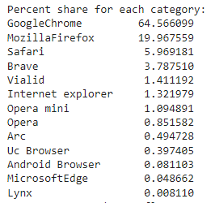
Count vs Browser(replace numericals with brower names)
64.5% percent of visitors are coming from browser google chrome followed by 20% from browser mozilla firefox.

Slide 41
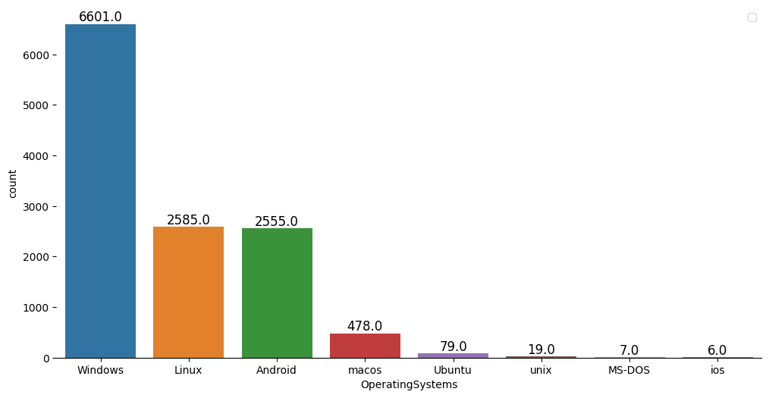
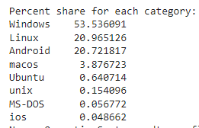
Count vs Operating Systems
More than 50% of visitors are using operating system windows.
Around 95% of visitors are coming from major three operating systems windows os(53.5%), os Linux (21%), Android os (21%)

Slide 42
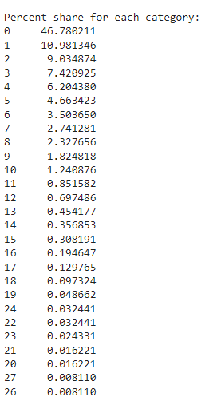
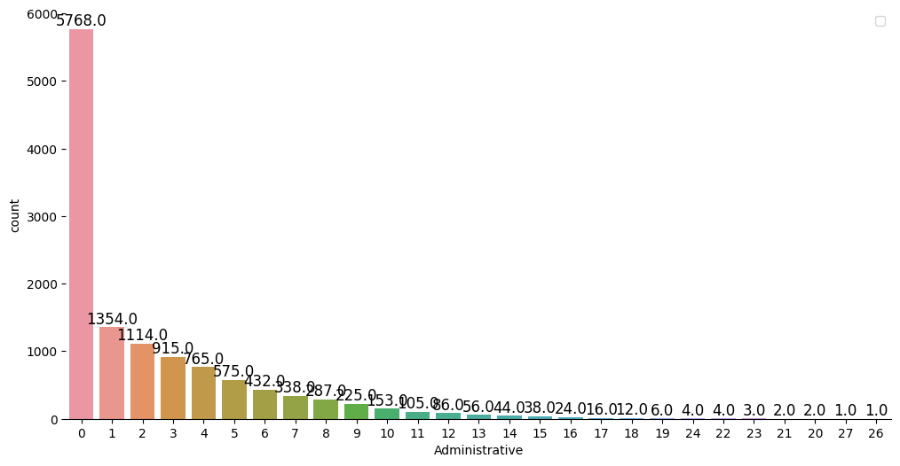
Count vs Administrative
users tend to visit page 0 the most often.

Slide 43
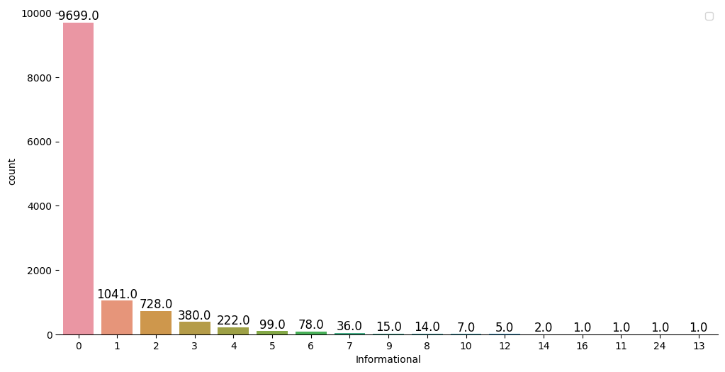
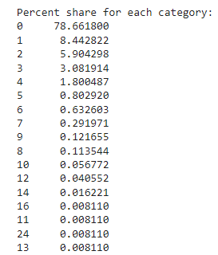
Count vs Informational
we can see that Information page 0 has the highest number of visitors.

Slide 44
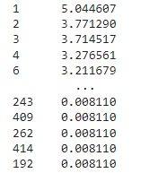
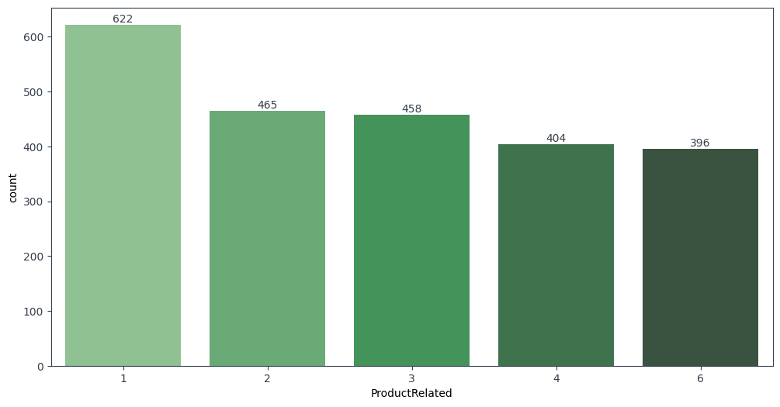
Count vs ProductRelated
we can see that Information page 0 has the highest number of visitors.

Slide 45
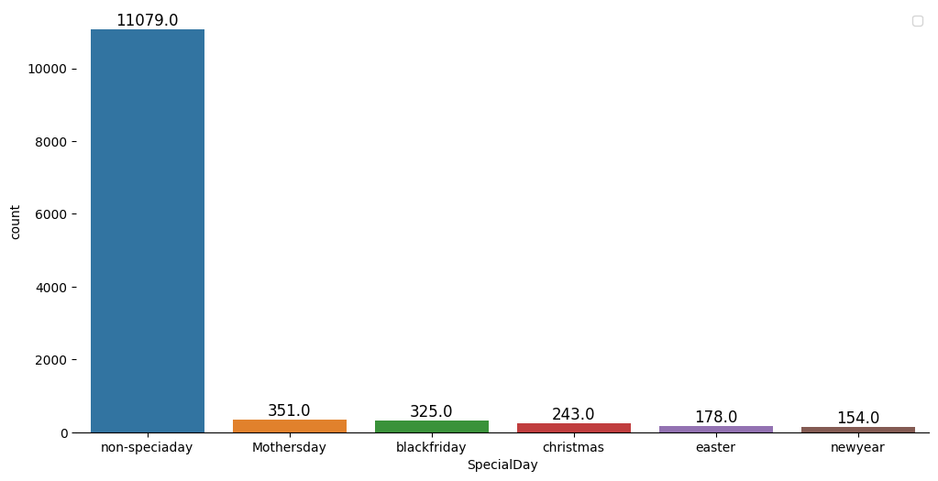
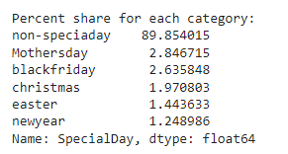
Count vs Special Day
we can see that special days have no impact on the number of visitors to our website.

Slide 46
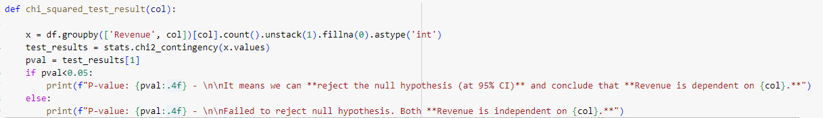
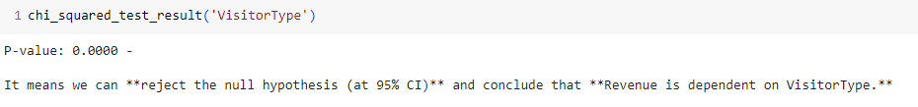
Chi Square test Visitor Type

Slide 47
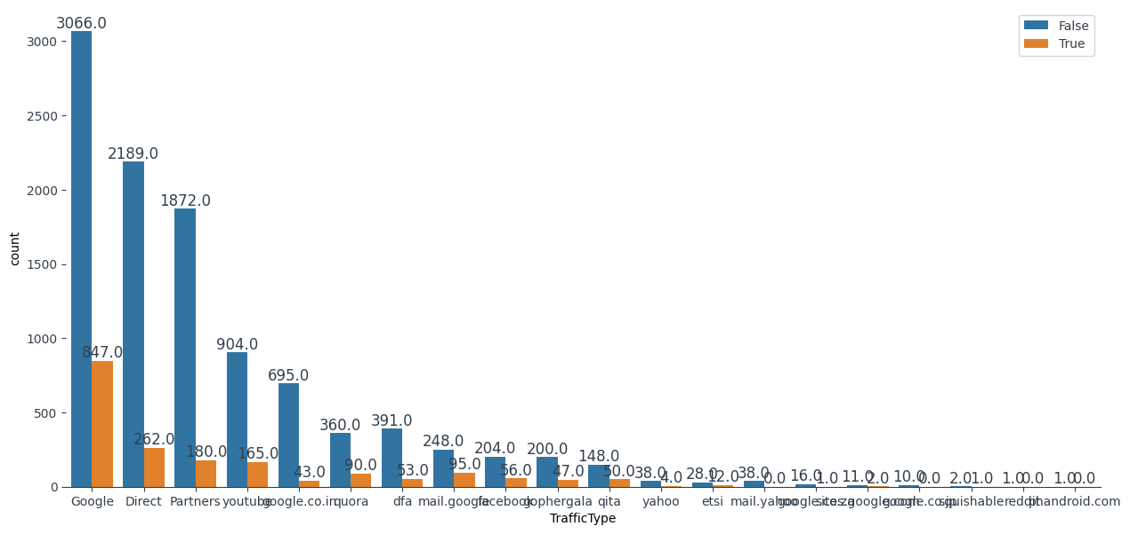
Countplot - TrafficType (True or False) Vs Sales (after replacing)
True: Made Purchase
False: Not purchased
We can see that more sales conversion happens for web traffic generated from source google traffic.

Slide 48
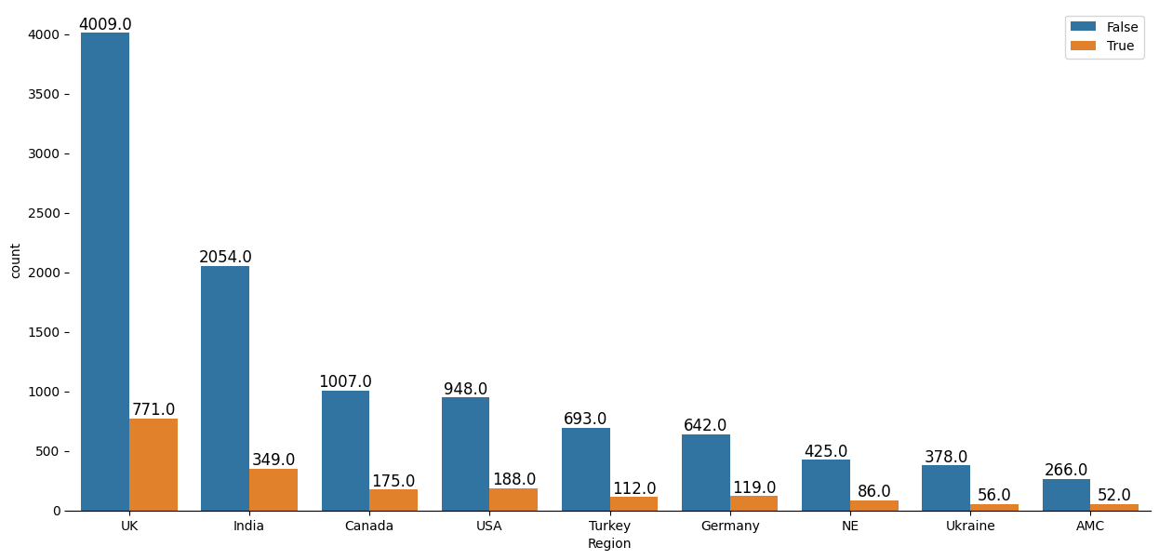

Countplot - Region (True or False) Vs Sales after replacing)
True: Made Purchase
False: Not purchased
Region UK accounts for most sales, and India the second most. With this information, we can plan our marketing and supply chain activities in a better way. For example, we might propose building a warehouse specifically catering to the needs of UK region to increase delivery rates and ensure that products in the highest demand are always well stocked.

Slide 49
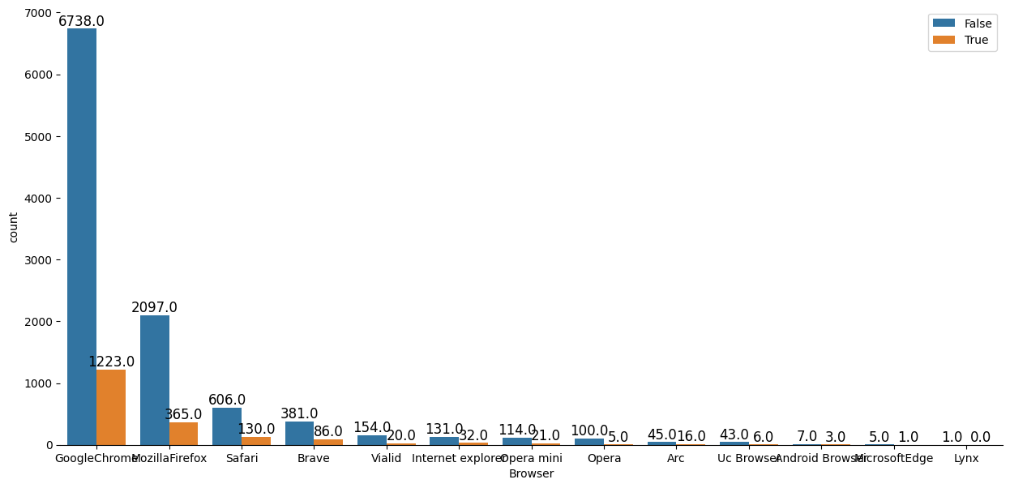
Countplot - Browser (True or False) Vs Revenue after replacing)
True: Made Purchase
False: Not purchased
more sales-generating transactions have been performed from chrome. Even though chrome creates a considerable number of sessions, the conversion rate is low. This is something we need to investigate further.

Slide 50
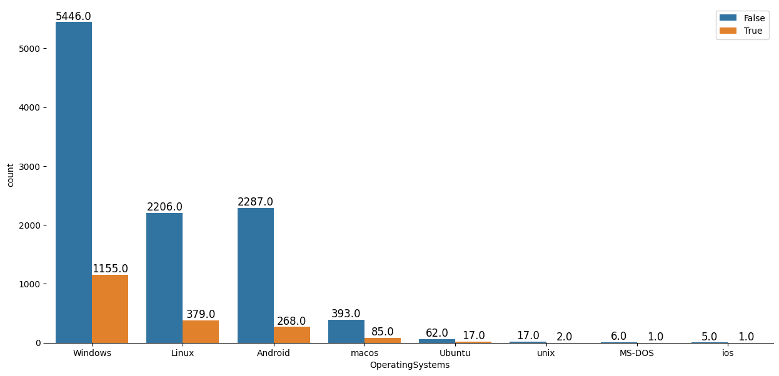
Countplot - OperatingSystems (True or False) Vs Revenue after replacing)
True: Made Purchase
False: Not purchased
more revenue-generating transactions happened with OS 2 than the other types.

Slide 51
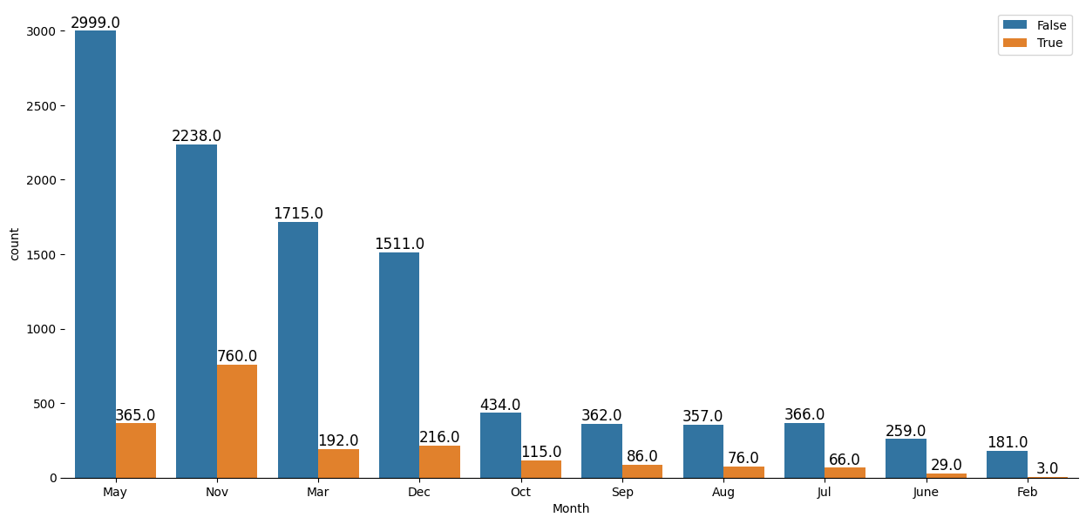
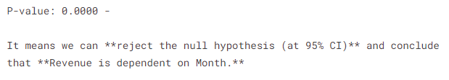
Countplot - Month (True or False) Vs Revenue after replacing)
True: Made Purchase
False: Not purchased
Website visitors may be high in May, but we can observe from the preceding bar plot that a greater number of purchases were made in the month of November.

Slide 52
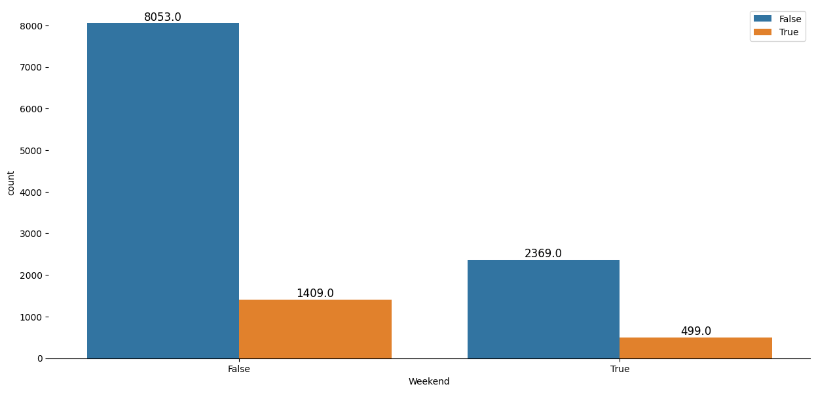
Countplot - Weekend(True or False) Vs Sales
True: Made Purchase
False: No purchase
Weekdays have higher sales rate compared to weekends
Notes:
# It appears proportion of session which yielded revenue is the highest in november
# February has the lowest proportion of sessions which yielded revenue
# Proportion of sessions which yielded revenue is the highest among users having operating system 8
# while operating system 3 yields the lowest proportion of these revenue positive sessions
# Browser 12 has the highest proportion of revenue positive sessions followed by browser 13 while browser 3 has the least contribution
# Region does not appear to play a significant role in determining whether the customer will purchase or not.
# Proportion of revenue positive sessions is the highest among new visitors followed by other visitors.
# Returning visitor sessions have a relatively lower proportion of revenue positive sessions.
# If it's a weekend, there are slightly more chances of having a sale! Visually, the difference does not appear to be a very big one!

Slide 53

Chi Square table Categorical
From chi-squared test we got that except Region all other discrete features are dependent on Revenue feature

Slide 54

Chi Square Numerical
From chi-squared test we got all numerical features are dependent on Revenue feature

Slide 55

Page-wise Sales Conversion
True: Made Purchase
False: Not purchased
Inference-
The majority of the sessions on the website included visit to product related pages. Further, it has the highest contribution to revenue generation. Therefore, product related pages are of utmost importance to the client as suggested by the number of customer visits.
sales

Slide 56

Page-wise time in seconds
True: Made Purchase
False: Not purchased
Inference-
The majority of the time spent on the website was on Product Related pages. Therefore, product related pages are of utmost importance to the client from the perspective of revenue generation.
sales

Slide 57

Analysis on only Revenue Positive Cases (15.5% Data)
From the above doughnut plot, it can be inferred that November has the most significant contribution to client’s sales followed by May, December and March. While February, June and July have the least contribution. Client needs to analyze what drives the customers during the peak months and implement similar strategies in the other months.

Slide 58

3D view of Bounce Rates, Exit Rates and Page Value
Here, Red points represent customers who did not bring sales and Black points represent sales positive customers. From the above visualization, following points are noted:
Customers who havent ended up shopping (Reds) have a relatively lower bounce rate and exit rate than the black points. Customers who ended up shopping have a page value on the higher side relative to the negative classes.

Slide 59
Distribution Plot Continuous Features

Slide 60

Outlier analysis - outliers of the numerical columns based on the boxplots.

Slide 61

Outlier analysis - Distribution of our numerical data
As seen on the histograms above, most of the numeric features suffer from right skewness. One way to correct it is apply a type of transformation that scales the data to a Gaussian manner which is power transformation,specifically 'Yeo-Johnson' transformation.

Slide 62
Power-Transformation('Yeo-Johnson'):

Slide 63

Outlier analysis - after power transform
As seen above, most of the columns were scaled to a Gaussian-like shape and the impact of multiple outliers was decreased to the point that they do no exceed the above quantiles anymore

Slide 64

Outlier analysis boxplot after applying power transform
Furthermore, instead of removing the outliers, the prower tranformation will just decrease their impact in a way that they are not considered outliers anymore. We consider this preferable to removing them as they could represent valuable information for our models.

Slide 65
Business EDA Summary
Month - Majority of the sessions in the data pertain to the month of may followed by November. Months such as November,May, December and March have the most significant contribution to client’s sales. The same is visible in the doughnut plot in the visualization section as well as Client needs to analyze what drives the customers during the peak months and implement similar strategies in the other months. It is therefore advisable to take maximum benefit out of these months by using aggressive marketing startegies.February has the lowest proportion of sessions which yielded sales
Bounce rate,Exit rate,Page Value - Customers who ended up shopping had a relatively lower bounce rate and exit rates while Average Page value of a page that user visited before making a transactions is visibly higher relative to the negative classes. Therefore, the focus should be on reducing the exit rates and bounce rates on your webpage as well as improving the factors that determine the page value.
Proportion of sales positive sessions is the highest among new visitors followed by other visitors. Returning visitor sessions have a relatively lower proportion of revenue positive sessions. So if a visitor is a returning visitor, there are more chances of not having a sale. Returning visitor feature also appears among the top 10 most important feature list above.

Slide 66
Technical EDA Summary
65% of visitors come from browser chrome and more than 85% of visitors come from chrome and mozilla. We can make website to more appealing, interactive and responsive to these browsers.
Approx 95% of visitors uses operating system Windows,Linux and Android.
Having a high bounce rate can mean the quality of the page is low. There’s nothing inviting to engage with.Your audience doesn’t match the purpose of the page, as they won’t engage with your page.Visitors have found the information that they were looking for.
If the bounce rate amongst new visitors is high, think about how you could improve their engagement with your site.
Therefore, along with product related pages, it is also important to further improve your websites administrative pages.
Operating system (which could possibly be Android) while majoirty of the users on this android would probably use Google Chrome as their browser.

Slide 67
MODEL BUILDING

Slide 68
Applying Base Model - with / without transformation

Slide 69

Scaling & Encoding (without transform)
Used the scalertransform to fit the numerical column without transform, encoded the data

Slide 70

After onehot-encoding
After onehot encoding there are 61 columns as input , aren't dropping any column as per pvalue, transform method

Slide 71


Train, Test , Validation Split
Data split (70:30:10)
Notes:
Precion score means out of total positive predictions (Revenue Positive Sessions), how many are correctly predicted. Recall score mean out of actually revenue positive sessions, how many are correctly predicted f1 score represents harmonic mean of precision and recall and takes into account both the values

Slide 72

Scaling & Encoding (with transform)
Used powertransform to fit the model , encoded the data

Slide 73

After onehot-encoding
After onehot encoding there are 61 columns as input , aren't dropping any column as per pvalue, transform method

Slide 74
Train, Test , Validation Split (After transform)
Data split (70:30:10)
Notes:
Precion score means out of total positive predictions (Revenue Positive Sessions), how many are correctly predicted. Recall score mean out of actually revenue positive sessions, how many are correctly predicted f1 score represents harmonic mean of precision and recall and takes into account both the values

Slide 75

Base Model Logistic Regression (with & without transform fit code )
To fit, predict the model

Slide 76

Result Comparison with & without transformed model
Based on the result will be using transformed data for future analysis
All the evaluation metrics except precision are improving by using power transformation. Further even ROC-AUC scores improve in the case of power transformation, I will use this power transformed data for any further analysis.

Slide 77
Applying various parametric,non-parametric & ensemble models with hyperparameter tuning
Point of action / steps to be taken -
Apply other parametric and non parametric models
Hyper-Parameter tuning for these models
Applying ensemble techniques such as Adaboost classifier, XGBoost, Gradient boosting
Applying customized grid search for n_estimators wherever necessary
Apply feature selection strategies
Will also use SMOTE analysis to see if the performance on test improves
I will use 5-Fold cross validation strategy to check the bias and variance error in the model and my scoring parameter will be 'ROC-AUC' since it's a more robust metric. The model which performs best will be finally evaluated on the test data.

Slide 78

Summarise model After (Tuning Code )

Slide 79

Bias-Variance error result
Xgboost have low bia,low variance error

Slide 80

Algorithm Selection Boxplot
XGBoost is the winner and shall be used in all further analysis

Slide 81

Code without using SMOTE
Code to train, test the power transformed data

Slide 82

Code SMOTE
Code to train, test the power transformed data

Slide 83

Test Result Overall
Final Conclusion - If the aim of the model is to minimize the the undetected sales sessions (False Negatives) and at the cost of incorrectly predicting non-revenue sessions as revenue sale , then SMOTE model should be chosen. For the current analysis, I will go ahead with a more generalized model i.e without SMOTE

Slide 84


Feature Importance Result
This is the top 10 feature from the xgboost classifier model (base model)

Slide 85


Feature Importance Visualisation
This is the top 15 feature from the xgboost classifier model (base model)

Slide 86


Confusion Matrix Result (XGB Base Model Validation Set)
Base Model
From the confusion matrix of the separate validation set, this best model try to predict a more negative class as the positive class.
The False Positive count 33 , and the False negative 51, True Positive increase from 99, and True Negative 681. The precision 75%.Additionally, recall (prev. 66% ), and AUC 90%.

Slide 87


Confusion Matrix Result (XGB Base Model with & with smote)
Base Model
SMOTE Model
From the confusion matrix of the separate validation set, this best model try to predict a more negative class as the positive class.
Compared to the previous training on the base model, the False Positive count increase from 33 to 98, and the False negative decrease from 51 to 21, True Positive increase from 99 to 129, and True Negative decrease from 681 to 616. The increase count of FP has an impact on the decreasing of the precision (previously 75% to 57%). It might be a sign of the model learning the noise inside the dataset.
Additionally, increasing of recall (prev. 66% to 86%), and decrease in AUC (prev. 94% to 93%).

Slide 88

ROC-AUC curve result and Curve for RF model(validation,train data)
Notes:
In extreme cases where the number of observations in the rare class(es) is really small, oversampling is better, as you will not lose important information on the distribution of the other classes in the dataset
An improvement on duplicating examples from the minority class is to synthesize new examples from the minority class. This is a type of data augmentation for tabular data and can be very effective.
Perhaps the most widely used approach to synthesizing new examples is called the Synthetic Minority Oversampling TEchnique, or SMOTE for short. This technique was described by Nitesh Chawla, et al. in their 2002 paper named for the technique titled “SMOTE: Synthetic Minority Over-sampling Technique.”
SMOTE works by selecting examples that are close in the feature space, drawing a line between the examples in the feature space and drawing a new sample at a point along that line.
Specifically, a random example from the minority class is first chosen. Then k of the nearest neighbors for that example are found (typically k=5). A randomly selected neighbor is chosen and a synthetic example is created at a randomly selected point between the two examples in feature space.

Slide 89



XGB base Model Inference, Test Set
From the base model, the False Positive count 136 and the False negative 205, True Positive 324 and True Negative 3034. The overall accuracy around 91%

Slide 90


Front End Code
UI function to get the input for 60 columns , predict with the model.predict function

Slide 91



UI Sample with 60 columns

Slide 92



Test Case 1
Actual 0 and predicted 0 output matches
Input to the column

Slide 93



Test Case 2
Actual 1 and predicted output is 0 did not match
Input to the column

Slide 94



Test Case 3
Actual 0 and predicted output is 1 did not match
Input to the column

Slide 95



Test Case 4
Actual 1 and predicted 1 output matches
Input to the column

