Slide 1
STEGANALYSIS OF IMAGES
Submitted by
Jaidev Chittoria(181IT119)
Naman Vijayvargiya (181IT129)
Shraddha Gole (181IT145)

Slide 2
Introduction
Today the growth in Information Technology, especially networks such as mobile communication, Internet and digital multimedia applications has opened new opportunities for steganography and information hiding techniques. Steganography is a method of hiding secret messages into an innocent-looking cover media known as stegogramme such that an unintended observer will not be aware of the existence of the hidden messages. With steganographic techniques, it is possible to hide information within images, audio, video files or text which is perceptually and statistically undetectable.The same technology employed for digital watermarking and for digital markings/copyrights .But it's not limited to it , anyone can use it to hide information, to bypass securities, contact a specific person, send malicious content etc .The software build can be used by companies for this purpose.

Slide 3
Scope of the problem
Steganalysis is the counterpart of steganography, as its goal is to detect the presence of hidden data. Steganography is the art of stealth communication or in a much simpler language we can say that it is the technique by which we can hide data, for say in digital images. Its purpose is to make communication undetectable to hide the presence of communication.
We would try to build a software that can detect hidden information encoded into the image using any of the three paradigms :J-UNIWARD,UERD,JMiPOD.
The scope of our project would cover many areas such as forensics investigation, surveillance systems, criminal investigation, medical imaging, journalism and intelligence services which use steganography for transferring the information in the form of an image.

Slide 4
Literature Survey
1. A Methodology of Steganalysis for Images
This paper provides a comparison of some of the steganalysis methods proposed in the literature, and using these comparison results, a global steganalysis methodology is proposed. The secret message detection capacities of these steganalysis methods are evaluated using stego images generated by typical data hiding algorithms. The evaluation of steganalysis methods is realized in terms of false negative and false positive error rates using 100 images. There is not any steganalysis that can detect presence of secret messages in all types of stego images. Therefore, to realize a reliable analysis about a suspicious image, several steganalysis methods must be efficiently combined. In this paper, some considerations about steganalysis are provided using the results obtained of the comparison of steganalysis methods.

Slide 5
2.Deep Convolutional Neural Network to Detect J-UNIWARD
This paper presents an observational ponder on applying convolutional neural systems (CNNs) to recognizing J-UNIWARD -- one of the foremost secure JPEG steganographic strategy. Tests directing the engineering plan of the CNNs have been conducted on the JPEG compressed BOSSBase containing 10,000 covers of measure 512×512. Comes about have confirmed that both the pooling strategy and the profundity of the CNNs are basic for execution. Comes about have too demonstrated that a 20-layer CNN, in common, outflanks the foremost advanced feature-based strategies, but its advantage continuously reduces on hard-to-detect cases. To appear that the execution generalizes to large-scale databases and to distinctive cover sizes, one explore has been conducted on the CLS-LOC dataset of ImageNet containing more than one million covers trimmed to bound together measure of 256×256. The proposed 20-layer CNN has cut the blunder accomplished by a CNN as of late proposed for large-scale JPEG steganalysis by 35%.

Slide 6
METHODOLOGY
We have used the WaterFall Model as an abstract representation of the process.The software is divided into stages which consists of-
Exploratory Data Analysis
This module includes the process of finding out whether the data is hidden in least significant bits of discrete Cosine transform.If data is hidden in LSB then image will be prone to noise and hence easily identified so most of the time data is hidden in DCT. Hence software build is such that it identifies that data is hidden in DCT. This step involves visualisation step-
Visualize YCbCr Channels: The Y or Luminous component is the brightness of the color. That means the light intensity of the color. The human eye is more sensitive to this component.Cb and Cr is the blue component and red component related to the chroma component.Filter out the Y, Cb and Cr components for each image separately using the convert function with the path of the image as the parameter.

Slide 7
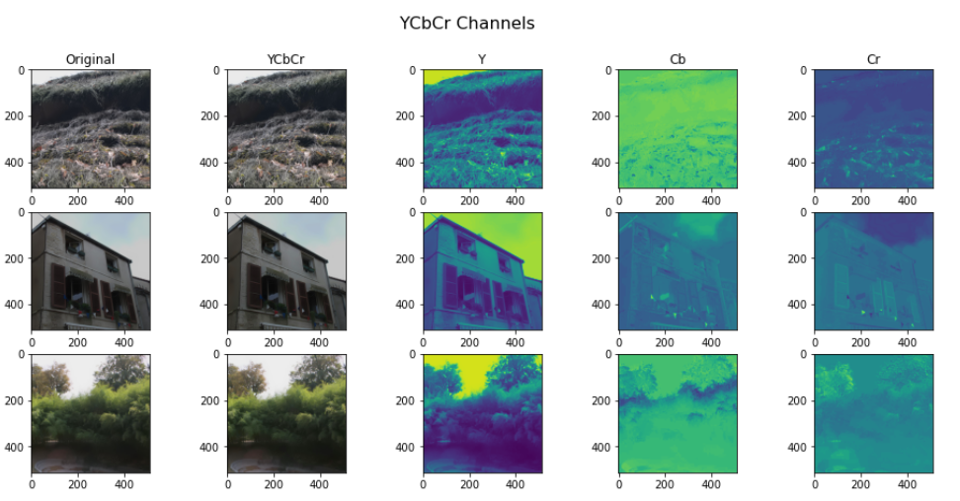
Visualize DCT coefficients: DCT is a transformation technique for data compression and probably a good domain where the data can be hidden, and it can be seen that in the image that only a single 8X8 block was used for analysis, and further it can be seen that there is a much difference in the values of the coefficients; white represents very high values and black very low, so there is a high variance of the data here.
When we did EDA on the images taken from dataset it is found that usually data is hidden in LSB and thus requires RGB to YCbCr conversion

Slide 8
Data Preprocessing and Augmentation
Now we will process the insights that we have gathered by EDA. As we have found that the chances of data being hidden in spatial domain are more than of it being in frequency domain.
Augmentation: It is done to reduce the chances of overfitting of a model. Here images are cloned but they are also rotated or flipped so that the size of training data can be increased and as a result there will be less chances of the model being overfitted.
After Augmentation, the next step is preprocessing the data. Data preprocessing is basically processing the data so that it can be feeded properly to the neural network. It includes converting image channels from BGR to RGB. Further the insights that we have gathered from EDA that spatial domain has high potential of having hidden data so the spatial domain data of the images will be extracted from the images i.e decompressing the original image to its YCbCr components.

Slide 9
Training and Inference
Now as the data has been preprocessed it is ready to be further passed to the model. So we first fit the data to the model and then we train it.The neural network that we have chosen is efficientNet-B2 because of its good accuracy.The dataset contained normal images and three different types of images that are encoded with hidden data using different algorithms which we have already mentioned above.
So, for training and testing purposes we divided the dataset in 8:2 ratio; where 80% images are used for training and 20% are used for testing how better the model performs.
The model is fitted by tuning the hyperparameters i.e learning rate,optimization techniques,num of epochs,batch size etc.

Slide 10
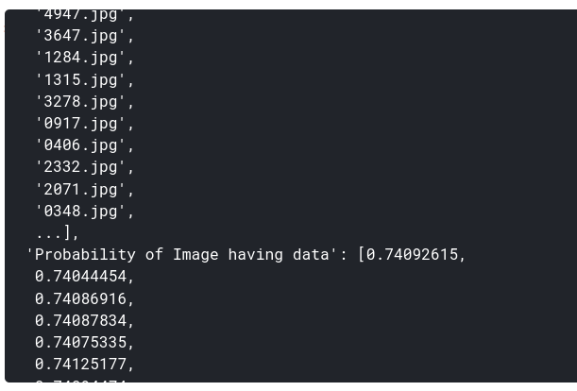
Results and Analysis
For each Id (image) in the test set, we provided a score that indicates how likely this image contains hidden data: the higher the score, the more it is assumed that image contains secret data. After training the data, we obtained a list containing the image id and their label. As we can see the predicted probability is high enough to classify an image as having some hidden data.
Fig- List of ids and their predicted labels

Slide 11
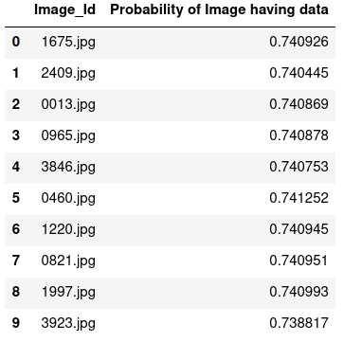
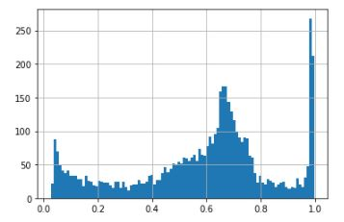
We divided the dataset into 100 bins and plotted the histogram for different bins of images and the range of probabilities predicted for them. As shown a large number of bins have probabilities in range 0.6 to 0.8.
Fig. Histogram of dataset and probabilities

Slide 12
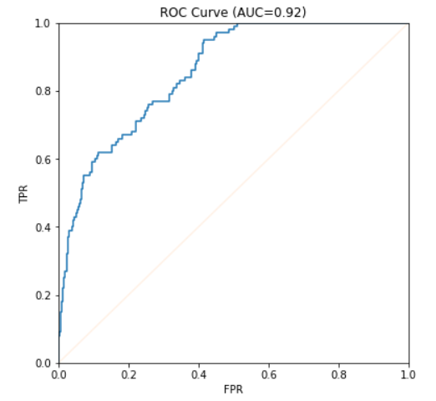
We plotted the ROC curve and chose AUC as the performance metric.We obtained an area of 0.92 under the curve which depicts the high accuracy of the model.
Fig. 9. Resultant ROC curve
Fig. Resultant ROC curve

Slide 13
Conclusion and Future Work
In this project , we have proposed a model which uses a EfficientNet B-2 neural network and trained on a dataset consisting four sets(cover,jmipod,juniverd,uerd) each of 75K images.
It has been demonstrated that this model can beat feature-based methods except in very difficult cases, and is therefore a promising research direction for further performance improvement.
Future works to assist move this inquire about ahead incorporates the taking after:
Supplant 4×4 DCT with more successful channel banks or something proportionate.
Bring the data caused by pooling (subsampling) back by making the Neural Network phase-ware.
Making the Neural Network indeed more profound.
Test the proposed Neural Network on other JPEG steganographic calculations

