Slide 1
ONE SHOT OBJECT DETECTION WITH CO-ATTENTION AND CO-EXCITATION
Prepared by:
Jaidev Chittoria(181IT119)
Ayush Bhandari(181IT209)

Slide 2
INTRODUCTION
The humans has ability to learn new concepts under limited guidance is such as the task of learning to identify and localize a never-before-seen object in an image based on a given query template.
Even without prior knowledge about the object’s category, the human visual system has evolved to be able to handle such a task by performing different functionalities that include grouping the pixels of objects as a whole, extracting distinctive cues for comparison, and exhibiting attention or fixation for localization.
All these can be done under a wide range of variations in object appearances, viewing angles, lighting conditions, and so on. On the other hand for a machine it is quite hard to detect objects that has never been seen before. So here we try to build a system that can perform one shot object detection remarkably.

Slide 3
LITERATURE SURVEY
S.No | Paper | Author | Summary
1 | Leveraging Bottom-Up and Top-Down Attention for Few-Shot Object Detection | Xianyu Chen, Ming Jiang, and Qi Zhao | To improve the performance and interpretability of few-shot object detectors, the author has proposed an attentive few-shot object detection network (AttFDNet) that takes the advantages of both top-down and bottom-up attention
2 | Few-Shot Object Detection with Attention-RPN and Multi-Relation Detector | Qi Fan,Wei Zhuo,Yu-Wing Tai | The author presented a few-shot object detection which aims to detect objects of unseen class with a few training examples. A new dataset was created with 1000 categories of object and the model also had a wide range of applicability.
3 | Comparison Network for One-Shot Conditional Object Detection | Tengfei Zhang,, Yue Zhang, Xian Sun, Hao Sun, Menglong Yan, Xue Yang, Kun Fu | The one-shot detection has been presented as a conditional probability problem. Working towards this, a novel one-shot conditional object detection (OSCD) framework, referred as Comparison Network (ComparisonNet), has been presented. Experiments show that the proposed approach achieves state-of-the-art performance on the proposed datasets of Fashion-MNIST and PASCAL VOC.

Slide 4
4 | Siamese Neural Networks for One-shot Image Recognition | Gregory Koch, Richard Zemel, Ruslan Salakhutdinov | Proposed the method for learning siamese neural networks which use a special structure which helps in ranking similarity between inputs.The method was able to outperforms all baselines by good margin but they only incur the dataset which involves alphabets in images.
5 | Transfer Learning by Borrowing Examples for Multiclass Object Detection | Joseph J. Lim ,Ruslan Salakhutdinov. | Paper discusses how to overcome the lack of training data for certain classes and also provides a novel way of augmenting the training data for each class by borrowing and transforming examples from other classes. It also a improvement over the state of art detector on dataset.

Slide 5
PROBLEM STATEMENT
Solving the problem of one shot object detection i.e when a similar one shot task of localization and perceptual categorization is performed using a framework (co-attention and co-excitation).

Slide 6
OBJECTIVES
Data Preprocessing and annotation of Images.
Developing siamese network to generate feature maps with respect to target-query image pair for similarity calculation.
Performing co attention and co excitation where a local operation is applied to feature maps with respect to query and target image in which the element wise sum over the feature maps is applied.
Final inference to predict the bounding box location of the query image in the target image.

Slide 7
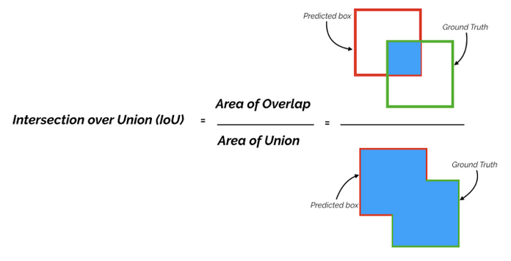

METHODOLOGY
Dataset :
Imagenet
COCO
Performance Metrics
To evaluate the performance of the model the following metrics has been considered
IoU
Average Precision
Average Recall
Mean Average Precision

Slide 8
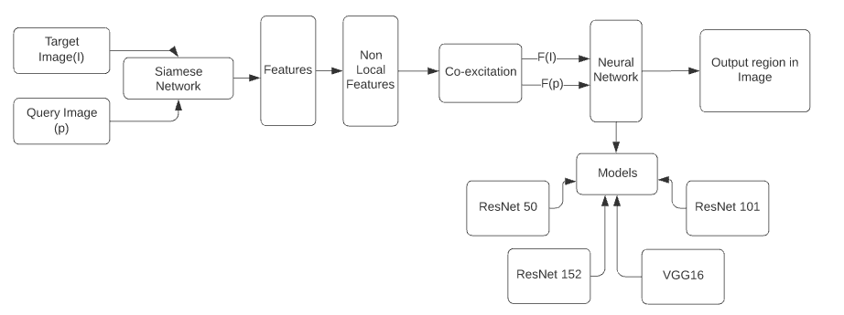
Architecture

Slide 9
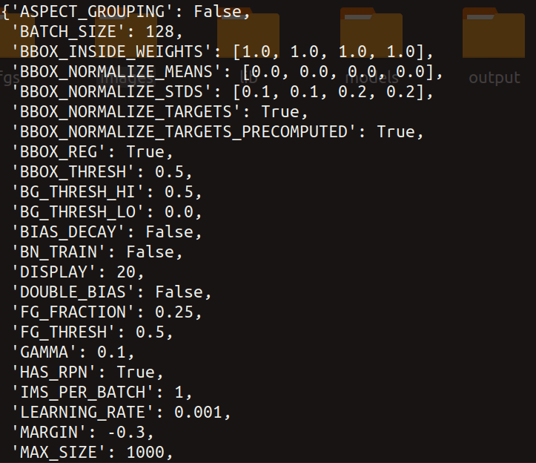
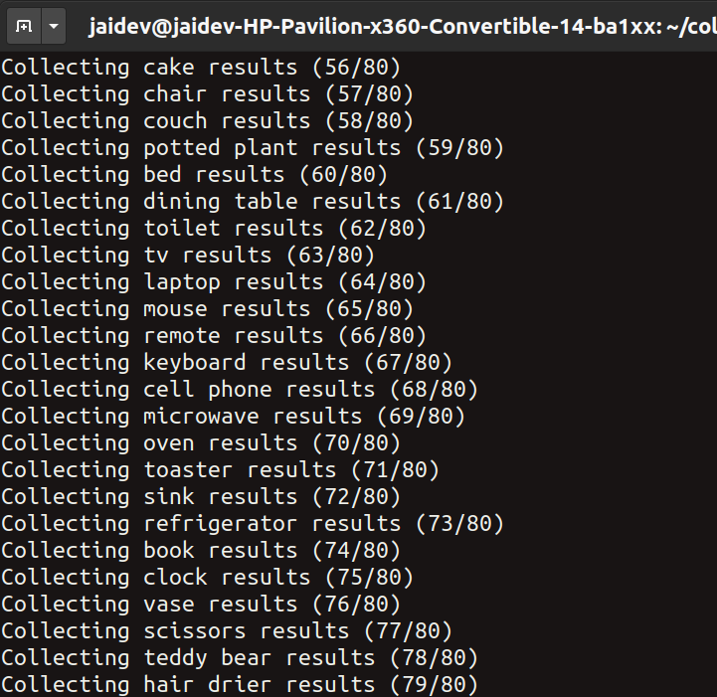
RESULT AND ANALYSIS
Hyperparameters
Target classes

Slide 10
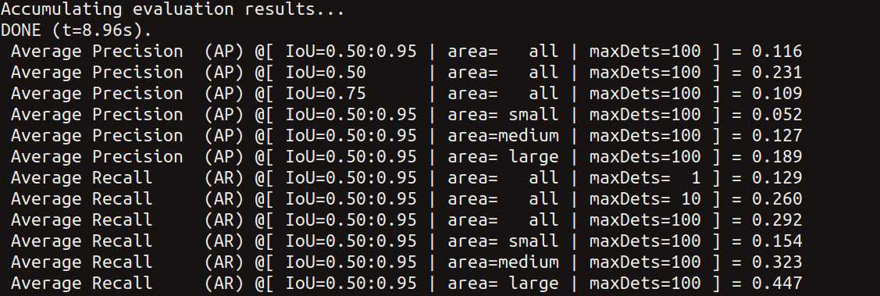
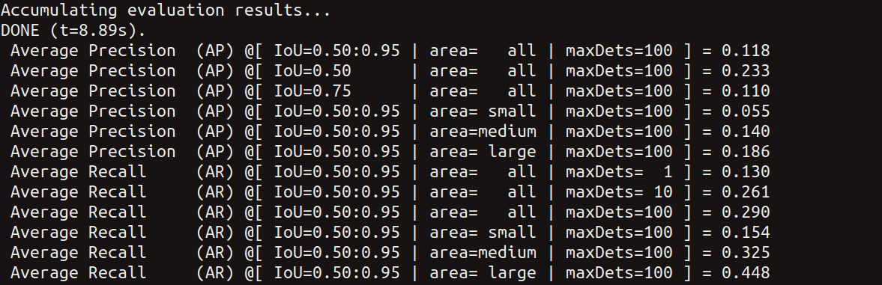
Evaluation results of vgg16
Evaluation results of res50

Slide 11
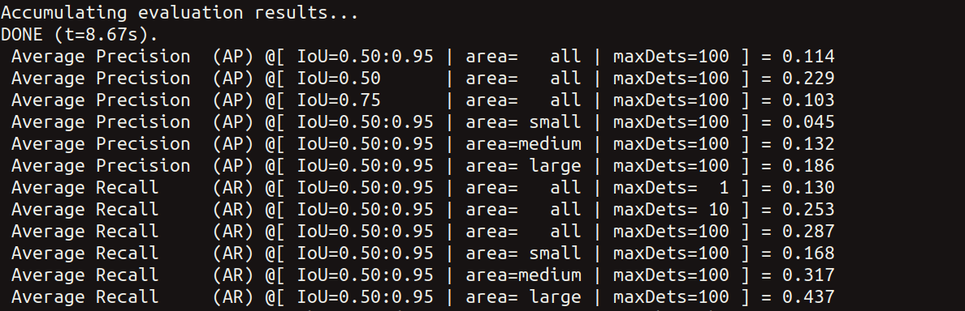
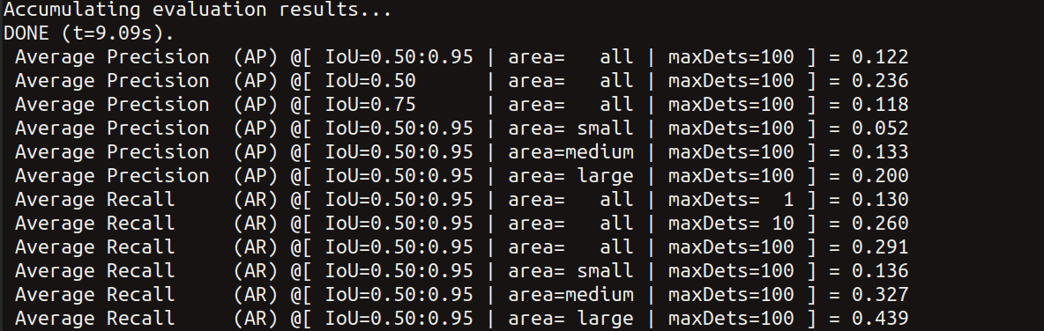
Evaluation results of res152
Evaluation results of res101

Slide 12
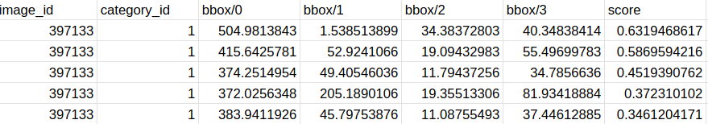
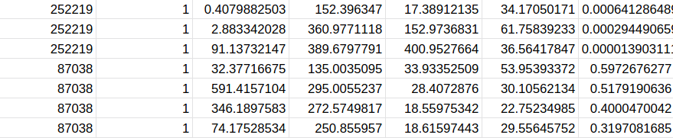
Snapshot of predicted bounding box pixel values and their respective scores

Slide 13

Comparison of different neural networks used on the basis of ap, ar and mAP(mean Average Precision)

Slide 14
CONCLUSION
In this paper both the proposed co-attention and co-excitation techniques were explored and the correlated evidence revealed by the query-target pairs which makes it generic and not heavily biased to the training data as it not completely depend on training labels.As a result, the proposed method can yield non-local object proposals and uses the co-excitation operation to emphasize important features shared by both the query and the target images. On experimenting with different neural network we found that ResNet101 perform best in comparison to other neural network.

Slide 15
Individual Contribution
Jaidev Chittoria: Developing inference and calculation regarding performance metrics
Ayush Bhandari: Data Preprocessing and building of Siamese Network.

Slide 16
Thank You

