Slide 1

Internet of Things
WEEK 1
Ms.Thanmayee
AL, Department of IT, NITK

Slide 2
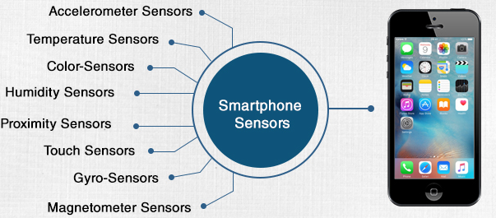
Sensors

Slide 3
Sensors
They perform some input functions by sensing or feeling the physical changes in characteristics of a system in response to a stimuli.
For example heat is converted to electrical signals in a temperature sensor, or atmospheric pressure is converted to electrical signals in a barometer.

Slide 4
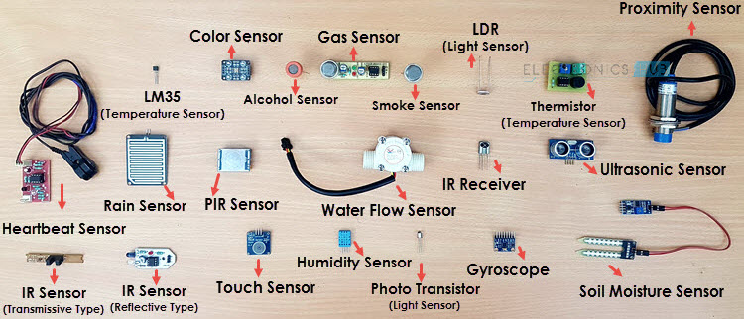
Examples:

Slide 5
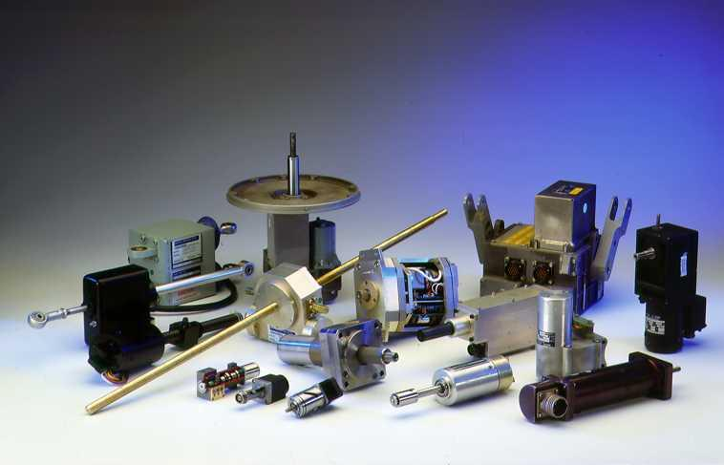
Actuators
Actuators affect the electromechanical or logical state of a product or environment.
Example: Light, valve, motors.

Slide 6
Types of actuators:
Hydraulic
Pneumatic
Electric
Mechanical

