Slide 1

FILE STATUS

Slide 2
OVERVIEW
This helps with the problem of file tracking by providing an interface between user and the officer so that users can track his file.
We have two modules in our project i.e. user and officer along with an admin panel.

Slide 3
KEY FEATURES
User can interact with the official handling his work.
The system involves QR code which makes tracking easy.
This gives a detailed information of file through various officials.

Slide 4
This has a Login and Signup option for users which helps them to create an account so that they can use it if they want in future as well.
Here if the user isn’t happy with the services, he/she can also complain to the senior of the officer because of delay in file.
This app provides transparency in official work.

Slide 5
TECHNOLOGY USED
MongoDB
Express.JS
Angular.JS
Node.JS
Android Studio
Git
AWS EC2

Slide 6
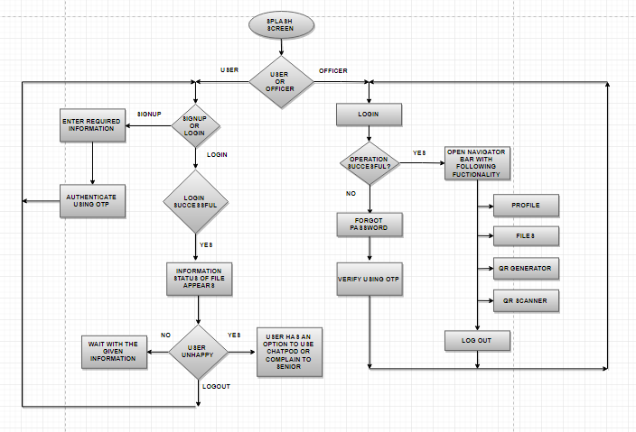
FRONT END FLOW DIAGRAM

Slide 7
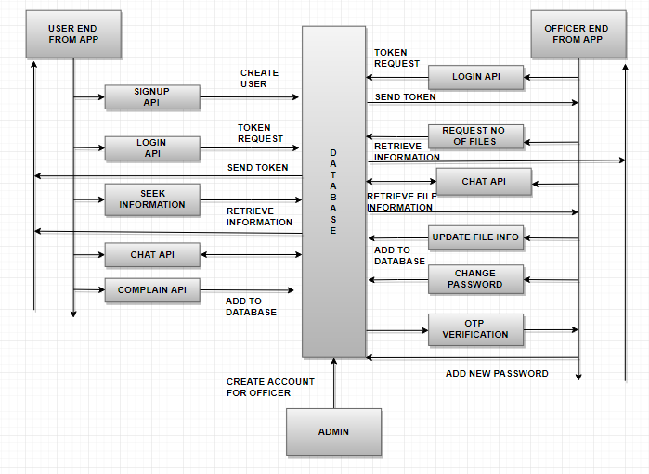
BACK END FLOW DIAGRAM

Slide 8
WHY MEAN
OPEN SOURCE SOFTWARE
ALL FRAMEWORKS USE JAVASCRIPT
USE OF MVC ARCHITECTURE
EASY TO TEST ON CLOUD
SECURITY

Slide 9
SECURITY
Use of middleware in Express.JS
JSON Web Token generation for all API services.
Storage of passwords in encrypted form.
Session management.

Slide 10
FUTURE UPDATES
Implementation using digital signatures like RSA tokens.
Notification service to user with progress in his file.
When linking with social media, Profile pic will be added.
Build on Reactnative.
Can be made in regional language.

Slide 11

ANY QUESTIONS…

Slide 12
TEAM NAME: Code-Rangers
I4c ID : 20147
Team Leader : Trivikram Narayan Singh
College : Chandigarh Engineering College

