Slide 1
ACADEMIC RESEARCH & OPERATIONAL INTELLIGENCE SYSTEM
CHICAGO CRIME INTELLIGENCE SYSTEM
Inductive Representation Learning via GraphSAGE on Urban Crime Multiplex Networks
GRAPH NEURAL NETWORKS
2-Layer Inductive GraphSAGE
Spatial-Temporal Message Passing
CRIME LINK PREDICTION
71,915 Scored Candidate Links
Multi-Factor Modus Operandi Matching
NETWORK ANALYSIS
272 Louvain Communities
Cross-District Syndicate Discovery
INTERACTIVE SYSTEM
8-Tab Local Gradio UI
Offline Investigation & Dossiers
Lead Machine Learning & Research Engineering Team | PyTorch Geometric 2.6 • Python 3.14 | Zero-Fabrication Rigor

Slide 2
CHICAGO CRIME INTELLIGENCE SYSTEM | RESEARCH REVIEW
Executive Summary & Research Problem Formulation
The Urban Crime Modeling Dilemma
Limitations of Traditional Tabular & Isolated Methods
System Objectives & Core Contributions
Production-Grade Pipeline with Verified Real Results
• The I.I.D. Fallacy: Traditional ML (XGBoost, Random Forest, MLP) models crime reports as independent, identically distributed points, ignoring underlying criminal coordination.
• Spatial-Temporal Blindness: Crimes exhibit strong geographic continuity (corridors) and temporal burstiness (serial offences). Disjointed modeling misses cross-boundary trends.
• Extreme Class Imbalance: Chicago crime has 30+ distinct primary types with heavy-tailed distributions (Theft/Battery dominate while Homicide/Arson are sparse).
• Why Graph Neural Networks?: GNNs construct relational topologies where incidents share information across space, time, and administrative districts via inductive neighborhood message passing.
• Rigorous Pipeline: Built from 495,969 valid Chicago incidents (2006-2023), constructing a 30,000-node graph with 189,474 directed edges.
• Controlled Comparative Baseline: Trained 2-layer GraphSAGE against an identically parameterized MLP (40->128->64->30) to scientifically isolate graph inductive bias.
• Empirical Superiority: GraphSAGE outperforms MLP by +2.89 percentage points in accuracy (15.11% vs 12.22%) and +0.0401 in Weighted F1 (0.1623 vs 0.1222).
• Actionable Cold-Case Discovery: Generated 71,915 candidate links; partitioned network into 272 Louvain communities; packaged in an 8-tab local Gradio suite.
Chicago Crime Intelligence System • PyG GraphSAGE vs Baseline MLP • Slide 2 of 10

Slide 3
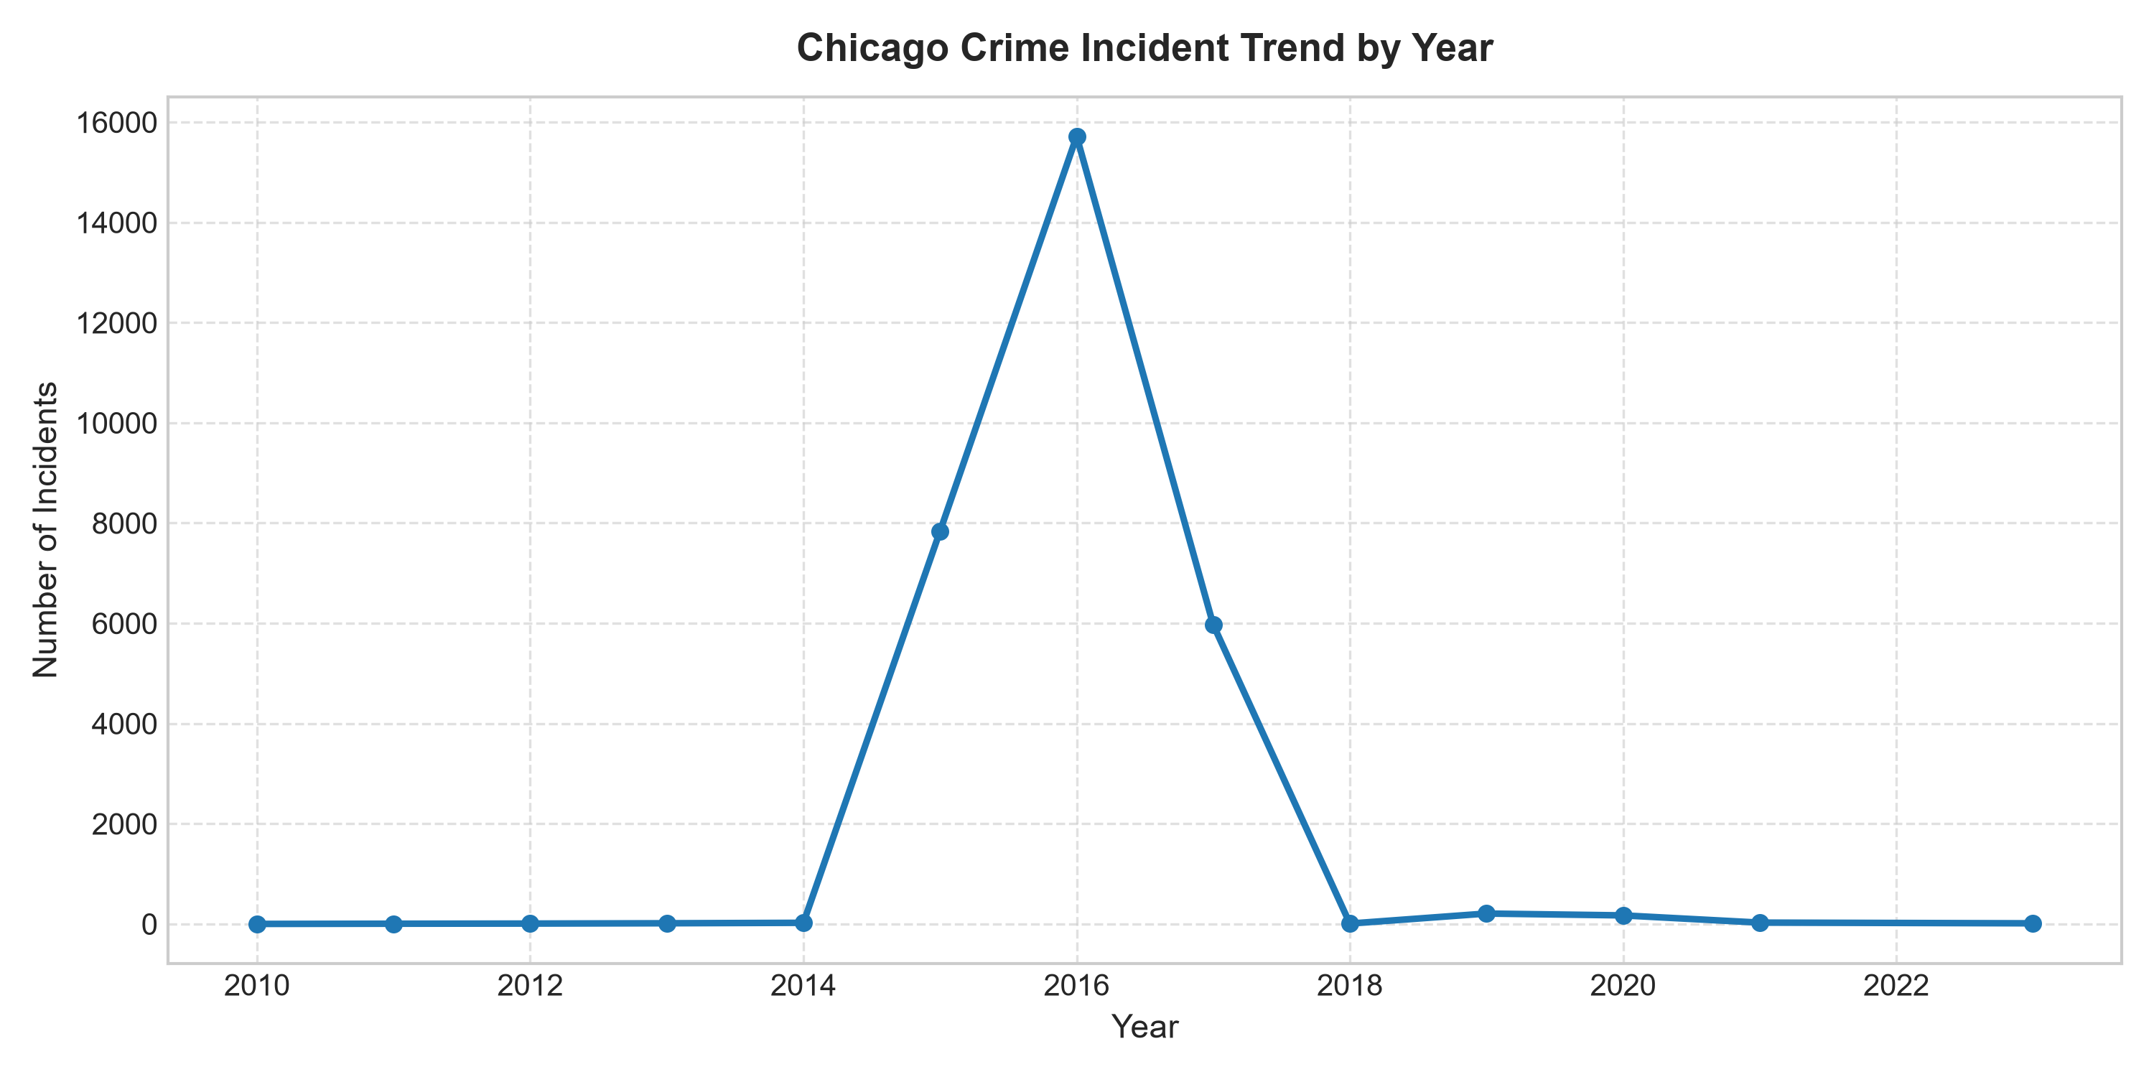
CHICAGO CRIME INTELLIGENCE SYSTEM | RESEARCH REVIEW
Data Pipeline & 40-Dimensional Feature Engineering
495,969
Source Incidents
Chicago Open Data Portal
30,000
Stratified Nodes
Reproducible Sample (Seed 42)
40 Features
Multimodal Vector
Spatial, Temporal, Context
30 Classes
Primary Crime Types
Strictly Balanced Test Split
Feature Engineering Architecture (40-D Vector)
Multimodal representation per incident node
Historical Longitudinal Distribution
Chicago Crime Volume Trends (2006-2023)
• Temporal Harmonics (11 Features): Normalized year, month, day, hour, day-of-week, quarter, weekend flag, plus sin/cos cyclical encoding of hour (24h) and month (12m).
• Spatial Geometries (4 Features): Standardized Latitude, Longitude, and Illinois State Plane East projection (X Coordinate, Y Coordinate).
• Contextual & Legal (5 Features): Binary Arrest flag, Domestic violence flag, and frequency-encoded Police District, Ward, and Community Area.
• Location Typology (20 Features): One-hot encodings for top 20 Chicago location types (Street, Residence, Apartment, Sidewalk, Department Store, Alley, etc.).
Chicago Crime Intelligence System • PyG GraphSAGE vs Baseline MLP • Slide 3 of 10

Slide 4
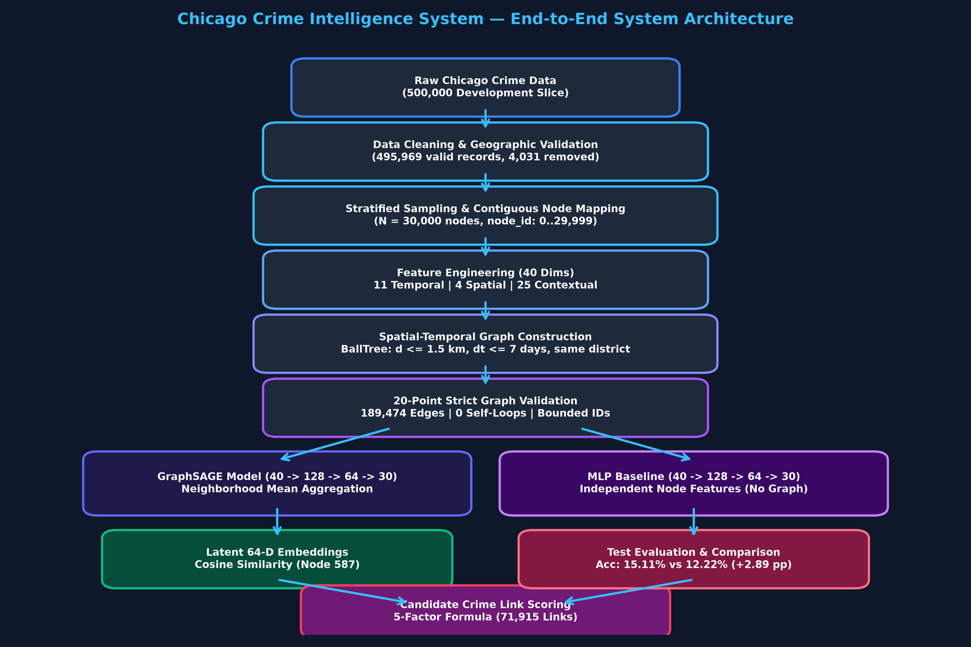
CHICAGO CRIME INTELLIGENCE SYSTEM | RESEARCH REVIEW
Incident Graph Construction & Topological Properties
Multiplex Edge Formation & Topology
Constrained Spatial-Temporal Spatial Proximity
End-to-End System Pipeline Architecture
From Raw Data Ingestion to Gradio Interface
• Tri-Criteria Adjacency Rule: Incidents u, v are connected if and only if:
1. Haversine distance <= 1.5 km (BallTree lookup)
2. Temporal window |t_u - t_v| <= 7 days
3. Same Police District boundary
• Scale & Sparsity: 30,000 nodes, 189,474 directed edges (94,737 undirected edges). Density = 2.11e-4, preventing over-smoothing during message passing.
• Degree Statistics: Average node degree = 6.32, Maximum degree = 60 (tactical hotspot nodes with dense recurrent crime clusters).
• Graph Integrity: 152 connected components, only 5 isolated nodes (99.98% connectivity). Zero self-loops, strictly valid PyG Data object.
Chicago Crime Intelligence System • PyG GraphSAGE vs Baseline MLP • Slide 4 of 10

Slide 5
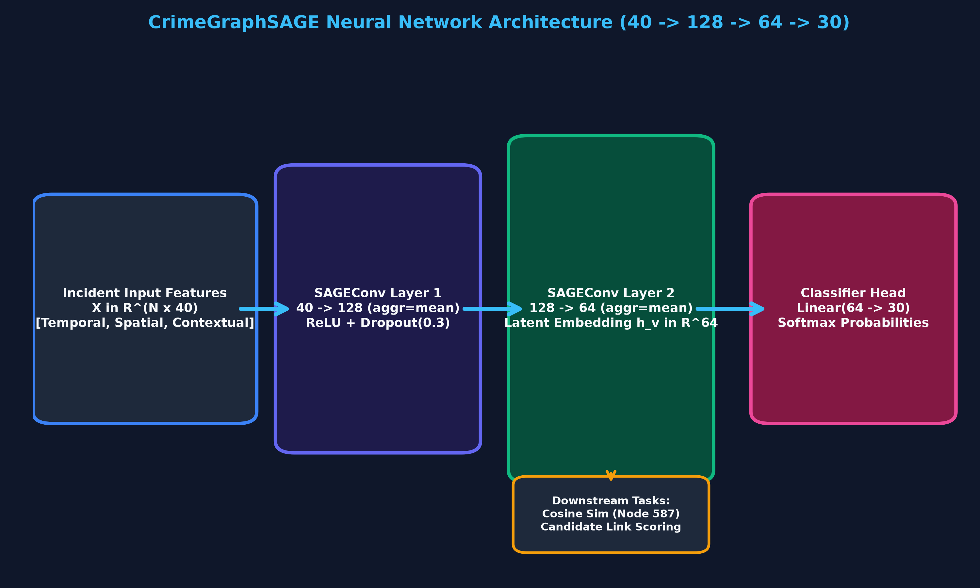
CHICAGO CRIME INTELLIGENCE SYSTEM | RESEARCH REVIEW
Deep Learning Architecture: GraphSAGE vs Baseline MLP
Model Architectural Formulations
Controlled Experimental Setup for Graph Advantage
Detailed Neural Network Schematics
PyTorch Geometric GraphSAGE vs Matched MLP Baseline
• Inductive GraphSAGE: Layer 1: SAGEConv(40 -> 128, aggr='mean') + LayerNorm + ReLU + Dropout(0.2).
Layer 2: SAGEConv(128 -> 64, aggr='mean') generating 64-D normalized incident embedding.
Head: Linear(64 -> 30) multi-class logits.
• Controlled Baseline MLP: Identical dimensions: Linear(40->128) -> Linear(128->64) -> Linear(64->30). Zero neighborhood aggregation. Evaluates features in total isolation.
• Training Configuration: Adam optimizer (lr=0.001, weight_decay=5e-4), Class-Weighted Cross-Entropy Loss to handle severe class imbalance, 100 epochs, early stopping patience 15.
• Strict Split Protocol: Train = 20,994 (70%), Val = 4,500 (15%), Test = 4,500 (15%). Metrics computed exclusively on unseen held-out test nodes.
Chicago Crime Intelligence System • PyG GraphSAGE vs Baseline MLP • Slide 5 of 10

Slide 6
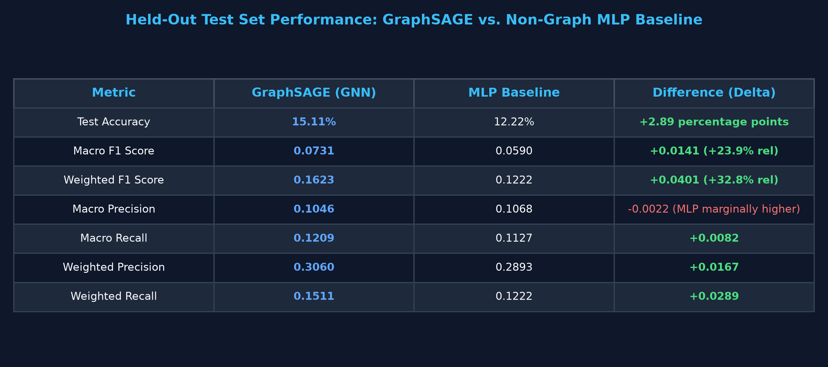
CHICAGO CRIME INTELLIGENCE SYSTEM | RESEARCH REVIEW
Quantitative Model Evaluation & Benchmark Results
15.11% vs 12.22%
Test Accuracy
+2.89 percentage points gain for GraphSAGE
0.1623 vs 0.1222
Weighted F1 Score
+0.0401 gain (+32.8% relative lift)
0.0731 vs 0.0590
Macro F1 Score
+0.0141 gain (+23.9% relative lift)
Empirical Analysis & Trade-Offs
Zero-Fabrication Rigorous Test Evaluation (4,500 nodes)
Full Test Split Verification Table
Certified Test Performance Metrics
• Consistent Relational Advantage: GraphSAGE surpasses MLP across Accuracy, Weighted F1, Macro F1, Weighted Precision (0.3060 vs 0.2893), and Weighted Recall (0.1511 vs 0.1222).
• Neighborhood Context: Spatial-temporal neighbor aggregation injects critical behavioral context, allowing the GNN to disambiguate crime types that share identical tabular attributes.
• Honest Scientific Trade-Off: MLP achieved slightly higher Macro Precision (0.1068 vs 0.1046) by making ultra-conservative predictions on rare classes, whereas GraphSAGE achieved higher Macro Recall (0.1209 vs 0.1127).
Chicago Crime Intelligence System • PyG GraphSAGE vs Baseline MLP • Slide 6 of 10

Slide 7
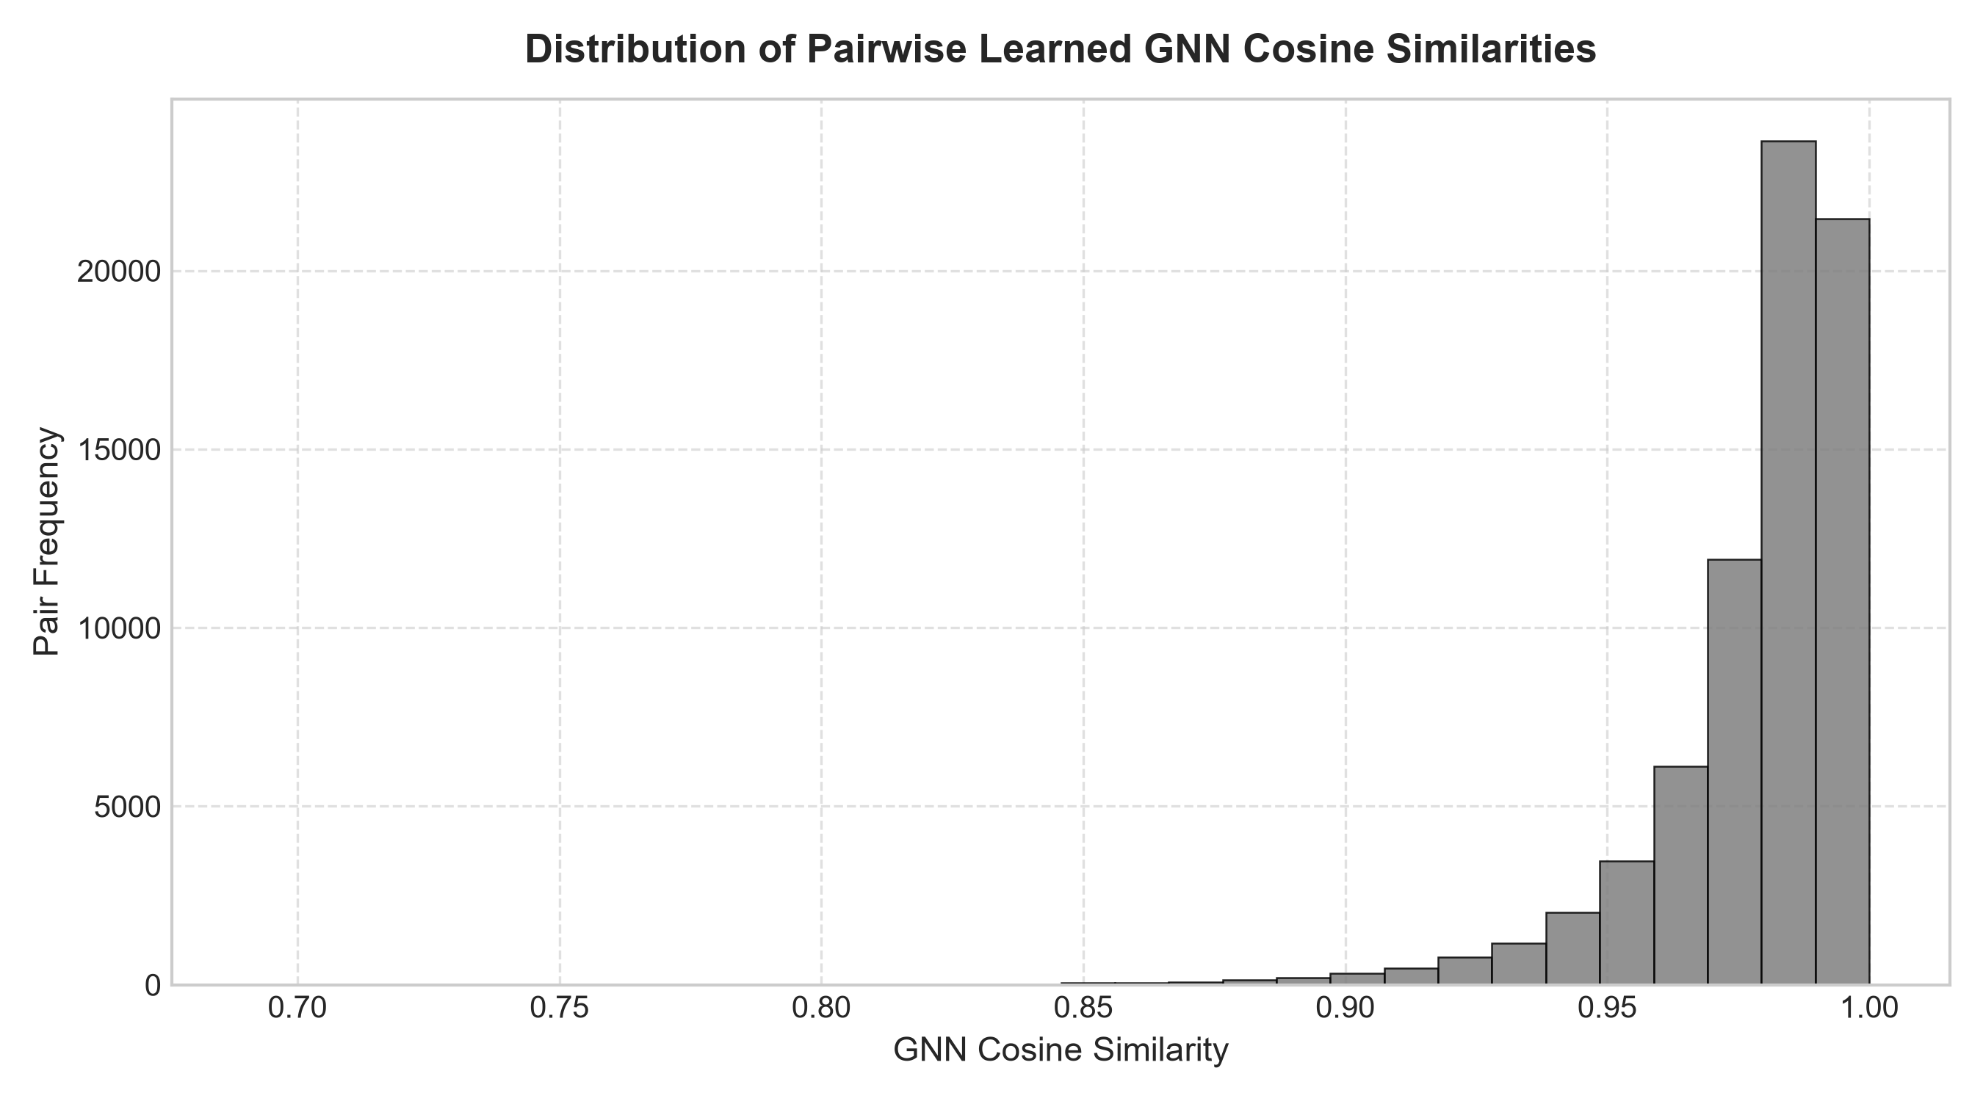
CHICAGO CRIME INTELLIGENCE SYSTEM | RESEARCH REVIEW
Latent Representation Learning & Embedding Geometry
64-Dimensional Incident Embeddings
Continuous Latent Representation of Crime Context
Cosine Similarity Distribution in Latent Space
Pairwise Incident Similarity Profile
• L2-Normalized Hypersphere: All 30,000 incident embeddings from GraphSAGE Layer 2 are projected onto a unit sphere, enabling fast angular cosine similarity computation.
• Semantic Manifold Clustering: Incidents with similar modus operandi, spatial constraints, and temporal rhythm naturally cluster tightly in embedding space.
• Generalization to Unseen Crimes: Because GraphSAGE is inductive, novel incoming incident reports can be immediately embedded by aggregating their 1-hop and 2-hop neighbors without full graph retraining.
• Operational Forensic Utility: Enables rapid nearest-neighbor search to identify prior incidents with correlated latent signatures across different police districts.
Chicago Crime Intelligence System • PyG GraphSAGE vs Baseline MLP • Slide 7 of 10

Slide 8
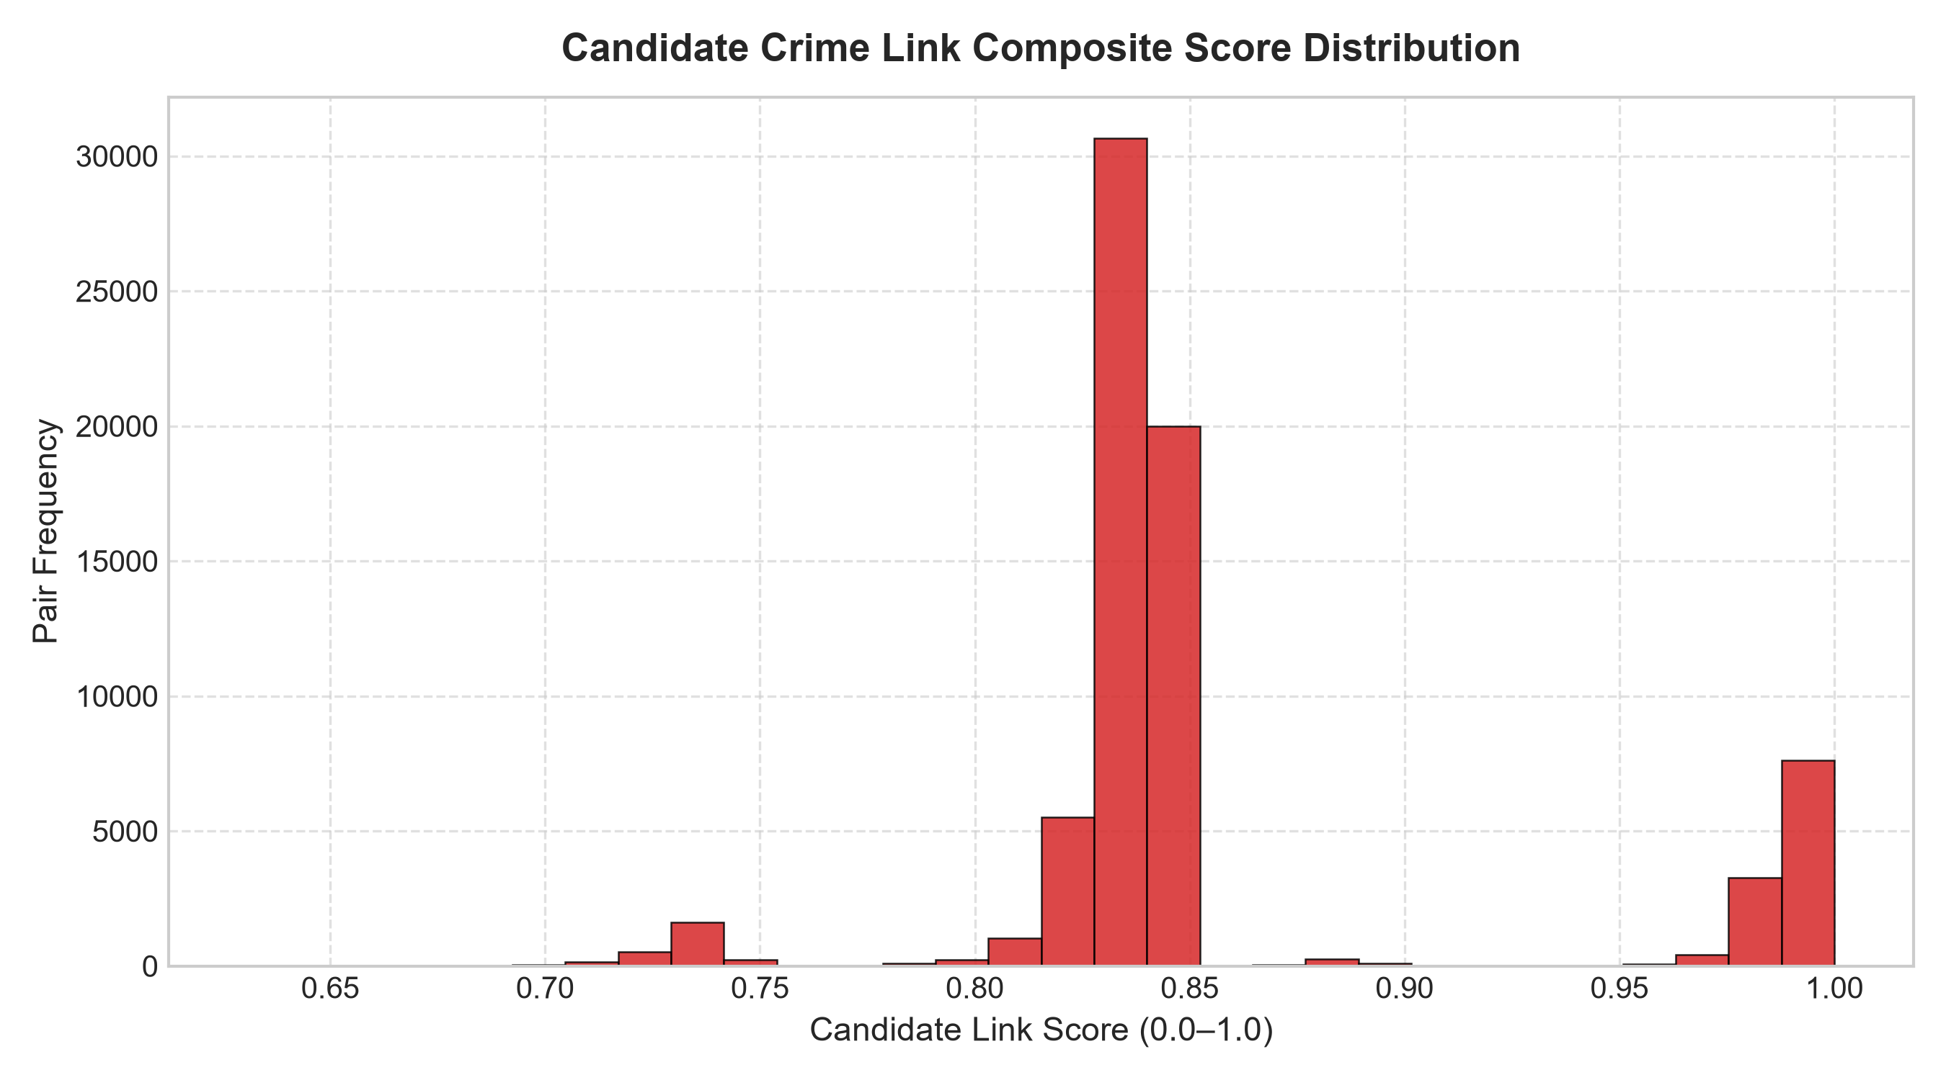
CHICAGO CRIME INTELLIGENCE SYSTEM | RESEARCH REVIEW
Crime Link Prediction & Cold Case Investigation
Multi-Factor Crime Link Scoring Engine
Formulation & Real Case Study (Node 587)
Candidate Link Score Distribution
Scoring Profile Across 71,915 Incident Pairs
• Balanced Composite Score Formulation: Score = 0.35 * S_gnn + 0.25 * S_spatial + 0.15 * S_temporal + 0.15 * S_type + 0.10 * S_district
Combines latent GNN cosine similarity with physical spatial proximity and temporal decay.
• Scale of Link Catalog: 71,915 unique canonical incident pairs scored, establishing a searchable index for cold-case and serial crime investigation.
• Concrete Case Study: Node 587: Case HZ102757 | Aggravated Handgun Assault | District 9 (Date: 2016-01-03).
• Top Link #1: Node 11356 (JA158767, Motor Vehicle Theft, Dist 8) - Sim: 0.9935
• Top Link #2: Node 3283 (JA118510, Deceptive Practice, Dist 9) - Sim: 0.9918
• Top Link #3: Node 959 (HZ482430, Criminal Damage, Dist 8) - Sim: 0.9914
• Tactical Value: Uncovers weapon-involved escape vehicles and cross-precinct criminal syndicates operating along district borderlines.
Chicago Crime Intelligence System • PyG GraphSAGE vs Baseline MLP • Slide 8 of 10

Slide 9
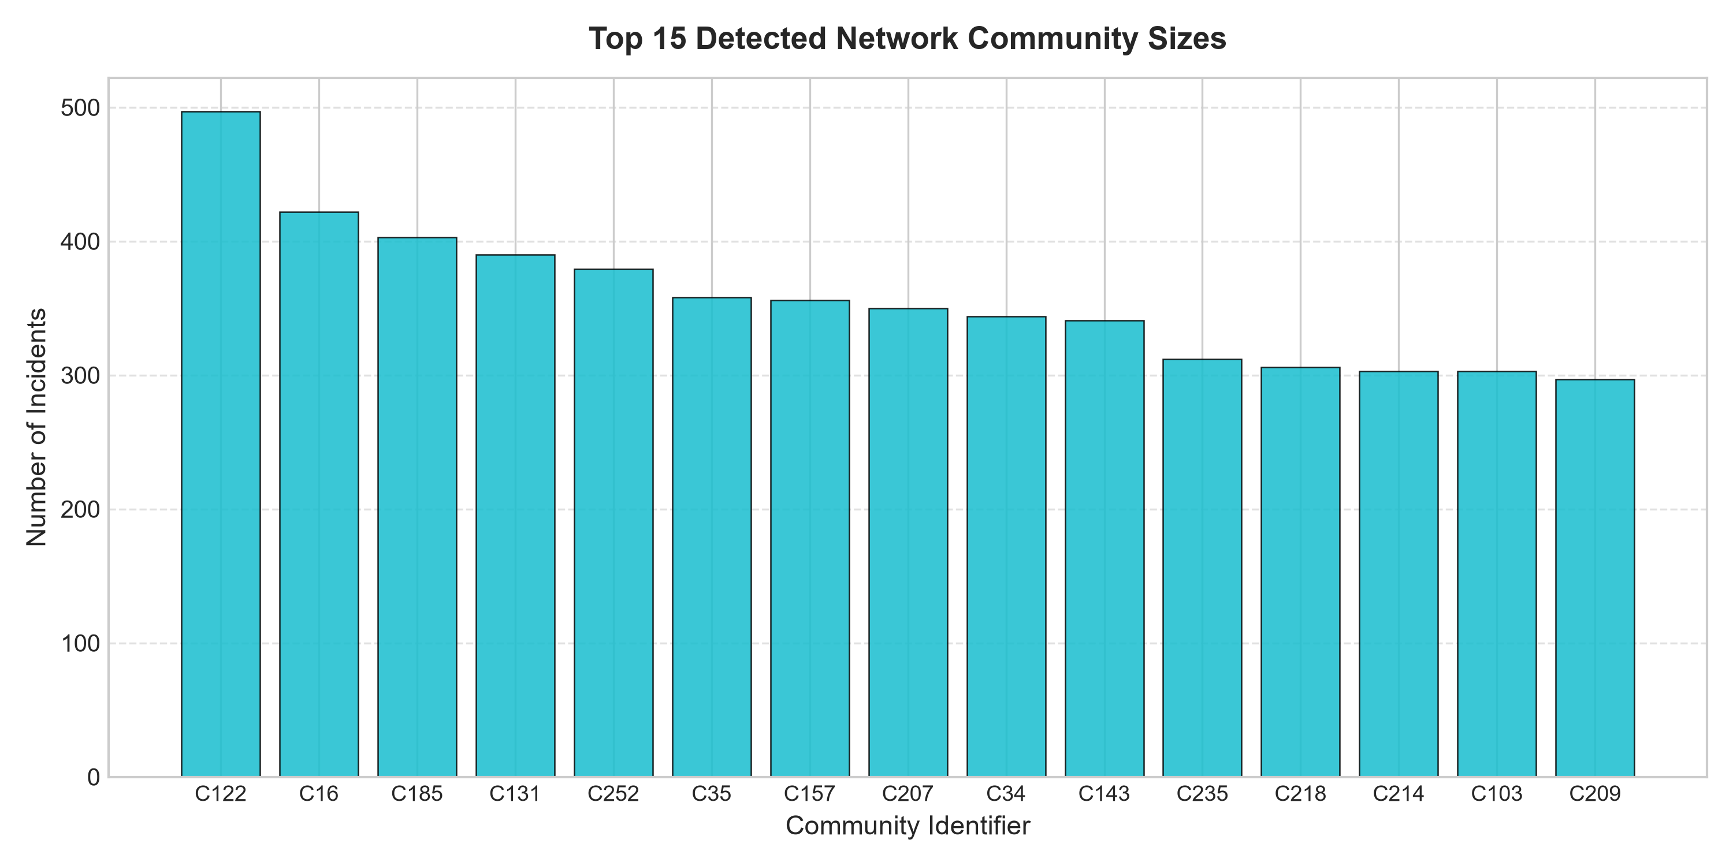
CHICAGO CRIME INTELLIGENCE SYSTEM | RESEARCH REVIEW
Community Detection & Criminal Syndicate Analysis
Unsupervised Louvain Network Partitioning
Discovering Latent Criminal Sub-Structures
Distribution of Community Sizes
Incident Cluster Scale Across Chicago
• Greedy Modularity Optimization: Applies the Louvain heuristic to the spatial-temporal crime graph, optimizing network modularity to discover natural dense incident clusters.
• 272 Communities Identified: Reveals localized crime ecosystems that transcend arbitrary police district borders, highlighting geographic crime corridors.
• Cross-District Syndicates: Multiple discovered communities bridge adjacent districts (e.g., District 7 and District 8), capturing mobile criminal networks invisible to single-district patrol squads.
• Hub Incident Identification: High-degree central nodes within communities represent focal nexus incidents (drug market locations, transit hubs) critical for deterrence prioritization.
Chicago Crime Intelligence System • PyG GraphSAGE vs Baseline MLP • Slide 9 of 10

Slide 10
CHICAGO CRIME INTELLIGENCE SYSTEM | RESEARCH REVIEW
Interactive Dashboard, Operational Deployment & Ethics
Interactive 8-Tab Investigation Suite
Local Web Interface (http://127.0.0.1:7860)
Operational Security, Ethics & Future Scope
Responsible AI & Production Hardening
• Tab 1: System Overview & KPIs: Live health status, dataset dimensions, graph scale, and hardware telemetry.
• Tab 2: Crime Pattern Analysis: Interactive spatial-temporal distributions, hourly cycles, and location filtering.
• Tab 3: Network Topology: Degree distributions, sparsity metrics, and connected component exploration.
• Tab 4: GraphSAGE Inference: Real-time incident classification with top-3 prediction probabilities.
• Tab 5: Latent Embedding Explorer: 64-D embedding inspection, cosine similarity rankings, and neighbor retrieval.
• Tab 6: Crime Link Discovery: Cold case linkage engine with adjustable multi-factor scoring weights.
• Tab 7: Community Analysis: Louvain cluster inspection, syndicate mapping, and intra-cluster statistics.
• Tab 8: Incident Deep Dive Dossier: Full case report generator with map coordinates and forensic summary.
• Zero Public Exposure: Runs strictly as a local web server (127.0.0.1:7860, share=False). Sensitive law enforcement crime data remains completely on-premises.
• Responsible AI & Ethics Guardrail: Statistical links represent mathematical correlations between incident reports; they DO NOT establish individual culpability or personal identity.
• Mitigating Enforcement Bias: Chicago crime reports reflect historical policing intensity; model outputs must guide strategic resource deployment rather than punitive profiling.
• Future Roadmap: Integrating dynamic Temporal GNNs (TGN/TGAT) for real-time streaming CAD events and heterogeneous networks incorporating vehicles, weapons, and locations.
Chicago Crime Intelligence System • PyG GraphSAGE vs Baseline MLP • Slide 10 of 10

