Slide 1
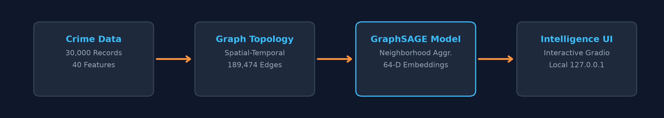
ACADEMIC PROJECT PRESENTATION | COLLEGE REVIEW & VIVA EVALUATION
CHICAGO CRIME INTELLIGENCE SYSTEM
GraphSAGE-Based Crime Classification, Candidate Link Prediction and Network Analytics
Project Investigators:
• A. JAI AAKAASH – 23MIA1092 • THARUNIKA RAVIKUMAR – 23MIA1090
Chicago Crime Intelligence System • A. Jai Aakaash (23MIA1092) & Tharunika Ravikumar (23MIA1090) • Slide 1 of 10

Slide 2
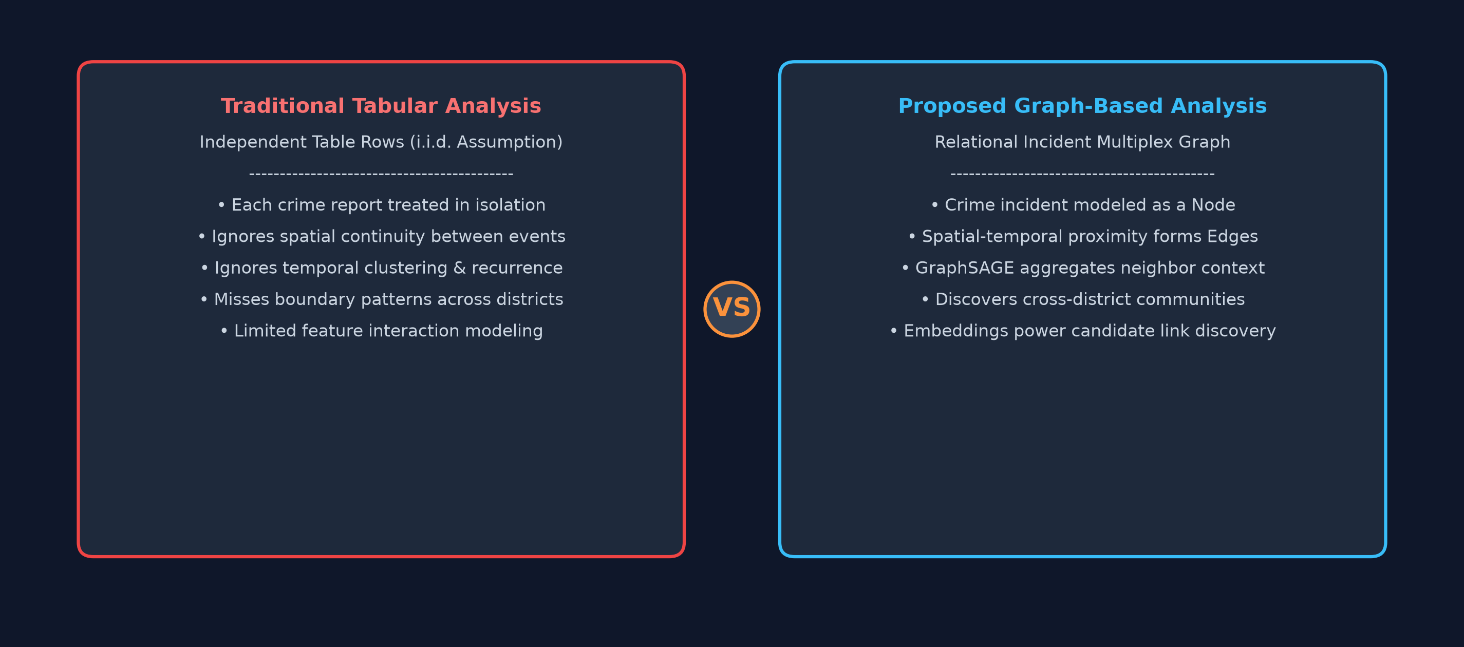
CHICAGO CRIME INTELLIGENCE SYSTEM | ACADEMIC PROJECT PRESENTATION
Problem & Objectives
Problem & Graph-Based Approach
From Isolated Table Rows to Relational Networks
Project Objectives
Concrete Milestones Executed in Pipeline
• The Problem: Traditional crime analysis often treats every incident as an independent table row, ignoring inherent spatial and temporal connections.
• Incident Relationships: Real-world crimes share latent relationships based on location, time, police district, and crime characteristics.
• Our Approach: Represent crime incidents as an attributed graph where each incident = Node, and spatial-temporal relationships = Edges.
• GraphSAGE Mechanism: Uses neighborhood message passing to aggregate information from connected neighboring incidents to learn better representations.
• Data Pipeline: Process and clean Chicago crime data; select a reproducible 30,000-incident sample.
• Feature Engineering: Engineer exactly 40 numerical features (temporal, spatial, contextual, location typology).
• Graph Construction: Construct spatial-temporal crime graph using distance, time window, and district rules.
• Model Training: Train a 2-layer GraphSAGE classifier and train an identical MLP baseline for fair comparison.
• Representation Learning: Generate 64-dimensional embeddings; query similar incidents using cosine similarity.
• Link Prediction: Generate multi-factor candidate incident links (71,915 unique pairs scored).
• Network Analytics: Analyze graph degree centrality, connected components, and 272 Louvain communities.
• Interactive UI: Develop an interactive local dashboard running on 127.0.0.1:7860.
Chicago Crime Intelligence System • A. Jai Aakaash (23MIA1092) & Tharunika Ravikumar (23MIA1090) • Slide 2 of 10

Slide 3
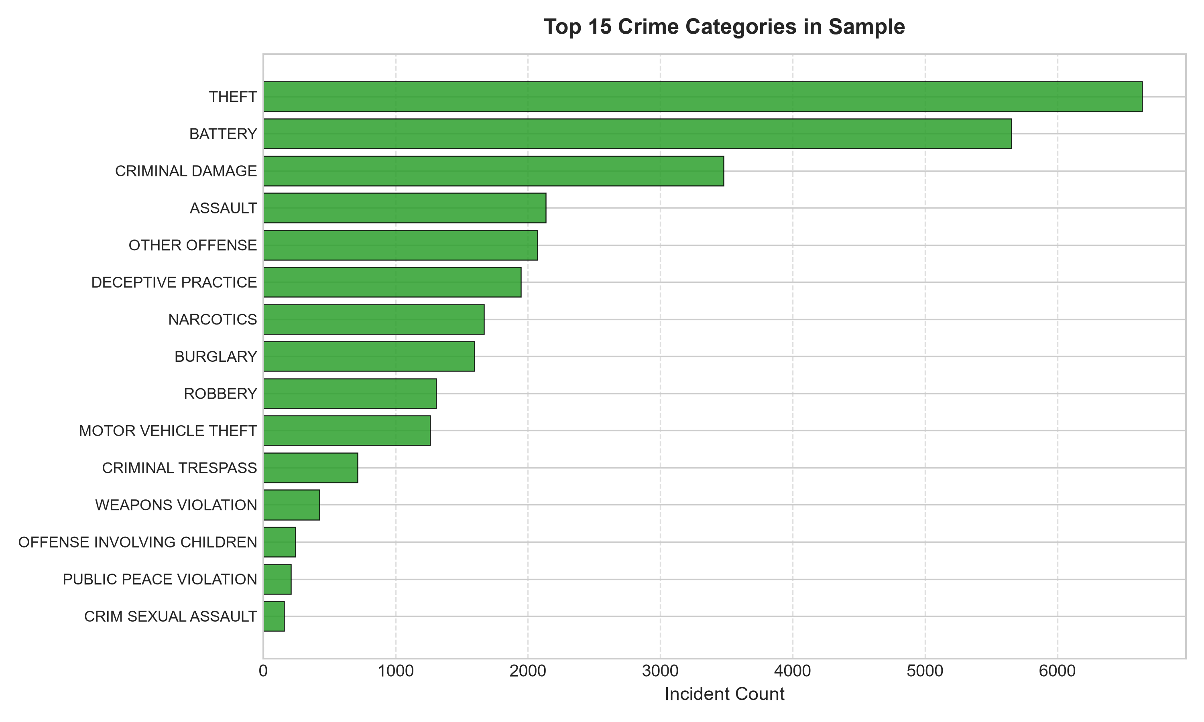
CHICAGO CRIME INTELLIGENCE SYSTEM | ACADEMIC PROJECT PRESENTATION
Dataset & Feature Engineering
7.8M+
Raw Chicago Records
City Open Data Portal
30,000
Experimental Incidents
Reproducible Sample (Seed 42)
40
Engineered Features
11 Temp + 4 Spat + 25 Context
30
Target Crime Classes
Covering July 2006 to March 2023
Dataset Splits & Feature Breakdown
Strict Experimental Protocol (No Model Trained on 7.8M+)
Crime Category Distribution
Pareto Breakdown of 30 Incident Categories
• Sampling Scope: Raw Chicago dataset has 7.8M+ records. After cleaning and geographic validation, an experimental sample of 30,000 incidents was drawn (July 2006 – March 2023).
• Data Splits: Training: 20,994 incidents (~70%)
Validation: 4,500 incidents (15%)
Testing: 4,500 incidents (15%)
• Feature Breakdown (40 Numerical): • Temporal = 11 (year, month, day, hour, day-of-week, quarter, weekend, cyclical sin/cos)
• Spatial = 4 (standardized lat/lon, X/Y State Plane)
• Contextual = 5 (arrest, domestic, district, ward, area)
• Location Typology = 20 (one-hot location categories)
Chicago Crime Intelligence System • A. Jai Aakaash (23MIA1092) & Tharunika Ravikumar (23MIA1090) • Slide 3 of 10

Slide 4
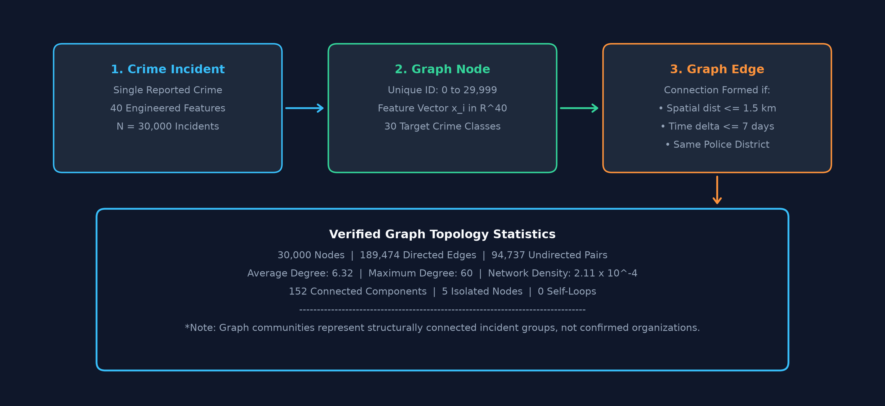
CHICAGO CRIME INTELLIGENCE SYSTEM | ACADEMIC PROJECT PRESENTATION
Crime Graph Construction
Spatial-Temporal Edge Formation
Connection Criteria & Network Topology
Multiplex Graph Construction Architecture
Visualizing Incident-to-Edge Transformation
• Graph Formulation: Each crime incident is modeled as a Graph Node with 40 numerical features.
• Tri-Criteria Connection Rule: A graph edge is established if and only if:
1. Spatial distance <= 1.5 km (BallTree lookup)
2. Temporal difference <= 7 days (168 hours)
3. Same police administrative district
• Verified Graph Statistics: • 30,000 Nodes
• 189,474 Directed Edges (94,737 Undirected Pairs)
• Average Degree: 6.32 (Max Degree: 60)
• 152 Connected Components
• 5 Isolated Nodes (99.98% Connected)
• 0 Self-Loops
• Scientific Note: Graph communities represent structurally connected incident groups. They are NOT confirmed crime syndicates.
Chicago Crime Intelligence System • A. Jai Aakaash (23MIA1092) & Tharunika Ravikumar (23MIA1090) • Slide 4 of 10

Slide 5
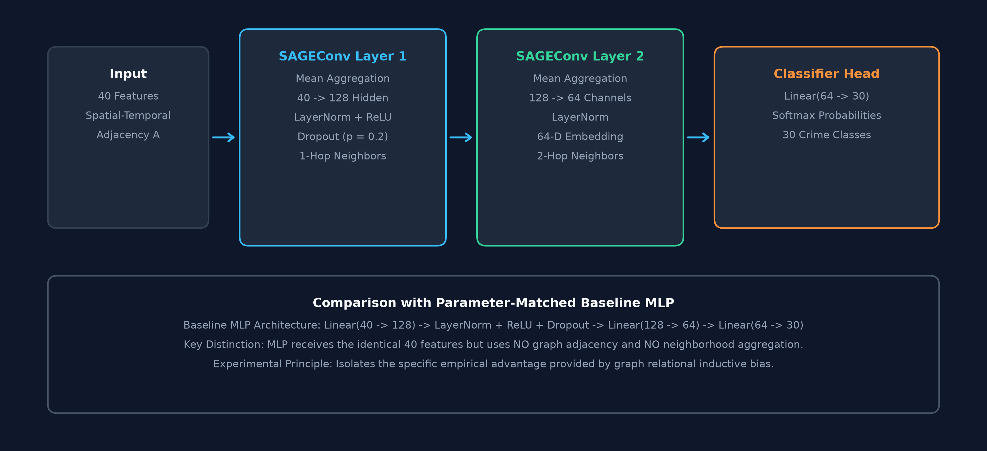
CHICAGO CRIME INTELLIGENCE SYSTEM | ACADEMIC PROJECT PRESENTATION
GraphSAGE Architecture
Neighborhood Aggregation Pipeline
Inductive Graph Representation Learning
Neural Network Structural Diagram
GraphSAGE Message Passing vs Baseline MLP
• Model Architecture: 40 Features → SAGEConv → 128 Hidden → LayerNorm + ReLU + Dropout(0.2) → SAGEConv → 64-Dimensional Embedding → 30-Class Classifier Head.
• Mean Aggregator: Computes the element-wise mean of neighbor feature vectors, combining the node's own features with local context.
• Inductive Representation: Node's own features + Neighbor information → GraphSAGE → Learned 64-D continuous representation.
• Baseline MLP Model: Identical dimensions: 40 → 128 → 64 → 30.
Receives the exact same 40 features but uses NO graph adjacency and NO neighborhood aggregation.
Chicago Crime Intelligence System • A. Jai Aakaash (23MIA1092) & Tharunika Ravikumar (23MIA1090) • Slide 5 of 10

Slide 6
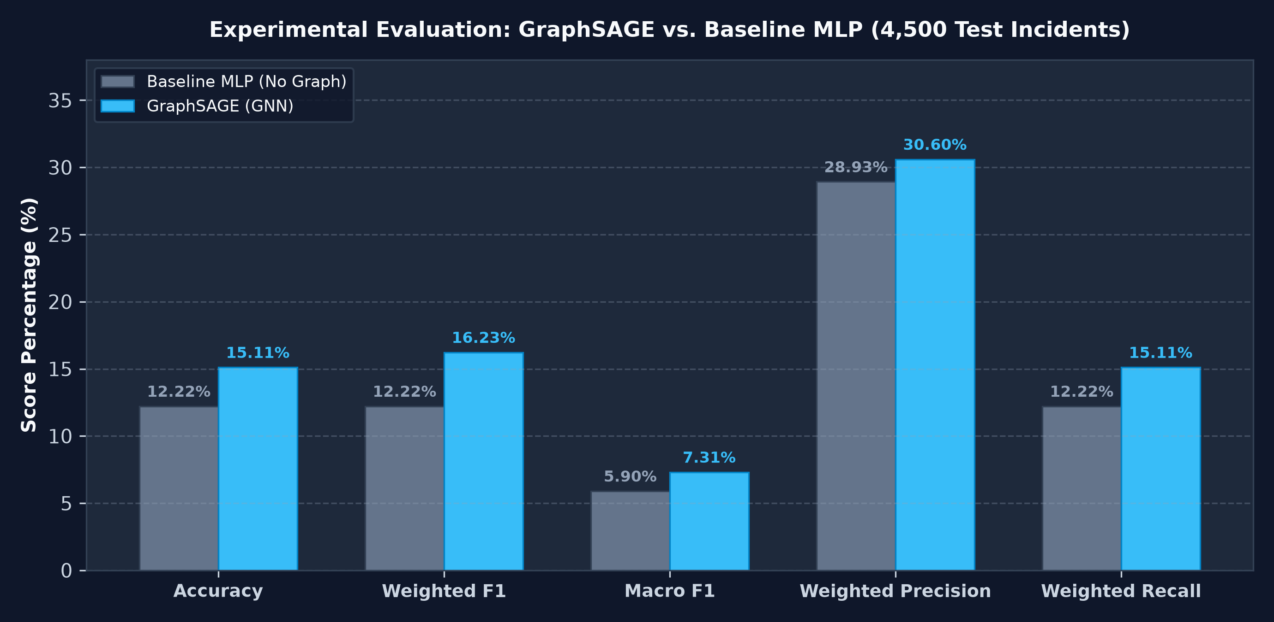
CHICAGO CRIME INTELLIGENCE SYSTEM | ACADEMIC PROJECT PRESENTATION
GraphSAGE vs MLP
Empirical Test Benchmark (4,500 Nodes)
Rigorous Comparison Across Verified Metrics
Benchmark Comparison Chart
Evaluated on Held-Out Test Data
• GraphSAGE Accuracy: 15.11% vs MLP 12.22% (+2.89 percentage points improvement).
• Weighted F1 Score: 0.1623 vs MLP 0.1222 (+0.0401 improvement).
• Macro F1 Score: 0.0731 vs MLP 0.0590 (+0.0141 improvement).
• Weighted Precision: 0.3060 vs MLP 0.2893 (+0.0167 improvement).
• Weighted Recall: 0.1511 vs MLP 0.1222 (+0.0289 improvement).
• Essential Academic Note: Classification performance is modest; GraphSAGE is presented as an experimental graph-based analytical model, NOT a production-ready automated crime classifier.
• Task Context: In a 30-class problem, random guessing is 3.33%. GraphSAGE achieves 4.54x random chance.
Chicago Crime Intelligence System • A. Jai Aakaash (23MIA1092) & Tharunika Ravikumar (23MIA1090) • Slide 6 of 10

Slide 7
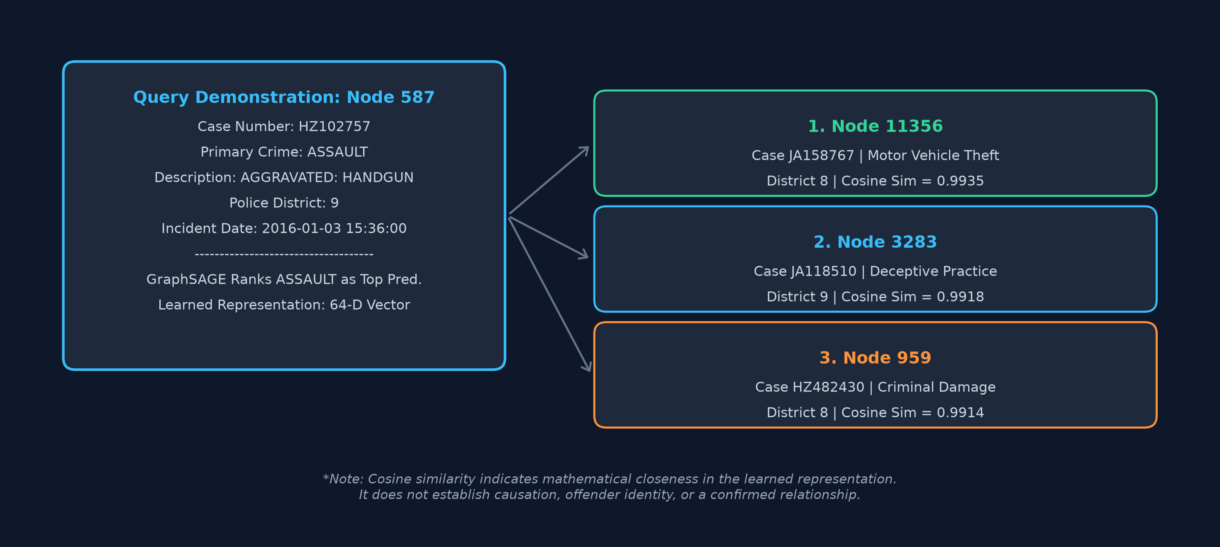
CHICAGO CRIME INTELLIGENCE SYSTEM | ACADEMIC PROJECT PRESENTATION
64-Dimensional Crime Embeddings & Similarity
Representation Learning Workflow
Incident Embeddings & Cosine Similarity
Visual Case Study: Node 587
Demonstrating Latent Space Incident Retrieval
• Workflow: Crime Incident → GraphSAGE → 64-Dimensional Embedding → Cosine Similarity → Similar Crime Incidents.
• Demonstration Incident (Node 587): • Case: HZ102757
• Crime: ASSAULT (AGGRAVATED: HANDGUN)
• Police District: 9
• Date: 2016-01-03 15:36:00
• Top Similarity Incidents: 1. Node 11356: Motor Vehicle Theft (Dist 8) | Sim = 0.9935
2. Node 3283: Deceptive Practice (Dist 9) | Sim = 0.9918
3. Node 959: Criminal Damage (Dist 8) | Sim = 0.9914
• Mathematical Meaning: Cosine similarity measures mathematical closeness in the learned 64-D representation space.
• Crucial Guardrail: Similarity does NOT establish causation, offender identity, or a confirmed relationship between incidents.
Chicago Crime Intelligence System • A. Jai Aakaash (23MIA1092) & Tharunika Ravikumar (23MIA1090) • Slide 7 of 10

Slide 8
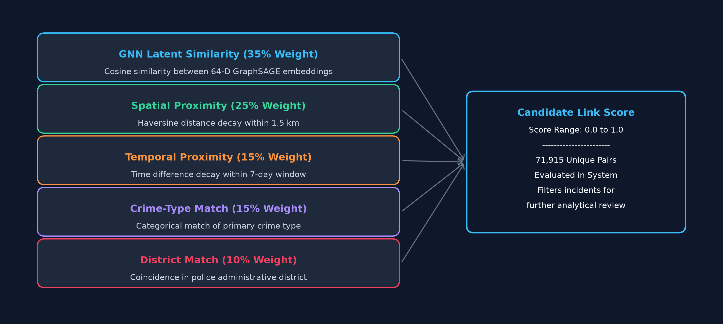
CHICAGO CRIME INTELLIGENCE SYSTEM | ACADEMIC PROJECT PRESENTATION
Multi-Factor Candidate Crime Link Analysis
Candidate Link Scoring Framework
Core Project Forensic Analytics Feature
Multi-Factor Scoring Architecture
Visualizing Composite Weight Flow
• Weighted Formula: Candidate Link Score =
• 35% GNN Embedding Similarity
• 25% Spatial Proximity (Haversine decay)
• 15% Temporal Proximity (7-day decay)
• 15% Crime-Type Match
• 10% Police District Match
• Scale of Link Catalog: 71,915 Unique Candidate Incident Pairs evaluated and indexed.
• Purpose: The system combines multiple similarity factors to identify incidents that are worth further comparison.
• Important Guardrail: Candidate links are analytical relationships, NOT confirmed criminal relationships.
• Strict Scope: Does NOT claim serial offender detection, cold case solving, or getaway vehicle identification.
Chicago Crime Intelligence System • A. Jai Aakaash (23MIA1092) & Tharunika Ravikumar (23MIA1090) • Slide 8 of 10

Slide 9
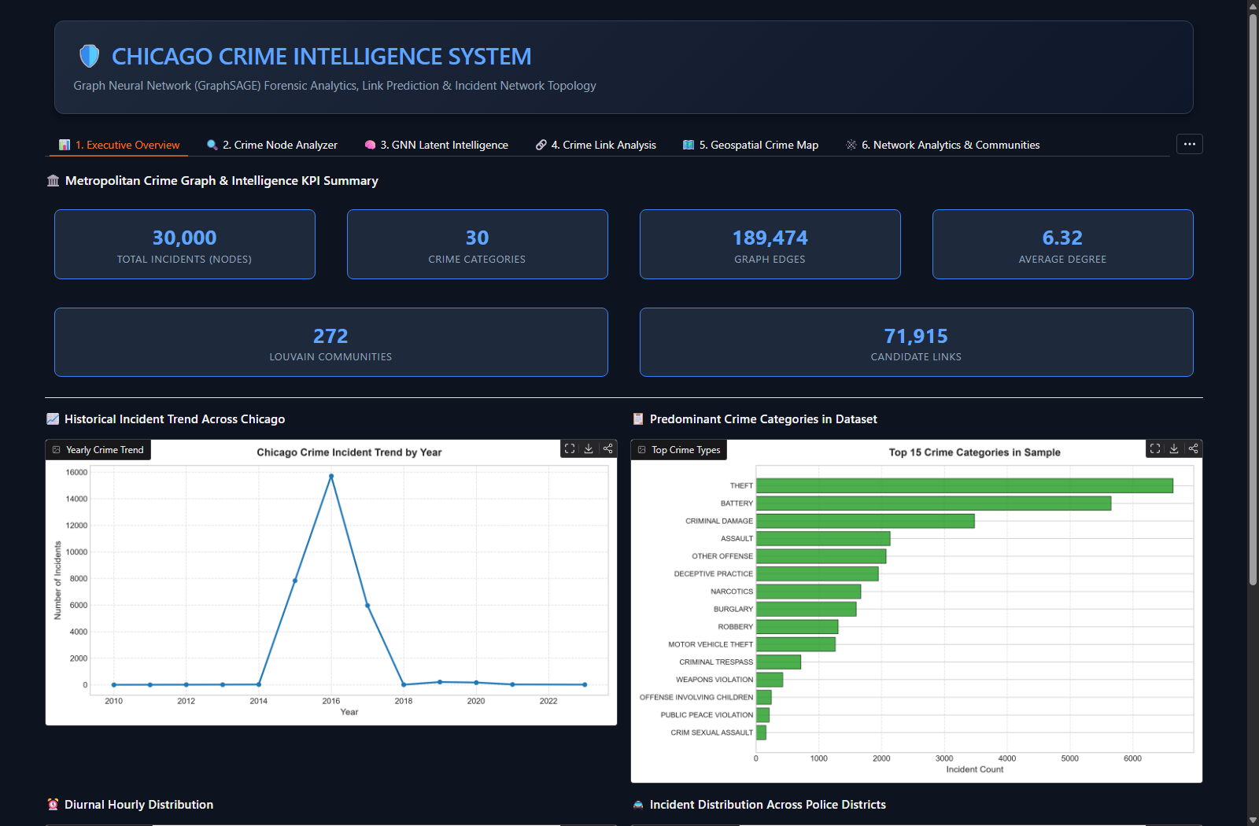
CHICAGO CRIME INTELLIGENCE SYSTEM | ACADEMIC PROJECT PRESENTATION
Network Analytics & Interactive Dashboard
Network Properties & Investigation UI
Localhost Deployment (127.0.0.1:7860)
Interactive Local Dashboard Interface
Localhost Web Server (127.0.0.1:7860)
• Verified Network Results: • 30,000 Nodes
• 189,474 Directed Edges
• 152 Connected Components
• 272 Graph Communities identified via Louvain modularity
• Network Metrics: Degree distribution, degree centrality, PageRank, connected components, and community structure.
• Community Clarification: Graph communities represent structurally connected incident groups. They are NOT confirmed criminal organizations.
• Dashboard Architecture: Runs strictly locally at http://127.0.0.1:7860 (no cloud deployment, ensuring local data security).
• Investigation Flow: Node Analysis → Embeddings → Similarity → Candidate Links → Network Analytics.
Chicago Crime Intelligence System • A. Jai Aakaash (23MIA1092) & Tharunika Ravikumar (23MIA1090) • Slide 9 of 10

Slide 10
CHICAGO CRIME INTELLIGENCE SYSTEM | ACADEMIC PROJECT PRESENTATION
Conclusion & Future Work
Project Conclusion & Summary
Key Technical Contributions
Future Work & Research Outlook
Avenues for Next-Generation GNN Systems
"The system converts historical crime incidents into a graph where each incident is represented as a node and spatial-temporal relationships form graph edges. GraphSAGE combines each incident's features with information from neighboring incidents to learn 64-dimensional representations."
• 30,000 Incidents: Modeled as an attributed graph with 189,474 edges.
• 40 Features: Engineered across temporal harmonics, spatial coords, and context.
• 64-D Embeddings: Generated via GraphSAGE for incident similarity queries.
• 71,915 Candidate Pairs: Evaluated via multi-factor link scoring.
• 272 Communities: Identified using unsupervised Louvain modularity optimization.
• Interactive Dashboard: Built and deployed locally at 127.0.0.1:7860.
• Dynamic Temporal GNNs: Incorporate continuous-time models like TGN and TGAT for streaming 911 dispatch feeds.
• Larger-Scale Graph Scaling: Expand graph construction and sampling across larger slices of the 7.8M+ historical dataset.
• Heterogeneous Graphs: Incorporate multiple entity types (incidents, vehicles, weapons, locations) via HeteroData.
• Explainable AI (XGNN): Integrate GNNExplainer to pinpoint critical subgraph neighbors influencing predictions.
• Additional Context: Incorporate environmental and socioeconomic context where ethically and legally appropriate.
"Graph-based modeling provides a way to incorporate relational information into historical crime-data analysis while keeping the resulting patterns as analytical relationships rather than evidence of causation or offender identity."
Chicago Crime Intelligence System • A. Jai Aakaash (23MIA1092) & Tharunika Ravikumar (23MIA1090) • Slide 10 of 10

