Slide 1
B.Tech Project End Semester Presentation Design and Simulation of High Power EV Charger
Bellamkonda Jai Abhiram – 200002020
Vankudoth Prasanth – 200002077
Under the Supervision of Prof. Amod C Umarikar
Electrical Engineering
Indian Institute of Technology Indore

Slide 2
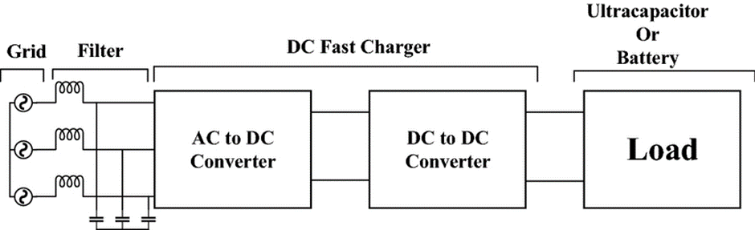
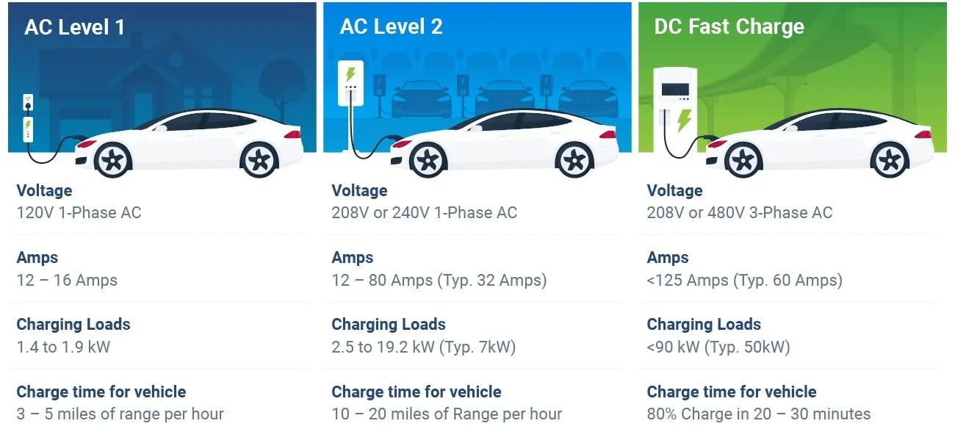
Electric Vehicle Charger
What is a charger? -A charger is a device that puts energy into a battery by sending an electric current through it
Basic structure of EV charger
Depending on the power rating EV chargers are classified into
Level 1
Level-2
Level-3

Slide 3
Objective: Design and Simulation of High Power EV Charger
Defining it more clearly, Design and simulation off-board Level 3 DC Fast Electric Vehicle Charger.
A EV charger consists of AC-DC Converter and DC-DC Converter.
In this EV Charger model we are using PWM Rectifier topology for AC-DC Conversion and Dual active bridge for DC-DC Conversion.
To Design a Pulse-Width Modulation (PWM) Based Rectifier system capable of maintaining the output voltage at a specified level while achieving a unity input power factor.
Why unity power factor?
To Design a Dual Active Bridge converter that is capable of converting given voltage level to desired voltage level with minimal losses.
Reducing losses?
EV Charger specifications
Power of Charger | 50 KW
Desired Output Voltage | 500 V
Output Voltage of PWM | 800 V
Desired Output Current | 100 A

Slide 4
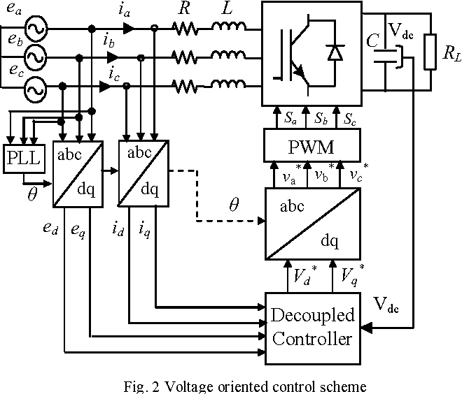
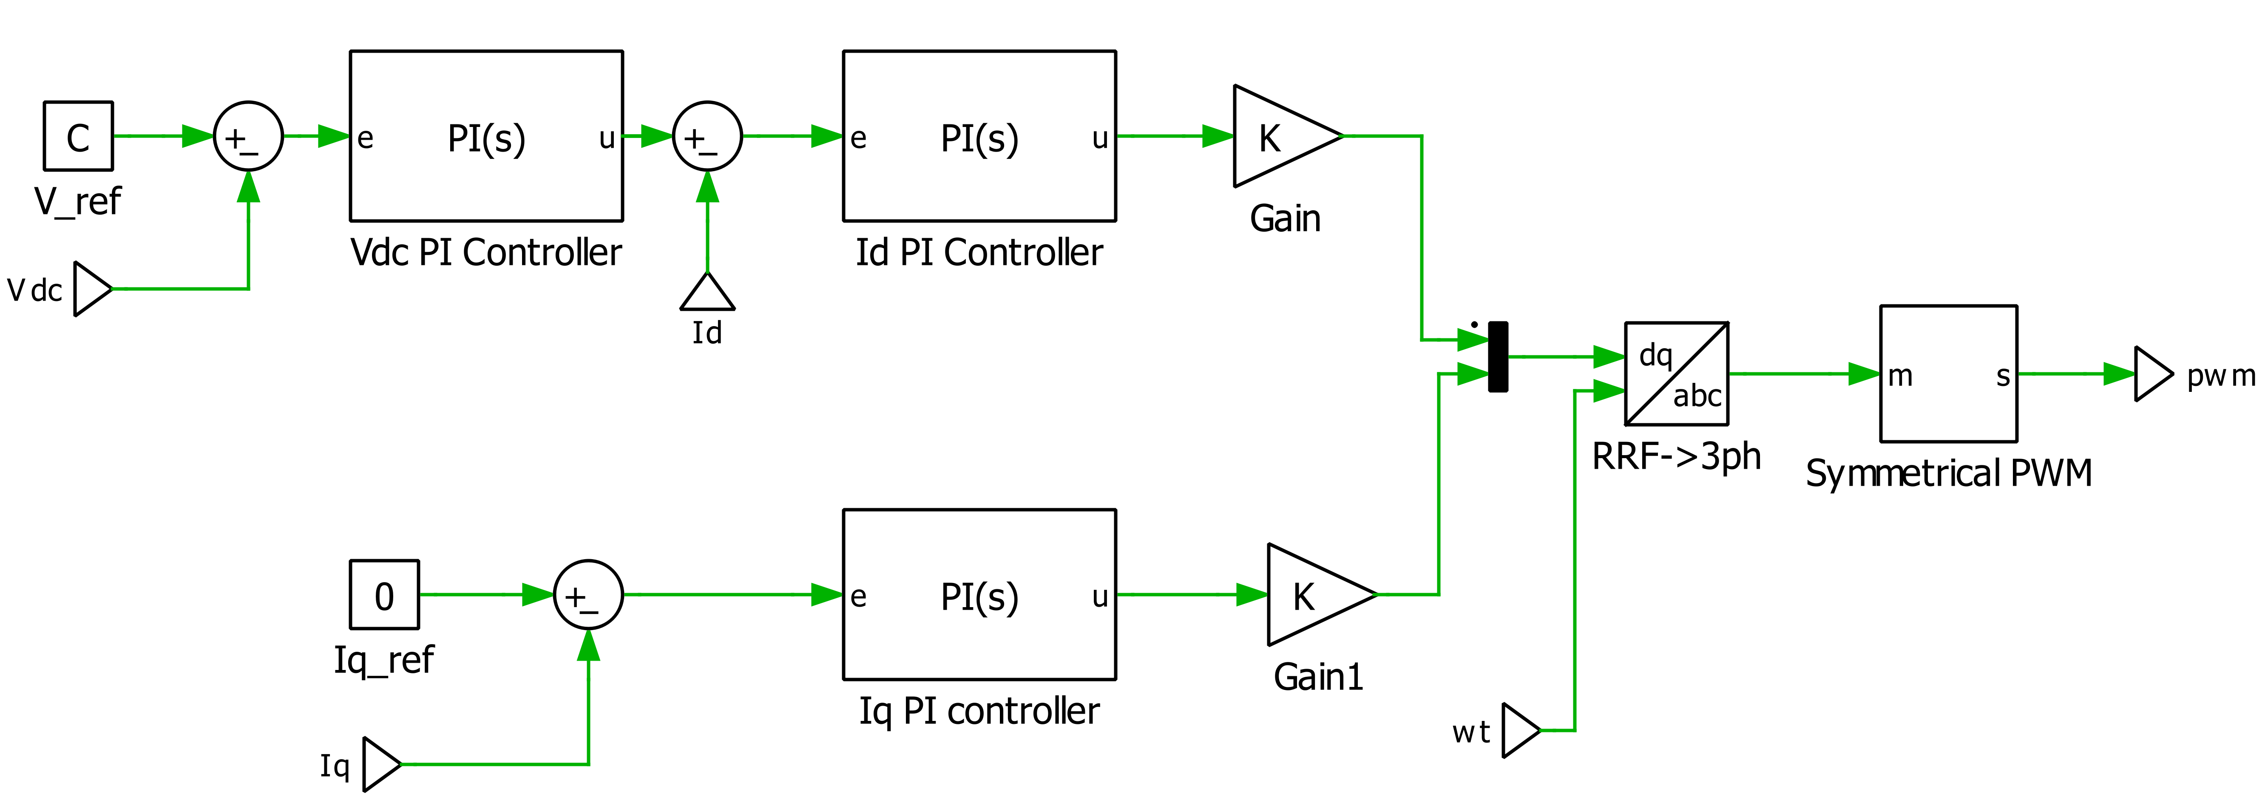
AC to DC Conversion – PWM Rectifier
Advantages:
Improved power quality
Precise Voltage Control
Fast response time
Unity power factor
High Efficiency
Bi-Directional power flow

Slide 5
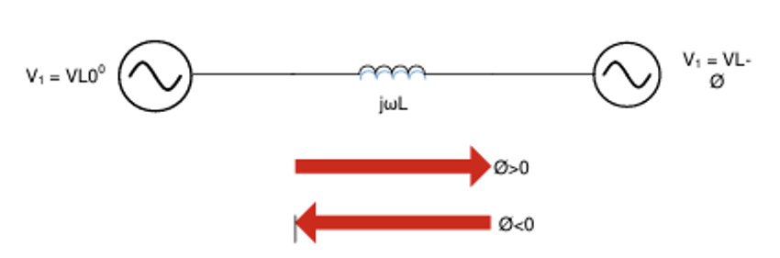
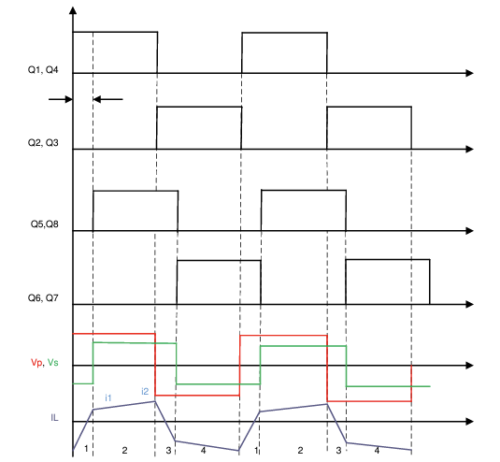
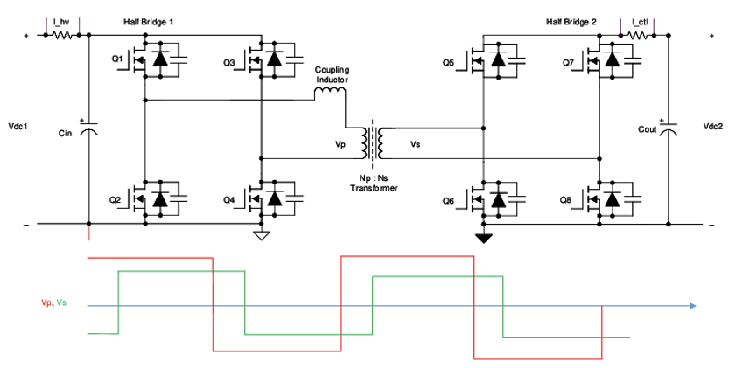

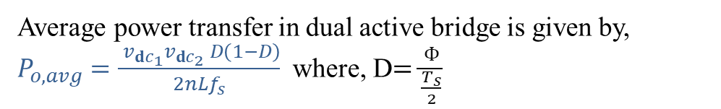
DC to DC Conversion – Dual Active Bridge
Basic working principal of Dual active bridge is based on AC power transfer.
Real power flows from higher angle to lower angle.
Power transfer is given by, P = $\frac{\left(V1∗V2∗sinØ\right)}{wL}$
At D=0.5 power is maximum,
From this, we can calculate maximum current and minimum primary inductance
Average power transfer in dual active bridge is given by,
$P_{o,avg}=\frac{ v_{ⅆc_{1}}v_{ⅆc_{2}} D\left(1−D\right)}{2nLf_{s}}$ where, D$=\frac{Փ}{\frac{T_{s}}{2}}$

Slide 6
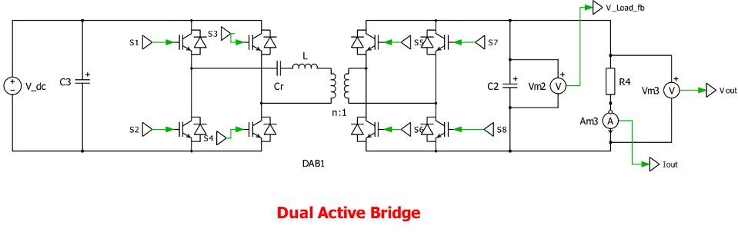
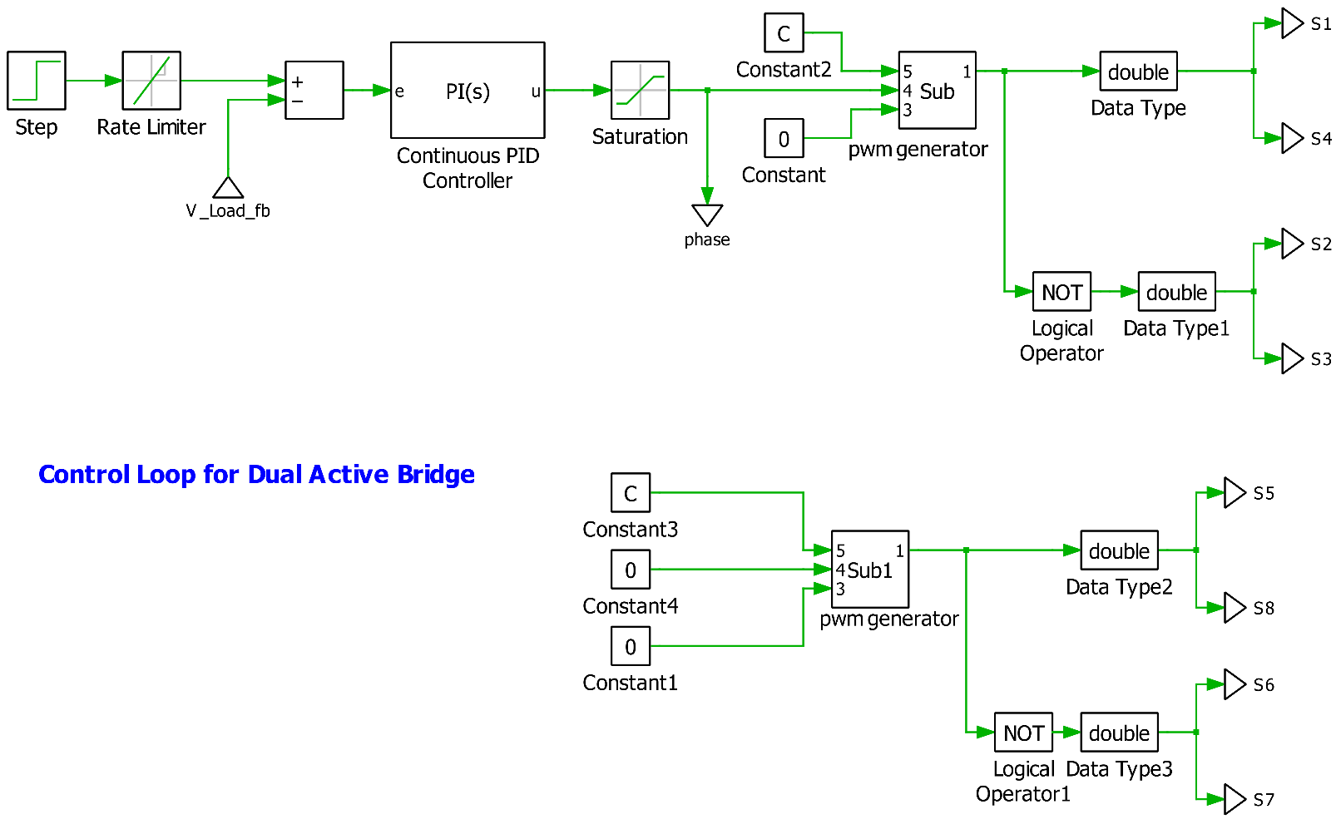
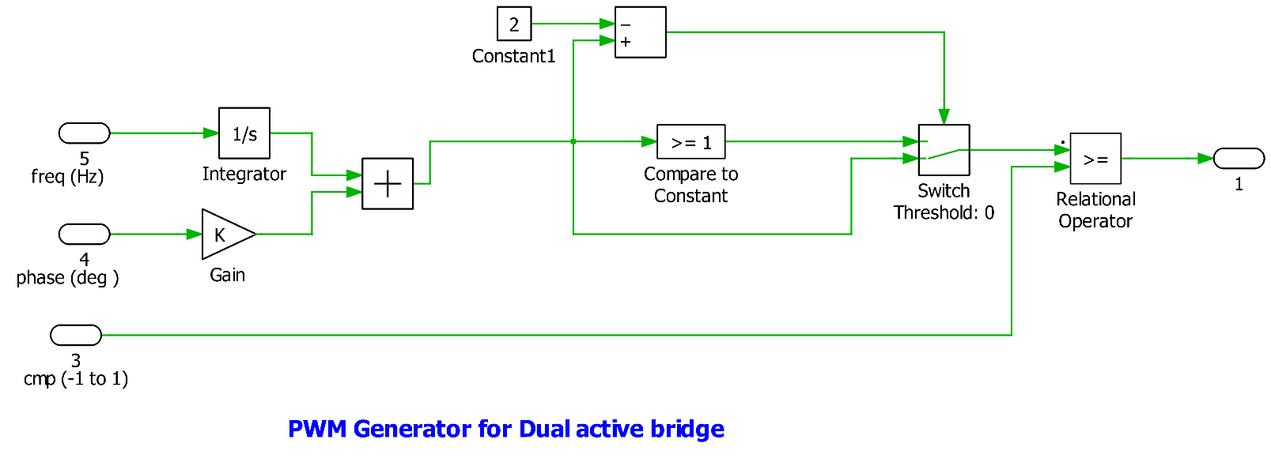
DC to DC Conversion – Dual Active Bridge
Advantages:
High Efficiency
Isolation
Bi-Directional power flow
Improved Power quality
Soft switching

Slide 7
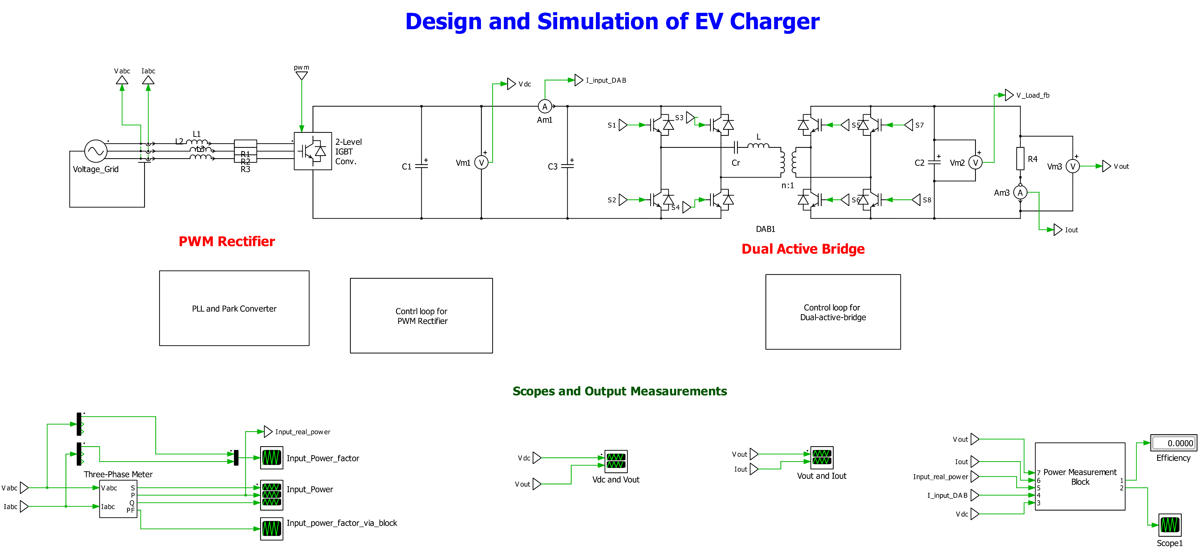
50KW Charger Design

Slide 8
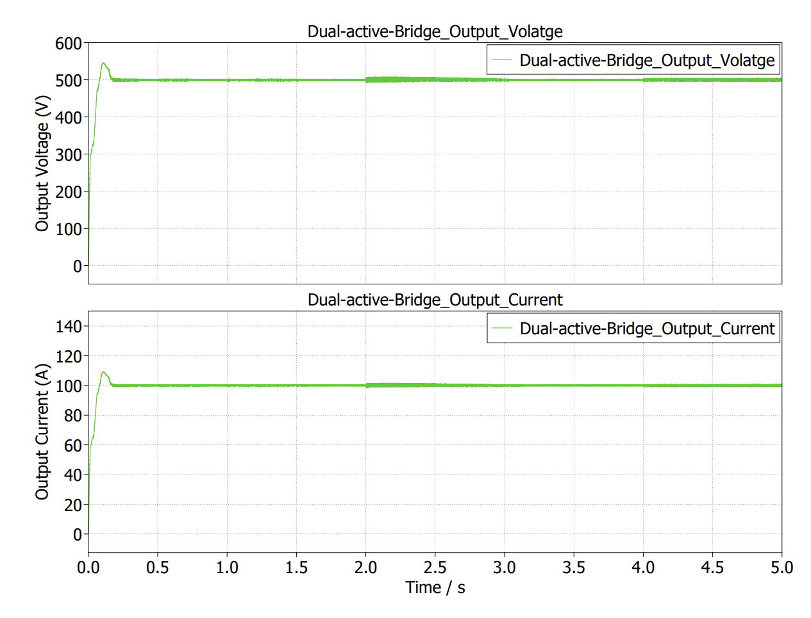
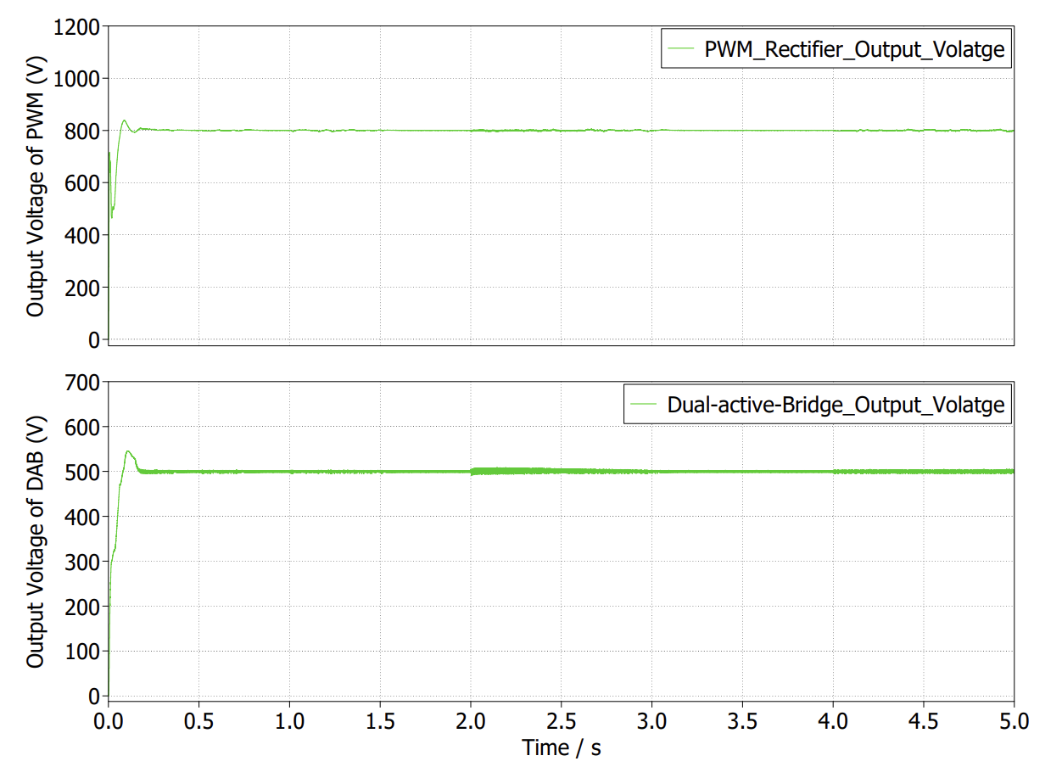
Results and discussion
Output voltage and current wave forms
PWM rectifier output voltage and DAB output voltage

Slide 9
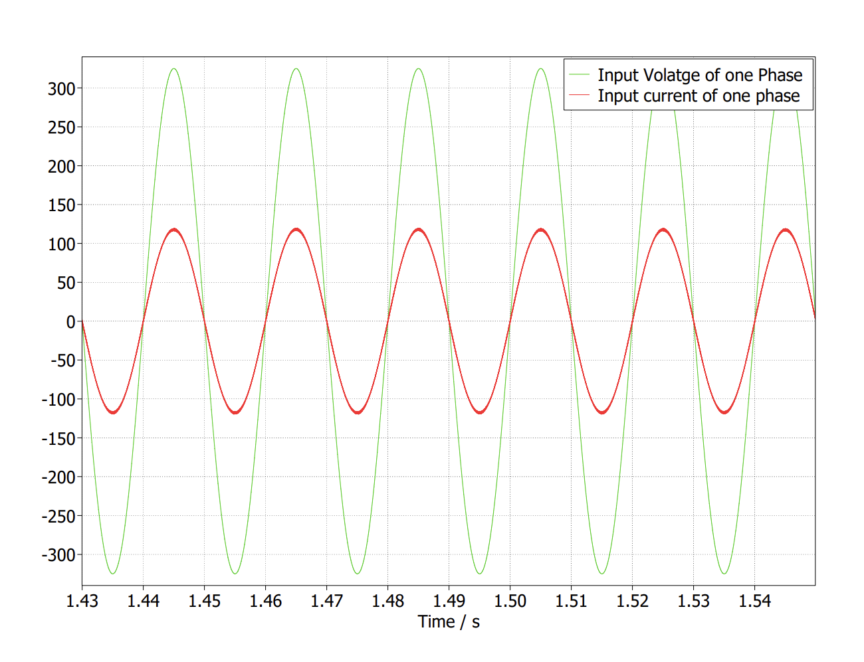
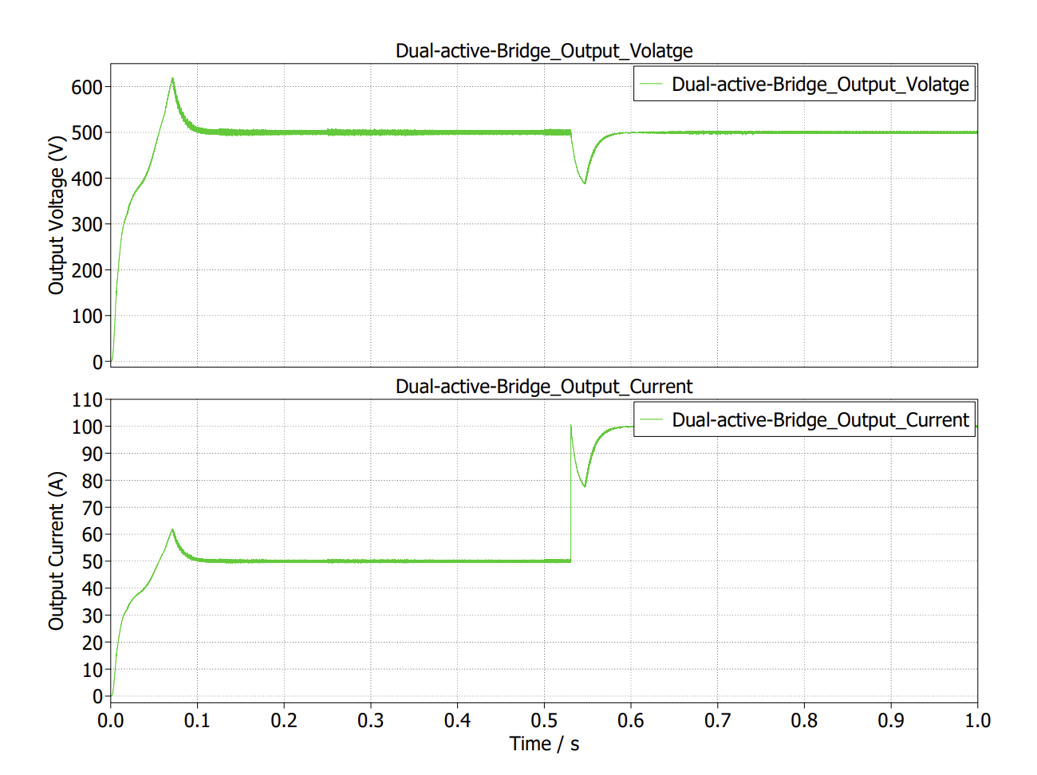
Results and discussion
Input current and voltage waveforms
Voltage response when the load suddenly increased
Here, Input current and voltage from the grid are in same phase this implies that power factor is unity
When the load is suddenly changes the control system
can able to track back the desired voltage level

Slide 10
Future Work
Advanced Control Algorithms
Implementing different modulation techniques in Dual Active Bridge
Thermal Analysis and Cooling System Enhancement

Slide 11
QUESTIONS / SUGGESTIONS

