Slide 1
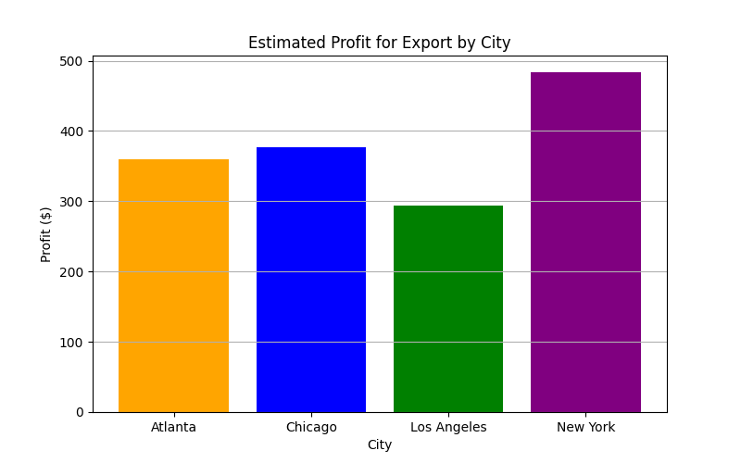
Farmer Export Prediction - Green Leaf Lettuce
Predicted Spread: 324.28%
Best City to Export: New York
Maximum Expected Profit: $483.11

