Slide 1
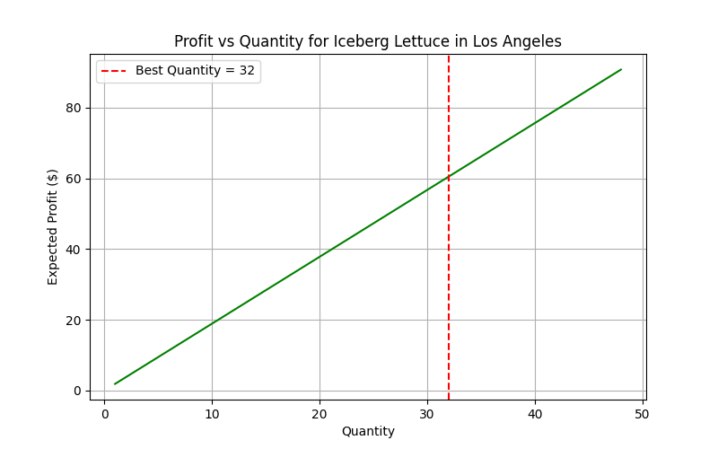
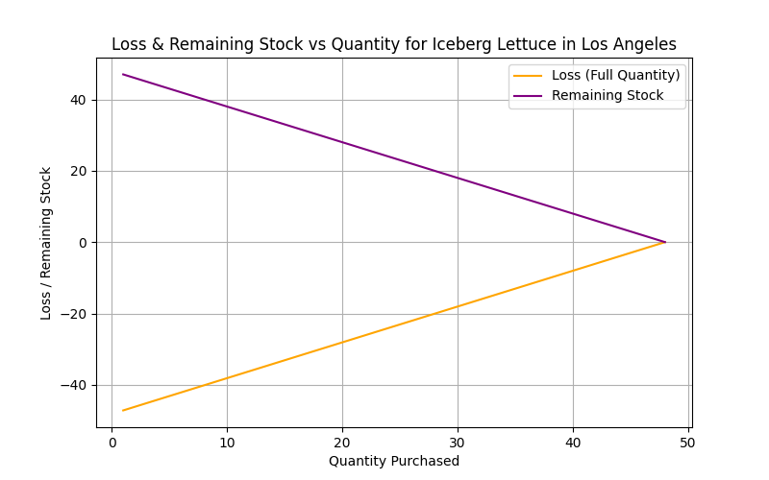
Shop Owner Prediction - Iceberg Lettuce in Los Angeles
Predicted Spread: 213.06%
Suggested Quantity: 32 out of 48
Expected Maximum Profit: $60.50
Loss if Buying Full Quantity: $-16.05

