Slide 1
Module 2 Lesson: Intro to CSS
Elio L. Arteaga, MFA
GRA1144c – Web Publishing

Slide 2
Intro to CSS3
CSS stands for Cascading Style Sheets, and the current version is 3, or CSS3. Cascading style sheets account for the visual attributes of the web page. The “cascading” part refers to the fact that web designers can specify three levels of styling attributes that can override each other depending on where they appear in the code.

Slide 3
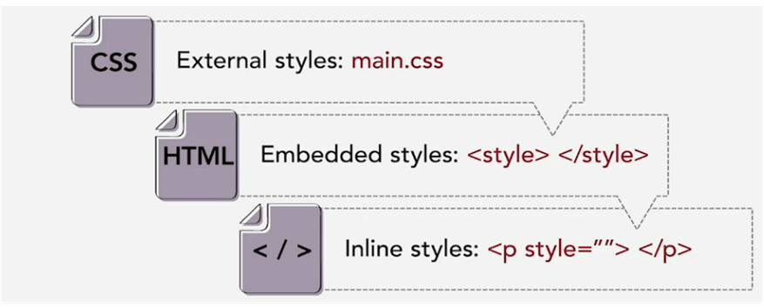
External Style Sheets
An external style sheet goes in a separate file and can affect HTML tags (and others) on all pages of a web site.
From most general to most specific (with specific overriding general):

Slide 4
Embedded Style Sheets
An embedded style sheet appears within the head section at the top of the page and can affect all the HTML tags (and others) within the current web page, and they can override styles specified in an external style sheet.

Slide 5
Inline Style Sheets
An inline style appears within a style="___" attribute within a specific HTML tag and affects that one tag only, overriding styles specified in both external and embedded style sheets.

Slide 6
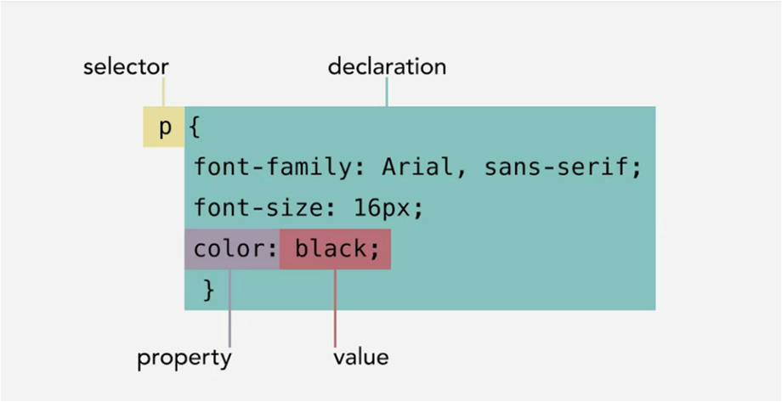
CSS Selectors
Style sheets consist of two parts: the selector and the declaration, and the declaration consists of one or more rules made up of properties and values. For example:

Slide 7
CSS Selectors
In addition to HTML tag selectors, CSS can also modify class selectors and ID selectors.
HTML tag selectors display the name of the HTML tag and can affect the appearance of the HTML element throughout the entire page or site. Be careful using them because they might affect unintended objects; use classes or IDs instead.
Class selectors affect the appearance of classes of objects that can be specified more than once in a page. In a CSS style sheet, class selectors are preceded by a period (.classname {}). Within the HTML element, a class appears as an attribute of the HTML object without the period ( <p class="classname">Styled paragraph goes here.</p> ).
ID selectors affect the appearance of unique objects that can only be specified only once in a page. In a CSS style sheet, ID selectors are preceded by a hashtag (#idname {}). Within the HTML element, an ID appears as an attribute of the HTML object without the hashtag ( <p id="idname">Styled paragraph goes here.</p> ).

Slide 8
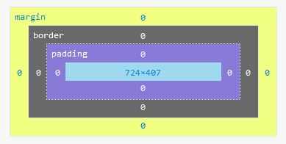
CSS Box Model
Every object within the web page sits within a rectangular box. Boxes are specified using:
Width (of content)
Height (of content)
Padding—space immediately touching the content, inside the border.
Border—the color, style and weight of a line surrounding the box.
Margin—space outside of the box’s border.

Slide 9
CSS Box Model
box-sizing: content-box; (default property)
box-sizing: border-box; measures a box’s width and height from the outside edge of the border, not just the content
background-color: the color of the background of a box that extends all the way to the inside edge of the border.
background-image: url(imagename.jpg);

Slide 10
Block or Inline
By default, body, header, nav, main, section, aside, article, footer, div, p, h1, h2, h3, h4, h5, h6 and other such elements are block elements. They are rectangular in shape, have width and height, and contain text and graphic elements. Block elements stack vertically.
On the other hand, em, strong, span, img and others are inline elements. They are not rectangular but have a starting and ending point within a line of text, hence the name. Inline elements stack horizontally.
Inline-block elements are the best of both worlds: their width and height can be specified, and they stack horizontally, enabling a variety of layouts. When inline objects stack horizontally, subtract 4px from their right margins so that they fit. (I don’t know why!)

Slide 11
Web Color
Colors on the web can be specified by an RGB triplet; for example, rgb(#,#,#), where each # can be a number from 0 - 255. This enables specifying up to 16.7 million colors. Transparency (or partial transparency) can be specified using rgba(#,#,#,#), where the fourth value, “alpha,” specifies a level of transparency between 0 (fully transparent) and 1.0 (fully opaque). For example, 0.5 or just .5 indicates 50% opacity.
Web colors can also be specified using hexadecimal code, in which three two-digit code numbers from 00 to FF can be used to represent the red, green and blue values. Adobe provides an excellent tool, color.adobe.com, for specifying web colors.

Slide 12
Hands-On Demo
Visit w3schools.com’s HTML Blocks page:
https://www.w3schools.com/html/html_blocks.asp
Using w3schools.com’s Online Editor (the “Try It Yourself” button on each page), try making the changes suggested in the text of the page to see what effect it will have.
Click “Next” on each page and experiment on each page until you reach the HTML Id page.

