Slide 1
RECOMMENDATION SYSTEM FOR INDIAN AGRICULTURE
DONE BY: JAI AGARWAL, GURUPRASAD M, SHREYAS NITIN PUJARI
TEAM: 221B BAKER STREET

Slide 2
What we worked on?
Problem statement: To build a recommendation system for Indian Agriculture wherein we are trying to recommend the best possible crop for a given district and parameters like available area, rainfall and temperature.
We worked on a dataset comprising the season, area and production of various crops of each district in India. We also worked on a dataset consisting of month wise average rainfall, district-wise.
We first checked for linearity and then tried various models to predict the production given the other parameters

Slide 3
Why we chose this topic?
The Agricultural system in India is not very effective.
A high yield of crops cannot be generated because most of the times the farmers do not know which crops to plant in which part of the country and in the particular seasons.
We try to improve on that particular aspect by looking at the dataset of the crops, area and production over the years.
We also try to study the weather patterns in certain parts of the country and try to estimate as to what the production of a particular crop in a particular area would be, during the various crop seasons.

Slide 4
Tests for linearity
Plotted a scatterplot of area vs production, there was no particular shape.
We then obtained a sample of the data points and plotted a scatter plot. The plot did not resemble a linear plot.
We then created a linear model of the given parameters and plotted the predicted values and the actual values. From the plot, it could be inferred that the relationship between production and the other parameters is non-linear

Slide 5
Non-linear model
To test for non-linearity, we tried to predict production , using area, crop and season as parameters.
Crop and season being categorical variables were converted to numerical values, using a suitable encoding technique
We used the LASSO regression technique to predict the values of production.
From the results, we conclude that, although the non linear model is better than a linear model, other models are needed to accurately obtain the relationship between production and the other parameters.

Slide 6
Decision Tree
A decision tree is a decision support tool that uses a tree like model of decisions and their possible consequences, including chance event outcomes, resource costs, and utility.
In our project we use two inputs in order to categorise the output.
For the input we have three dimensions [“Area”,”Production”].
The output is a number that indicates the crop which is the best to harvest given the above parameters.
The model has a testing efficiency of 40.32%, this is mainly due to the limitation of the dataset.

Slide 7
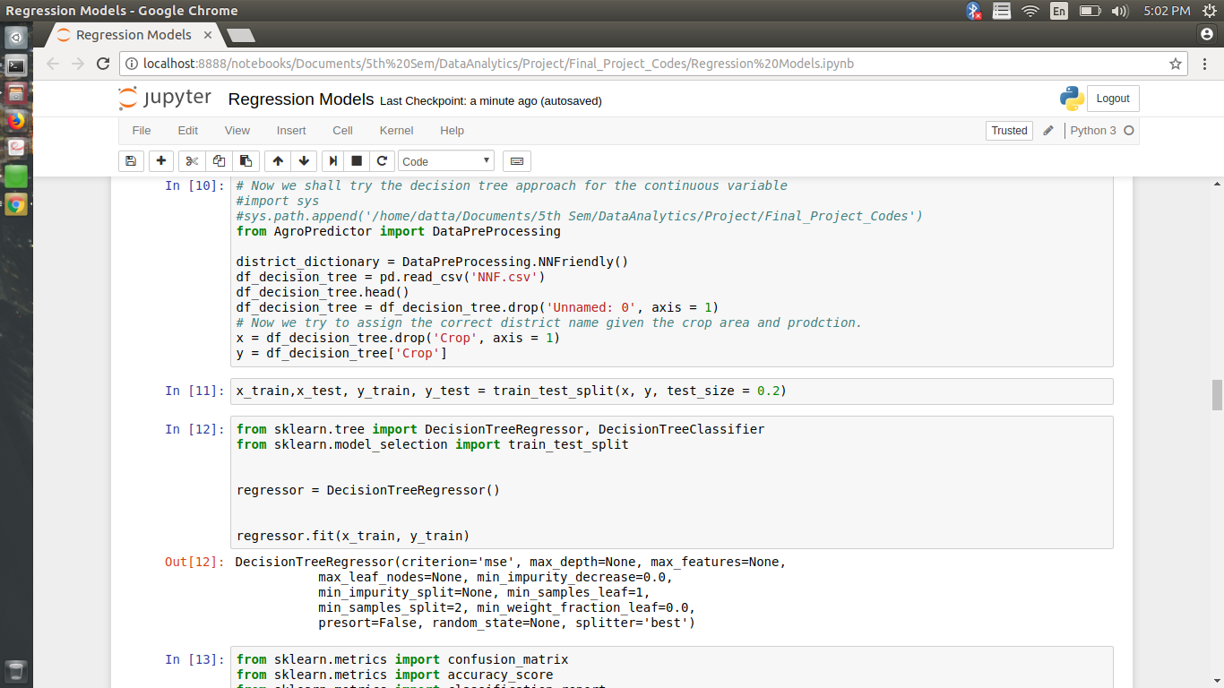

Slide 8
Neural Network
A neural network is a statistical model that uses examples to automatically infer rules for recognizing outputs based on the given inputs.
The neural network approach was used because the decision tree approach and regular statistical models weren’t accurate.
The Accuracy of our neural network is about 40.17%. In the neural network we get the crop that can be harvested using the area and production.

Slide 9
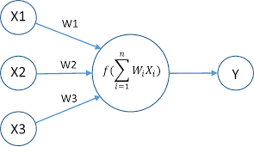

Slide 10
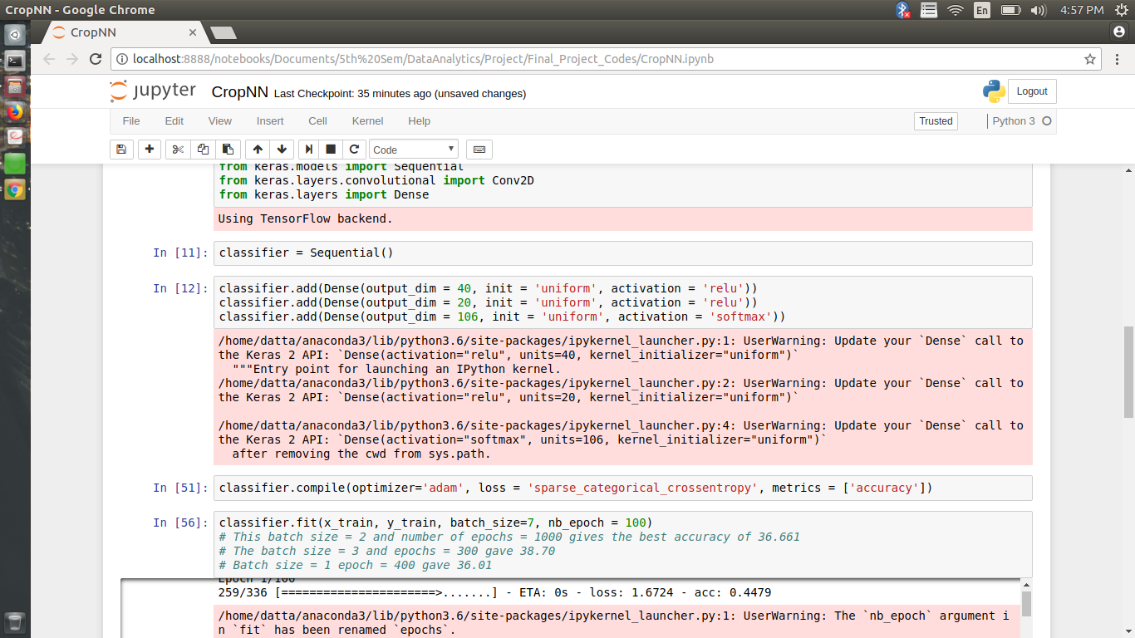

Slide 11
Our neural network has 3 layers
One input layer that has 2 dimensions
The activation function is relu (rectified linear unit)
We have 1 hidden layer which is also relu.
Finally the output layer is a cost function called the softmax function.
The use of softmax function in the last layer (output layer) is important because of categorical data for which the softmax function is necessary.
We calculate both the training and testing efficiency of the dataset:
Optimizer = “adam”
Loss calculated = “sparse_categorically_crossentropy”
Metrics = “accuracy”

Slide 12
Recommendation based on Climatic Parameters
Built a time series model to forecast temperature and rainfall
Started by collecting data sets since 1901 with average temp and rainfall trends which is monthly
Pre-processing done to obtain the columns in required format with date column indexed in the form(YYYY-MM-01)
The idea is to get the forecasted temperature and rainfall for a particular district, for the upcoming months.
This forecast will help us make a knowledge based recommendation on the crop to be planted, this will help farmers in making the right decisions according weather trends.

Slide 13
Time Series model used
We chose the state of Tamil Nadu and 10 districts to do our forecast to demonstrate the model used.
SARIMAX model is used to fit the time series model and hence do the forecasts
The dataset we worked on is inherently stationary and has a seasonal trend associated with it. This is why we chose SARIMAX as rainfall and temperatures have a obvious seasonal trend associated with them, and X represents exogenous parameters can influence weather patterns which we are accounting for by using this model.
The parameters used for evaluating the accuracy is AIC criterion to obtain accurate p,d,q values for model. RMSE score with the observed and predicted values was calculated, also a graph depicting forecasted and observed values was drawn to see the trends.

Slide 14
Recommendation of crop
A dataset of about 10 crops (presently, can be expanded later) having avg rainfall and avg temperature was gathered.
Using the forecasted values we calculate a euclidean distance parametric with available records.
A low euclidean distance tells us the name of the crop which is closest to the forecasted growth conditions. This is the knowledge based recommendation
In future we want to add other parameters like soil quality, humidity, fertilisers and minerals data to better recommend crops

Slide 15
THANK YOU

