Slide 1
ChainzCommerce: Revolutionizing online shopping.
NoPlayButton

Slide 2
Github
Link:
https://github.com/jaibhedia/Project-Proposal-Templates/tree/main/NoPlayButton/ChainzCommerce

Slide 3

Logo

Slide 4
Outline
Revolutionizing online shopping with a secure, decentralized blockchain-based eCommerce platform for seamless, transparent, and efficient transactions.
NoPlayButton

Slide 5
Name of the project
ChainzCommerce
NoPlayButton

Slide 6
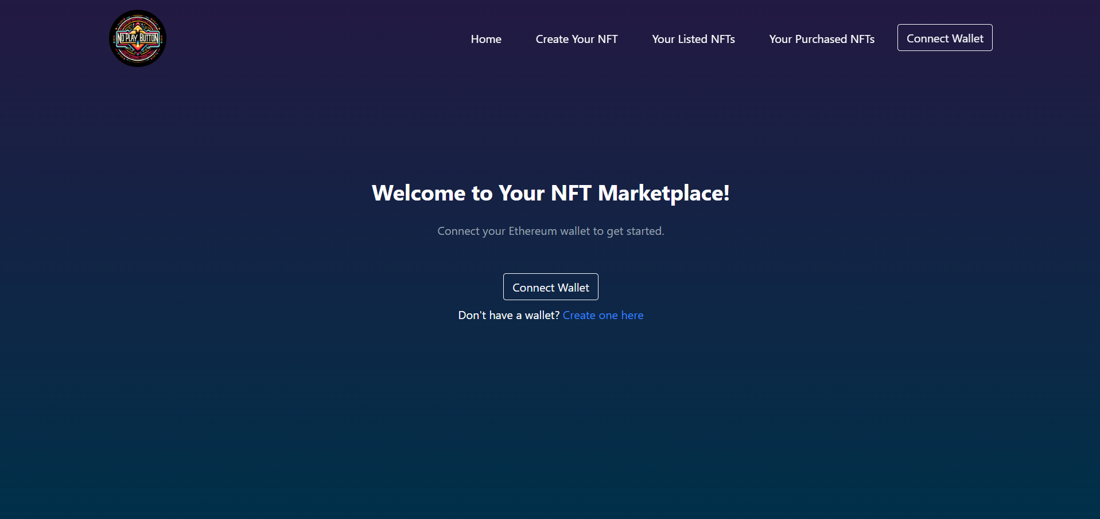
Images of the project
NoPlayButton
Home

Slide 7
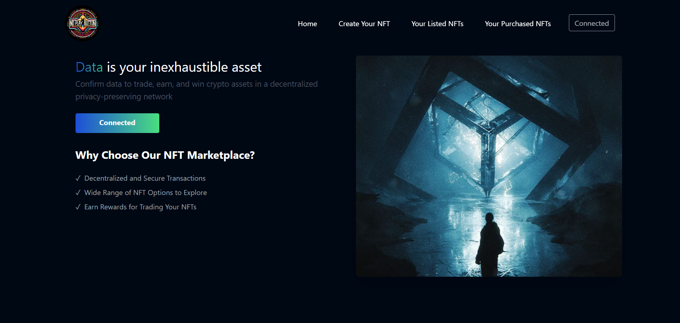
Images of the project
NoPlayButton
Logged in

Slide 8
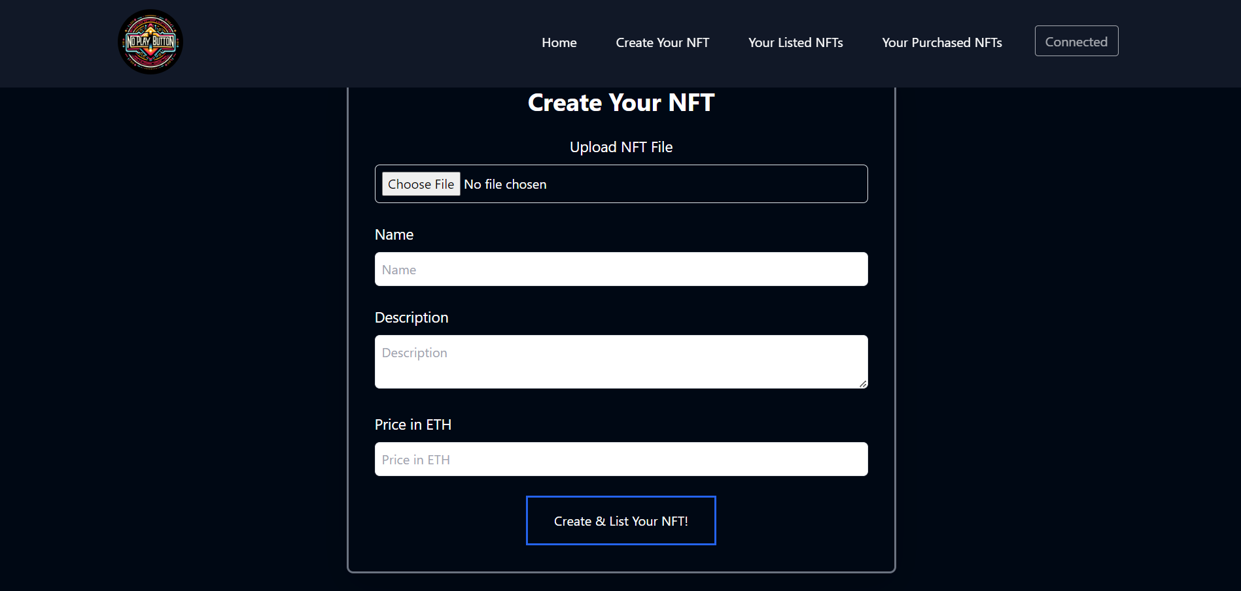
Images of the project
NoPlayButton
List NFTs

Slide 9
Video
Link: https://www.loom.com/share/b348c85e874b48ba8ab3913b99e6eaa8
NoPlayButton

Slide 10
Website
Link: https://project-proposal-templates.vercel.app/
NoPlayButton

Slide 11
Description
What We're Building:
ChainzCommerce is set to revolutionize the e-commerce landscape by integrating blockchain technology. Our focus is on developing a user-friendly NFT-based marketplace, enabling users to seamlessly list and transact NFTs using cryptocurrencies.
Problem Statement:
Our goal is to demystify the use of Web 3 technology in everyday life, transforming the perception of blockchain from merely a trading platform to a valuable tool for artists, collectors, and the general public.
Functionality of ChainzCommerce:
View Purchased NFTs: Users can access their collection of purchased or owned NFTs.
Create NFTs: Facilitates the easy creation and minting of new NFTs, complete with customizable attributes and metadata.
Explore Listed NFTs: Offers a platform to browse and purchase a diverse range of listed NFTs.
NoPlayButton

Slide 12
Description
Project Scope
ChainzCommerce is a pioneering platform in blockchain-integrated e-commerce, addressing the need for secure, reliable online transactions and offering innovative solutions to the challenges in the e-commerce sector.
Milestone Breakdown
Project Kick-off (Days 1): Smart Contract development and testing.
Design Phase (Days 2): Create wireframes and finalizing the frontend design.
Development Sprint (Days 3-4): Implementing the frontend design and working on the backend to connect the contracts with the frontend.
NoPlayButton

Slide 13
Description
Potential Enhancements:
AR and VR Integration: Creating an AR and VR exhibition museum for showcasing artistic NFTs aligned with the Metaverse theme.
Expansion to Full-Fledged E-Commerce: Transitioning into a comprehensive e-commerce website for everyday purchases.
ML-Driven Blockchain Analytics: Implementing a machine learning model to predict blockchain currency rates and gas fees, aiding users in making profitable decisions.
Scalability Plans:
Expanding to a Web 3-based storage provider to handle increased user activity and data volume.
Project Summary:
ChainzCommerce is a decentralized application (DApp) on the Ethereum blockchain, designed for interactive NFT transactions, offering functionalities for viewing, creating, and exploring NFTs, and poised for future expansions in AR, VR, and ML technologies.
NoPlayButton

Slide 14
Tech Stack
Solidity (Writing Smart Contract)
Javascript (React & Testing)
Ethers (Blockchain Interaction)
Hardhat (Development Framework)
Ipfs (Metadata storage)
React routers (Navigational components)
NoPlayButton

Slide 15
Team Names
Shantanu Swami: Smart Contract Development and Testing
Kushal M Handigund: Backend Development
Nandish M: Frontend Development
NoPlayButton

Slide 16
Thank You
NoPlayButton

