Slide 1
What Customer Want?
~ Jaideep Raikwar

Slide 2
Problem Statement
What all features of ABC bank is challenging for customer enhancement and how to overcome it?

Slide 3

How to Achieve it

Slide 4

TEXT MINING!!
Only Answer is:

Slide 5
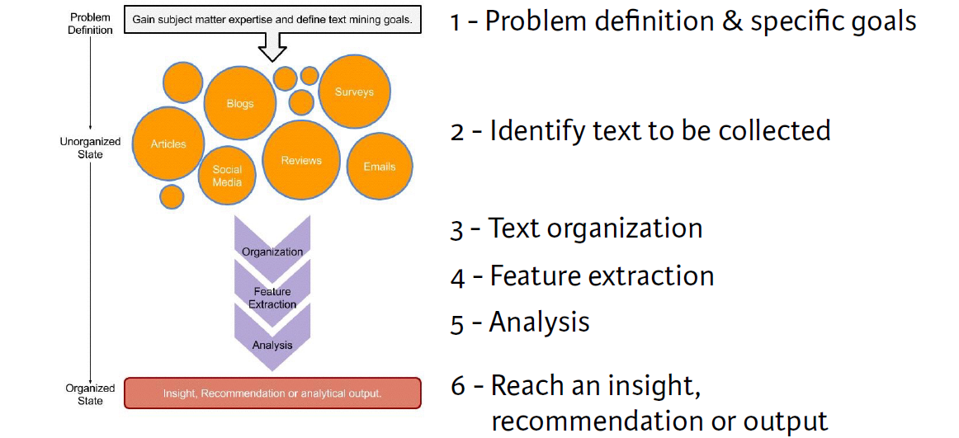
TEXT MINING WORK FLOW

Slide 6
Identify Text for doing Analysis
Reviews & Feedback would be channelize through different Media resources. For Ex:-
Tweets ( through Twitter)
Facebook comments for the Bank
Voice Bots
Bank websites
Online and text feedbacks by customers.

Slide 7
Text Organization
It was done for performing better text analysis.
All the words and other unwanted symbols would be removed and only sentiment words & feature words will be collected.

Slide 8
Feature Extraction
It’s a three way process:
Create Term frequency document
Determine most frequent word by creating
Word Cloud.
Create Clusters of words to determine
different features of Bank.

Slide 9
Sentiment Analysis
Once we get the number of clusters then we label each cluster with a feature name by looking into Word Cloud of frequent terms.
Then once we get the features of cluster, then we determine the Negative and Positive sentiments of the customer for each feature.
And finally we gauge under which feature we have problem & what would be it’s possible solution.

