Slide 1
Sentiment Analysis of a Bank
Author : Jaideep Raikwar

Slide 2
Technology Used : R Programming
Version :-
language R
version.string R version 3.3.1 (2016-06-21)
nickname Bug in Your Hair
Packages need for tm:-
tm – the text mining package (see documentation). Also check out this excellent introductory article on tm.
SnowballC – required for stemming (explained below).
ggplot2 – plotting capabilities (see documentation)
wordcloud – which is self-explanatory (see documentation)

Slide 3
Scraping Data from local Directory
setwd("//ecvdafs01/userdata1/ja305643/Desktop/Datascience/SentimentAnalysis")
reviewbnk <-read.csv("sampled_data1.csv",header=TRUE,stringsAsFactors = FALSE)

Slide 4

Create COPRPUS
#create corpus from vector
docs <- Corpus(VectorSource(reviewbnk$Comment))
Contains 272 documents

Slide 5
Verify Term Frequency
#Create document-term matrix & Verify Frequecy of most frequent words
We can clearly see the bank, abc, account, good, branch & abcd was used very frequently

Slide 6
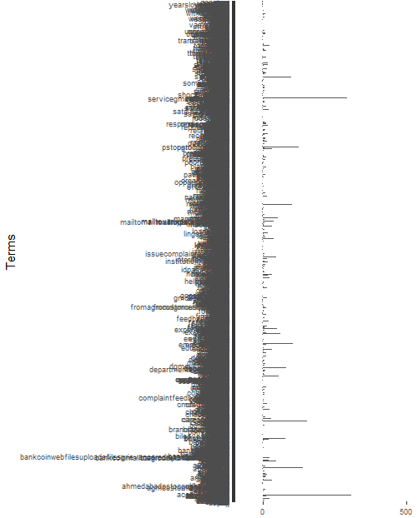
Plot Frequent words Frequency Not visible for all Terms

Slide 7
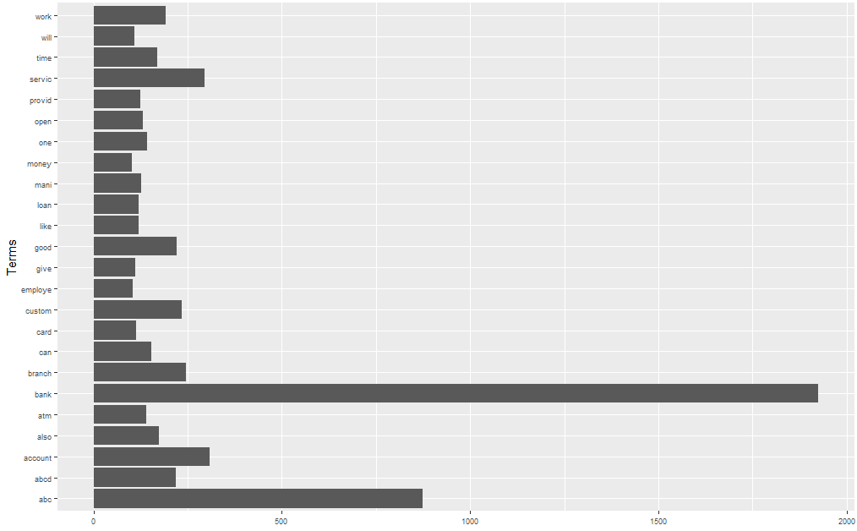
Plot Frequent word plot for most frequent words:-

Slide 8
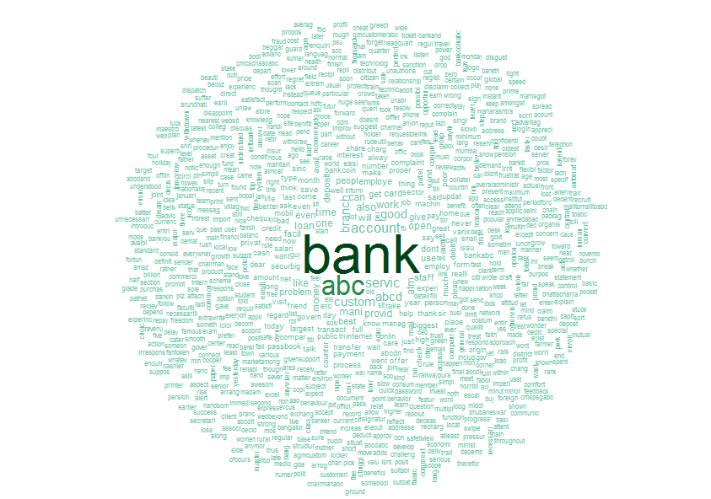
Wordloud : for frequent words

Slide 9
Association of frequent words
> findAssocs(dtm, "account", 0.32)
$account
open transfer branch bangalor bhubaneswar figur flight liabl mismatch local
0.70 0.45 0.36 0.34 0.34 0.34 0.34 0.34 0.34 0.32
> findAssocs(dtm, "bank", 0.4)
$bank
abc abcd economi depost servic can
0.79 0.58 0.45 0.44 0.43 0.42
> findAssocs(dtm, "atm", 0.32)
$atm
denomin giant occas upgrad outdat avail barcod gcc metropolitan
0.41 0.41 0.41 0.41 0.38 0.36 0.35 0.35 0.35
ownself user
0.35 0.33

Slide 10
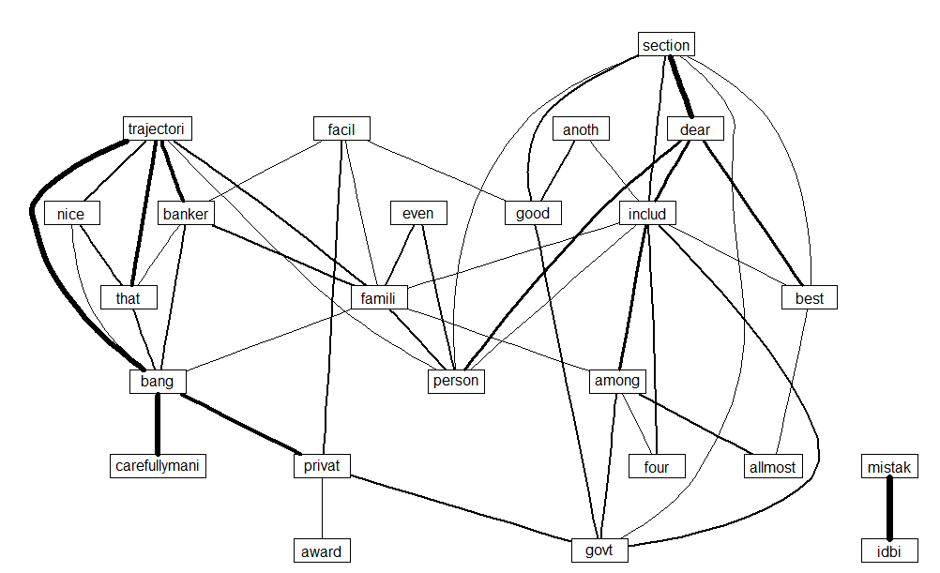
Network of terms

Slide 11
Topic Modelling
Topic 1
"bank, abc, work, account, also, can, branch, mani"
Topic 2
"bankcoin,mail, branch, patel, abc, varix, complaint, bank"
Topic 3
"bank, abc, good, servic, account, abcd, also, atm"
Topic 4
"bank, abc, account, open, branch, will, custom, servic"
Topic 5
"bank, abc, branch, servic, time, account, work, come"
Topic 6
"bank, abc, abcd, atm, servic, card, can, money"
Topic 7
"bank, abc, custom, abcd, work, employe, employ, account"
Topic 8
"bank, abc, work, abcd, custom, employe, good, account"

Slide 12
Sentiment Analysis
# install package sentiment140
require(devtools)
library(sentimentr)
It will provide the polarity graph for entire document we have with us. From which we can check the customers were talking more about the good or bad services about the particular bank.

Slide 13
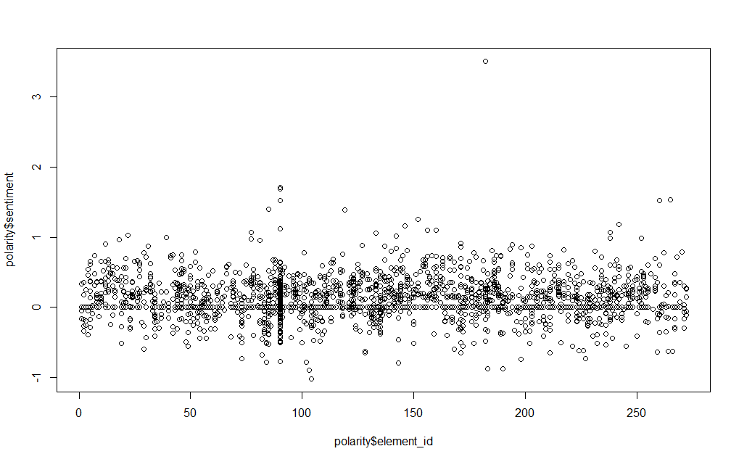
Sentiment Analysis : Polarity Graph

Slide 14
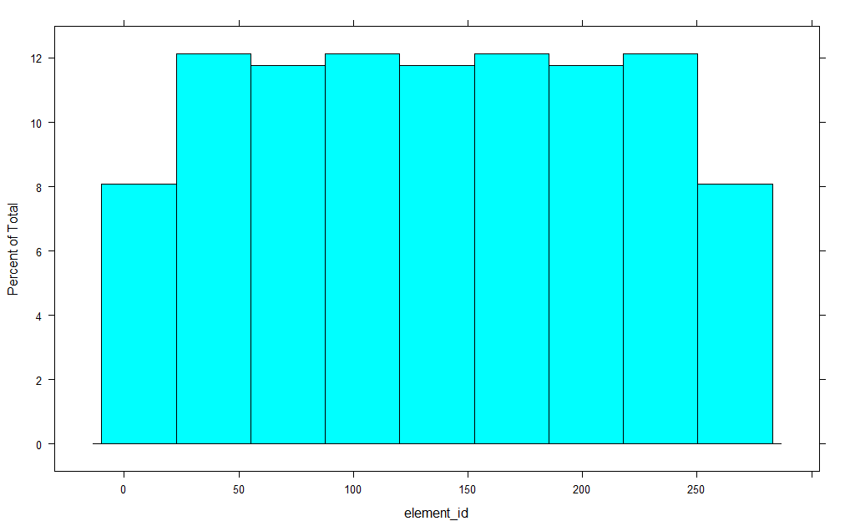
Histogram: POLARITY of SENTENCES

Slide 15
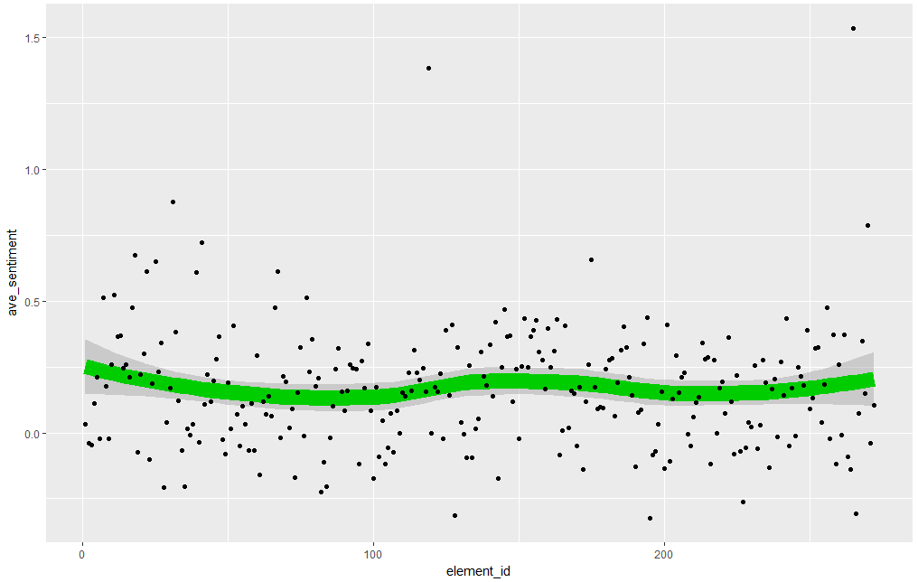
Sentiment of sentences through GGplot

Slide 16
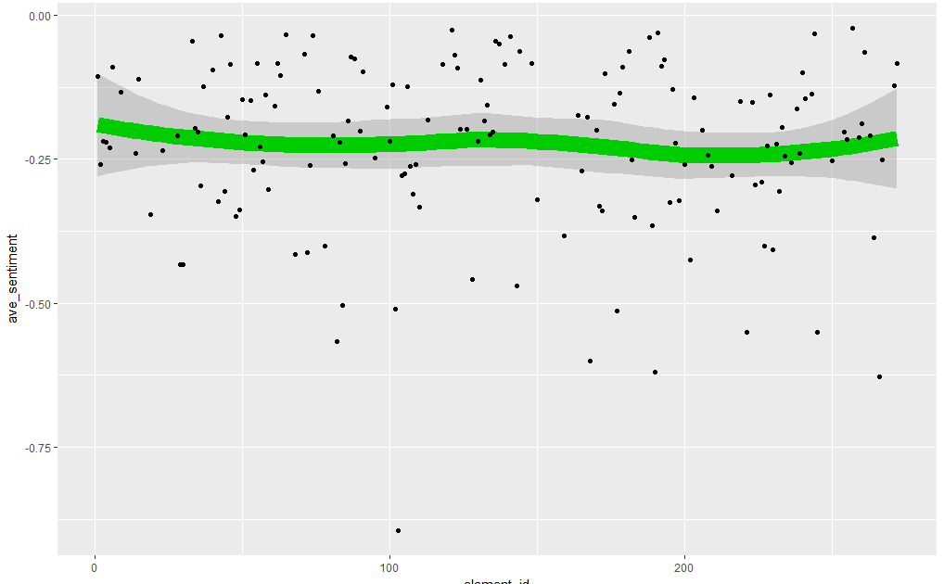
Negative Sentiment of sentences

