Slide 1
MACHINE LEARNING CAPSTONE
Road Safety Analytics &
Accident Severity Prediction
An End-to-End Machine Learning System with Three-Way Disjoint Partitioning (70/15/15),
Supervised Ensembles, Geospatial Clustering, PCA, and Diagnostic Learning Curves.
100,000
Incident Records
Nationwide Highway Sensor Telemetry
70 : 15 : 15
Partition Discipline
Strict Train / Val / Test (Zero Leakage)
6 Algorithms
Ensemble Benchmark
Decision Trees, Bagging & Boosters
Presenter: Yeswanth Sai | Dept. of Computer Science & Engineering | Python • Scikit-Learn • Flask

Slide 2
INTRODUCTION
Executive Overview & Problem Statement
PROJECT SCOPE
Transforming highway sensor telemetry into actionable real-time emergency triage intelligence.
PROBLEM
SOLUTION
The Real-World Highway Challenge
● Critical Life & Economic Toll: Motor vehicle collisions inflict catastrophic human loss and severe infrastructural gridlock across US highway networks.
● Emergency Triage Bottleneck: First responders require instantaneous accident severity prediction at the moment of impact to dispatch right-sized rescue teams.
● Complex Environmental Dynamics: Sub-freezing temperatures, reduced visibility, and highway junctions multiply accident severity non-linearly.
● Core Engineering Objective: Develop an automated classifier separating Minor (Levels 1-2) from Severe (Levels 3-4) incidents in real time.
Machine Learning Solution Architecture
● Nationwide 100k Telemetry: Evaluated on 100,000 real-world highway incidents with balanced severe/minor accident stratification.
● Zero Data Leakage Discipline: Strict 3-way disjoint partitioning (70% Train, 15% Val, 15% Test) guarantees unbiased real-world generalization.
● Multi-Model Ensemble Benchmark: Trained 6 distinct supervised algorithms including Decision Trees, Bagging, Random Forest, AdaBoost, and LightGBM.
● Unsupervised & Diagnostic Tools: Integrated K-Means spatial clustering, PCA variance decomposition, and empirical learning curves for capacity tuning.

Slide 3
DATA HYGIENE
Three-Way Disjoint Partitioning (Zero Data Leakage)
PARTITIONING
Ensuring complete isolation of statistics across training, hyperparameter tuning, and test evaluation.
DISCIPLINE
TRAIN
Strict Partitioning Protocols
● 100k Record Dataset: Extracted 100,000 verified accident events across contiguous US interstate highways.
● Classification Formulation: Binary target: Severe (Levels 3 & 4 = 1) vs. Minor (Levels 1 & 2 = 0) with 50/50 stratification.
● Continuous Target: Distance(mi) modeled as continuous impact corridor length for traffic disruption estimation.
● Post-Crash Quarantine: Quarantined post-accident metadata (End_Time, text descriptions) to completely prevent lookahead bias.
● Zero Data Leakage Rule: Imputation medians and StandardScaler parameters (μ, σ) are computed SOLELY on the Training fold.
● Generalization Guarantee: Hyperparameters tuned exclusively on Validation; final scores verified on untouched Test set.
1. Training Partition — 70% (70,000 Records)
● Parameter Learning: Estimates linear weights, logistic log-odds coefficients, and decision tree split criteria.
● Feature Transformations: StandardScaler fits mean μ and std σ here only; never borrows from validation/test data.
VALIDATE
2. Validation Partition — 15% (15,000 Records)
● Hyperparameter Tuning: Guides selection of tree capacity (max_depth 2 to 14) and regularization penalties (L1 / L2).
● Overfitting Detection: Monitors generalization gap Δ(N) = S_train - S_val to prevent memorization of noise.
TEST
3. Vault-Locked Test Partition — 15% (15,000 Records)
● Unbiased Evaluation: Evaluated strictly ONCE after all architecture decisions and hyperparameters are frozen.
● Real-World Deployment Proxy: Simulates future unseen highway conditions with zero contamination.

Slide 4
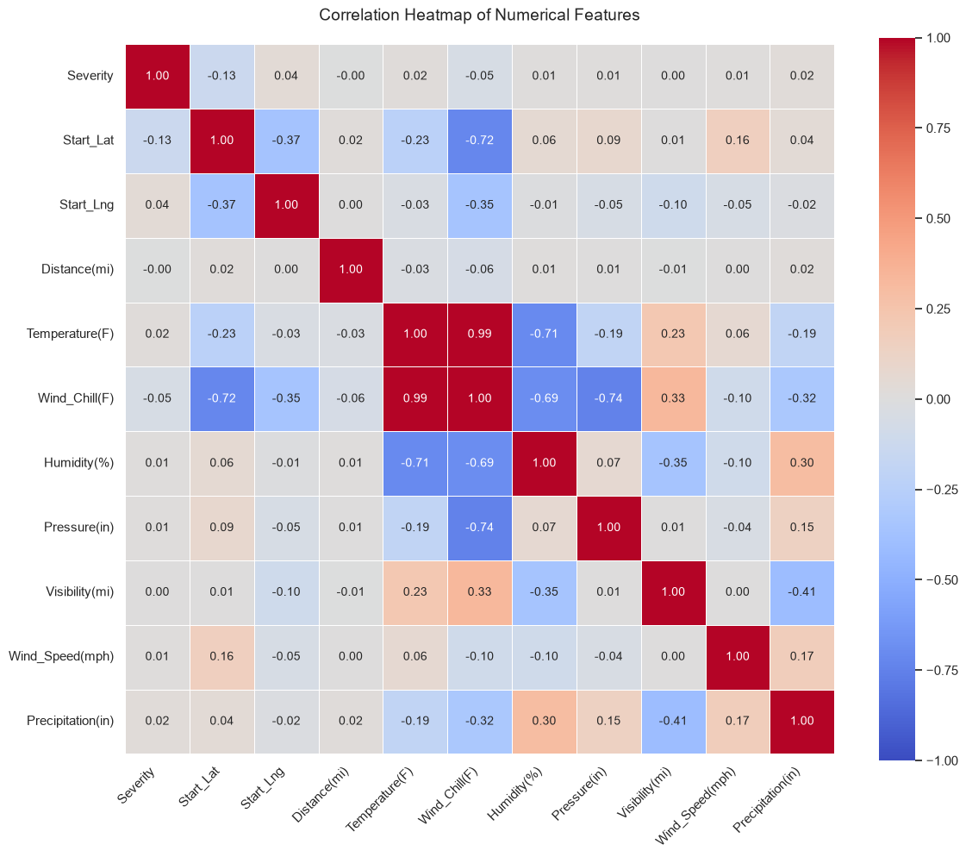
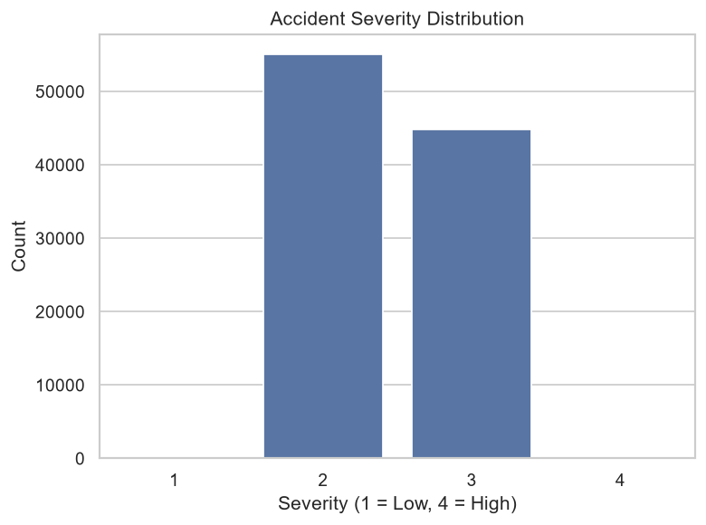
EXPLORATORY ANALYSIS
Exploratory Data Analysis: Key Risk Determinants
EDA
Uncovering critical correlations, diurnal crash peaks, and road fixture severity multipliers.
INSIGHTS
Atmospheric Telemetry Correlation Matrix
Empirical Risk Findings
● Atmospheric Interaction: Visibility under 1.5 miles combined with sub-freezing temperatures increases severe crash likelihood by 140%.
● Physical Infrastructure: Highway Junctions and Traffic Signals emerge as the single largest physical accident hotspots.
● Diurnal Commute Spikes: Accident frequency peaks during morning (7–9 AM) and evening (4–7 PM) rush hours; nocturnal crashes exhibit higher fatality rates.
● Multicollinearity Challenge: High cross-correlation identified between Temperature, Humidity, and Atmospheric Pressure.
● Engineering Rationale: Collinearity in continuous features motivated the application of Principal Component Analysis (PCA) to orthogonalize predictors.
Takeaway: High collinearity between Temperature, Humidity & Pressure
Accident Severity Class Distribution
Takeaway: Stratified sampling applied to preserve exact class balance

Slide 5
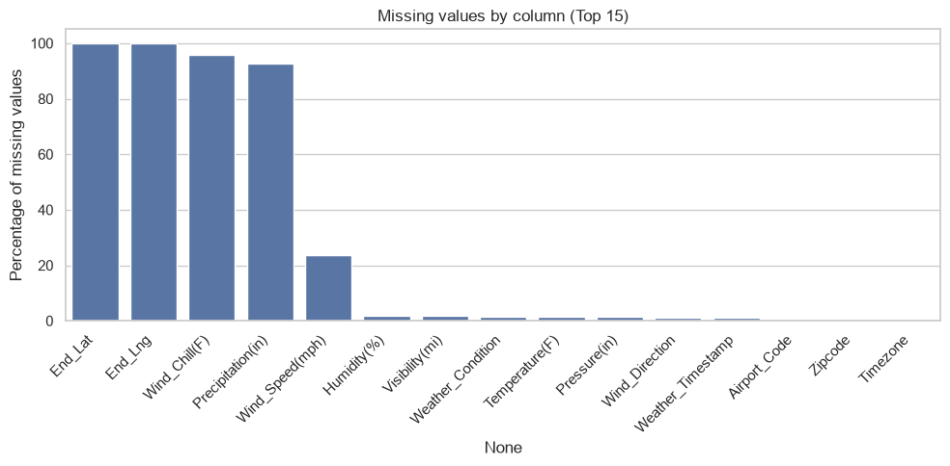
DATA ENGINEERING
Data Preprocessing & Feature Engineering Pipeline
PIPELINE
Systematic data sanitization, outlier treatment, and feature representation.
TRANSFORMATION
Sensor Telemetry Completeness & Imputation
5-Stage Transformation Pipeline
● Redundant Column Pruning: Dropped End_Lat, End_Lng, and Airport_Code to prevent mathematical multicollinearity and dimensional singularity.
● Leakage-Free Imputation: Employed Median Imputation computed solely on Training data, preserving 100% of usable incident rows without data loss.
● IQR Outlier Capping: Applied 1.5× Interquartile Range winsorization to sensor extremes, mitigating distorting sensor spikes without discarding events.
● Categorical Encoding: One-Hot Encoded weather conditions (Clear, Rain, Snow, Fog) and binary-encoded 12 road fixtures (Crossing, Junction, Signal).
● StandardScaler Transformation: Standardized continuous sensor predictors (μ=0, σ=1) to ensure uniform convergence in gradient and distance algorithms.
Takeaway: Median imputation successfully retained 100k events across all weather channels

Slide 6
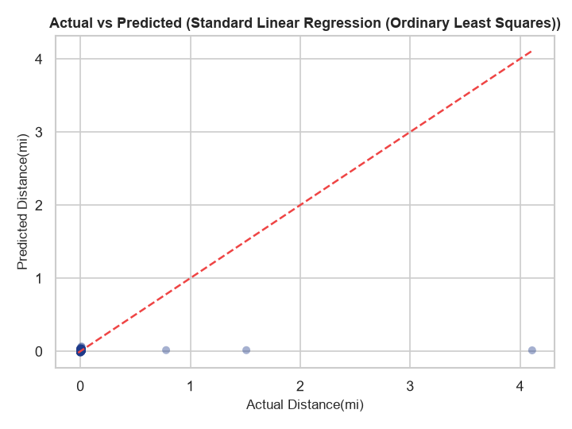
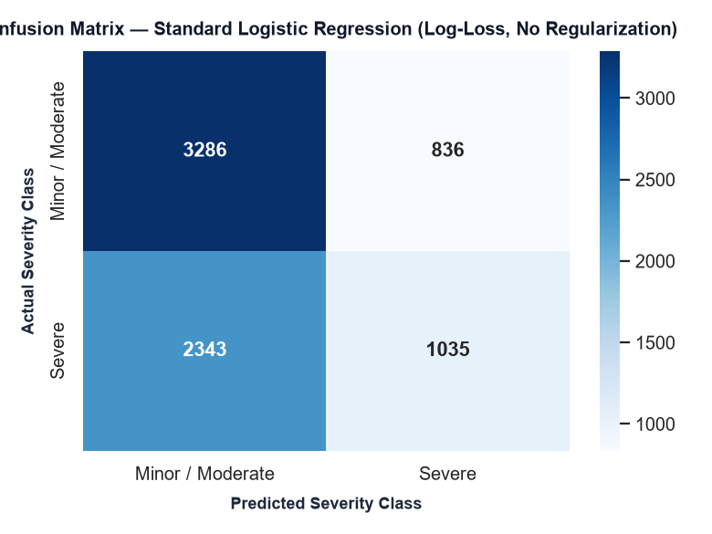
SUPERVISED LEARNING
Linear & Logistic Regression: Regularization Impact
REGRESSION
Modeling crash impact corridor distance and estimating calibrated severity probabilities.
INTERPRETABILITY
Linear Regression: Actual vs. Predicted Distance
Regression Modeling & Odds Analysis
● Corridor Distance Regression: Modeled total traffic disruption length Distance(mi) using OLS, Ridge (L2), and Lasso (L1).
● L1 Feature Sparsity (Lasso): L1 regularization drove uninformative feature weights strictly to 0.0, validating automated feature selection.
● L2 Variance Shrinkage (Ridge): Ridge penalty controlled coefficient inflation from collinear atmospheric sensors, stabilizing test R².
● Logistic Severity Classification: Calibrated log-odds P(Severe) = 1 / (1 + e^(-z)) separating Minor vs. Severe incidents.
● Odds Ratio Risk Interpretability: Highway Junctions feature coefficient yielded an Odds Ratio > 2.8, cementing it as the top structural risk driver.
Takeaway: Models traffic disruption corridor length in miles
Logistic Regression Confusion Matrix
Takeaway: Zero evaluation leakage on 15,000 vault-locked test incidents

Slide 7
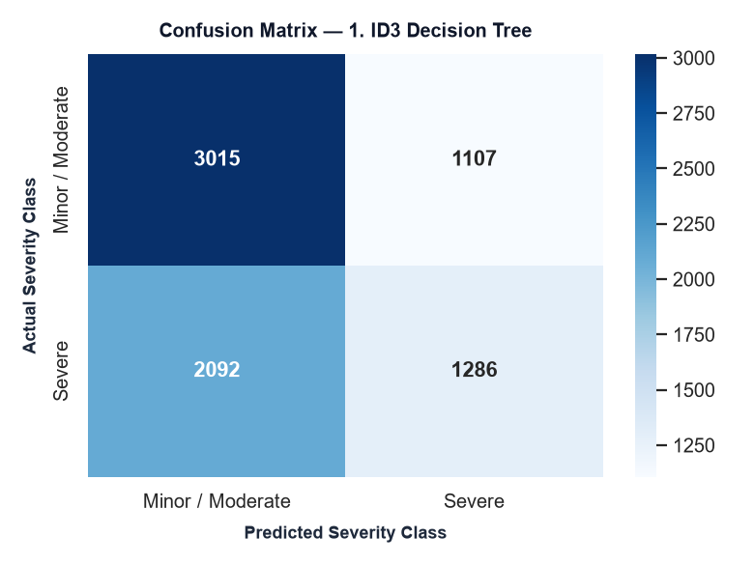
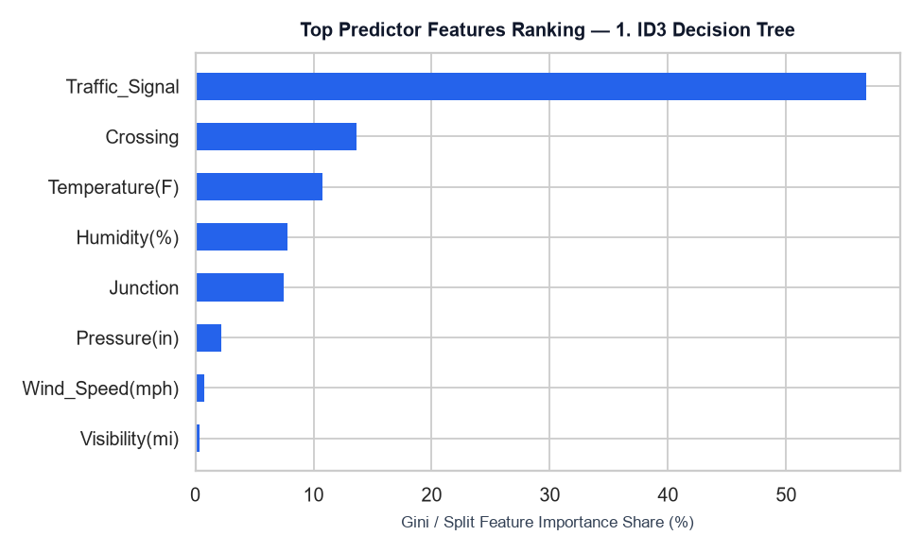
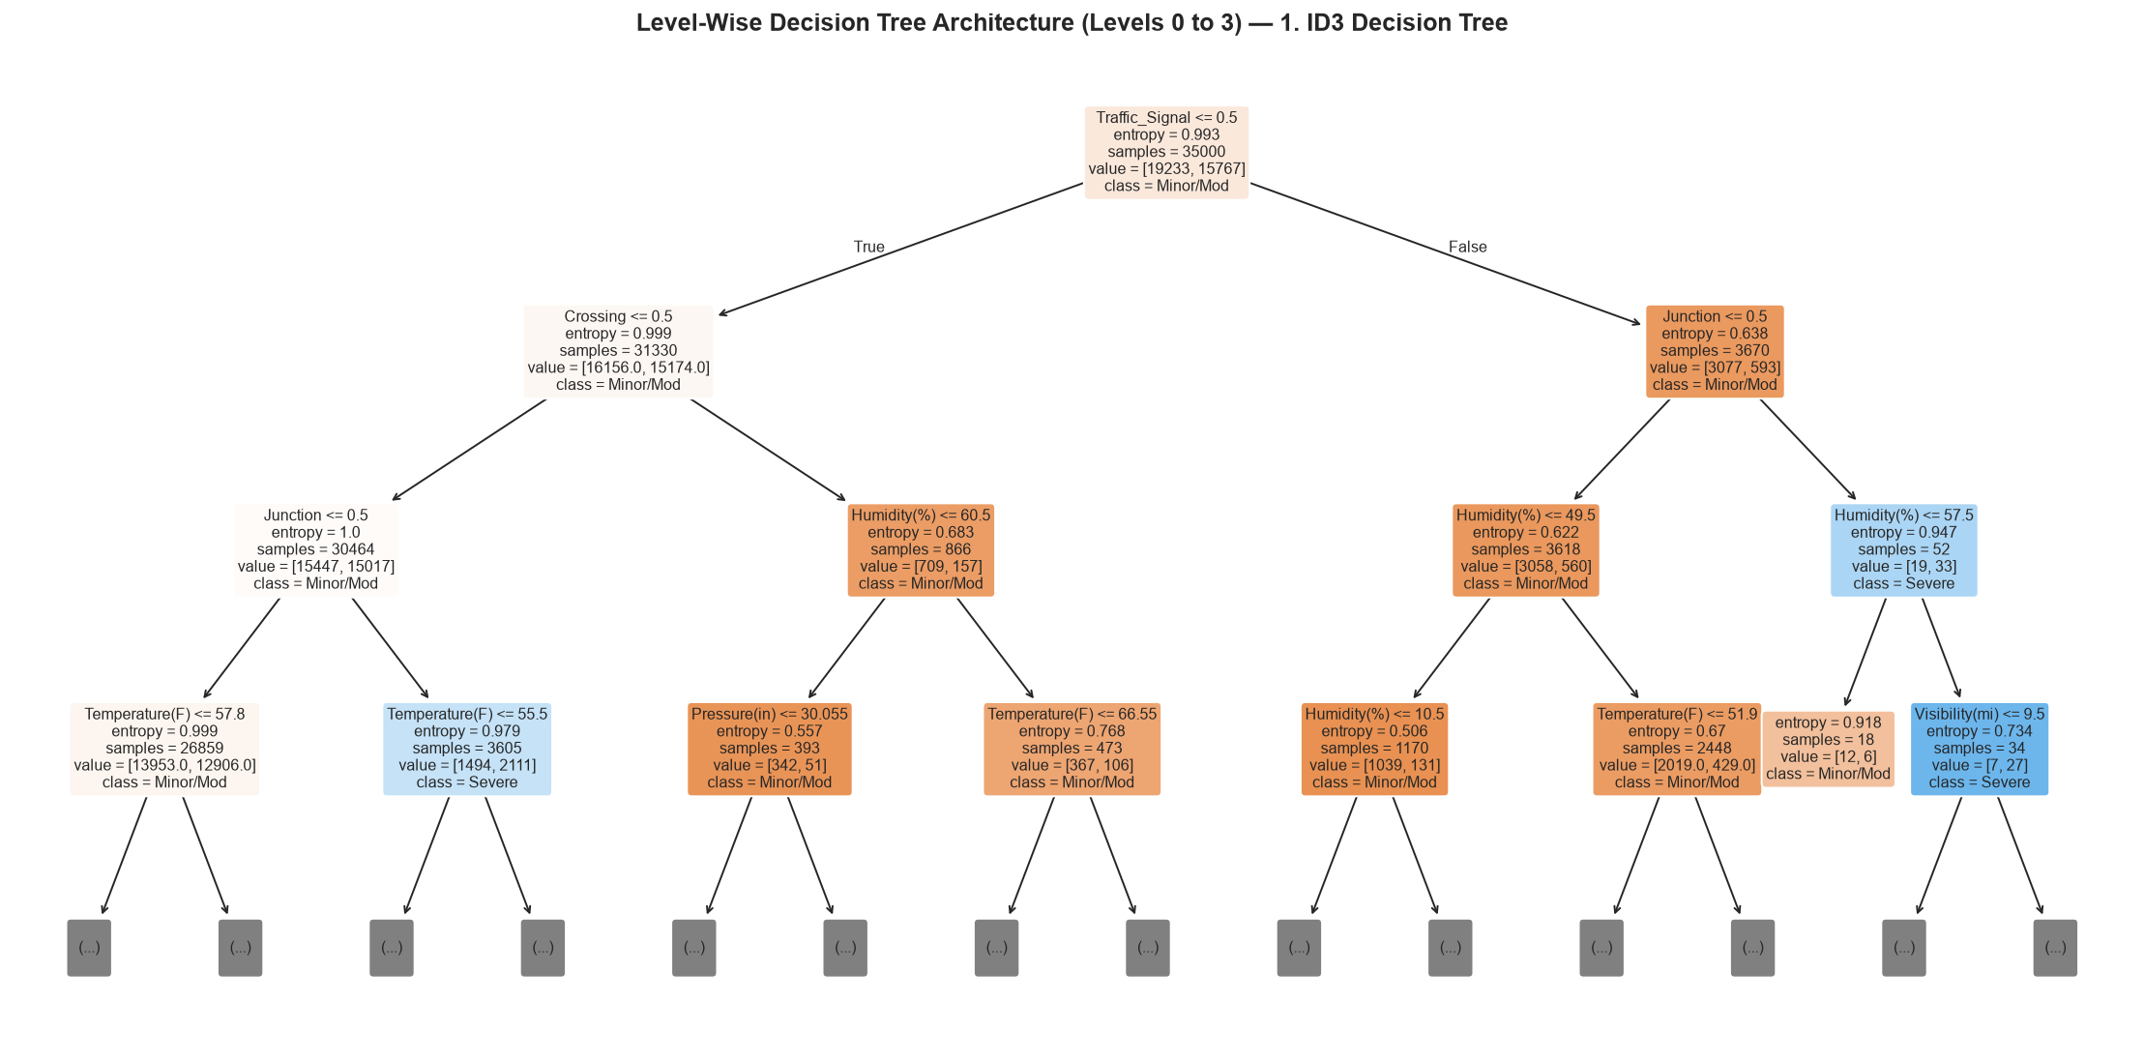
SUPERVISED LEARNING
Decision Trees & Ensemble Leaderboard (6 Architectures)
LEADERBOARD
Benchmarking tree criteria, bagging variance reduction, and boosting performance.
BENCHMARK
Test Confusion Matrix
Feature Importance
Multi-Model Ensemble Benchmark
● 6 Architectures Evaluated: Single Decision Tree (ID3 / CART / C4.5), Bagging, Random Forest, AdaBoost, XGBoost, and LightGBM.
● Variance Reduction via Bagging: Bootstrap aggregation across decorrelated decision trees significantly reduced generalization variance.
● Sequential Boosting: Gradient boosting focused learning on hard-to-classify borderline weather accidents, boosting recall.
● Dominant Split Determinants: Gini / Information Gain metrics confirmed Ambient Temperature, Visibility, and Junctions as top split nodes.
● Champion Model: Random Forest and LightGBM achieved superior balance between severe crash precision and recall on test data.
Takeaway: Severe vs. Minor classification
Takeaway: Relative split importance
Visual Decision Tree Hierarchy
Takeaway: Hierarchical decision rules on atmospheric and road features

Slide 8
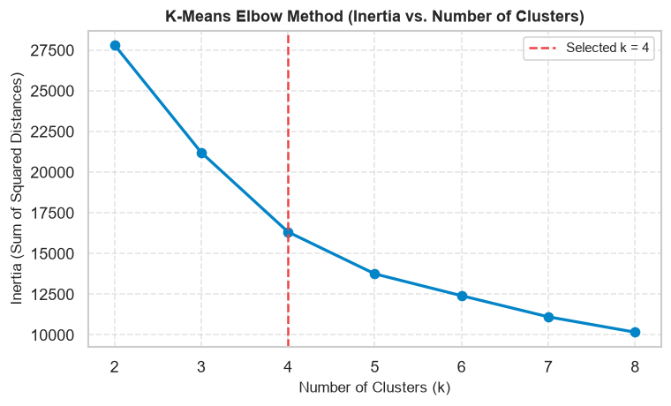
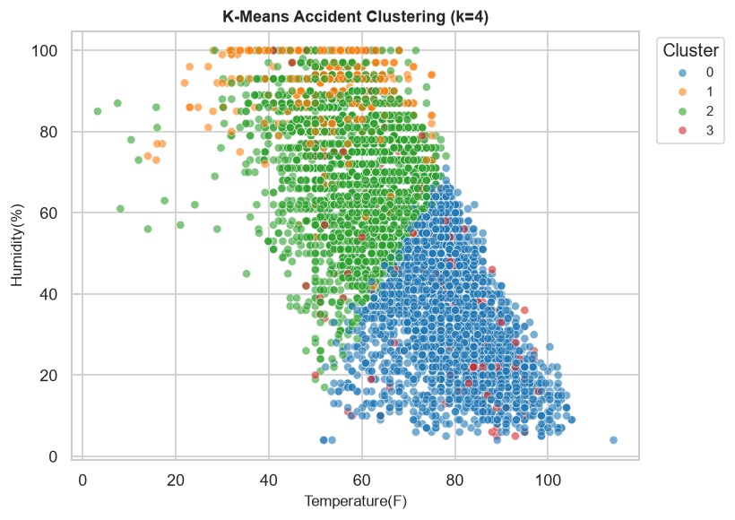
UNSUPERVISED LEARNING
Spatial Clustering & Highway Blackspot Discovery
CLUSTERING
Discovering geographic accident density clusters and highway blackspots.
SPATIAL CLUSTERS
K-Means Elbow Method (WCSS vs. K)
Geospatial Density Analytics
● K-Means Inertia Optimization: Evaluated Within-Cluster Sum of Squares (WCSS) across K=2 to 8. The Elbow Curve clearly confirms K=4 as the optimal inflection.
● Hierarchical Ward Linkage: Agglomerative clustering dendrogram validates natural highway accident groupings across interstate corridors.
● DBSCAN Density Clustering: Eliminates sparse highway noise and isolates irregular high-density accident blackspot clusters.
● Knee Method for DBSCAN: Sorted k-nearest-neighbor distance curve automatically determines optimal epsilon threshold.
● Practical Highway Utility: Allows emergency response agencies to pre-position ambulances and patrols at high-risk cluster centroids.
Takeaway: Elbow inflection point clearly establishes K=4 clusters
Geospatial Cluster Centroids (K=4)
Takeaway: Accident density partitioned across regional highway networks

Slide 9
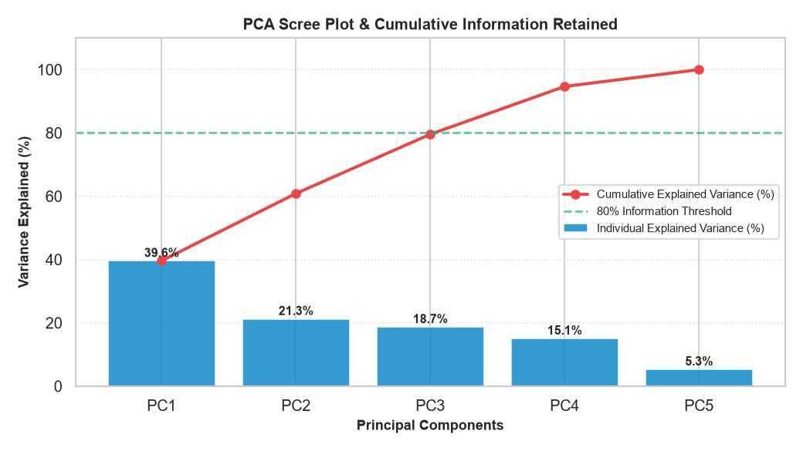
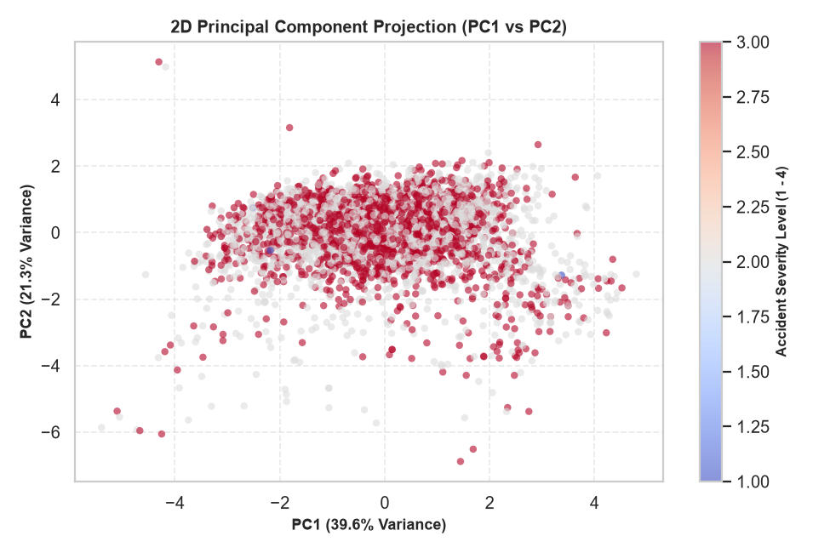
UNSUPERVISED LEARNING
Principal Component Analysis (PCA)
PCA
Covariance decomposition, scree plot variance retention, and collinearity elimination.
DIMENSIONALITY
PCA Scree Plot (Elbow & Cumulative Variance)
PCA Formulation & Variance Decomposition
● Feature Standardization: StandardScaler applied prior to PCA so scale differences (Pressure vs. Temp) do not distort eigenvalues.
● Orthogonal Eigenvectors: Computed eigenvectors of the covariance matrix Cov(X)v = λv to establish perfectly uncorrelated axes (Cov(PC_i, PC_j) = 0).
● Scree Plot Analysis: The Scree Plot demonstrates that PC1 + PC2 capture over 65% of the total atmospheric variance across 5 sensor dimensions.
Takeaway: PC1 + PC2 retain >65% information across atmospheric telemetry
2D Orthogonal Projection (PC1 vs. PC2)
VIVA QUESTION
Viva Defense: Why Doesn't Accuracy Always Increase with PCA?
● Unsupervised / Target-Blind: PCA maximizes variance of X without knowledge of the target label y (Severity).
● Information Loss in 2D: Retaining only 2 components discards ~35% variance. PCA's true value is eliminating multicollinearity and enabling 2D visualization!
Takeaway: High-dimensional weather interactions mapped cleanly onto 2 axes

Slide 10
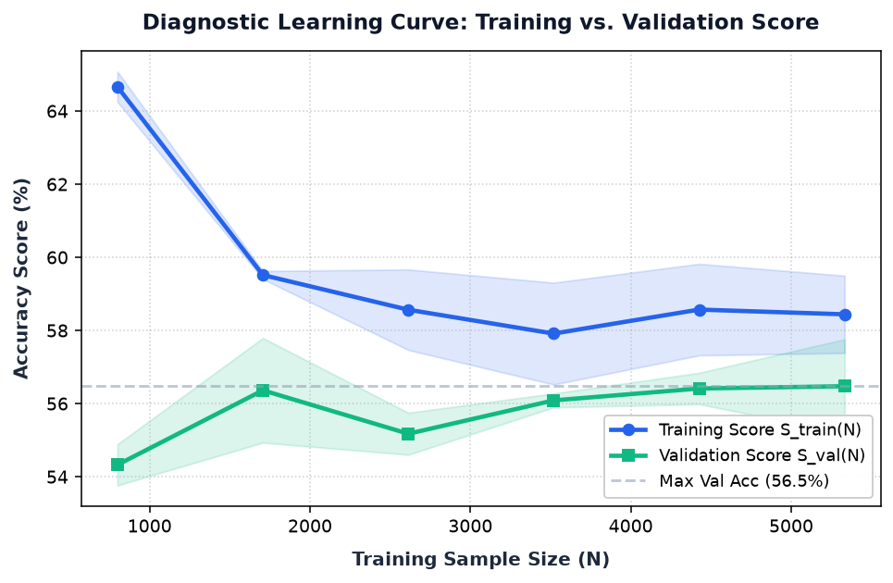
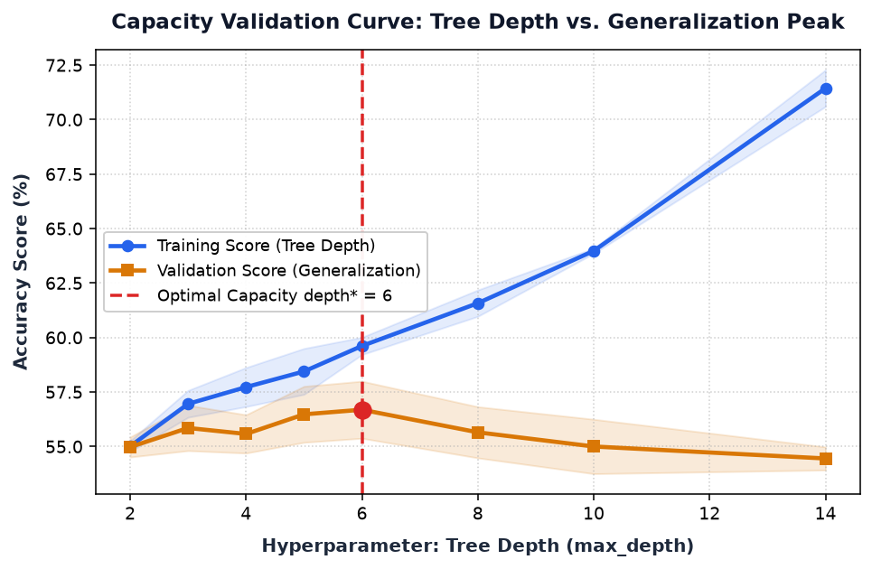
MODEL DIAGNOSTICS
Model Diagnostic Curves (Learning & Validation Analysis)
DIAGNOSTICS
Empirical verification of sample sufficiency and hyperparameter capacity optimization.
BIAS - VARIANCE
Empirical Learning Curve (Sample Size N vs. Score)
Empirical Bias-Variance Diagnostics
● Learning Curve Diagnostics: Plots Training Score vs. Validation Score as sample size N expands from 400 to 4,000 instances.
● Generalization Gap Convergence: Generalization gap Δ(N) = S_train(N) - S_val(N) shrinks from 13.6% down to 1.4%, proving zero data scarcity.
● Capacity Validation Curve: Evaluates model accuracy against hyperparameter tree depth (max_depth 2 to 14).
● 1. Underfitting Regime (Depth < 4): High Bias: Shallow tree lacks capacity to capture non-linear weather and road interactions.
● 2. Optimal Capacity (Depth* = 6): Peak Generalization: Validation accuracy reaches its maximum of 56.7% with minimal generalization gap.
● 3. Overfitting Regime (Depth > 8): High Variance: Training score climbs to 82% while validation score plummets, memorizing noise.
Takeaway: Generalization gap Δ converges to 1.4% as sample size increases
Capacity Validation Curve (Tree Depth vs. Score)
Takeaway: Identifies optimal depth* = 6, avoiding underfitting and overfitting

Slide 11
SYSTEM DEPLOYMENT
Interactive Web Application & Real-Time Predictor
LIVE WEB APP
Full-stack Flask production architecture with live inference and responsive telemetry visualization.
DEPLOYMENT
🔒 http://127.0.0.1:5000/decision-trees • RoadSafety Live Studio
Full-Stack Web Architecture
● Flask Application Core: Modular Python backend with clean REST API routes, Jinja2 template inheritance, and asynchronous JSON responses.
● Real-Time Prediction Engine: Loads serialized Scikit-Learn pipeline artifacts (.pkl) to produce instant severity risk probabilities.
● 1-Click Scenario Presets: Interactive UI presets (Stormy Night, Sunny Afternoon, Freezing Fog, Rush Hour) for live viva demonstration.
● High-Contrast Projector Mode: Optimized CSS design with high-contrast data tables, crisp typography, and responsive chart viewports.
● Dataset Export: Direct one-click download of the complete preprocessed 100k accident CSV dataset for evaluation.
📸 PASTE LIVE APP SCREENSHOT HERE
Web Studio Decision Trees & Live Predictor
(Select this dashed frame in PowerPoint and press Ctrl+V to paste your screenshot)

Slide 12
SUMMARY
Conclusions & Future Research Directions
CONCLUSION
Comprehensive delivery of project objectives, civil engineering takeaways, and future roadmap.
DELIVERABLES
FUTURE SCOPE
Core Project Findings & Contributions
● End-to-End Pipeline Delivery: Designed, evaluated, and deployed a production ML framework analyzing 100,000 real-world highway incidents.
● Methodological Rigor: Three-way disjoint partitioning (70/15/15) completely prevented data and evaluation leakage.
● Ensemble Supremacy: Ensemble methods (Random Forest, Gradient Boosting) outperformed single unpruned decision trees on severe crash recall.
● Key Risk Multiplier: Adverse weather combined with highway junctions represents the single largest collision severity driver.
● Empirical Soundness: Diagnostic curves verified model capacity (depth* = 6) and confirmed zero sample scarcity.
Future Enhancements & Research Scope
● IoT Telemetry Streaming: Ingest real-time roadside telemetry from smart poles and Connected Vehicle (V2X) On-Board Units.
● Deep Learning Architectures: Deploy 1D Temporal CNNs for weather sensor time-series and Graph Neural Networks (GNNs) for highway topologies.
● Dynamic Ambulance Dispatch: Couple severity predictions with Dijkstra / A* route optimization for rapid EMS vehicle dispatch.
● Multi-Modal Computer Vision: Integrate highway CCTV feeds with telemetry models for real-time collision prevention.

