Slide 1
Veeva CLM Selector Training Modules
Veeva Professional Services

Slide 2
Agenda
Training overview and goals
BET Training
End User Training
Admin training

Slide 3
Training overview & goals
This training is designed for the use and configuration of the CLM Selector tool
The CLM Selector tool allows end users (Reps/MSLs) to pick and choose which CLM Presentations they would like to Select and download to iRep
The training will be provided to the following three groups:
BETs
End Users (Reps/MSLs)
Admin training (System Admins/CLM Admins)

Slide 4
Roles and Responsibilities
BETs
BETs shall be responsible for defining the Public Groups for the Admins to be able to create these in iConnect
BETs shall be responsible for configuring the CLM Presentations in iConnect so as to clearly indicate which Public Groups get the Presentations
End Users
End Users shall be responsible for understanding the use of the CLM Selector tool
Admin Users
Admin Users shall be responsible for
Creating Public Groups
Configuring CVCs
Making CLM Selector available to the right profiles

Slide 5
BET Training

Slide 6
BET Training: Pre-requisites
CLM must be enabled for the organization
CLM Presentations must already exist in the organization
BETs must have edit permissions on the following fields on the CLM Presentation object (they must be assigned profile “JNJ CLM Content Mgmt” in iConnect):
Groups_to_Share_to_JnJ__c
Country_Usage_JNJ__c

Slide 7
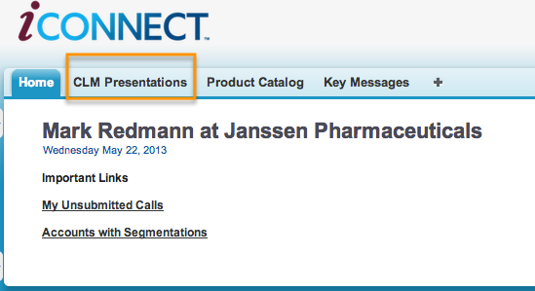
BET Training: Configuration steps
Login to Veeva using your UserId and Password
Navigate to the “CLM Presentations” tab by clicking on it

Slide 8
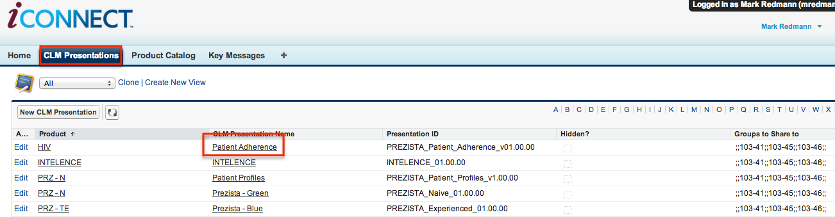
BET Training: Configuration steps
Click the “Go” button next to the “All” List View
Select a CLM Presentation to be added to a Public Group by click on CLM Presentation Name link of the corresponding CLM Presentation

Slide 9
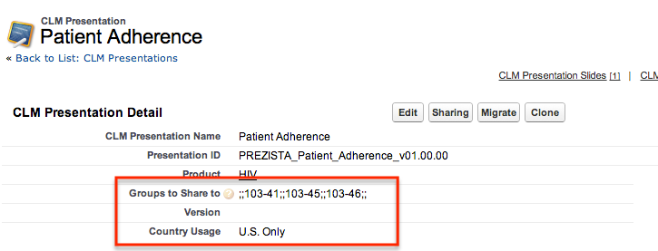
BET Training: Configuration steps
Add one or more Public Groups that you would like this CLM Presentation shared to:
Update the field “Groups to Share to” by adding each Public Group name in the format ;;<PublicGroupName>;;
For eg: To share the CLM Presentation with Groups 103-41 and 103-45, “Groups to Share to” field value should be appended with the following string: ;;103-41;;;;103-45;;
Update the field Country Usage if required to one of the following values: U.S. Only, Canada Only or U.S. & Canada

Slide 10
End User Training

Slide 11
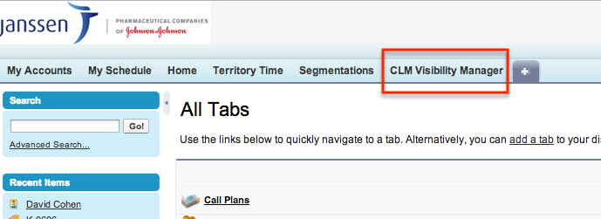
End User Training: Pre-requisites
CLM must be enabled for the organization
CLM Presentations must already exist in the organization
End users must have access to iConnect & CLM Visibility Manager tab

Slide 12
Veeva CLM Selector Overview
The CLM Selector tool provides the ability to a user to see their current state of visibility for CLM presentations and update it according to their specific field use needs
It manifests itself as a simple iConnect tab
CLM Selector changes the Sharing structure of one or more CLM Presentations online only – users must perform a “Refresh Database” operation on iRep to effect changes on iRep

Slide 13
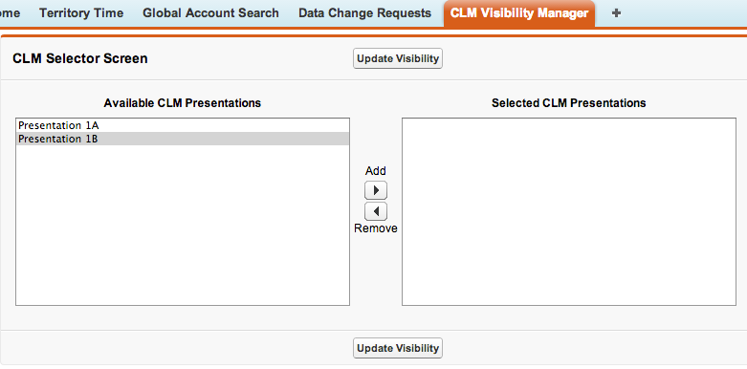
End User Training: Making Available/Selected lists
See detailed instructions on next slide

Slide 14
End User Training: Making Available/Selected lists
Login online to iConnect (this operation should only be performed Online ) by going to https://login.salesforce.com using a Web browser
Click on the CLM Visibility Manager to arrive at the following screen
Move over presentations to/from Available/Selected lists by clicking the Add/Remove button
Selected List presentations will be available for use in iRep & downloaded to iPad
Available list presentations will not be available for use in iRep
Click the button “Update Visibility” for the selections to take effect
After updating visibility online, please perform a “Database Refresh” by logging into iRep on the iPad (see next slide)

Slide 15
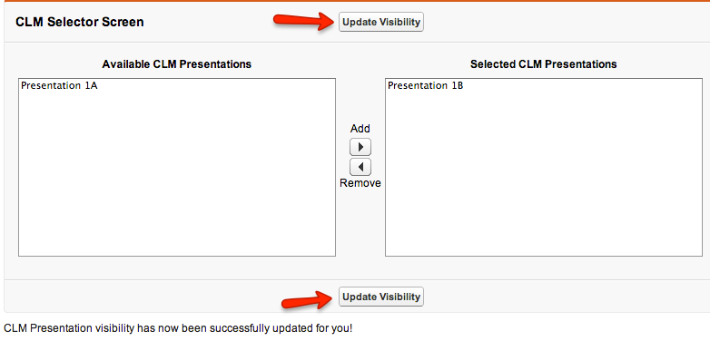
End User Training: Updating Selections
Click on the “Update Visibility” button to update your changed selections
Notice the success message at the bottom

Slide 16
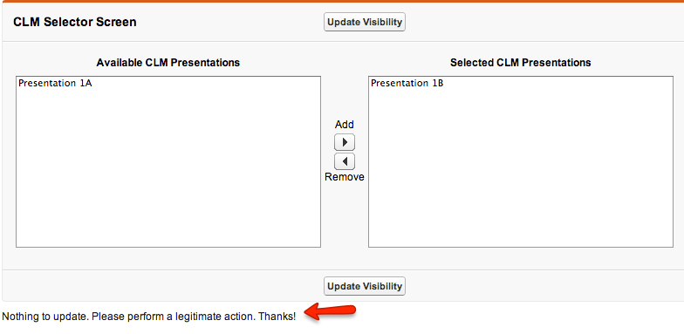
End User Training: Updating Selections
Clicking the “Update Visibility” button without making any changes to Available and Selected lists will result in an error message

Slide 17
Admin Training

Slide 18
Admin Training: Pre-requisites
CLM must be enabled for the organization
CLM Presentations must already exist in the organization
CLM Selector code package (see Appendix) must already be installed
Must know Veeva/SFDC basic configuration/fundamentals

Slide 19
Admin Training: Overview
Install CLM Selector Code package
Configure CLM Selector/CLM Visibility manager custom settings per Profile or Organization as applicable
Upload CVC objects based on Public Group and Country Usage assignments as provided by the BETs
Update User profiles to provide proper access to CLM Visibility Manager tab

Slide 20
V-CVM Available & Visible Lists
V-CVM has two main lists –
Available Presentations – By Default, if nothing is specified/configured, Users will see every CLM Presentation associated to Products they have access to
Visible/Selected Presentations – Users will always see this list as Empty at the outset in a private OWD setting for CLM Presentations at the outset. This list cannot be controlled/defaulted to specific state using this tool
Available Presentations Definition
These are defined as CLM Presentation objects that exist in Veeva however are not yet Shared with the user by any means – either using Sharing rules or manual sharing or any other way. The User will never be able to see these presentations at the outset
Visible Presentations Definition
These are defined as CLM Presentation objects that exist in Veeva AND the user has access to these presentations. To set a default on these, Users will need to put in Sharing rules or share Presentations manually with the User

Slide 21
CVC Overview
CLM Visibility Configuration Object (CVC)
CVC is a configuration setting for the V-CVM tool that defines what further filters need to be applied to the Default Available List. At no time will a user ever be able to see more than the Default Available List
A CVC object can be created at a User, Profile and/or Public Group level
Each User/Profile/Public Group level CVC must be unique for that level
If no CVC exists for the logged in User at either the User, Profile or Public Group level, then Presentations shows in Available list
The CVCs can be manually created in Veeva, however typically will be data-loaded in practice using the Salesforce Data Loader tool by an Administrator

Slide 22
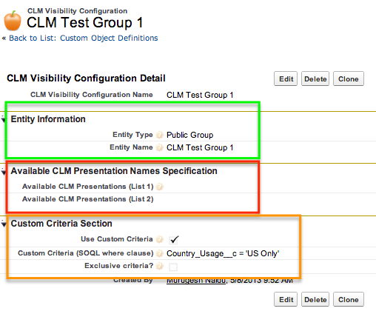
Building a CVC configuration object
There are overall 3 key sections that need to be populated as shown below, however at anytime, you would only populate two of these

Slide 23
CVC Config: Entity Configuration
Each CVC has two mandatory fields that must always be populated:
Entity Type: This Picklist field defines if the CVC applies for a Profile, User or a Public Group. Valid values are Profile, User and Public Group
Entity Name: This is a text field that needs to be populated with either a UserName, Profile Name or Public Group, depending on Entity type selected
System has in-built mechanism to ensure valid Entity Name is entered and throws an error for invalid Entity Names
Each Entity can only have one (1) CVC instance. The Unique External ID for this object is basically the Entity ID and will cause an error if duplicates are attempted to be added

Slide 24
CVC Config: Available Presentation Names
Each CVC has two optional fields that may be populated if there is a clear mapping available between Entity Type (Public Group/Profile/User) and CLM Presentations that need to be made available to that Entity
Available CLM Presentations (List 1) & Available CLM Presentations (List 2) – Each of these fields is a 255 character Textarea field and will take a semi-colon seperated list of CLM Presentation Names
Two fields are provided in case one field is not enough to handle all CLM Presentation names
Eg: Safety of Cholecap;Therapy Days;
If more than one CVC instances exist for a logged in user (say one at a Profile level and one at Public Group level) with CLM Presentation names specified, then the system will combine the two lists from all CVCs and make them all available to the User. This is the only option available if Names are specified

Slide 25
CVC Config: Custom Criteria
A Custom Criteria based on CLM Presentation Object fields can also be specified instead of filtering based on Presentation names
Specifying the Custom Criteria involves the following fields:
Use Custom Criteria: Must be checked to use Custom Criteria. If this is checked, any values in Available Names List 1 & 2 are cleared on Save
Custom Criteria: Must be populated with a string that constructs a valid where clause (without the word “where”) based on CLM Presentation Object fields or lookup fields on the CLM Presentation object
Eg: Country_Usage__c = 'US Only' and Type_vod__c = 'HQ’
Exclusive Criteria ?: This can only be checked at the User level (Entity type = User). If checked, then criteria in this CVC overrides any other criteria that may exist at the Public Group and/or Profile level
Active: Must be checked for the CVC to take effect. Only Active CVCs are considered by the Selector. All Validations & checks still apply even to non-active CVCs

Slide 26
Selective CLM Content (Key Message) Download
iRep is built to download ALL Key Messages (including CLM Content Key Messages) associated to User’s accessible Products
This may result in User(s) being stuck with downloading CLM Content (Key Messages) that they have actually chosen NOT to download using the CLM Selector tool
To get around this, the CLM Selector implements a mechanism to selectively download only those CLM Content/Key Messages for a User that he has chosen to make available for themselves
This mechanism has zero effect on non-CLM Key message downloads nor would it apply to groups/people who are not using the CLM Selector tool
As of Release 1.0 for CLM Selector, end users must make at-least one visibility change using the Selector to enable this functionality

Slide 27
Selective CLM Content (Key Message) Download
CLM Selector adds a new Object called “Invisible CLM Key Message”
ALL End User Profiles must have read/create access to this Object
Since this mechanism is targeting the iRep download functionality which is linked to Products, it takes into account ALL Key Messages associated to the User accessible Products when populating this table
Additionally, a “Top Level” or “Full Sync” VMobile Object Configuration (VMOC) needs to exist either at the Org or Profile level for Key Message object with the following criteria included:
Where Id Not In (Select Key_Message__c from Invisible_CLM_Key_Message__c where OwnerId = @@VOD_SF_USER_ID@@)

Slide 28
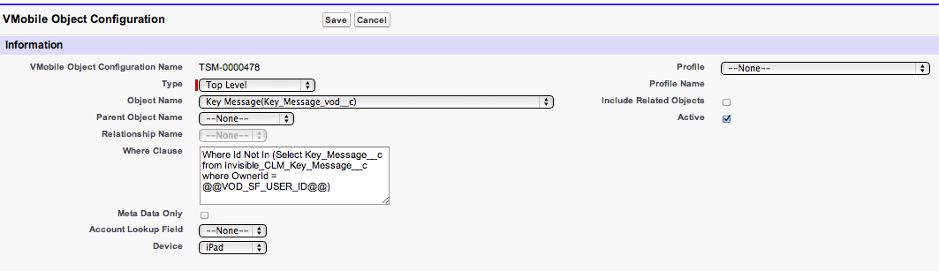

VMOC for Selective Key Message Download
If there is already a VMOC with a where clause for Key Messages, append the afore-mentioned clause to it using an “AND” operator
If there is none, then the where clause can be fed in on its own. Clear cache after VMOC update
Note– Put “AND Product_vod__c <> '’” because it seems if no Products are assigned, then those key messages are also downloaded

Slide 29
Custom Setting
Custom setting (VPROF_CLM_Selector_Setting__c) controls some of the CLM Selector behavior and UI Messaging
Hierarchy type (can be set at User, Profile or Org level)
Must have at-least an org level custom setting to ensure smooth VF page renditions. Some of the attributes are optional as described below
Optional attributes:
Default_No_CVC_Behavior__c (Default value DISPLAY_ALL)
Enable_Key_Message_Download_Handling__c (Default value true)
Required attributes (all have default values defined):
Page_Title__c, Available_List_Title__c, Visible_List_Title__c, Box_Size__c, Box_width__c, Update_Button_Text__c

