Slide 1
Veeva CLM Selector v1.0
Veeva Professional Services

Slide 2
Agenda
Overview of Veeva CLM Selector
CLM Selector Installation
CLM Selector Configuration
Contacts and Miscellaneous Information

Slide 3
CLM Selector Overview and Useability

Slide 4
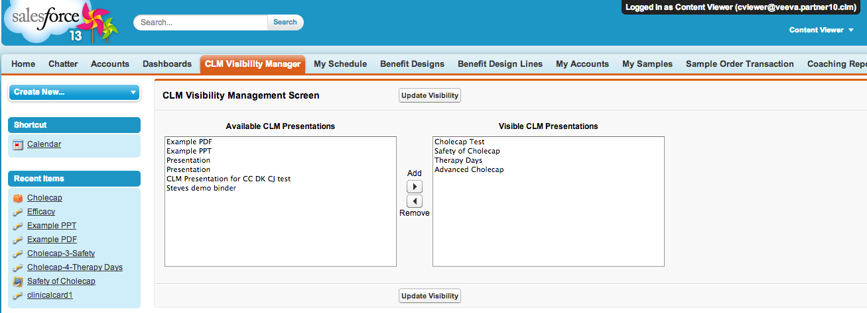
CLM Selector/CLM Visibility Manager Overview
The CLM Selector tool allows end users (Reps/MSLs) to pick and choose which CLM Presentations they would like to Select and download to iRep

Slide 5
CLM Selector Overview
The CLM Selector tool provides the ability to a user to see their current state of visibility for CLM presentations and update it according to their specific field use needs
It manifests itself as a simple Veeva/SFDC tab
CLM Selector changes the Sharing structure of one or more CLM Presentations online only
Users must perform a “Refresh Database” operation on iRep to effect changes on iRep (unless v18 Enhanced Sync is enabled for CLM Presentation objects

Slide 6
CLM Selector Overview
As of Release 1.0, only the “Available Presentations” list can be controlled via Configuration – this list essentially constitutes the presentations that exist in Veeva but are not yet shared with the End user
As of Release 1.0, CLM Presentation Object’s Org Wide Default setting must be Private
Key Message OWD does not matter

Slide 7
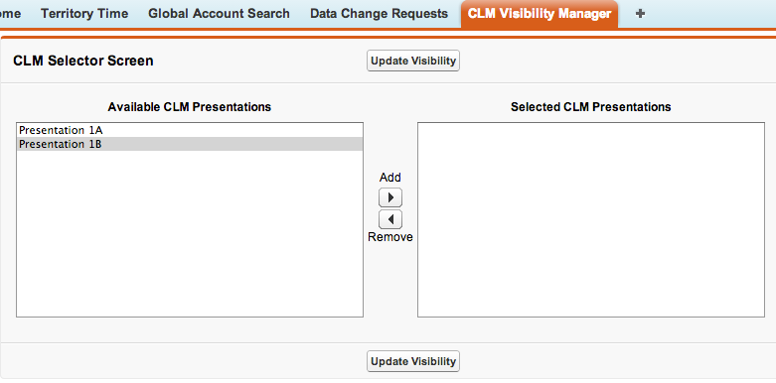
Using the CLM Selector tool
Choose one or more or all the CLM Presentations that you would like to download to iRep from the “Available Presentations” list on the left

Slide 8
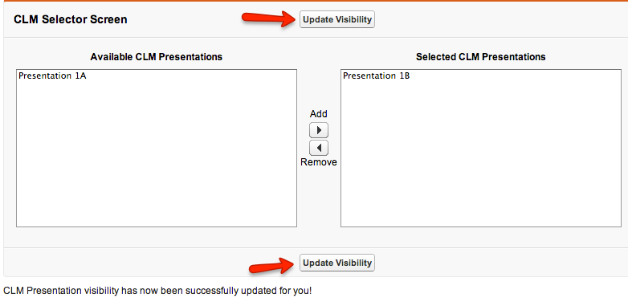
Using the CLM Selector: Updating Selections
Click on the “Update Visibility” button to update your changed selections
Notice the success message at the bottom

Slide 9
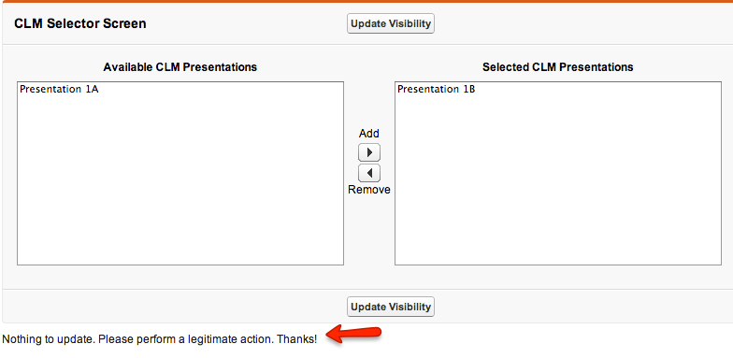
Using the CLM Selector: Updating Selections
Clicking the “Update Visibility” button without making any changes to Available and Selected lists will result in an error message
After updating visibility online, please perform a “Database Refresh” by logging into iRep on the iPad (unless v18 Enhanced Sync is enabled)

Slide 10
CLM Selector Installation

Slide 11
CLM Selector Installation
Go to the following GitHub URL using your favorite browser:
https://github.com/VeevaCodeRepo/VeevaCLMVisibility
Click on the ZIP ( ) button to download the source files (VeevaCLMVisibility-master.zip) onto your hard drive
Expand the zip file and double-click into the folder till you see a folder called “src”
Right click on the “src” folder and zip it into a zip file –let’s call it src.zip (NOTE: I’ve had to use Windows Zip (winzip) to create this file using my Windows Parallel on the MAC. MAC OS/X compression does not seem to work with SFDC Workbench)
Login to the Salesforce Org where you would like to install the CLM Selector

Slide 12
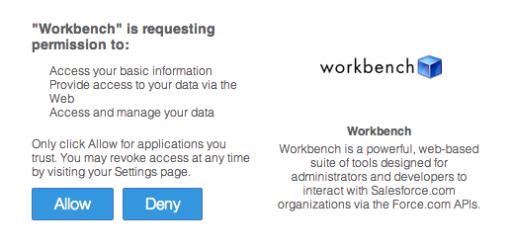
CLM Selector Installation
Open another tab in the browser and navigate to the SFDC Workbench site (choose Sandbox or Production depending on what type of Org you logged into in Step #5)
Click the “Login with Salesforce” button to login to the workbench using Oauth
If this is the first time you are accessing this org via Workbench, you will see the following message. Click Allow to proceed further

Slide 13
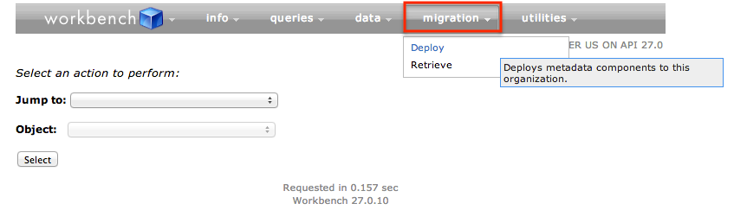
CLM Selector Installation
From the Workbench home page, click Migration➔Deploy
On the next screen, choose “src.zip” file by clicking the “Choose File” button and check the “Check Only” checkbox to only validate but not actually deploy the code into your destination org
Once the “Check Only” succeeds, repeat step #10 but without the “Check Only” checbox checked to actually deploy the Selector

Slide 14
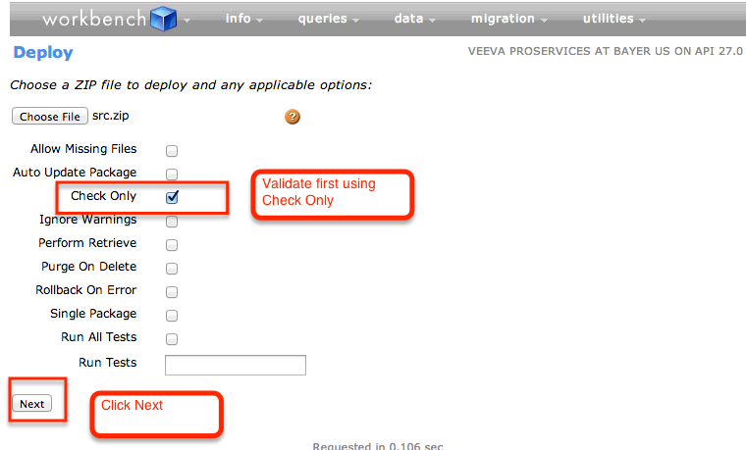
CLM Selector Installation

Slide 15
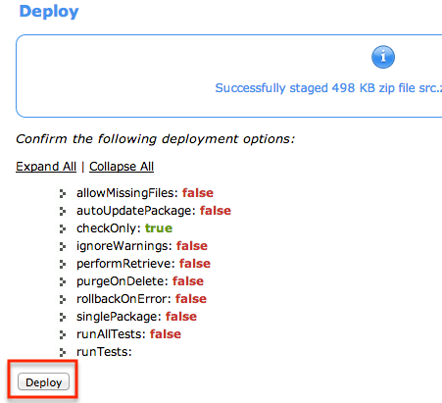
CLM Selector Installation

Slide 16
CLM Selector Installation

Slide 17
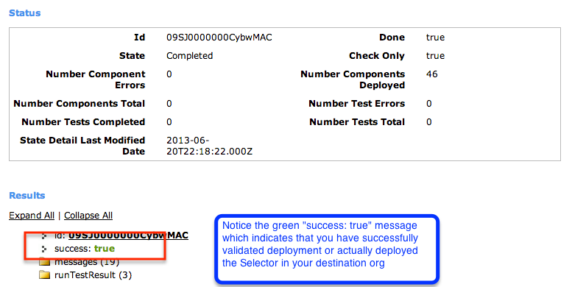
CLM Selector Installation: Final Confirmation Step

Slide 18
Post-install Steps
After logging into the Veeva Org where you installed the selector, navigate to Setup→Develop→Custom Settings→Veeva CLM Selector Setting
Click Manage→New→ Save (Save a default Custom Setting). Custom Setting configuration is explained in later slides
After the successful installation, you should notice a tab called “CLM Visibility Manager” under the “+” menu

Slide 19
CLM Selector Configuration

Slide 20
CLM Selector Configuration Deep Dive
CLM Selector has two main lists –
Available Presentations – By Default, if nothing is specified/configured, Users will see every CLM Presentation associated to Products they have access to
Visible/Selected Presentations – Users will always see this list as Empty at the outset in a private OWD setting for CLM Presentations at the outset. This list cannot be controlled/defaulted to specific state using this tool
Available Presentations Definition
These are defined as CLM Presentation objects that exist in Veeva however are not yet Shared with the user by any means – either using Sharing rules or manual sharing or any other way. The User will never be able to see these presentations at the outset
Visible/Selected Presentations Definition
These are defined as CLM Presentation objects that exist in Veeva AND the user has access to these presentations. To set a default on these, Users will need to put in Sharing rules or share Presentations manually with the User

Slide 21
CLM Selector Custom Setting
Custom setting (VPROF_CLM_Selector_Setting__c) controls some of the CLM Selector behavior and UI Messaging
Hierarchy type (can be set at User, Profile or Org level)
Must have at-least an org level custom setting to ensure smooth VF page renditions. Some of the attributes are optional as described below
Optional attributes:
Default_No_CVC_Behavior__c (Default value DISPLAY_ALL)
Enable_Key_Message_Download_Handling__c (Default value true)
Required attributes (all have default values defined):
Page_Title__c, Available_List_Title__c, Visible_List_Title__c, Box_Size__c, Box_width__c, Update_Button_Text__c

Slide 22
CVC Overview
CLM Visibility Configuration Object (CVC)
CVC is a configuration setting for the Selector tool that defines further filters that need to be applied to the Default Available List. At no time will a user ever be able to see more than the Default Available List
A CVC object can be created at a User, Profile and/or Public Group level
Each User/Profile/Public Group level CVC must be unique for that level
If no CVC exists for the logged in User at either the User, Profile or Public Group level, then depending on the Profile/User specific Custom Setting value (discussed in earlier slide), the user may see either ALL CLM Presentations linked to their Products or NONE at all
The CVCs can be manually created in Veeva, however typically will be data-loaded in practice using the Salesforce Data Loader tool by an Administrator

Slide 23
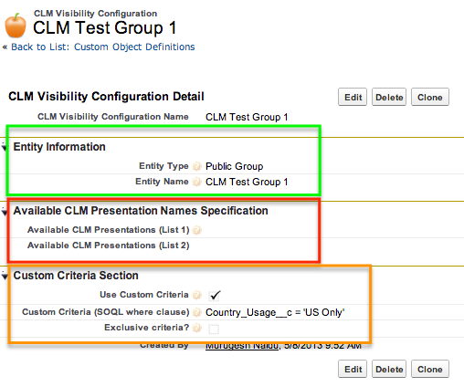
Building a CVC configuration object
There are overall 3 key sections that need to be populated as shown below, however at anytime, you would only populate two of these

Slide 24
CVC Config: Entity Configuration
Each CVC has two mandatory fields that must always be populated:
Entity Type: This Picklist field defines if the CVC applies for a Profile, User or a Public Group. Valid values are Profile, User and Public Group
Entity Name: This is a text field that needs to be populated with either a UserName, Profile Name or Public Group, depending on Entity type selected
System has in-built mechanism to ensure valid Entity Name is entered and throws an error for invalid Entity Names
Each Entity can only have one (1) CVC instance. The Unique External ID for this object is basically the Entity ID and will cause an error if duplicates are attempted to be added

Slide 25
CVC Config: Available Presentation Names
Each CVC has two optional fields that may be populated if there is a clear mapping available between Entity Type (Public Group/Profile/User) and CLM Presentations that need to be made available to that Entity
Available CLM Presentations (List 1) & Available CLM Presentations (List 2) – Each of these fields is a 255 character Textarea field and will take a semi-colon seperated list of CLM Presentation Names
Two fields are provided in case one field is not enough to handle all CLM Presentation names
Eg: Safety of Cholecap;Therapy Days;
If more than one CVC instances exist for a logged in user (say one at a Profile level and one at Public Group level) with CLM Presentation names specified, then the system will combine the two lists from all CVCs and make them all available to the User. This is the only option available if Names are specified

Slide 26
CVC Config: Custom Criteria
A Custom Criteria based on CLM Presentation Object fields can also be specified instead of filtering based on Presentation names
Specifying the Custom Criteria involves the following fields:
Use Custom Criteria: Must be checked to use Custom Criteria. If this is checked, any values in Available Names List 1 & 2 are cleared on Save
Custom Criteria: Must be populated with a string that constructs a valid where clause (without the word “where”) based on CLM Presentation Object fields or lookup fields on the CLM Presentation object
Eg: Country_Usage__c = 'US Only' and Type_vod__c = 'HQ’
Exclusive Criteria ?: This can only be checked at the User level (Entity type = User). If checked, then criteria in this CVC overrides any other criteria that may exist at the Public Group and/or Profile level
Active: Must be checked for the CVC to take effect. Only Active CVCs are considered by the Selector. All Validations & checks still apply even to non-active CVCs

Slide 27
CLM Selector Special Handling for Key Messages

Slide 28
Selective CLM Content (Key Message) Download
Presently, iRep is built to download ALL Key Messages (including CLM Content Key Messages) associated to User’s accessible Products
This may result in User(s) being stuck with downloading CLM Content (Key Messages) that they have actually chosen NOT to download using the CLM Selector tool
To get around this, the CLM Selector implements a mechanism to selectively download only those CLM Content/Key Messages for a User that he has chosen to make available for themselves
This mechanism has zero effect on non-CLM Key message downloads nor would it apply to groups/people who are not using the CLM Selector tool
The User must however make at-least one qualifying change to Visibility using the Selector for this to kick in (as of Rel 1.0)

Slide 29
Selective Content Download Under the Hood
CLM Selector adds a new Object called “Invisible CLM Key Message”
After every CLM visibility change performed using the CLM Selector User, the “Invisible CLM Key Message” table is updated with associated Key Messages that are not visible to the user
Additionally, a “Top Level” VMobile Object Configuration (VMOC) needs to exist either at the Org or Profile level for Key Messages with the following criteria included:
Where Id Not In (Select Key_Message__c from Invisible_CLM_Key_Message__c where OwnerId = @@VOD_SF_USER_ID@@)

Slide 30
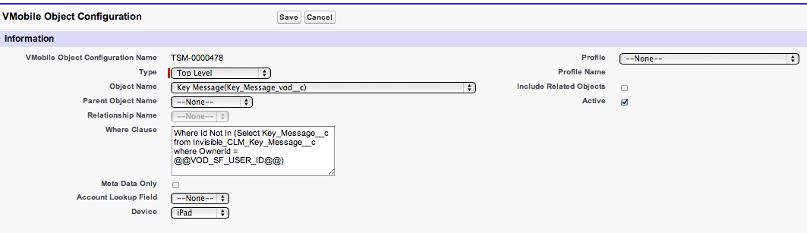

VMOC for Selective Key Message Download
If there is already a VMOC with a where clause for Key Messages, append the afore-mentioned clause to it using an “AND” operator
If there is none, then the where clause can be fed in on its own. Clear cache after VMOC update
Note– Put “AND Product_vod__c <> '’” because if no Products are assigned to Key Messages, then those key messages are also downloaded

Slide 31
Contacts

Slide 32
Contacts
Carol Jacobson - All things CLM!
Murugesh Naidu – CLM Selector Technical Architect and Developer

