Slide 1

Optimal Gameplay in Take Away Sticks: Leveraging the Sprague-Grundy Strategy
Group Member names:
Thakur Jaideep Singh
KVSG Vinayak
Aneesh Narayan Bandaru
M. Sri Sathvik Chowdary
Supervisor name: Dr.Srinivasa K G
Date:30-04-2024
Dr. Shyama Prasad Mukherjee International Institute of Information Technology, Naya Raipur
International Institute of Information Technology, Naya Raipur

Slide 2
Content
Introduction
Motivation: Issues and Challenges
Problem definition
Objectives of the project
Proposed System/Methodology
Results and discussion
Conclusion
Future Directions
*

Slide 3
Introduction
Impartial Games: Players take turns, no inherent advantages. Fascinating for mathematics.
Take Away Sticks Game: Remove sticks from pile, simple rules, deep strategy.
Optimal Gameplay Strategies: Enhance gameplay, increase winning chances, crucial for competitive gaming.
Sprague-Grundy Strategy: Systematic approach for optimal impartial game strategies. Proposed in 1935, developed in 1939.
*

Slide 4
Motivation
Significance of Impartial Games in Game Theory: Analyze strategic decision-making. Rich landscape for optimal strategies.
Complexity of Take Away Sticks Game: Simple rules, deep strategy. Anticipating and countering moves is key.
Need for Systematic Approaches: Traditional gameplay may not optimize. Structured strategies like Sprague-Grundy optimize gameplay
*

Slide 5
Problem statement
Take Away Sticks Game: Players remove sticks, leaving last stick for opponent. Simple game with strategic depth, ideal for analysis.
Goal:
Determine Optimal Gameplay Strategies: Identify moves that lead to advantageous positions, ultimately increasing the chances of winning.
Challenges:
Strategic Complexity, Recursive Calculation of Grundy Numbers: Calculating Grundy numbers for each position requires recursively analyzing all possible moves.
*

Slide 6
Objective (s) of the Project
Analyze the Sprague-Grundy strategy: Evaluate effectiveness in Take Away Sticks for determining optimal strategies.
Implement Python-based solution: Develop Python solution applying Sprague-Grundy for optimal move determination.
Assess strategy efficacy: Compare performance against alternatives for superior gameplay outcomes.
*

Slide 7
Proposed Framework/Methodology
Calculation of Grundy Numbers:
Assign numerical values (Grundy numbers) to each game position
Calculate recursively based on Grundy numbers of resulting positions from possible moves
Optimal Move Determination:
Select moves that minimize the Grundy number of resulting position
Moves leading to Grundy number 0 are "zero moves" or winning positions
*

Slide 8
Proposed Framework/Methodology
Algorithm:
Calculate Grundy numbers for all possible positions
For each move option:
Calculate Grundy number of resulting position
If Grundy number is 0, select as optimal move
If no optimal move, randomly select a move
Recursive Game Tree Analysis:
Construct game tree representing all possible moves and positions
Recursively calculate Grundy numbers based on child positions
*

Slide 9
Results
Experimental Results: Data shows Sprague-Grundy's effectiveness in optimizing gameplay performance.
Comparison with Alternative Strategies: Superior to other approaches, highlighting systematic strategies' strengths.
Discussion on Strategic Decision-making: Leveraging math principles to enhance gameplay and optimal decision-making.
*

Slide 10
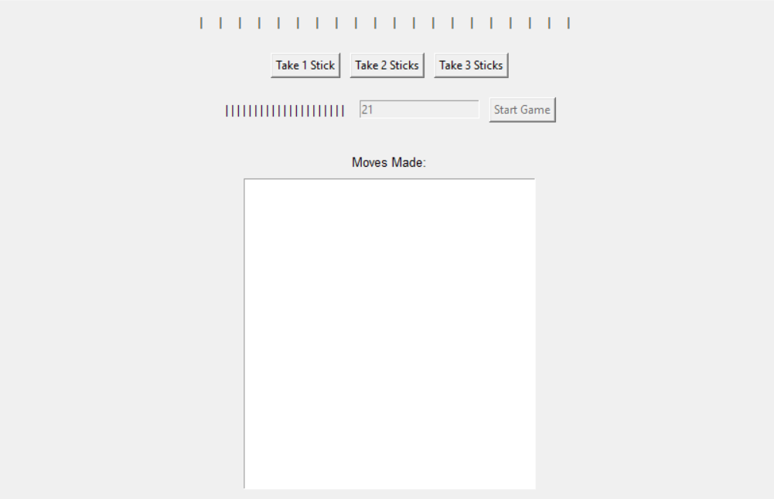

Slide 11
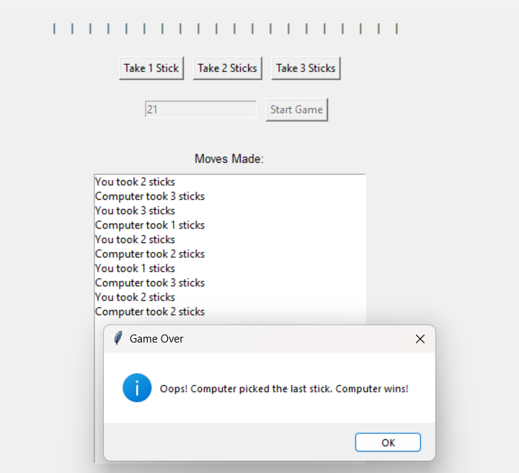

Slide 12
Conclusions
Summary of Findings: Sprague-Grundy offers systematic approach for optimal decisions, enhancing gameplay.
Importance in Game Theory: Establishes significance of mathematical analysis for gameplay optimization.
Potential for Future Research and Applications: Extending to complex games, real-world decision-making scenarios.
*

Slide 13
Future Directions
Extension to Complex Games: Exploring Sprague-Grundy in diverse environments with imperfect information, dynamic rules.
Integration with Other Techniques: Hybrid approaches combining computational techniques and math analysis.
Scalability and Optimization: Addressing large state spaces, algorithm optimization, distributed systems.
Real-world Applications Beyond Recreational Games: Leveraging principles in cybersecurity, resource allocation, strategic planning.
*

Slide 14
Thank You
..
Dr. Shyama Prasad Mukherjee International Institute of Information Technology, Naya Raipur
*

